Slide 1
GeoDB-R
An R wrapper for the GEO-DB public API obtaining worldwide data on cities, counties, islands, regions and countries.
http://geodb-cities-api.wirefreethought.com/
https://wirefreethought.github.io/geodb-rest-api-docs/
Group 6:
Andre Gnandt
Manpreet Singh
Yihang Wang

Slide 2
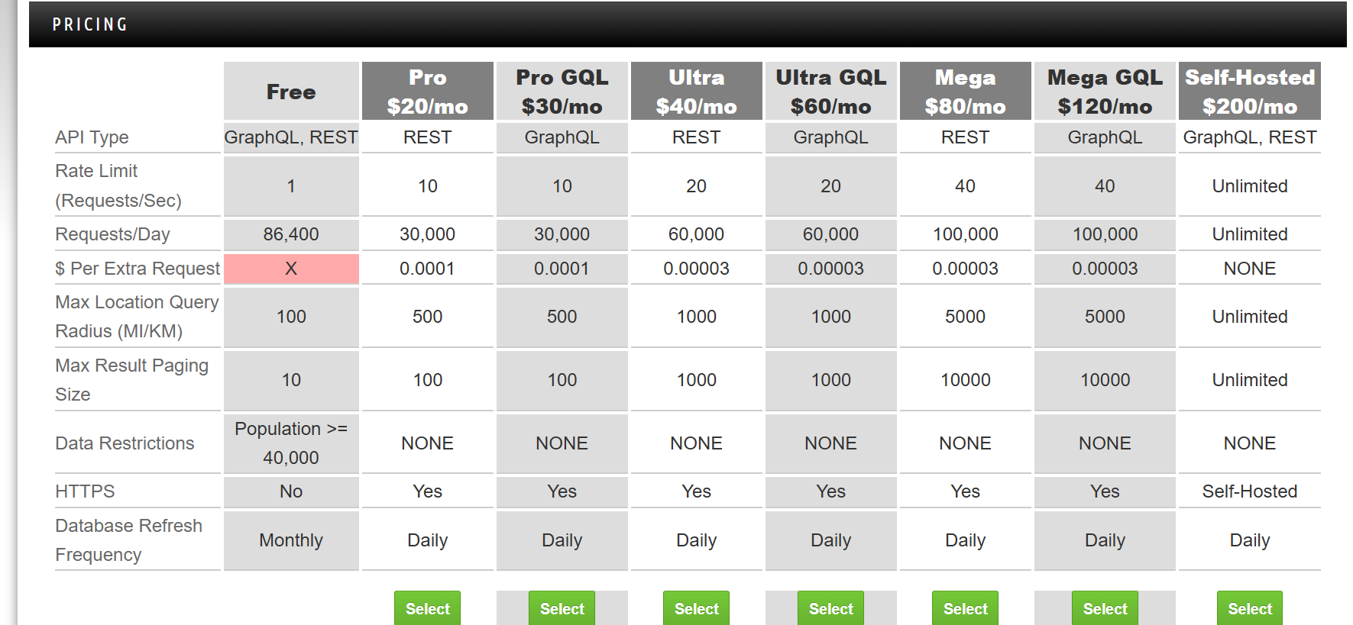
Wrapper includes options for different API plans

Slide 3
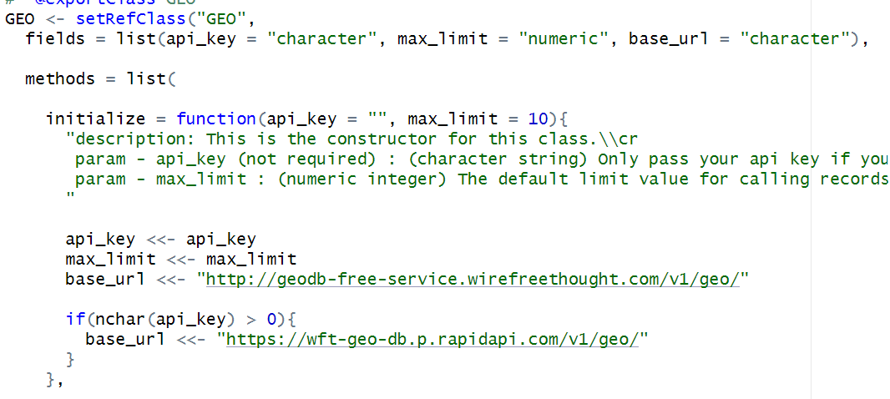
Wrapper includes options for different API plans through R object:

Slide 4
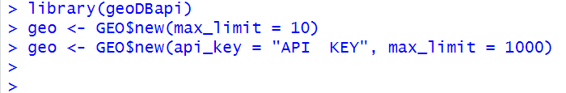
Call constructor according to your usage plan:
Line 2: Initialize GEO object for “free API plan”
Line 3: Initialize GEO object for a “pro API plan”

Slide 5
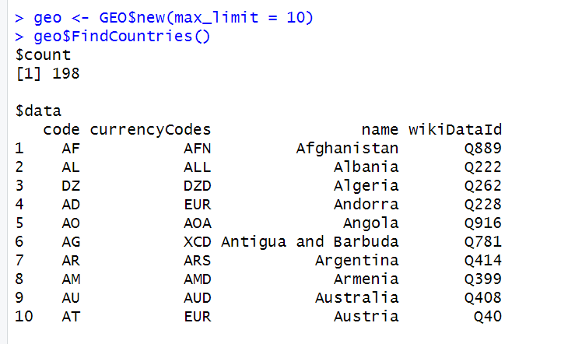
Examples of some Wrapped API calls:
Find Countries:

Slide 6
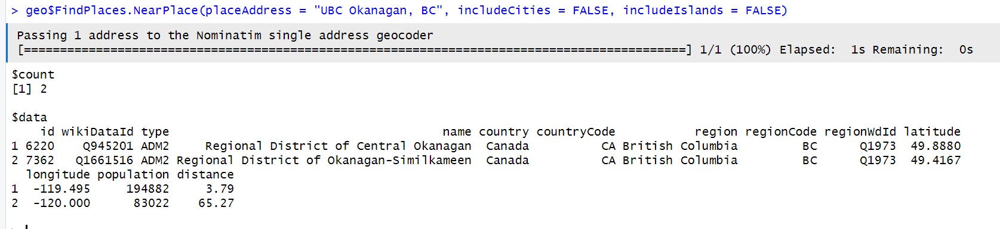
Find all ‘Districts’ near UBCO:

Slide 7
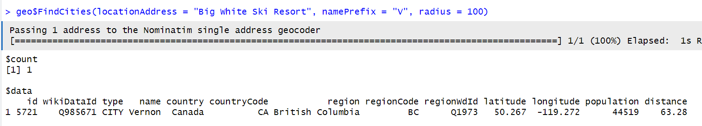
Find all cities within a 100km radius of Big White Ski Resort that start with the letter V:

Slide 8
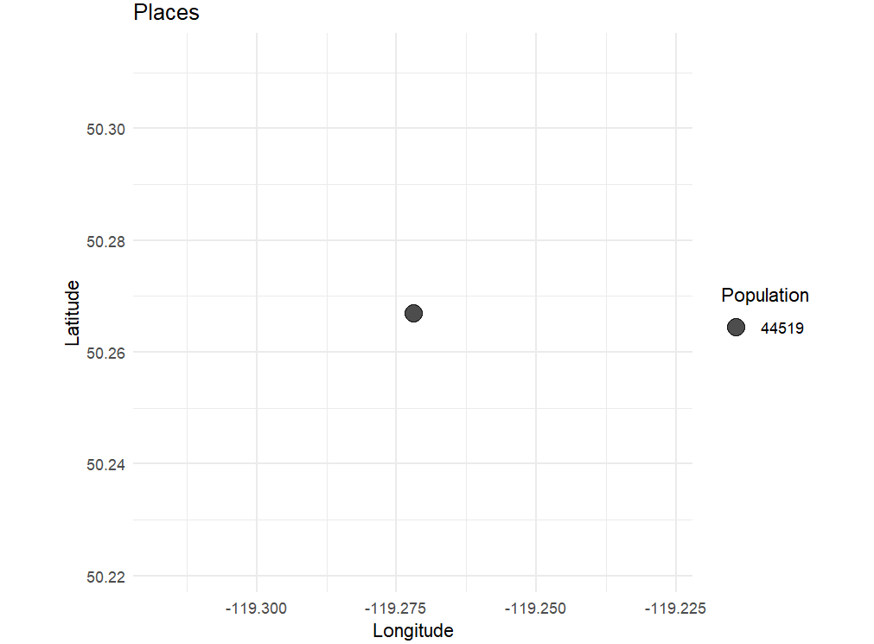
Find cities near Big White that start with “V” and render chart: geo$FindPlaces(locationAddress = "Big White Ski Resort", namePrefix = "V", radius = 100, chart = TRUE)

Slide 9
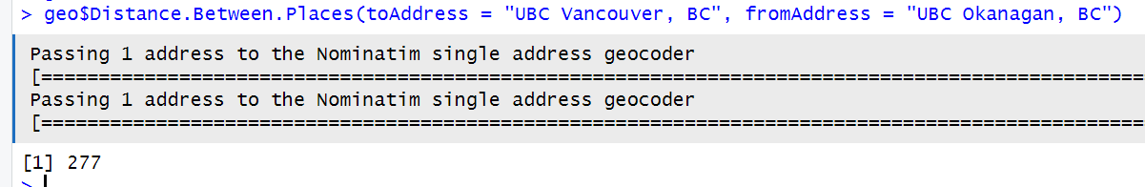
Distance between UBCO and UBCV:

Slide 10
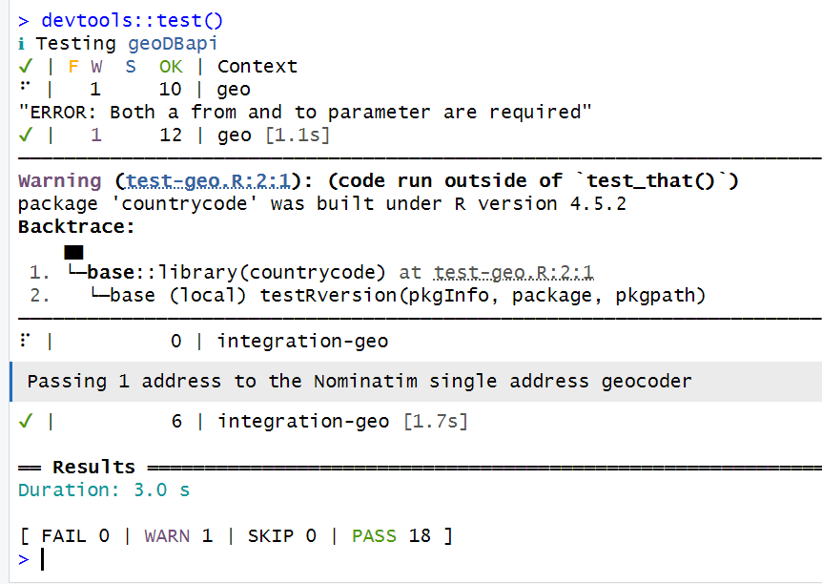
Tests:

Slide 11
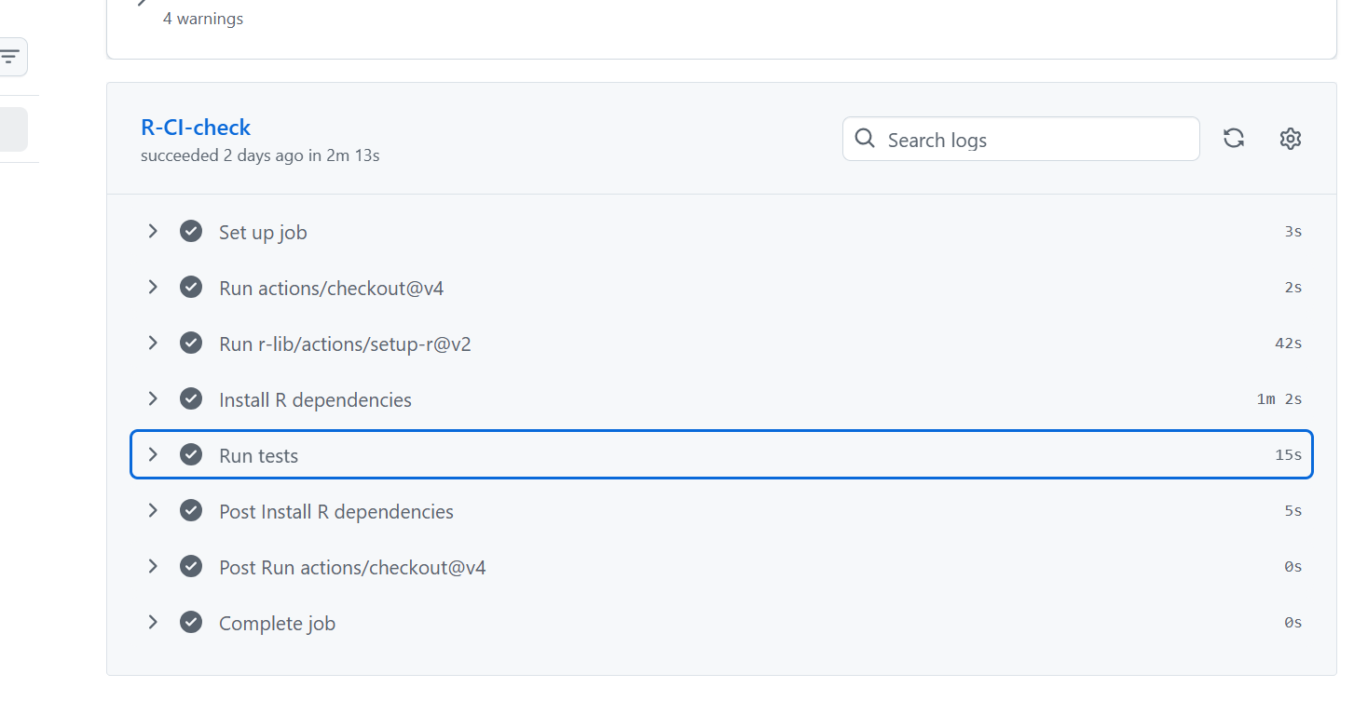
Continuous Integration:

Slide 12
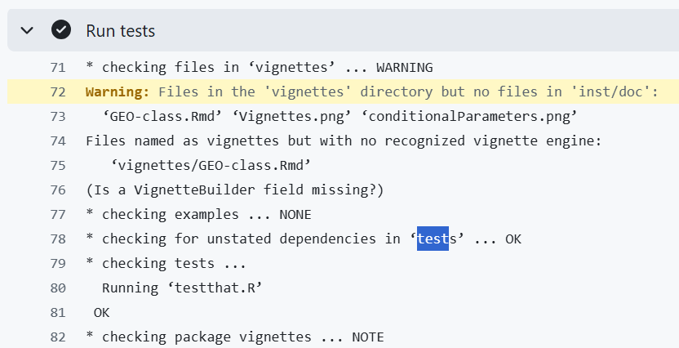

Slide 13
THANK YOU!

