Slide 1
MURI Nozzle Designs
Notes:
Jule-Thompson effect
Helium cylinder $400 – 290 ft^3
Charged Particles -> velocity larger charges less variance.
Seagate Donations.
Mass Spec.
Mesh(induction) shock velocity measurement
Charge detection mass spec. -> Keyword.
Martin Jarrold -> great papers.

Slide 2
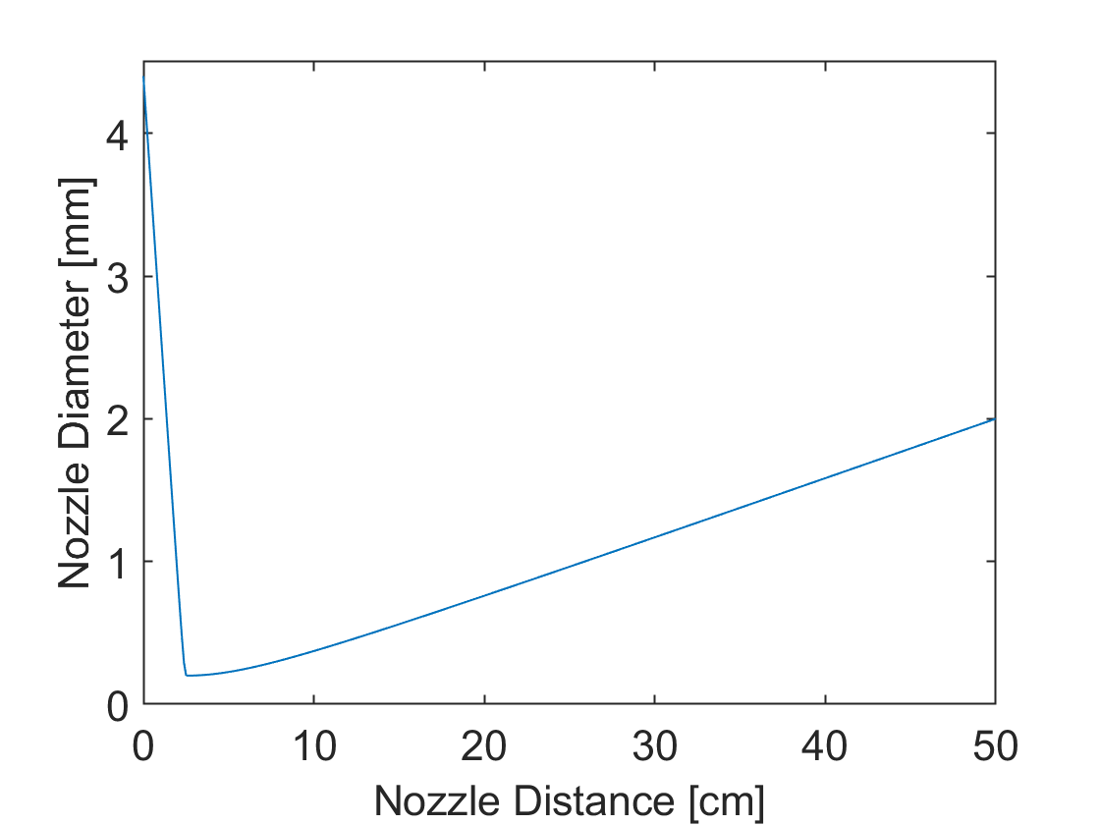
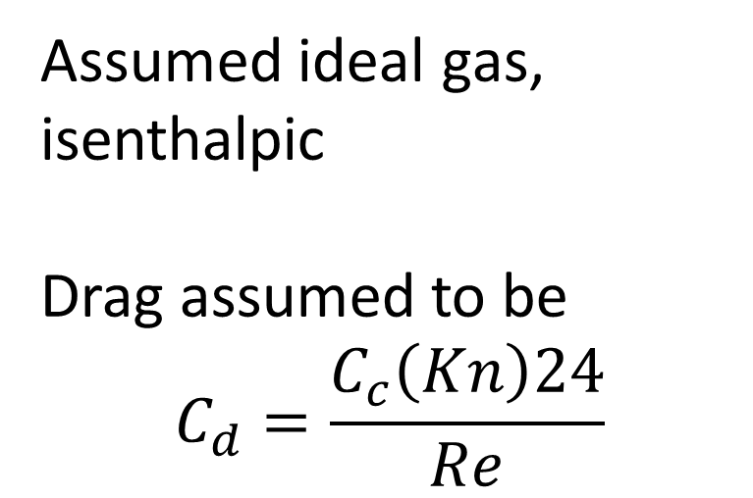
Geometry – Same as paper (Li et al.) with added length
Assumed ideal gas, isenthalpic
Drag assumed to be
$$C_{d}=\frac{C_{c}\left(Kn\right)24}{Re}$$

Slide 3
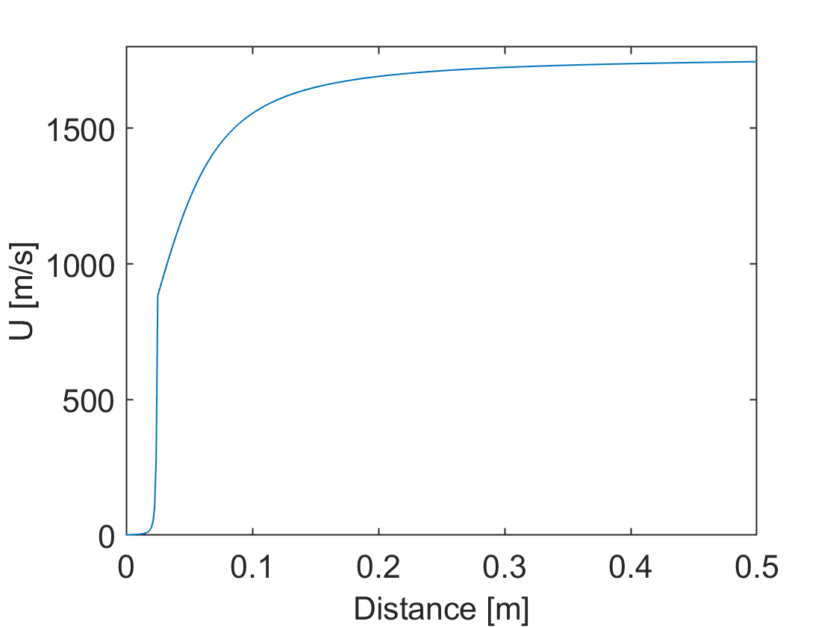
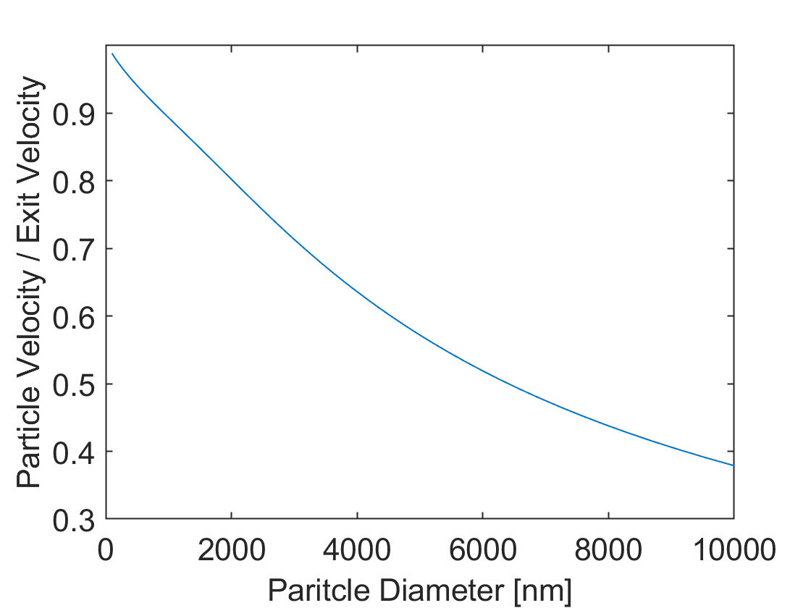
300K helium 50cm nozzle

Slide 4
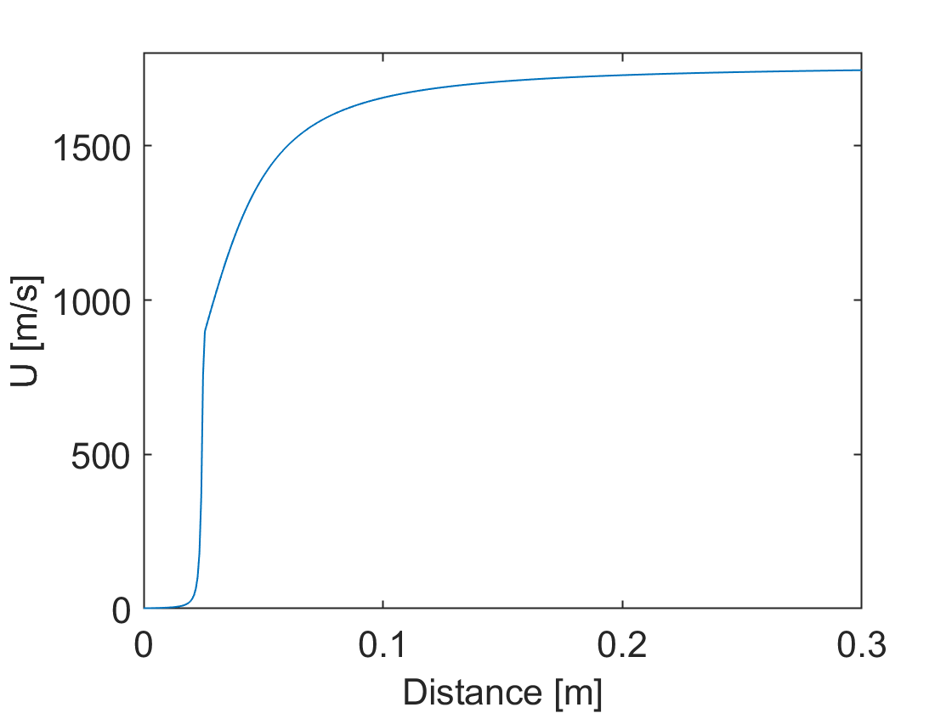
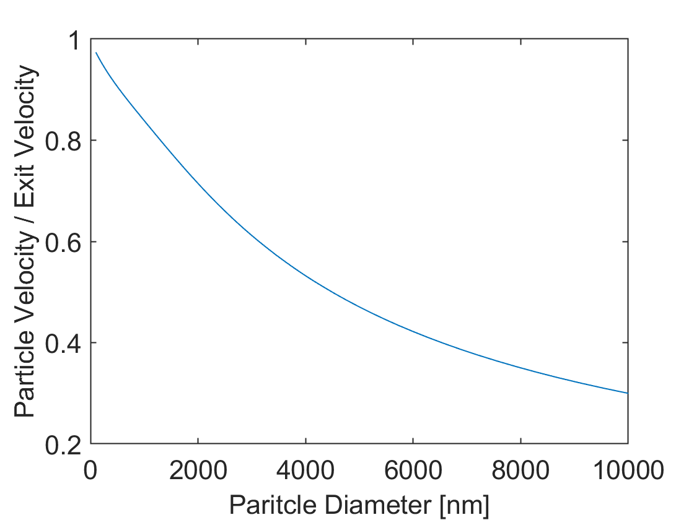
300K Helium – 30 cm Nozzle

Slide 5
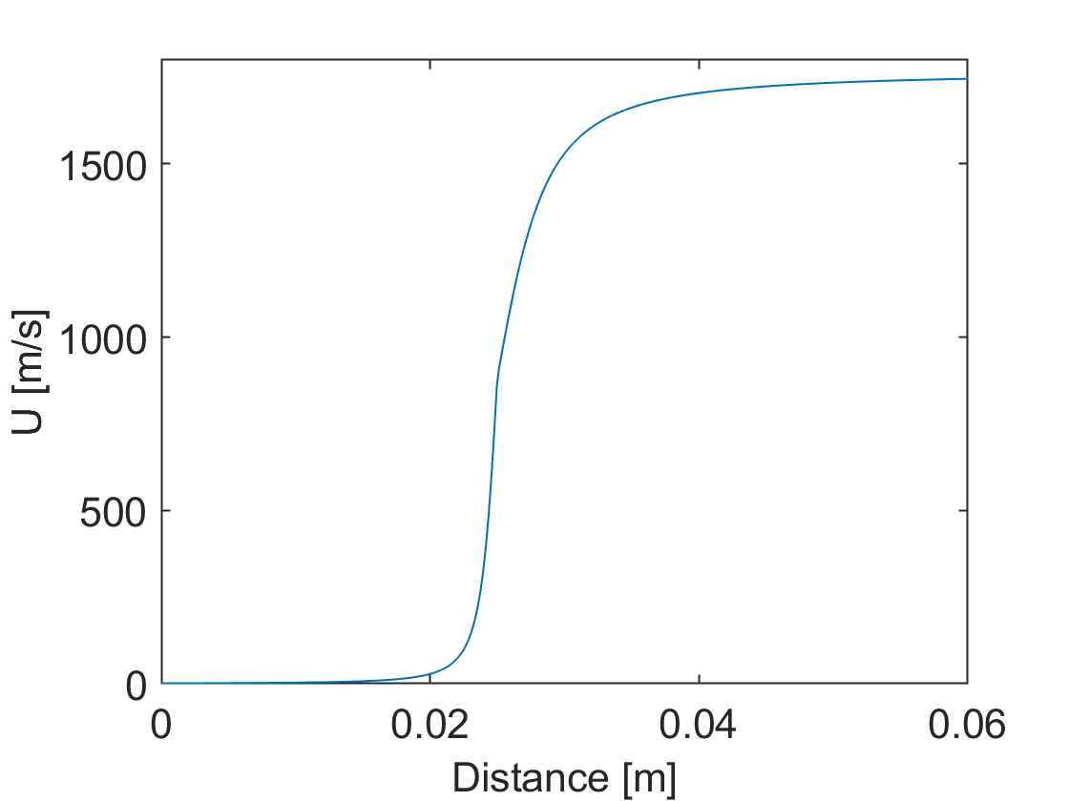
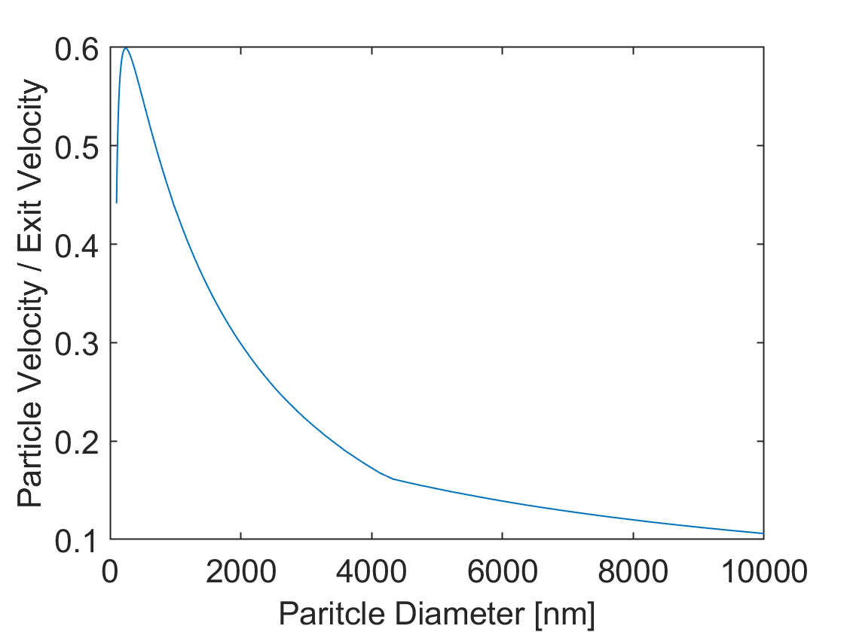
300K Helium – 6 cm nozzle

Slide 6
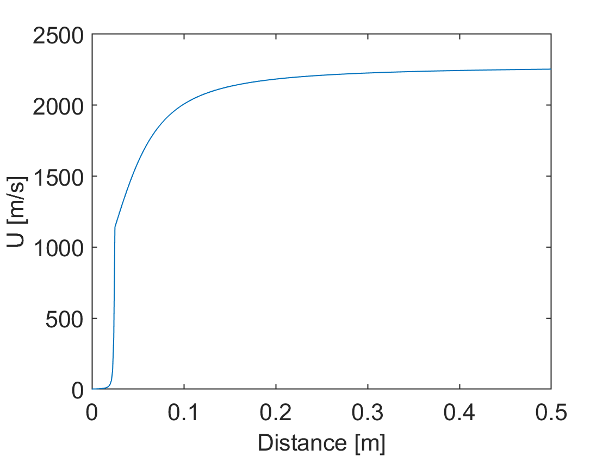

500K helium 50cm nozzle

Slide 7
Next Steps
Reach out to shop for quotes/Limitations

