Slide 1


Slide 2
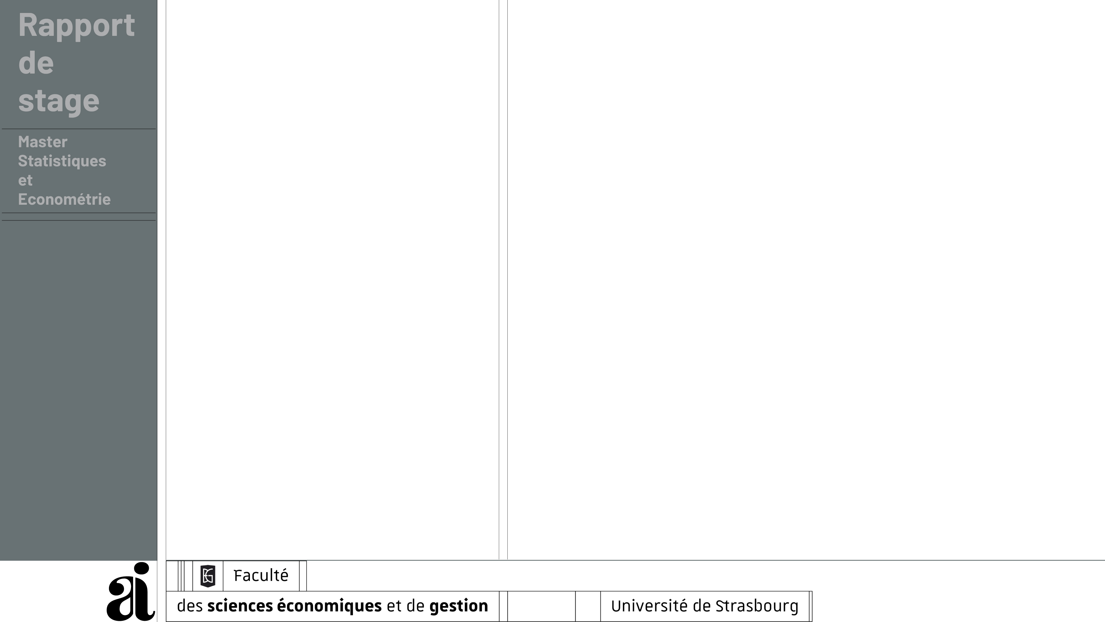
Structure
Literature Review
  Causal Inference
  Optimal Bandwidth
Methods
  Differences-in-Differences
    Setup
    Identification
    Estimation
  Regression Discontinuity Design
    Setup
    Identification
    Estimation
  Difference-in-Discontinuities
    Setup
    Identification
Diff-in-Disc Estimation
  Local Linear Regression
  Optimal Bandwidth
    Plug-in Estimator (Imbens & Kalyanaraman, 2012)
    Robust Bias-Corrected Estimator (Calonico et al., 2014)
    Adaptive Stochastic Gradient Descent
Simulation
  Data
  Results
    Biased Results for RD and DiD
    Diff-in-Disc results for different Bandwidth Estimators
Application - Estimating the Effect of Rent Control in Paris on Real Estate Prices
  Context
  Data
  Diff-in-Disc Analysis

Slide 3
Revue de littérature

Slide 4
Revue de littérature

