Slide 1
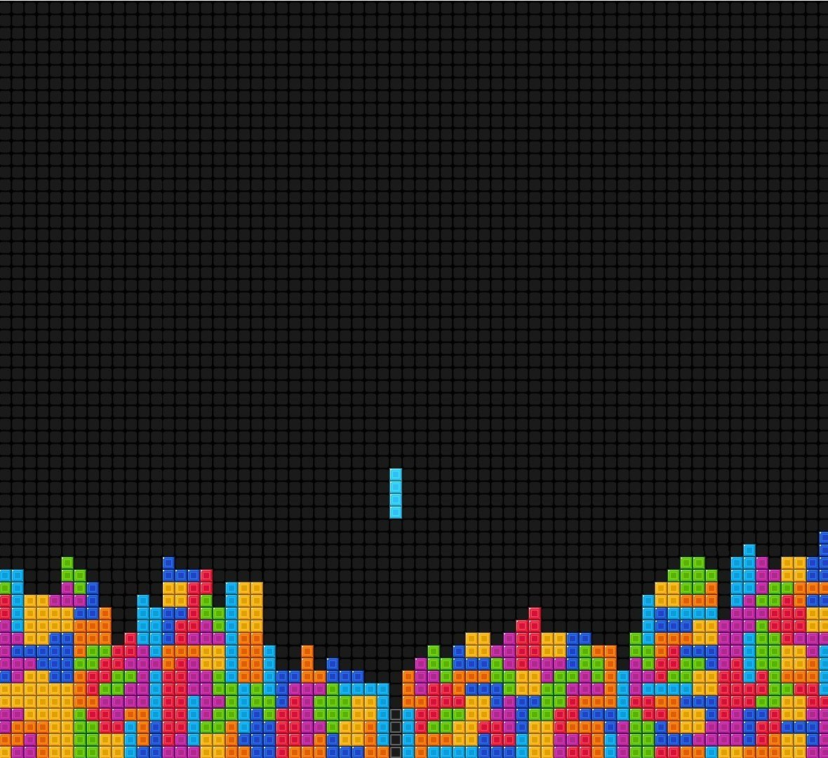
Tetris
Structure out of Chaos
Andre Amirsaleh Brooke Bullek
Xizhou Li
Daniel Vasquez
Notes:
Our project was a Tetris++ clone. Puzzle mode

Slide 2
Scrum
Strengths:
Each completed backlog meant a runnable product
Burnout was not a big problem
Weakness:
Prep work

Slide 3
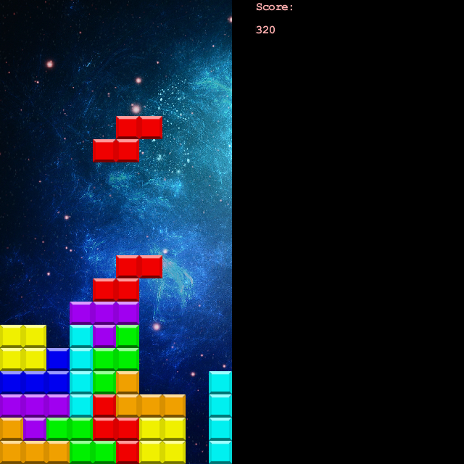
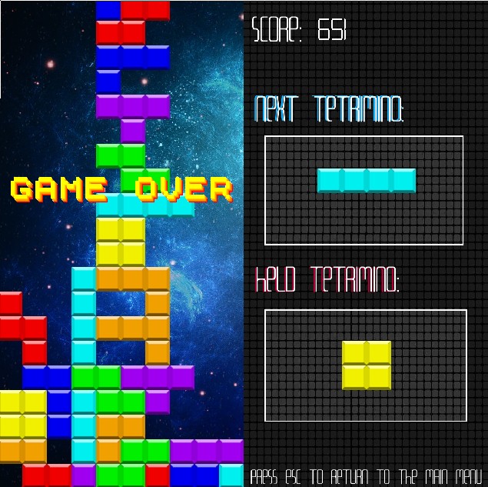
Some Terminology

Slide 4
How it works
Physics are not the answer to everything
Major classes:
Tetrimino and Block
GameBoard
MainModel
Notes:
Don’t overthink the problem. Each Tetrimino (the game pieces) is comprised of 4 Blocks. The GameBoard is a 2D array that stores the Blocks after being placed. The GameBoard also checks for lines and clears them.

Slide 5
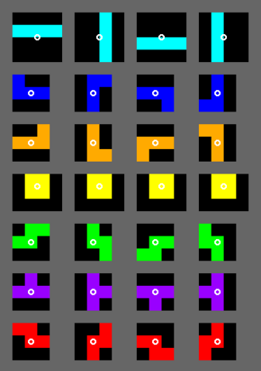
Rotation
Not as straight-forward as it looks

Slide 6

Slick 2D
Avoid outdated/abandoned libraries!
Slick is great for 2D games
Built in gameloop
Easy to draw graphics
Easy to play audio
A pain to manage through git
Notes:
The git problems are due to inexperience on the team’s part. However, it should be known that it will cause you trouble if you aren’t familiar with managing libraries with git. Maven and similar tools could have helped us, but that’s more on top of the learning curve we already had before us.

Slide 7
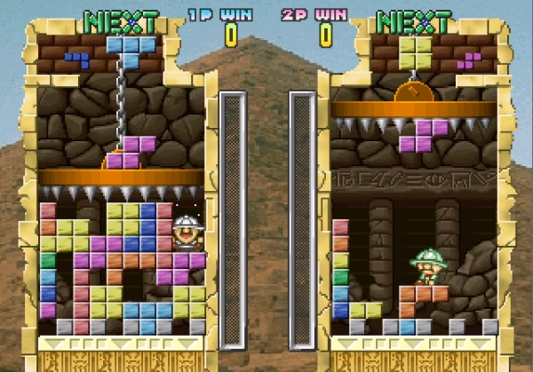
Cutting features
You will not implement every feature!
Puzzle mode
T-Spin
Multiplayer
Networking
Tetris Official Standards
etc…..

Slide 8
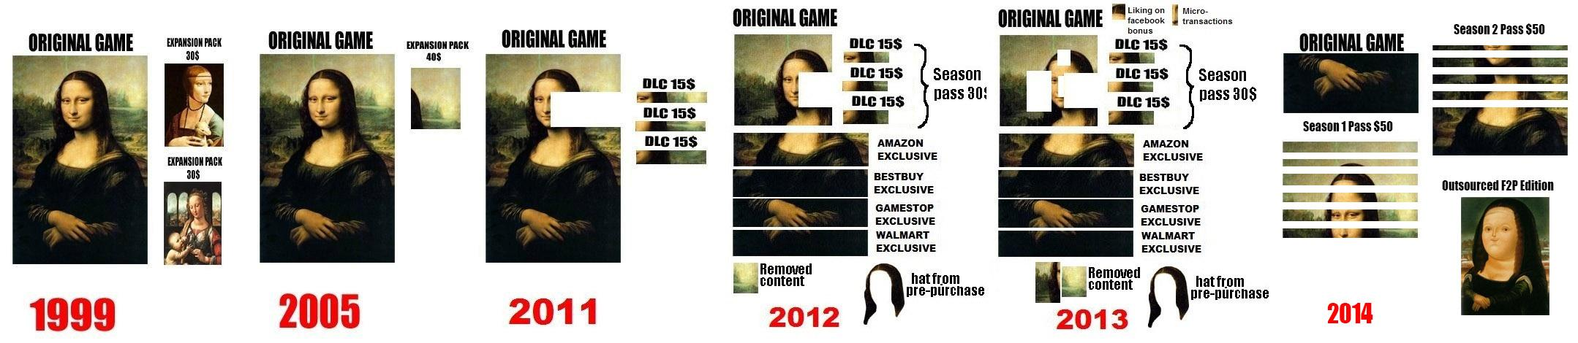
That’s OK
Just don’t cut a portion of your game and sell it as DLC
Outdated image, we know

Slide 9
What we learned...
Configure your libraries!
Do not push broken code to your master branch!
Refactor!
Breathe

