Slide 1
Distributed Software Development
13-10-31
<numero>

Slide 2

Real-Time Bridge Monitoring
Requirements & Design
The Development Group
13-10-31
<numero>

Slide 3
Overview (I)
Team Organization
  The Development Group
Requirements
  Use Cases
  Mock-up
  Non-functional Requirements
13-10-31
<numero>

Slide 4
Overview (I)
Design
  Scope
  Interfaces
  Technologies
  Architecture
    Parser
    Data Relations
13-10-31
<numero>

Slide 5


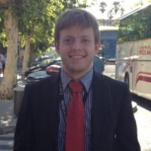

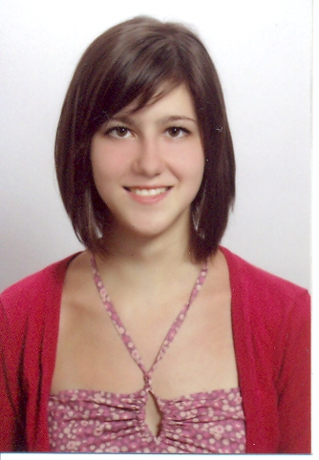
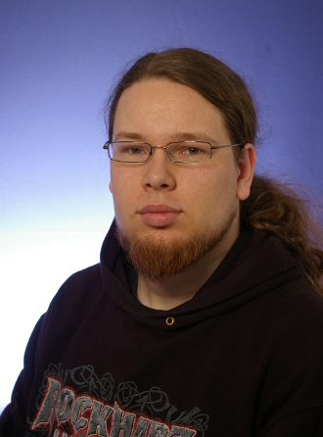
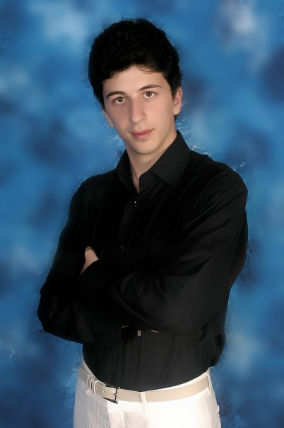

Team Organization
The Development Group
Andrea Bottoli (PoliMi) Lorenzo Pagliari (PoliMi) Marko Brčić (FER) Ghazal Shojaee (PoliMi)
Dzana Kujan (MDH) Jörn Tillmanns (MDH) Miraldi Fifo (MDH) Nikola Radisavljevic (MDH)
13-10-31
<numero>

Slide 6
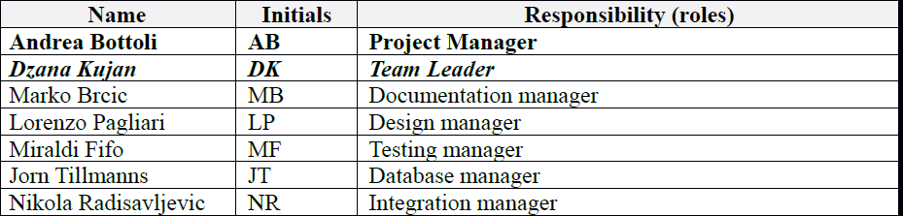
Project plan changes
New team member (Ghazal Shojaee, PoliMi)
Roles distribution

Slide 7
Project Plan changes
Functionalities for each prototype defined
Alpha prototype plan revised
New risk: Documentation and source code in italian (7000 lines of code)

Slide 8
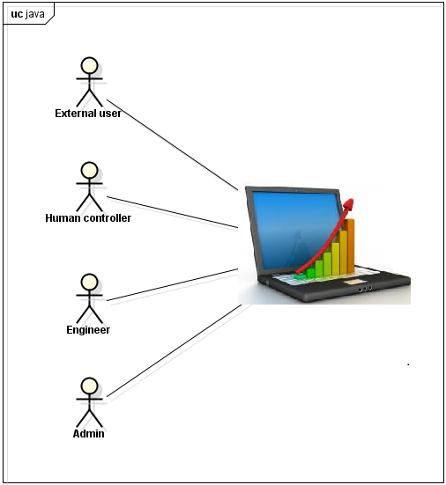
Use Cases
13-10-31
<numero>

Slide 9
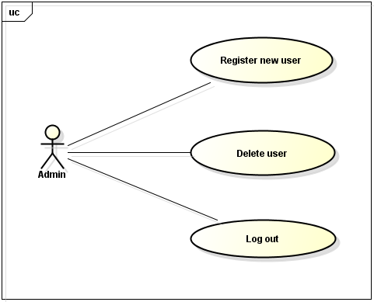
Use Cases
13-10-31
<numero>

Slide 10
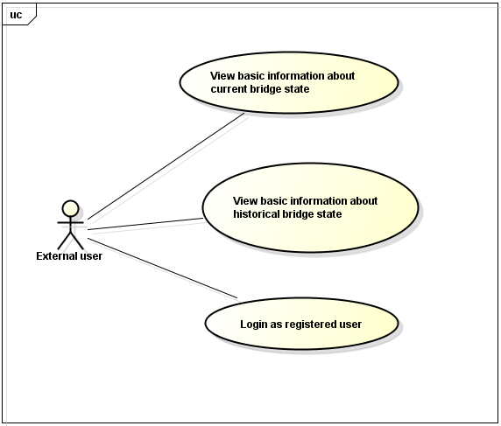
Use Cases
13-10-31
<numero>

Slide 11
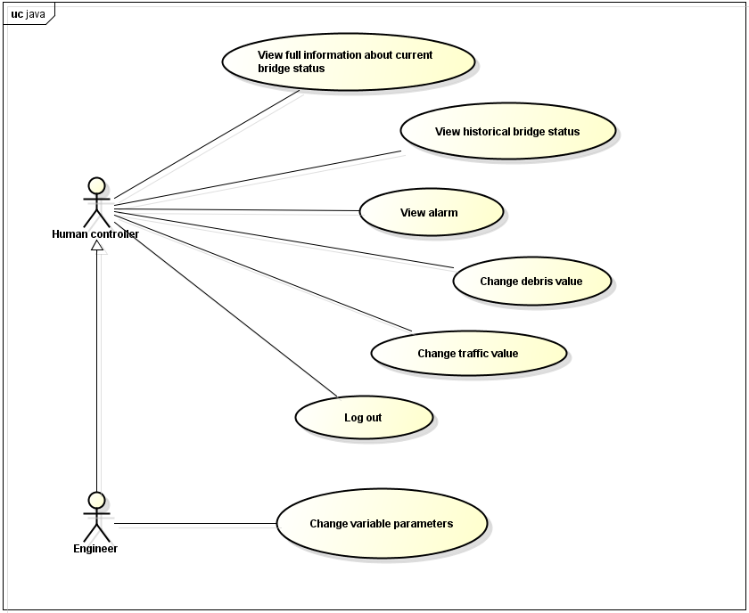
Use Cases
13-10-31
<numero>

Slide 12
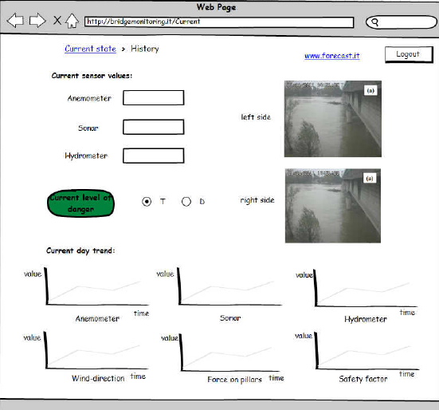
Mock-up for Human Controller
13-10-31
<numero>

Slide 13
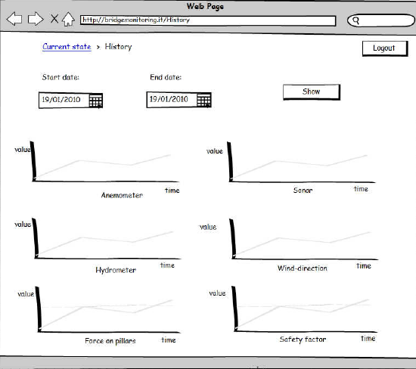
Mock-up for Human Controller
13-10-31
<numero>

Slide 14
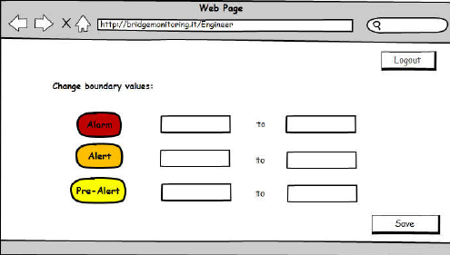
Mock-up for engineer
13-10-31
<numero>

Slide 15
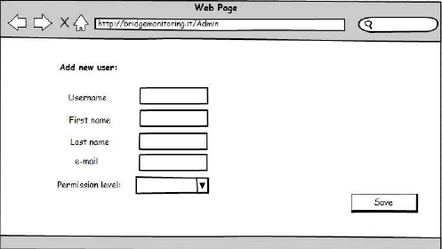
Mock-up for admin
13-10-31
<numero>

Slide 16
Non-functional Requirements
Confirmation pop-up windows
  Are you sure to delete this user?
  Are you sure to change the bounds of risk factors?
Data updates every 10 minutes – 1 hour
Different permission levels
13-10-31
<numero>

Slide 17
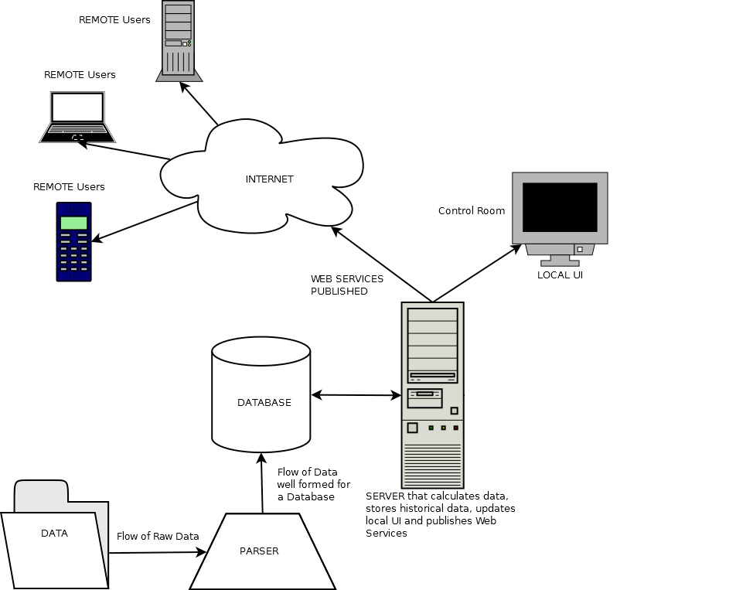
System Scope
13-10-31
<numero>

Slide 18
System Interfaces
HTTP
HTTPS
HTTP
HTTPS
JDBC
MySQL API
13-10-31
<numero>

Slide 19
Technologies
html
Javascript
html
Javascript
MySQL
Java & Java Servlets
Python
13-10-31
<numero>

Slide 20
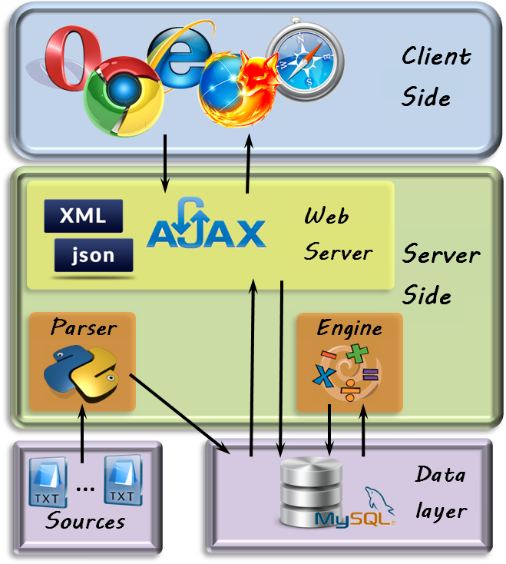
Architecture
13-10-31
<numero>

Slide 21


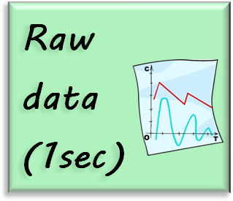

Parser
13-10-31
<numero>

Slide 22
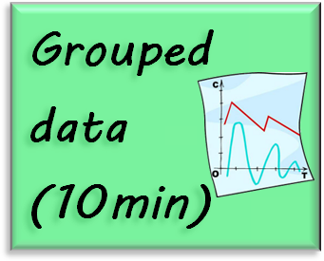
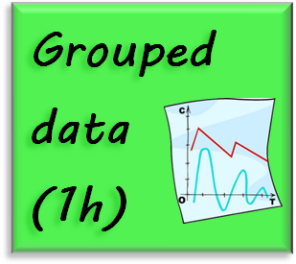
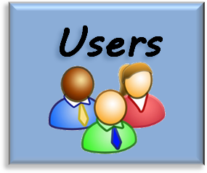

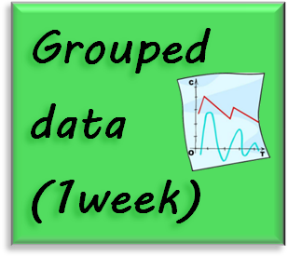


Data Relations
13-10-31
<numero>

Slide 23

Question Time
13-10-31
<numero>

Slide 24

Thank You
Thank you for your attention :-)
13-10-31
<numero>

