Slide 1
Distributed Software Development
14-01-07
<numero>

Slide 2

Real-Time Bridge Monitoring
Final Presentation
The Development Group
14-01-07
<numero>

Slide 3
Overview
Team Organization
Project Status
New Requirements
Mockups
Beta Prototype
Meetings
Experiences
14-01-07
<numero>

Slide 4
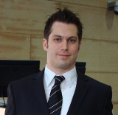

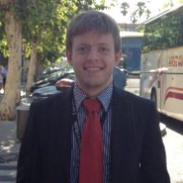
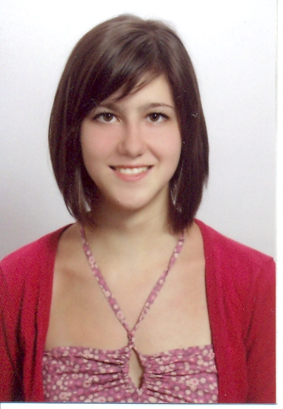
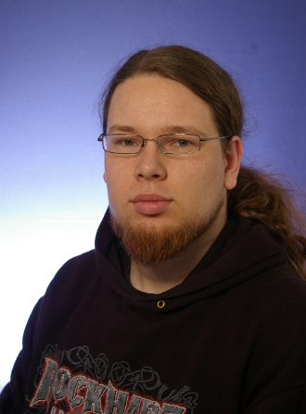
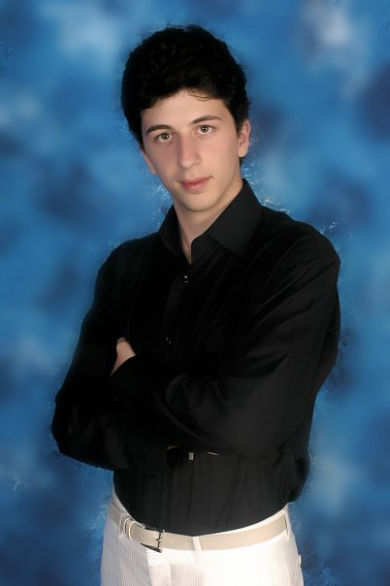

Team Organization
The Development Group
Andrea Bottoli (PoliMi) Lorenzo Pagliari (PoliMi) Marko Brčić (FER)
Dzana Kujan (MDH) Jörn Tillmanns (MDH) Miraldi Fifo (MDH) Nikola Radisavljevic (MDH)
14-01-07
<numero>

Slide 5
Team Organization
Roles
Name | Initials | Responsibility (roles)
Andrea Bottoli | AB | Project Manager
Dzana Kujan | DK | Team Leader
Marco Brčić | MB | Documentation Manager
Lorenzo Pagliari | LP | Design Manager
Miraldi Fifo | MF | Testing Manager
Jörn Tillmanns | JT | Database Manager
Nikola Radisavljevic | NR | Integration Manager
14-01-07
<numero>

Slide 6

Project Status
Project Plan
  Where we are and what we have to do
14-01-07
<numero>

Slide 7
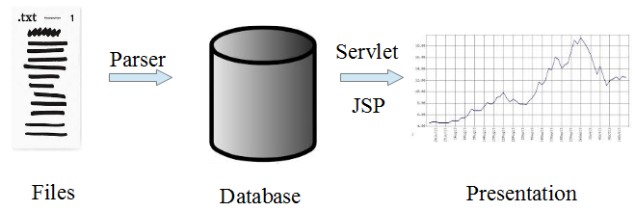
Project Status
Alpha Prototype
14-01-07
<numero>

Slide 8
New Requirements
Conform to NTC 08 & EU 305/11
  Technical Standards for Constructions conformed to the European Directive EU 305/2011
  Part of European Directive 86/106/CEE
  Defines a standard domain in which every component of a structure can be without nor severe changes on its state from a static point of view
We have to do “reverse engineering”: no one did something like this before
14-01-07
<numero>

Slide 9
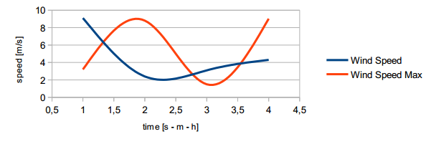

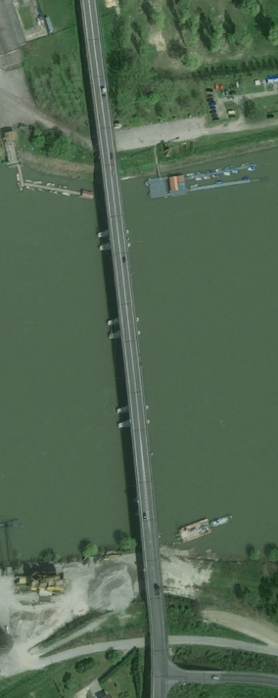
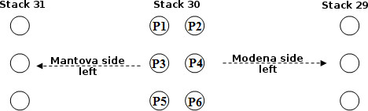
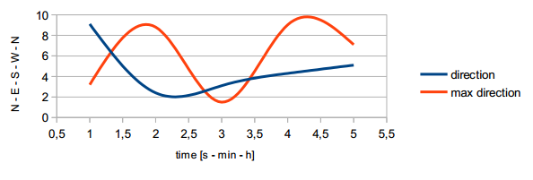
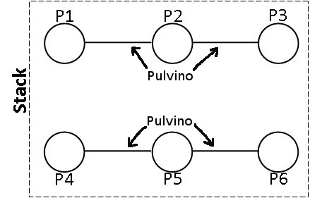
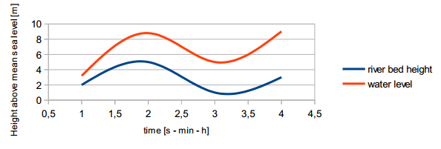
New Requirements
External User: new graphs and pictures
14-01-07
<numero>

Slide 10
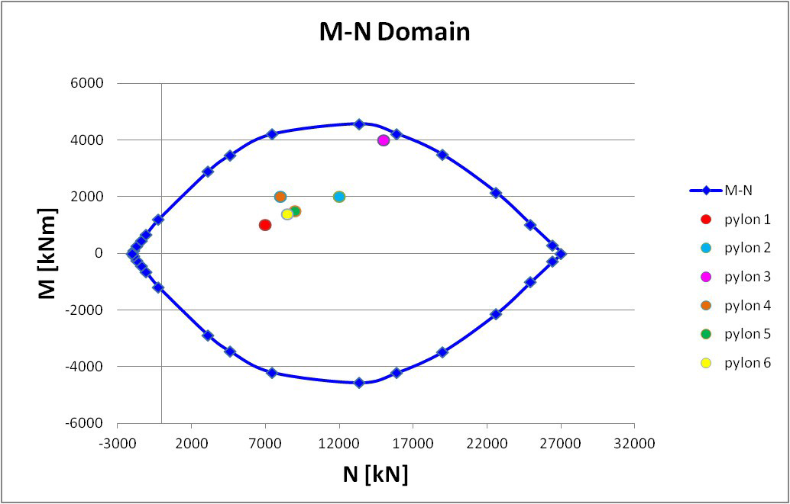
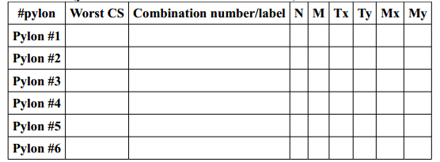
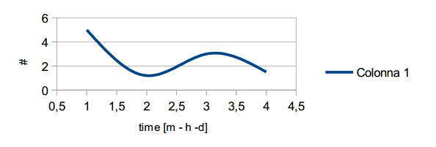
New Requirements
Operator
  Current state: M-N plus Pylon table
  History diagrams
  CS trend: Coefficiente di Sicurezza / Safety Factor
14-01-07
<numero>

Slide 11
New Requirements
Engineer
  Change ALL parameters
Administrator
  Add/Edit/Delete User
  See the user list
14-01-07
<numero>

Slide 12
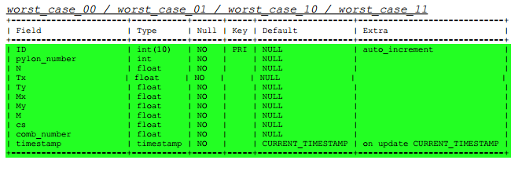
New Requirements
Changed the representation of the alarm
  The operator launches the alarm
Some changes in the database
14-01-07
<numero>

Slide 13
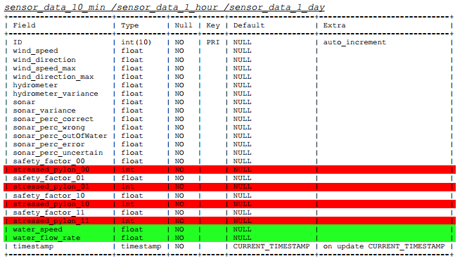
New Requirements
Changed the representation of the alarm
  The operator launches the alarm
Some changes in the database
14-01-07
<numero>

Slide 14
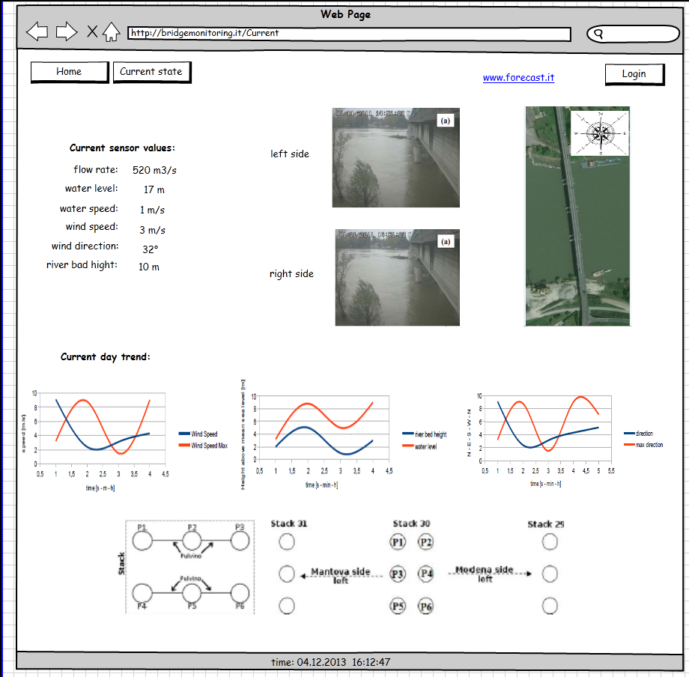
Mockups
External User
14-01-07
<numero>

Slide 15
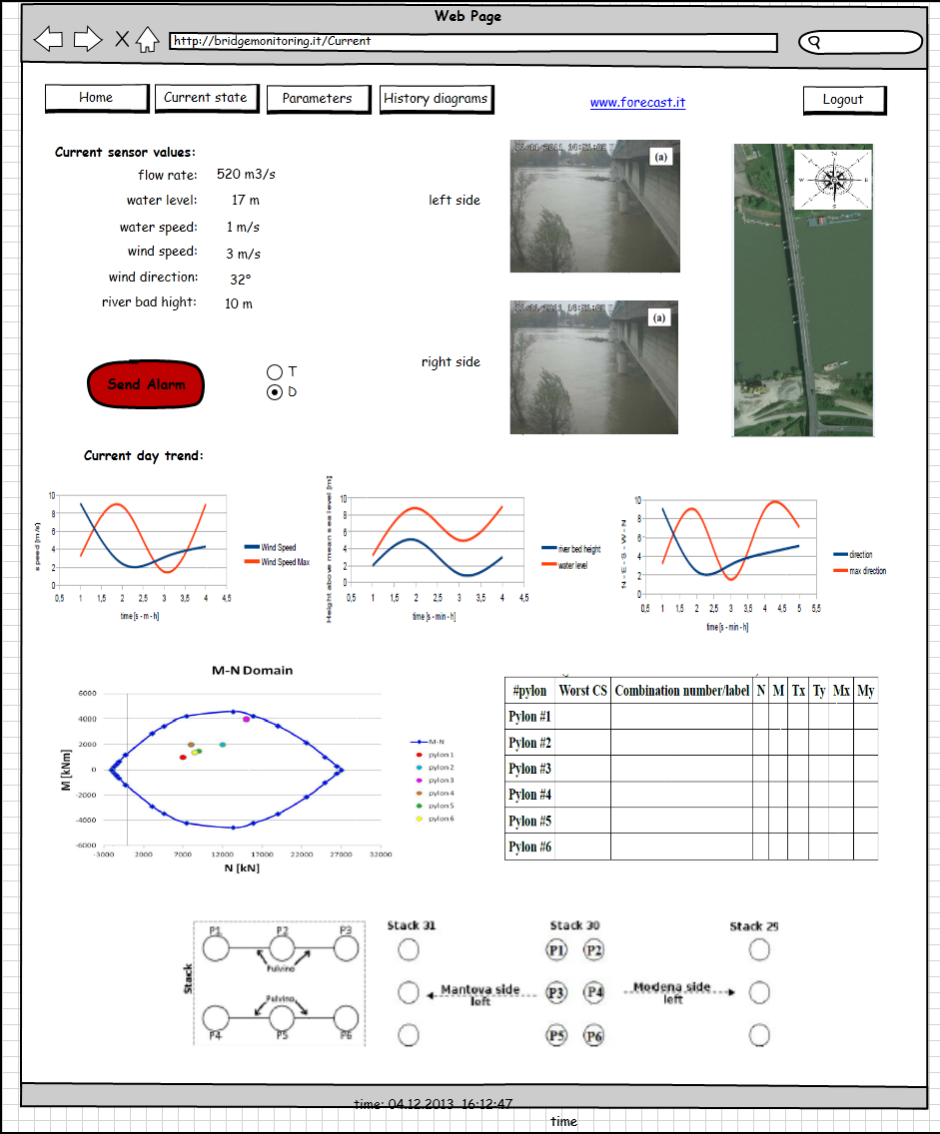
Mockups
Operator (Current State)
14-01-07
<numero>

Slide 16
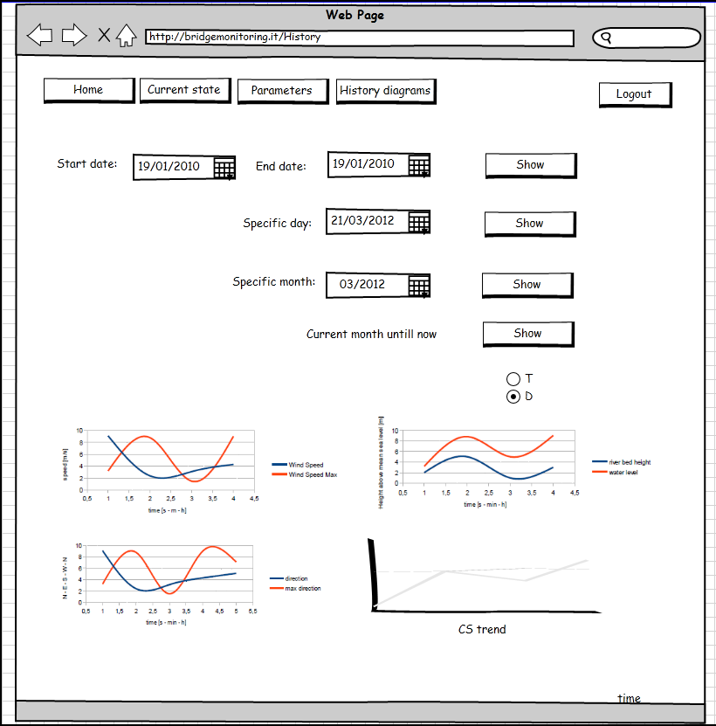
Mockups
Operator (History)
14-01-07
<numero>

Slide 17
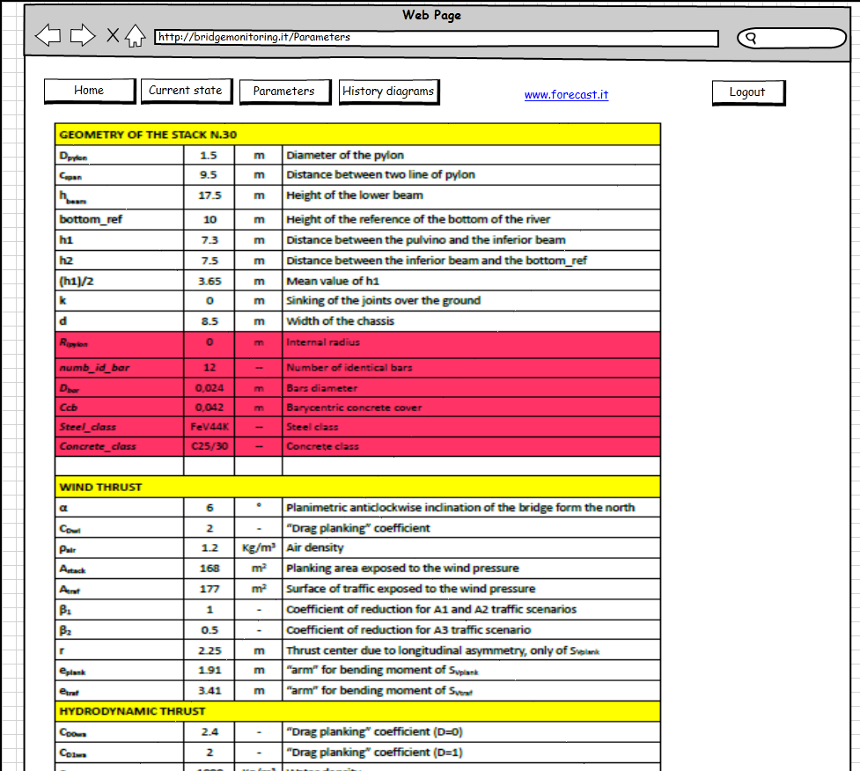
Mockups
Engineer (which is also an operator)
14-01-07
<numero>

Slide 18
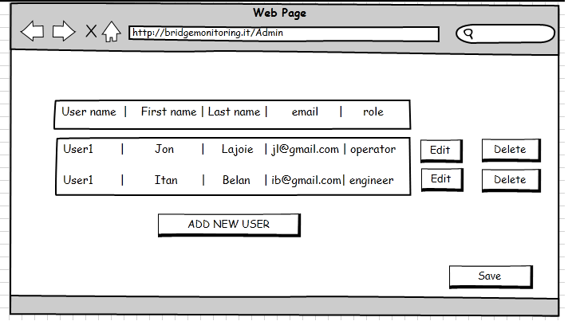
Mockups
Admin
14-01-07
<numero>

Slide 19
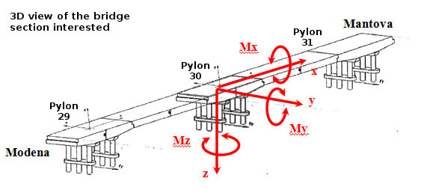
Beta Prototype
Calculations
14-01-07
<numero>

Slide 20
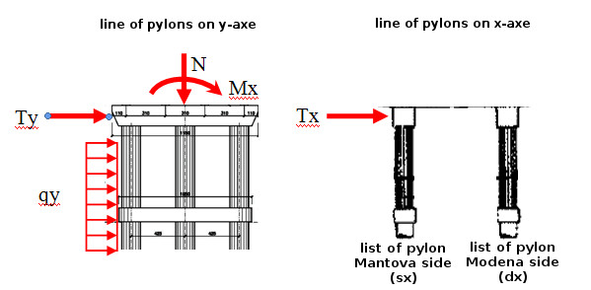
Beta Prototype
Calculations
14-01-07
<numero>

Slide 21
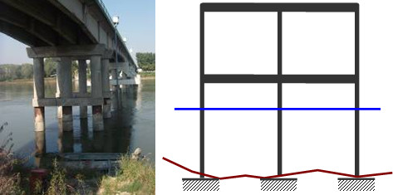
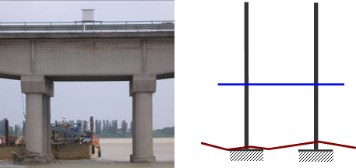
Beta Prototype
Calculations
14-01-07
<numero>

Slide 22
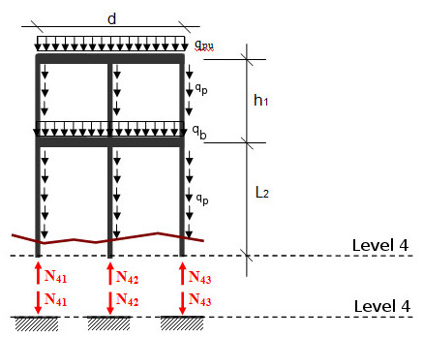
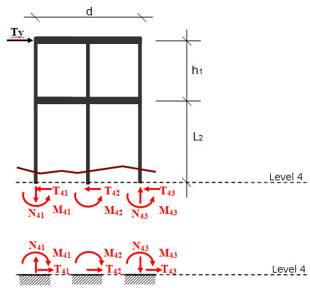
Beta Prototype
Calculations
14-01-07
<numero>

Slide 23
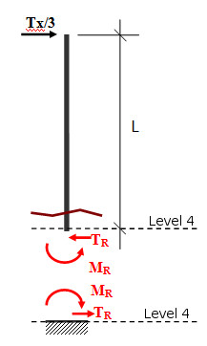
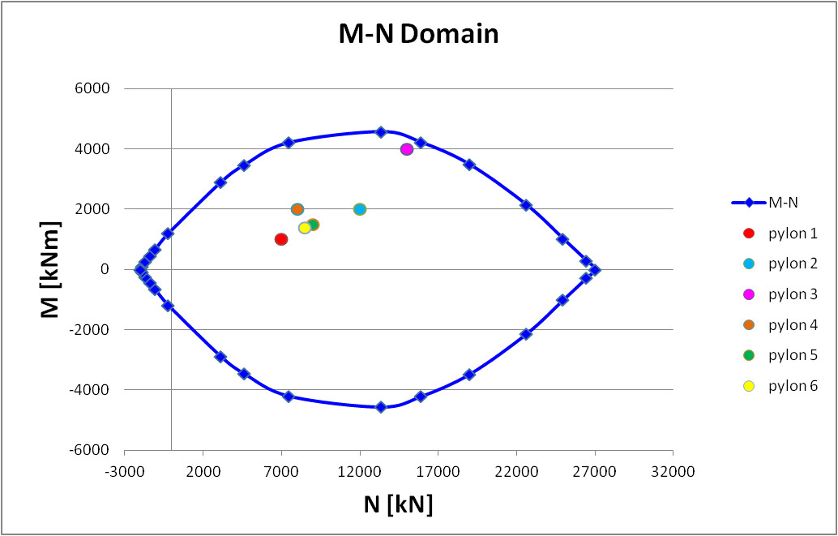
Beta Prototype
Calculations
14-01-07
<numero>

Slide 24

Beta Prototype
Math Engine
14-01-07
<numero>

Slide 25

Meetings
Both chat & video
Group Meetings
  Face to face meetings
  Formally scheduled every Monday and Thursday
  Chat used everyday by each member of the group
Project Leader & Team Leader Meetings
  About every day (during the week)
  Formally scheduled every Tuesday
14-01-07
<numero>

Slide 26
Meetings
Customers Meetings
  One every week
    Project status
    Customers desires
    Requirements
  First one with both customers
    Ing. Francesco Ballio
    Ing. Gianluca Crotti
  The others with ing. Crotti
14-01-07
<numero>

Slide 27
Meetings
Supervisors Meetings
  One every week
  Inform about
    Project status
    Group status & managing
    Report about customer meetings
  Gather advices, suggestions and proposals
  Report problems
14-01-07
<numero>

Slide 28
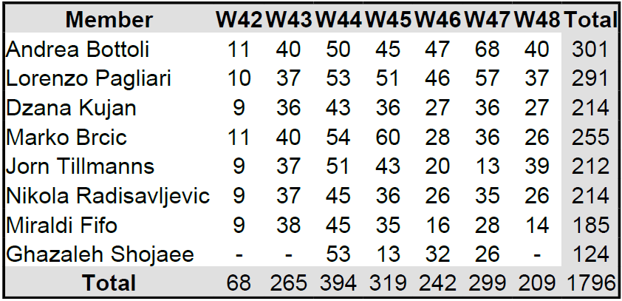
Experiences
Effort
14-01-07
<numero>

Slide 29
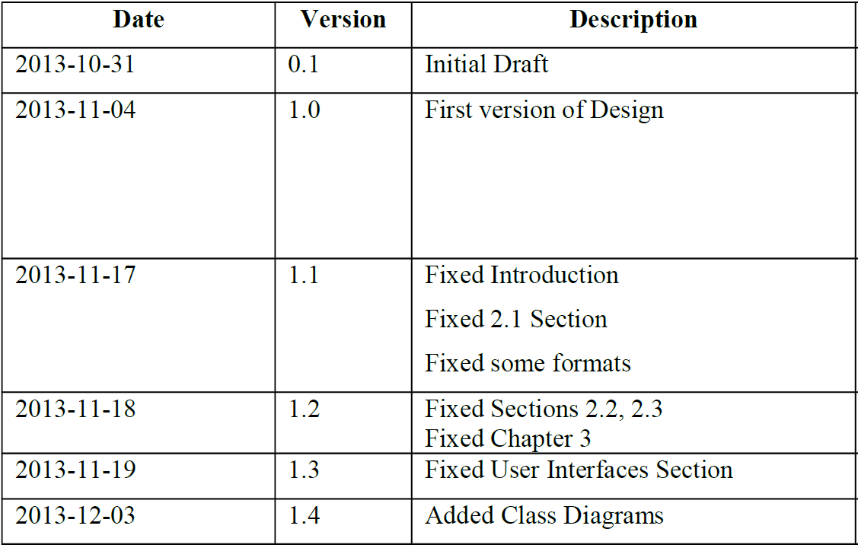
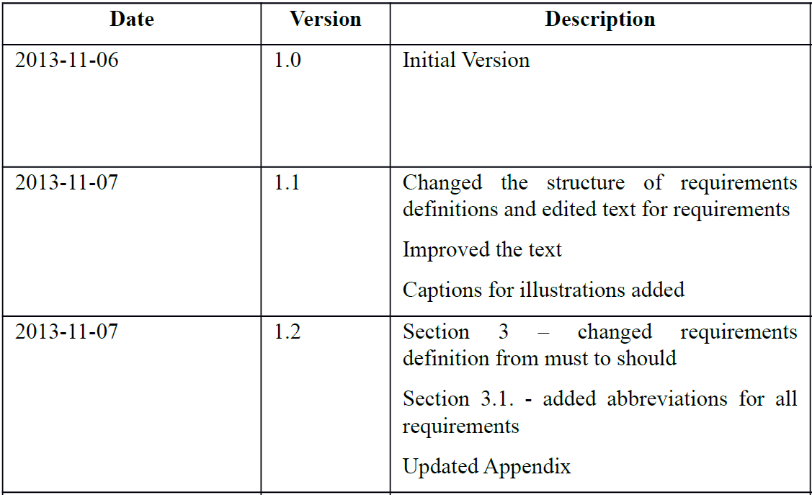
Experiences
Changes in documentation
  Requirement document
  Design document
  Input and Convertions document
14-01-07
<numero>

Slide 30
Experiences
Problems
  Communication, management, technologies, environment
Solutions
  Additional meetings, tasks on Github, hours spend in learning and helping each other
Positive experiences
  Team work, good collaboration and fun meetings :)
  We are improving our skills and doing the best
14-01-07
<numero>

Slide 31

Question Time
14-01-07
<numero>

Slide 32

Thank you for your attention
14-01-07
<numero>

