Slide 1
Distributed Software Development
13-11-06
<numero>

Slide 2

Real-Time Bridge Monitoring
Status Report
The Development Group
13-11-06
<numero>

Slide 3
Overview
Team Organization
  The Development Group
  Updated Roles
Project Status
  Actual Project Plan
  Actual Architecture
  Some API Diagrams
  Some Sequence Diagrams
13-11-06
<numero>

Slide 4
Overview
Meetings
  Group meetings
  Customer meetings
  Supervisor meetings
13-11-06
<numero>

Slide 5


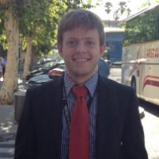
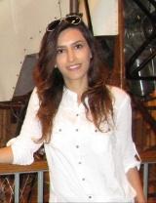
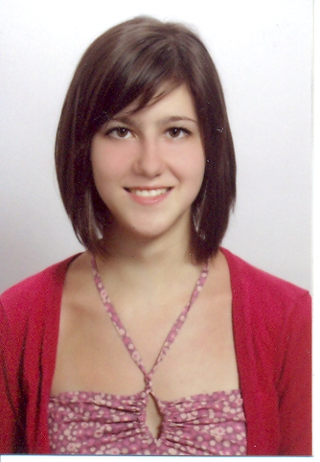
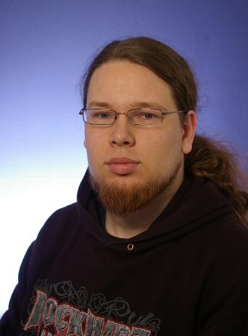
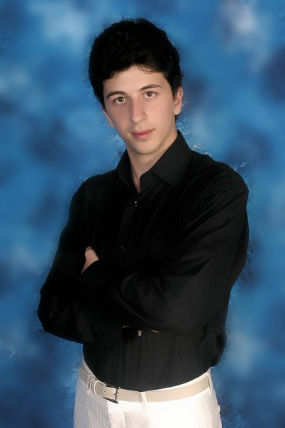

Team Organization
The Development Group
Andrea Bottoli (PoliMi) Lorenzo Pagliari (PoliMi) Marko Brčić (FER) Ghazal Shojaee (PoliMi)
Dzana Kujan (MDH) Jörn Tillmanns (MDH) Miraldi Fifo (MDH) Nikola Radisavljevic (MDH)
13-11-06
<numero>

Slide 6
Team Organization
Updated Roles
Name | Initials | Responsibility (roles)
Andrea Bottoli | AB | Project Manager
Dzana Kujan | DK | Team Leader
Marco Brčić | MB | Documentation Manager
Lorenzo Pagliari | LP | Design Manager
Miraldi Fifo | MF | Testing Manager
Jörn Tillmanns | JT | Database Manager
Nikola Radisavljevic | NR | Integration Manager
Ghazal Shojaee | GS | Design Manager
13-11-06
<numero>

Slide 7
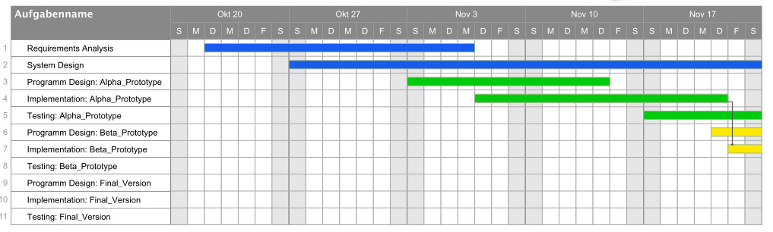
Project Status
Actual Project Plan (I)
  Where we are
13-11-06
<numero>

Slide 8

Project Status
Actual Project Plan (I)
  What we have still to do
13-11-06
<numero>

Slide 9
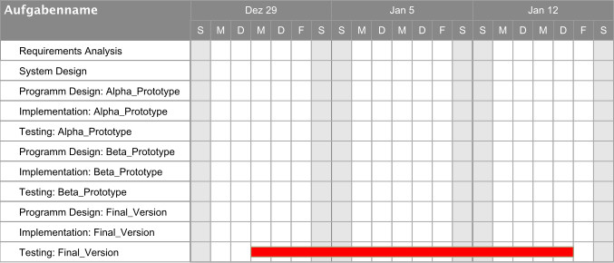
Project Status
Actual Project Plan (I)
  What we have still to do
13-11-06
<numero>

Slide 10
Project Status
Actual Project Plan (II)
  Modules distribution (persons in charge)
    Data Access Layer is divided in:
      DB Layer and Source Layer
    Math layer is divided in:
      Parser and Math Engine
    DB Layer, Source Layer and Parser:
      Jörn Tillmanns and Marko Brčić
    Math Engine and Business Layer
      Andrea Bottoli, Lorenzo Pagliari and Ghazal Shojaee
    Presentation Layer
      Dzana Kujan, Miraldi Fifo, Nikola Radisavljevic
13-11-06
<numero>

Slide 11
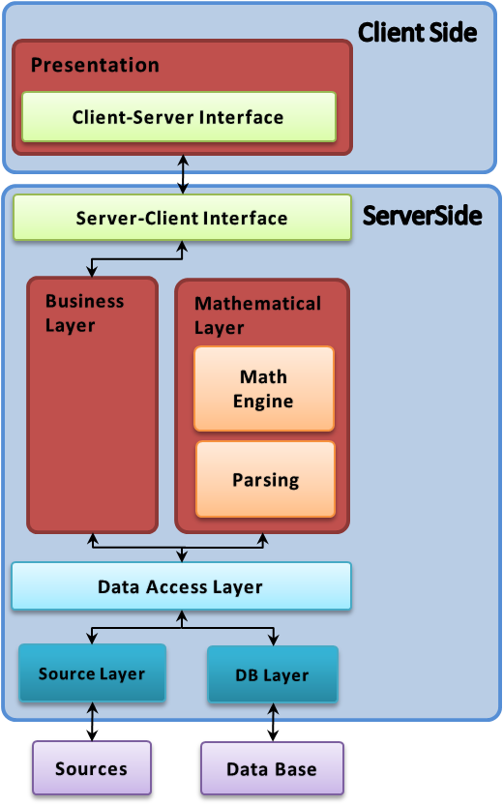
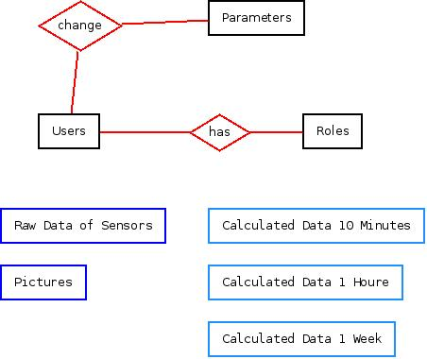
Project Status
Actual Architecture
13-11-06
<numero>

Slide 12
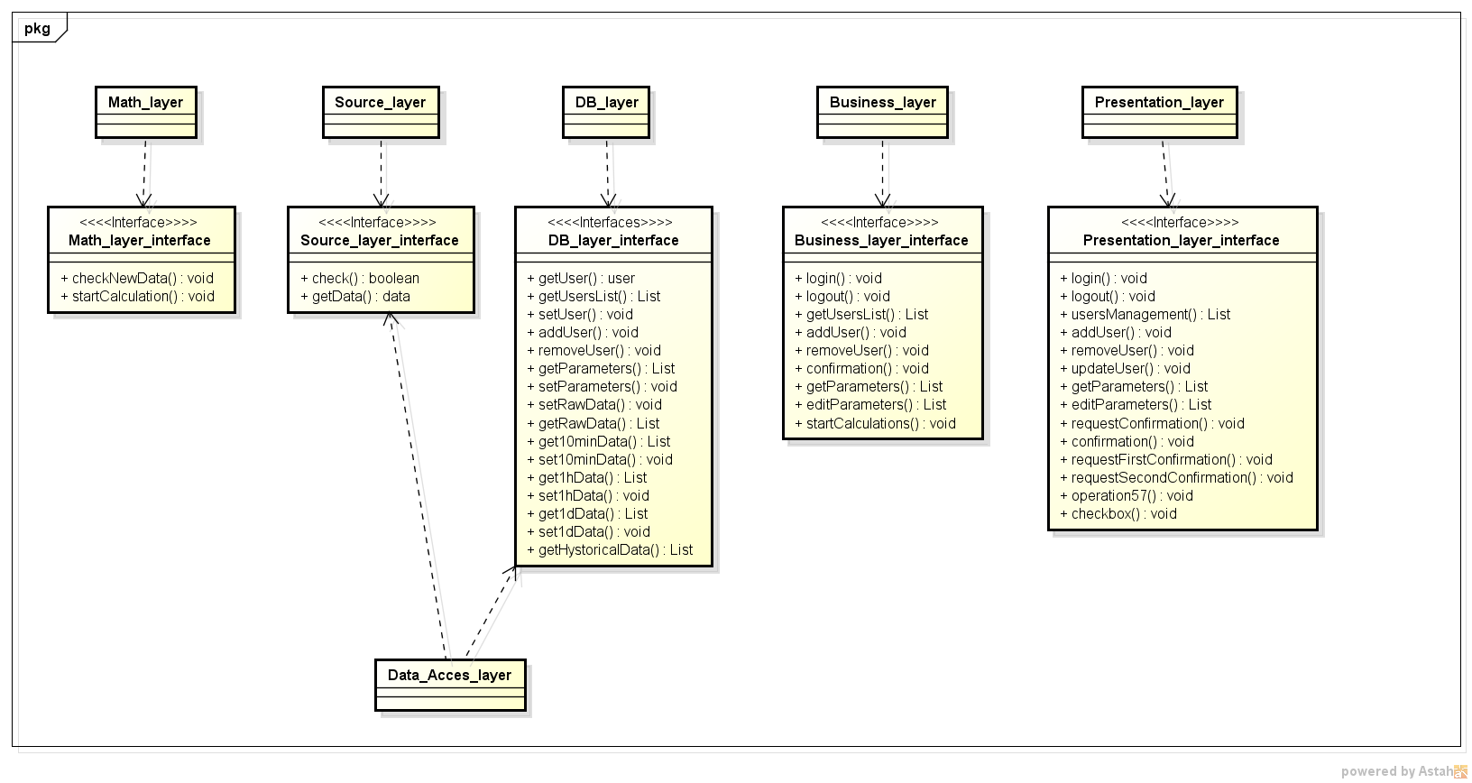
Project Status
Some API Diagrams
13-11-06
<numero>

Slide 13
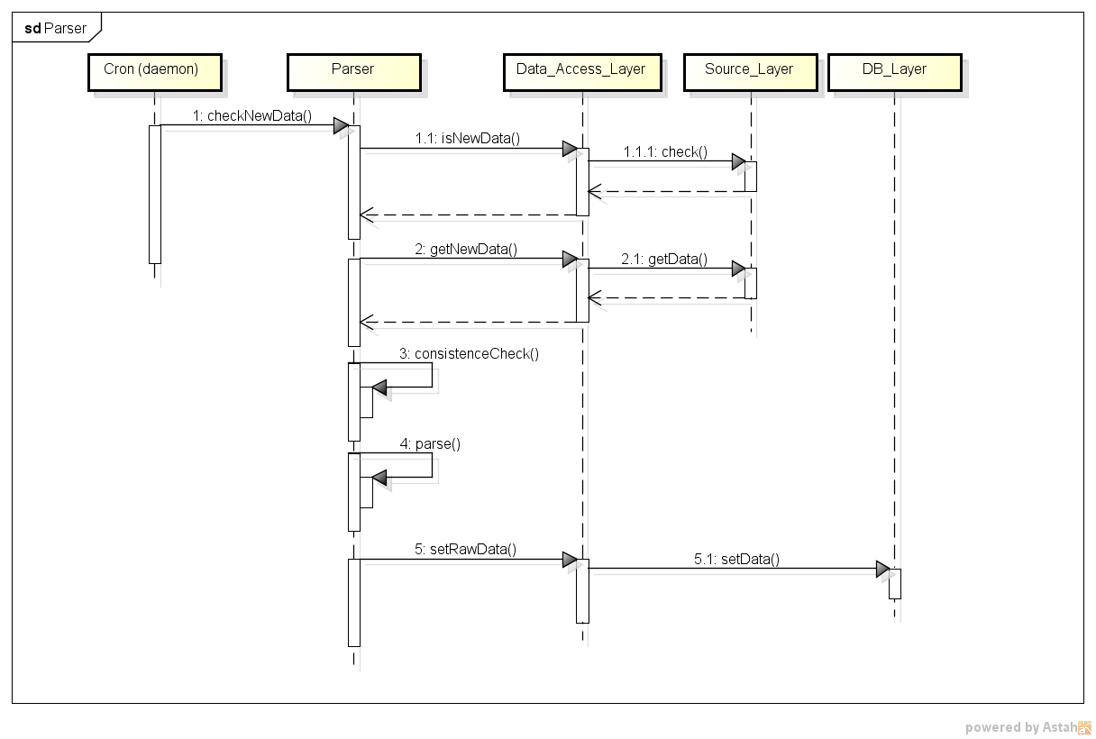
Project Status
Some Sequence Diagrams (I)
  Parser
13-11-06
<numero>

Slide 14
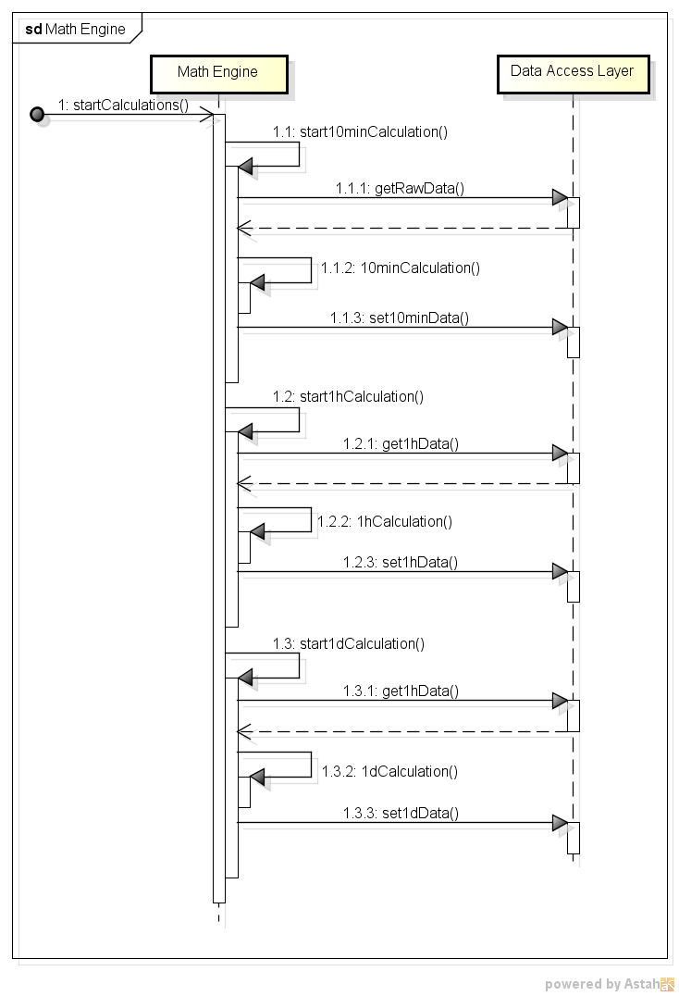
Project Status
Some Sequence Diagrams (II)
  Math Engine
13-11-06
<numero>

Slide 15
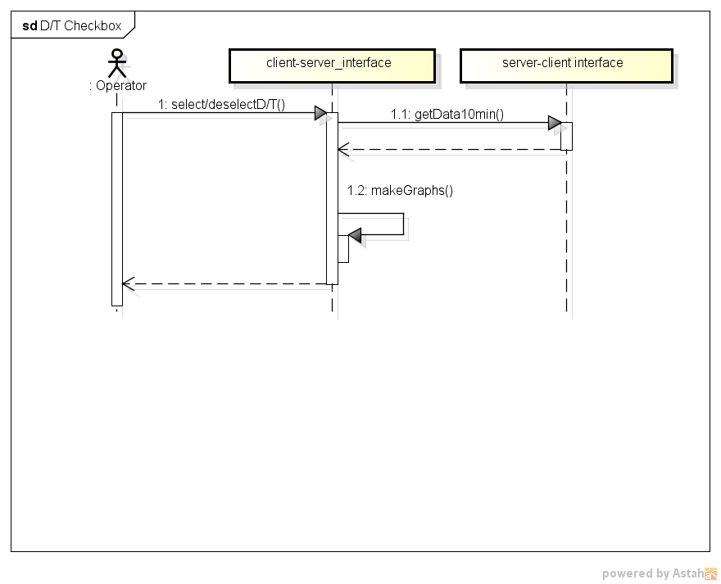
Project Status
Some Sequence Diagrams (III)
  Change Parameters: operator
13-11-06
<numero>

Slide 16
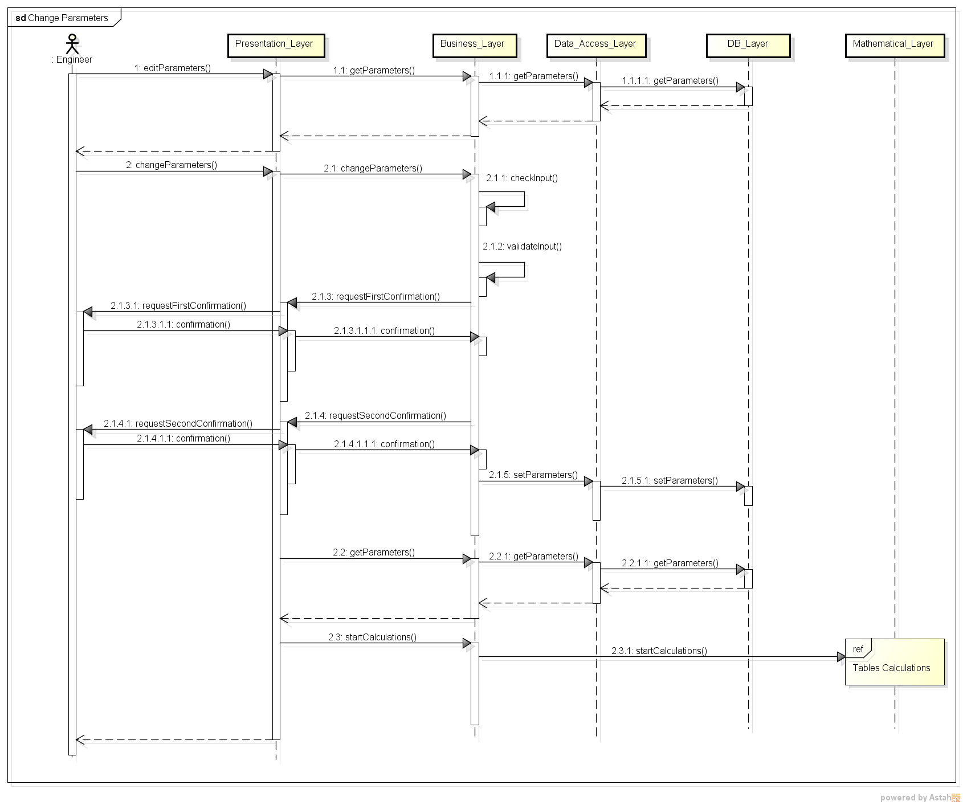
Project Status
Some Sequence Diagrams (IV)
  Change Parameters: engineer
13-11-06
<numero>

Slide 17
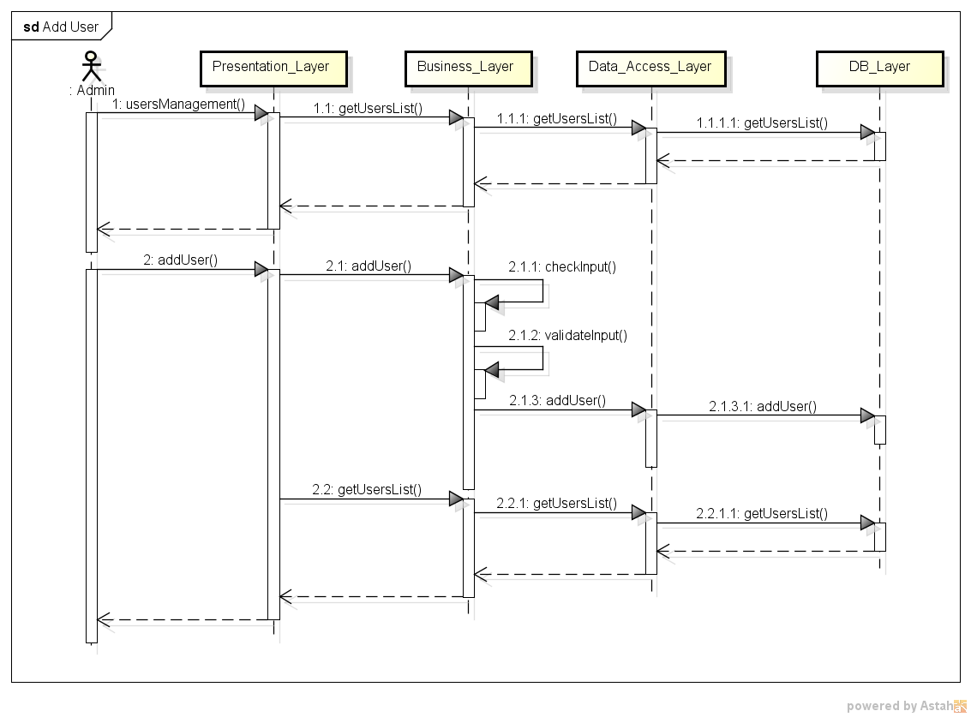
Project Status
Some Sequence Diagrams (V)
  User managing: add user
13-11-06
<numero>

Slide 18
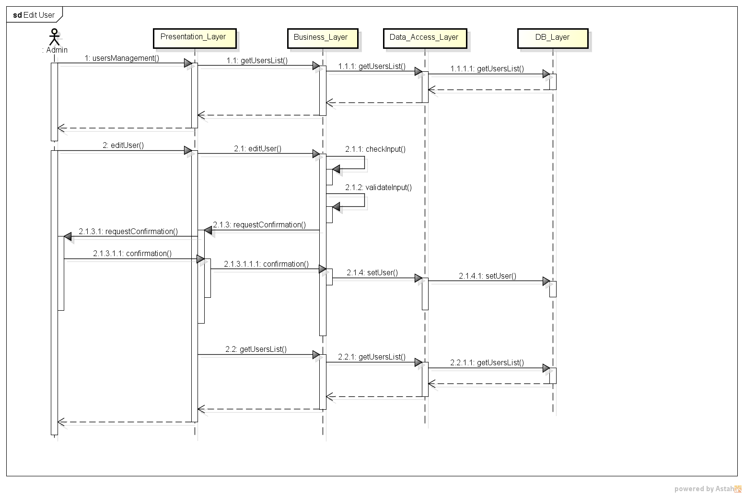
Project Status
Some Sequence Diagrams (VI)
  User managing: edit user
13-11-06
<numero>

Slide 19
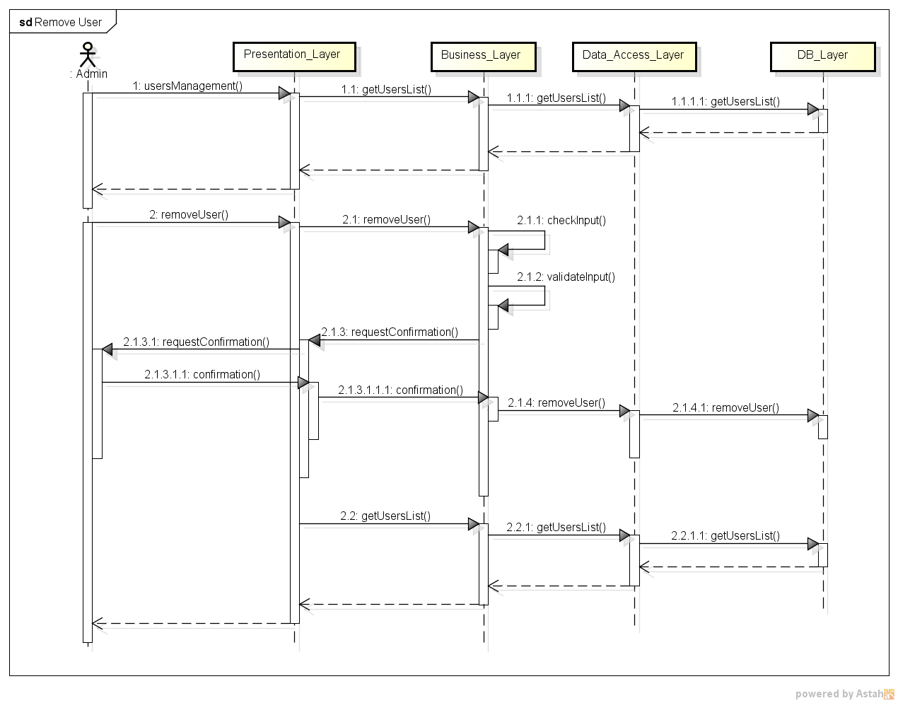
Project Status
Some Sequence Diagrams (VII)
  User managing: remove user
13-11-06
<numero>

Slide 20
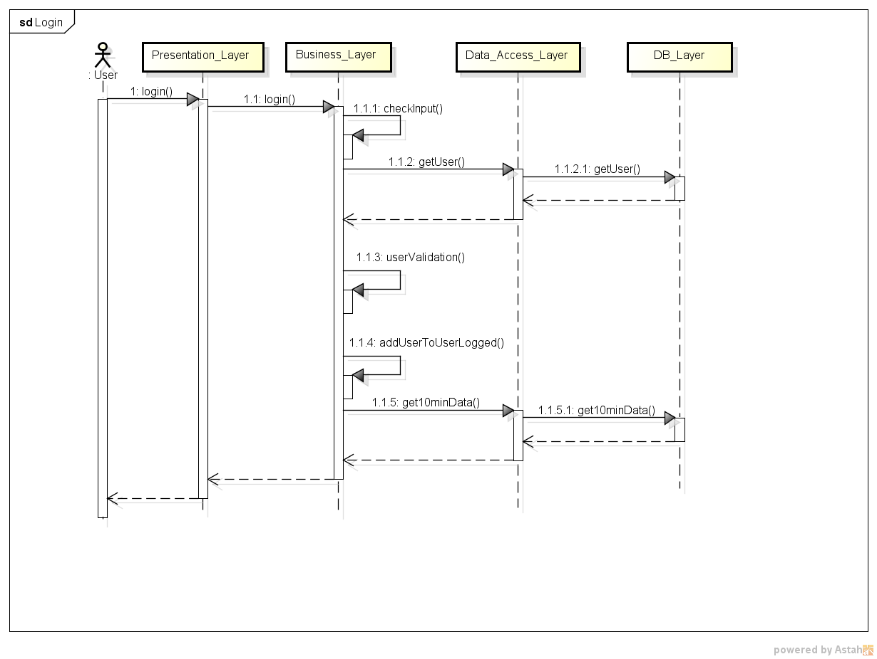
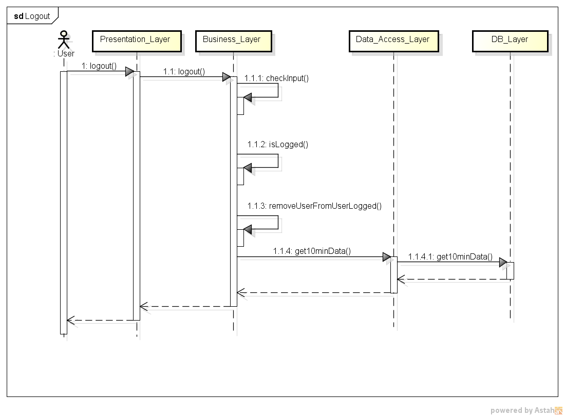
Project Status
Some Sequence Diagrams (VIII)
  Login & Logout
13-11-06
<numero>

Slide 21
Meetings
Both chat & video
Group Meetings
  Face to face meetings
  Formally scheduled every Tuesday 7 P.M.
  Actually, about 3 or 4 every week ;-)
  9 Minutes of Meetings
Project Leader & Team Leader Meetings
  About every day (during the week)
13-11-06
<numero>

Slide 22
Meetings
Customers Meetings
  One every week
    Project status
    Customers desires
    Requirements
  First one with both customers
  The others with ing. Crotti
13-11-06
<numero>

Slide 23
Meetings
Supervisors Meetings
  One every week
  Inform about
    Project status
    Group status & managing
    Report about customer meetings
  Gather advices
  Report problems
    until now, not needed --> no problems ;-)
13-11-06
<numero>

Slide 24

Question Time
13-11-06
<numero>

Slide 25

Thank You
Thank you for your attention :-)
13-11-06
<numero>

