Slide 1
Distributed Software Development
13-11-27

Slide 2

Real-Time Bridge Monitoring
Status Report
The Development Group
13-11-27

Slide 3
Overview
Current Project Status
Project Organization
Experiences
Alpha prototype demo
Future development
13-11-27

Slide 4


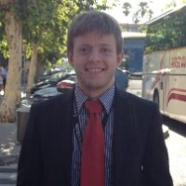
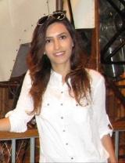
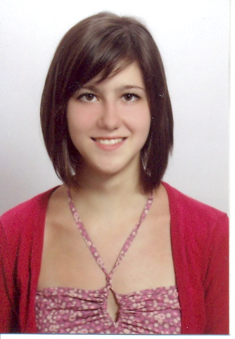
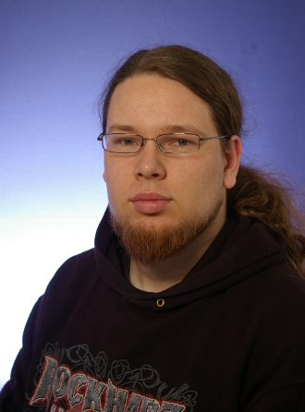
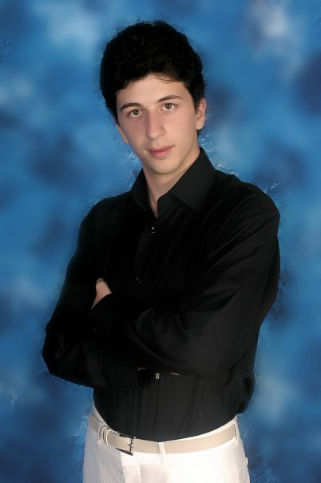

Team Organization
The Development Group
Andrea Bottoli (PoliMi) Lorenzo Pagliari (PoliMi) Marko Brčić (FER) Ghazaleh Shojaee Nia (PoliMi)
Dzana Kujan (MDH) Jörn Tillmanns (MDH) Miraldi Fifo (MDH) Nikola Radisavljevic (MDH)
13-11-27

Slide 5
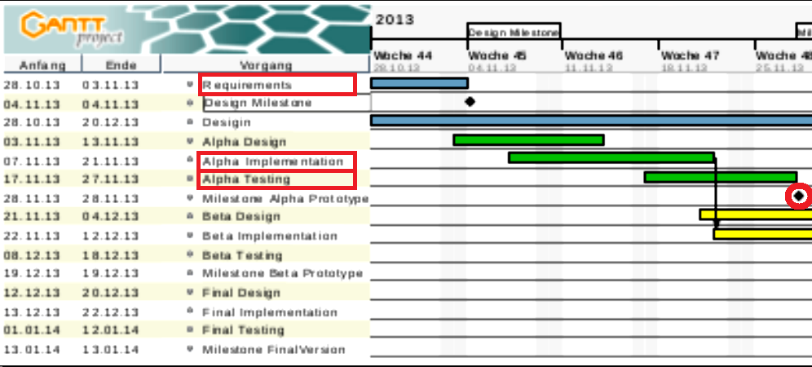
Current Project Status
Project development process
  Initial plan
13-11-27

Slide 6
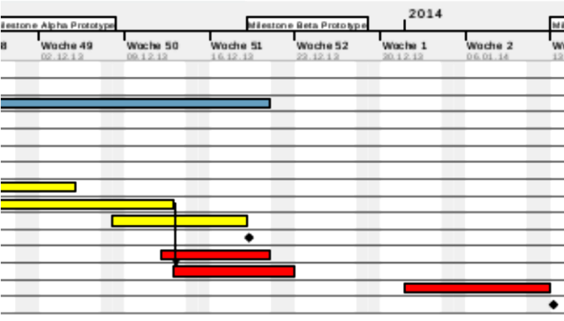
Current Project Status
Project development process
  Initial plan
13-11-27

Slide 7
Current Project Status
Project plan, Alpha prototype
  Complete database implementation
  Complete parser
  Connection with front end
13-11-27

Slide 8
Current Project Status
Status of the Alpha prototype
  Database implementation
  Scheduler: periodically calls the parser
  Parser: parses the .txt files (and does needed conversions) (+ stores in database)
  Webpage: design/layout, Current State View, Parameters View
  Website is running on the VM
  Acceptence test
13-11-27

Slide 9
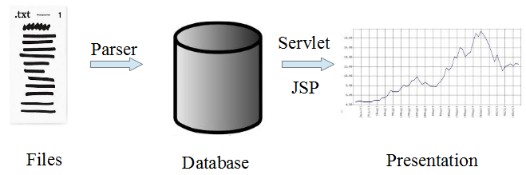
Current Project Status
13-11-27

Slide 10
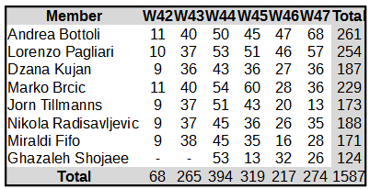
Current Project Status
Effort so far
13-11-27

Slide 11
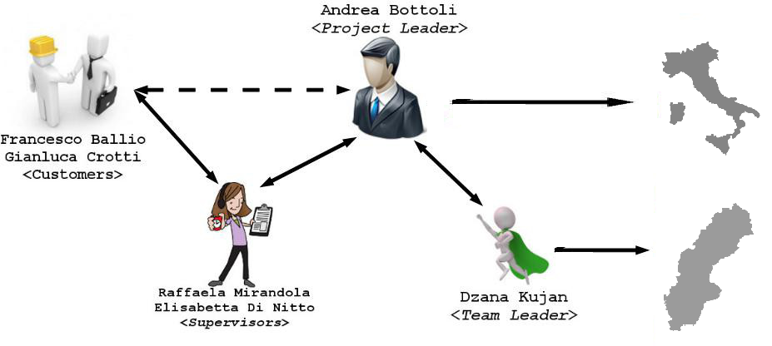
Project Organization
Meetings and communication
  Weekly meeting with customer, and supervisor
  Project manager and team leader weekly meeting
  Two weekly group meetings
13-11-27

Slide 12
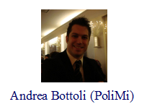
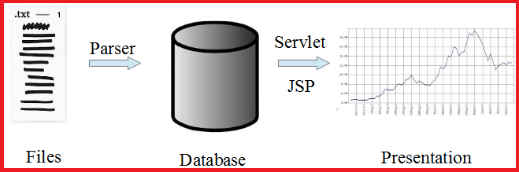
Work distribution
13-11-27

Slide 13
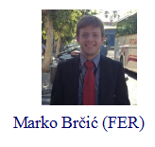
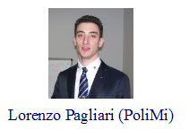
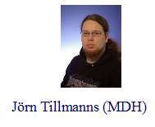
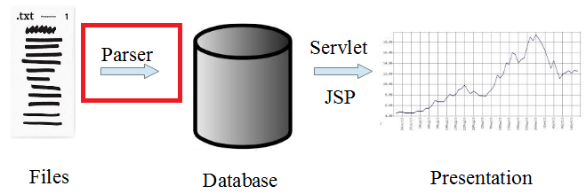
Work distribution
13-11-27

Slide 14
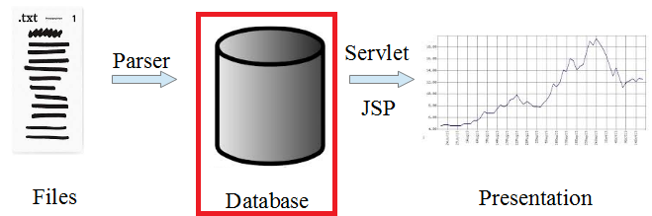
Work distribution
13-11-27

Slide 15
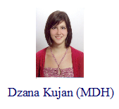
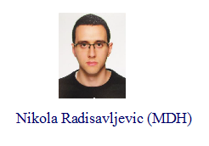

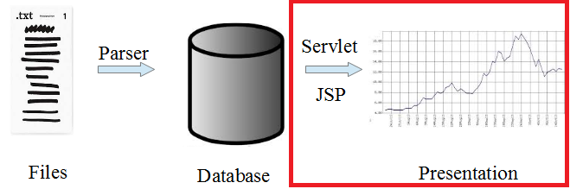
Work distribution
13-11-27

Slide 16
Work distribution
  Good system design, and good communication leads to easy separation of work and easy integration :)
13-11-27

Slide 17
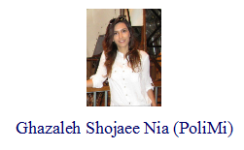

Work distribution
  Math engine
13-11-27

Slide 18
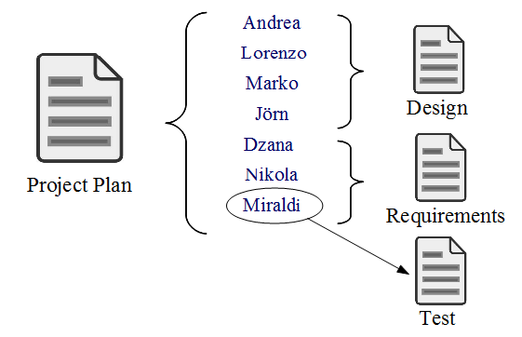
Work distribution
Documentation
  Constant update of documents
  Quality: Peer review
13-11-27

Slide 19


Project Organization
Tools used
  Google Hangout
  Skype
  Git
  Plug-ins for Eclipse:
    Mylyn
    Egit
13-11-27

Slide 20
Experiences
Issues
  Communication
  Management
  Ineficient meetings
  Technologies not familiar to all
  Setting up environment
  Being late for meetings
Solutions
  Additional Meetings
  Tasks on github
  Meeting agenda introduced
  Additional hours spent on learning
  Helping each other :)
  Chocolate penalties :)
13-11-27

Slide 21

Experiences
Unanticipated risks
  Documentation in Italian (40 pages, and counting...) --> all translated by Lorenzo
  Far more complex calculations than expected
  Still receiving requirements from customer
13-11-27

Slide 22

Experiences
Positive experiences
  Team work
  Fun meetings :)
  Everyone is doing a hard work and trying to do the best they can
  Improved skills and distributed development experience
  Good collaboration
13-11-27

Slide 23
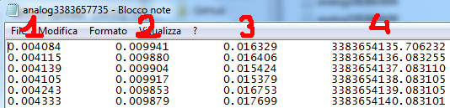
Alpha prototype demo
Analog files
13-11-27

Slide 24
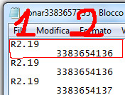
Alpha prototype demo
Echo sonar files
13-11-27

Slide 25
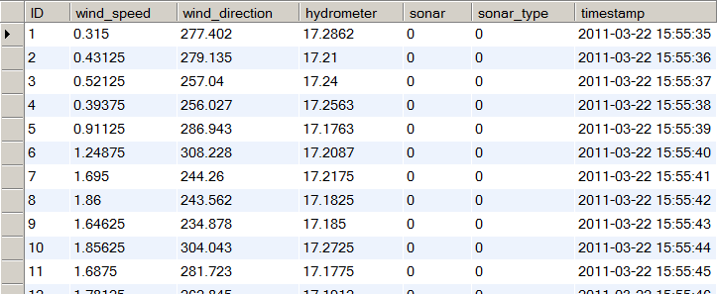
Alpha prototype demo
Database (STILL NEEDS TO BE UPDATED – expected tonight before midnight)
13-11-27

Slide 26
Alpha prototype demo
Live demo :)
13-11-27

Slide 27
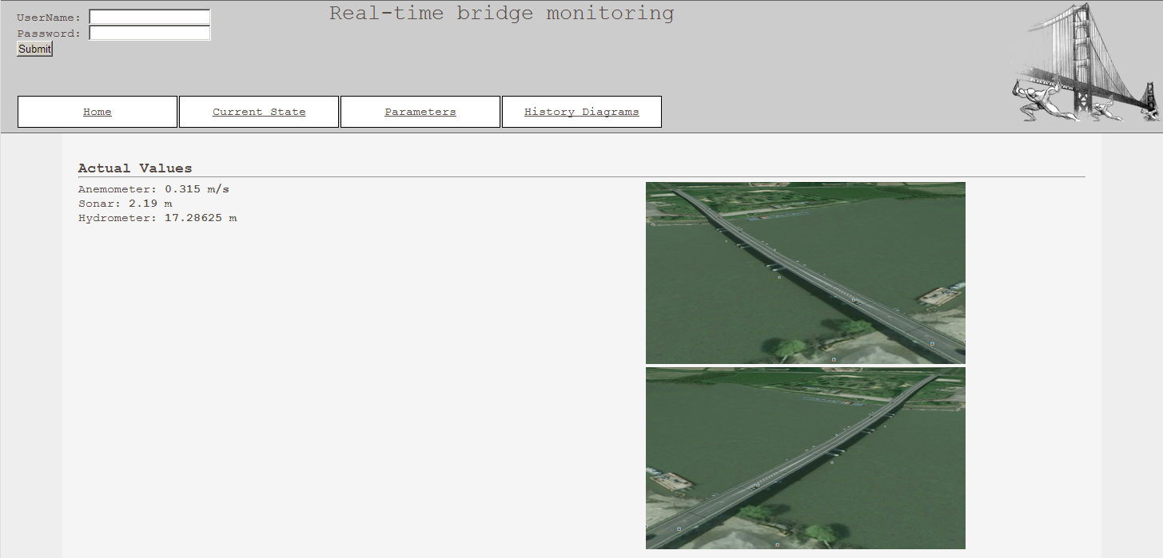
13-11-27

Slide 28
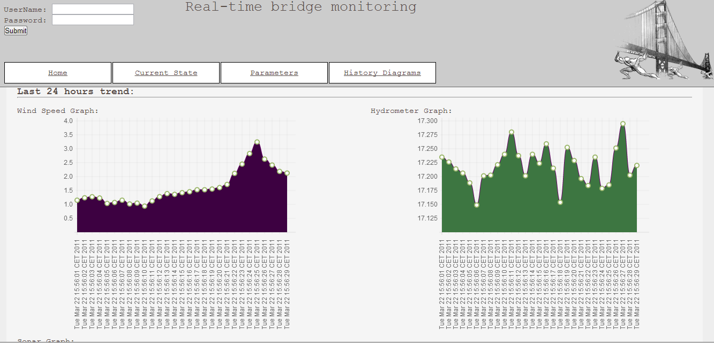
13-11-27

Slide 29
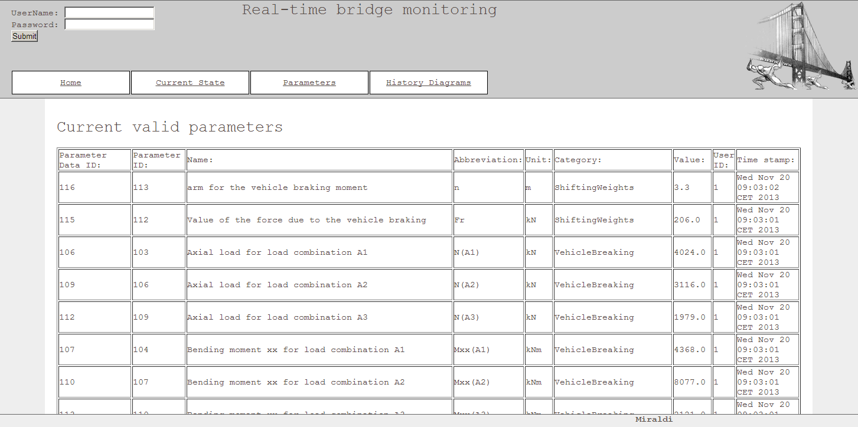
13-11-27

Slide 30
Future development
•The beta prototype:
– Finalize graphs and pictures on the website
•The final product:
–all the features: historical statistics, graphs, login for different users
Final documentation + user manual +installation manual + final archive that contains both the product and the installation & configuration files
13-11-27

Slide 31
Conclusion
Current Project Status
Project Organization
Experiences
Alpha prototype demo
Future development
-->On track and satisfied team :)
13-11-27

Slide 32

Question Time
13-11-27

Slide 33
Thank you for your attention
13-11-27

