Slide 1
Distributed Software Development
13-12-02
<numero>

Slide 2

Real-Time Bridge Monitoring
Status Report 2
The Development Group
13-12-02
<numero>

Slide 3
Overview
Team Organization
  The Development Group
  Roles
Project Status
  Actual Project Plan
  Actual Architecture
  Package Dependencies
13-12-02
<numero>

Slide 4
Overview
Meetings
  Group meetings
  Customer meetings
  Supervisor meetings
Experiences
  Effort
  Problems and solutions
  Positive experiences
The web site
13-12-02
<numero>

Slide 5


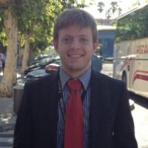
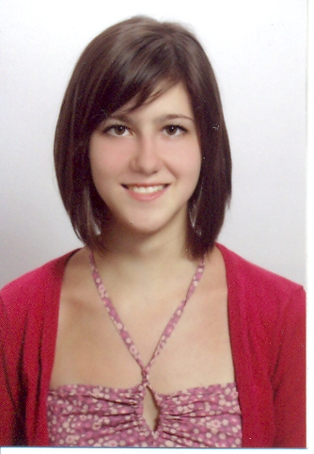
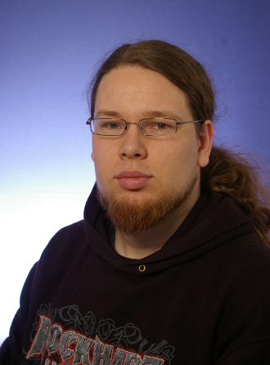
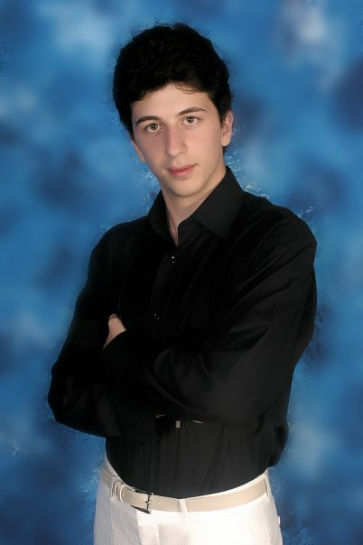

Team Organization
The Development Group
Andrea Bottoli (PoliMi) Lorenzo Pagliari (PoliMi) Marko Brčić (FER)
Dzana Kujan (MDH) Jörn Tillmanns (MDH) Miraldi Fifo (MDH) Nikola Radisavljevic (MDH)
13-12-02
<numero>

Slide 6
Team Organization
Roles
Name | Initials | Responsibility (roles)
Andrea Bottoli | AB | Project Manager
Dzana Kujan | DK | Team Leader
Marco Brčić | MB | Documentation Manager
Lorenzo Pagliari | LP | Design Manager
Miraldi Fifo | MF | Testing Manager
Jörn Tillmanns | JT | Database Manager
Nikola Radisavljevic | NR | Integration Manager
13-12-02
<numero>

Slide 7

Project Status
Actual Project Plan (I)
  Where we are and what we have to do
13-12-02
<numero>

Slide 8
Project Status
Actual Project Plan (II)
  Alpha Prototype
    Database implementation
    Scheduler: periodically calls the parser
    Parser: parses the .txt files and stores in database
    Webpages
    Website is running on the VM
    Acceptence test
13-12-02
<numero>

Slide 9
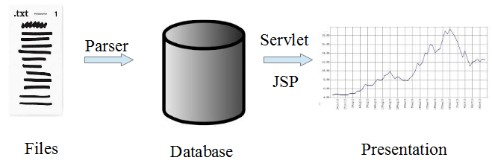
Project Status
Actual Project Plan (II)
  Alpha Prototype
13-12-02
<numero>

Slide 10
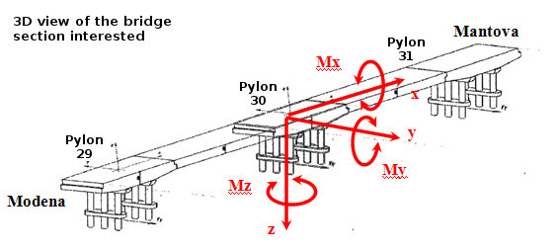
Project Status
Actual Project Plan (III)
  Beta Prototype
13-12-02
<numero>

Slide 11
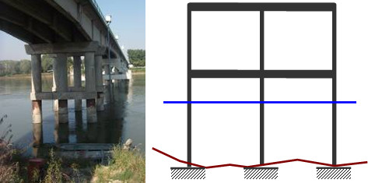
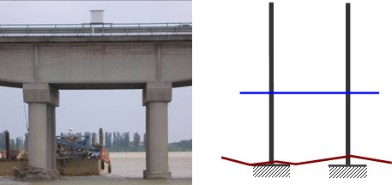
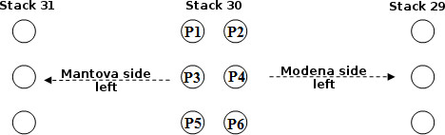
Project Status
Actual Project Plan (III)
  Beta Prototype
13-12-02
<numero>

Slide 12
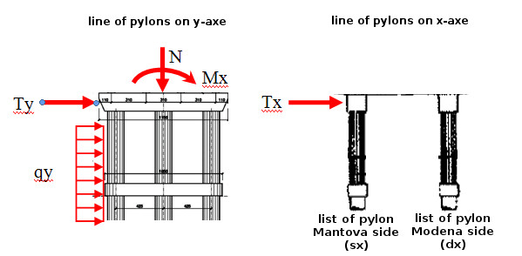
Project Status
Actual Project Plan (III)
  Beta Prototype
13-12-02
<numero>

Slide 13
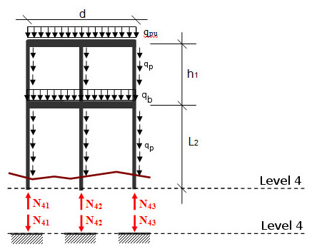
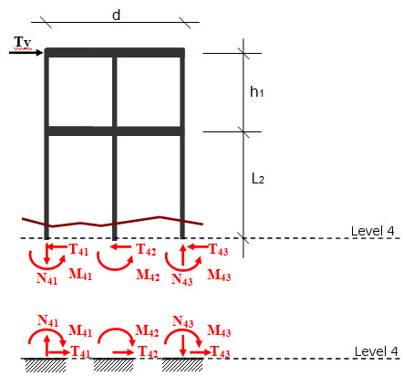
Project Status
Actual Project Plan (III)
  Beta Prototype
13-12-02
<numero>

Slide 14
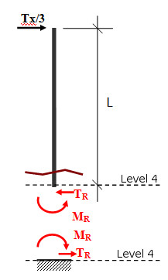
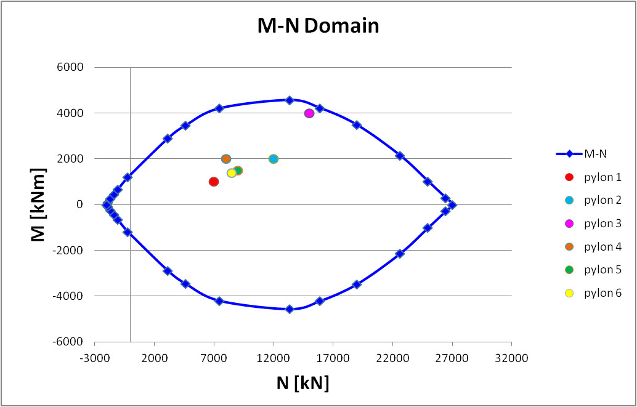
Project Status
Actual Project Plan (III)
  Beta Prototype
13-12-02
<numero>

Slide 15

Project Status
Actual Project Plan (III)
  Beta Prototype
Math Engine
13-12-02
<numero>

Slide 16
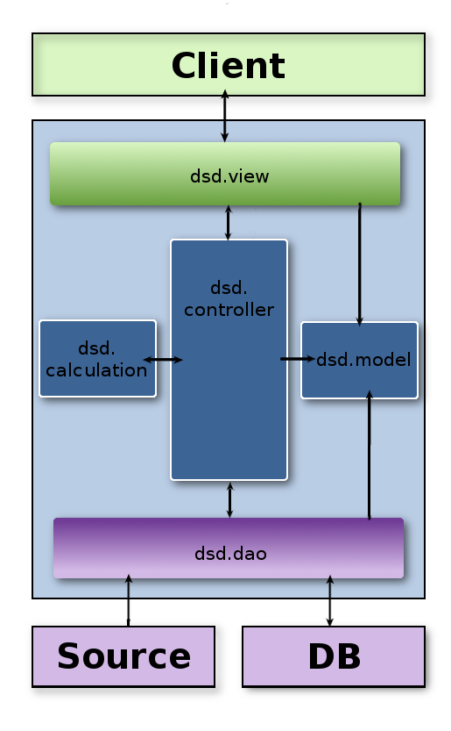
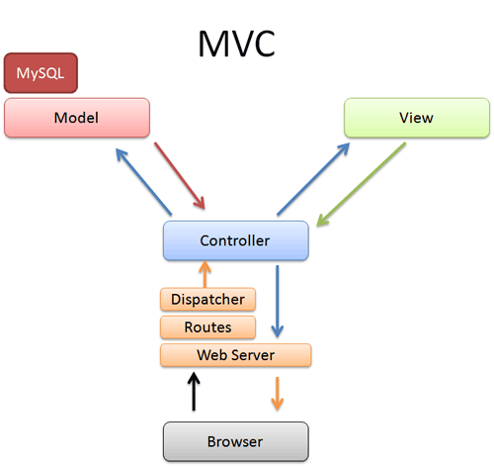
Project Status
Actual Architecture
13-12-02
<numero>

Slide 17
Project Status
Actual Architecture
  Modules distribution (persons in charge)
    dsd.dao
      Marco Brčić and Jörn Tillmanns
    dsd.controller
      Each member creates what he needs
    dsd.model
      Each member creates what he needs
    dsd.calculation
      Lorenzo Pagliari and Andrea Bottoli
    dsd.view
      Dzana Kujan, Nikola Radisavljevic
13-12-02
<numero>

Slide 18
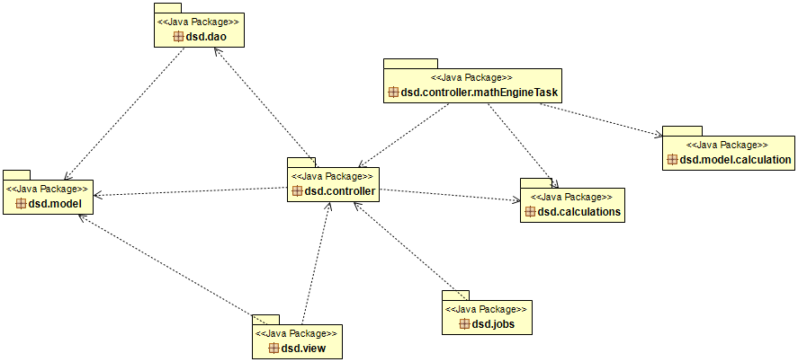
Project Status
Package Dependencies
13-12-02
<numero>

Slide 19

Meetings
Both chat & video
Group Meetings
  Face to face meetings
  Formally scheduled every Monday and every Thursday 7 PM
Project Leader & Team Leader Meetings
  About every day (during the week)
  Formally scheduled every Tuesday 10 PM
13-12-02
<numero>

Slide 20
Meetings
Customers Meetings
  One every week
    Project status
    Customers desires
    Requirements
  First one with both customers
    Ing. Francesco Ballio
    Ing. Gianluca Crotti
  The others with ing. Crotti
13-12-02
<numero>

Slide 21
Meetings
Supervisors Meetings
  One every week
  Inform about
    Project status
    Group status & managing
    Report about customer meetings
  Gather advices, suggestions and proposals
  Report problems
13-12-02
<numero>

Slide 22
Experiences
Effort
  << table from summary week report >>
13-12-02
<numero>

Slide 23
Experiences
New Requirements
  << M-N domain >>
  << NTC 08 and EU 305/2011 >>
  << NEW MOCKUPS >>
13-12-02
<numero>

Slide 24
Experiences
Changes in documentation
  Requirement document
    3 versions, working on the 4th (the final one)
  Design document
    3 versions, working on the 4th
  Input and Convertions
    5 versions, now it is complete
13-12-02
<numero>

Slide 25
Experiences
Problems
  Communication
  Management
  Ineficient meetings
  Technologies not familiar to all
  Setting up environment
  Being late for meetings
Solutions
  Additional Meetings
  Tasks on github
  Meeting agenda introduced
  Additional hours spent on learning
  Helping each other :)
  Chocolate penalties :)
13-12-02
<numero>

Slide 26
Experiences
Problems and Solutions
  Ghazaleh
    She decided to left the group
    Our supervisors told her that her that her contribution to the project was too small to be considered sufficient for the purposes of this course
13-12-02
<numero>

Slide 27
Experiences
Positive experiences
  Team work
  Fun meetings :)
  Everyone is doing a hard work and trying to do the best they can
  Improved skills and distributed development experience
  Good collaboration
13-12-02
<numero>

Slide 28
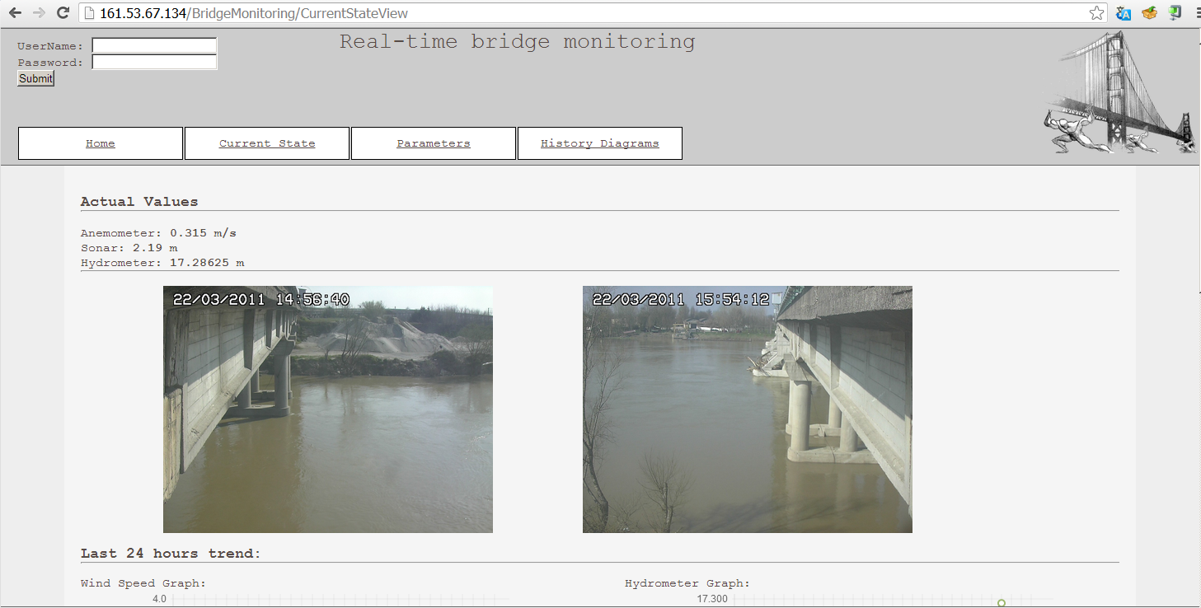
The Web Site
Some Screenshots
13-12-02
<numero>

Slide 29
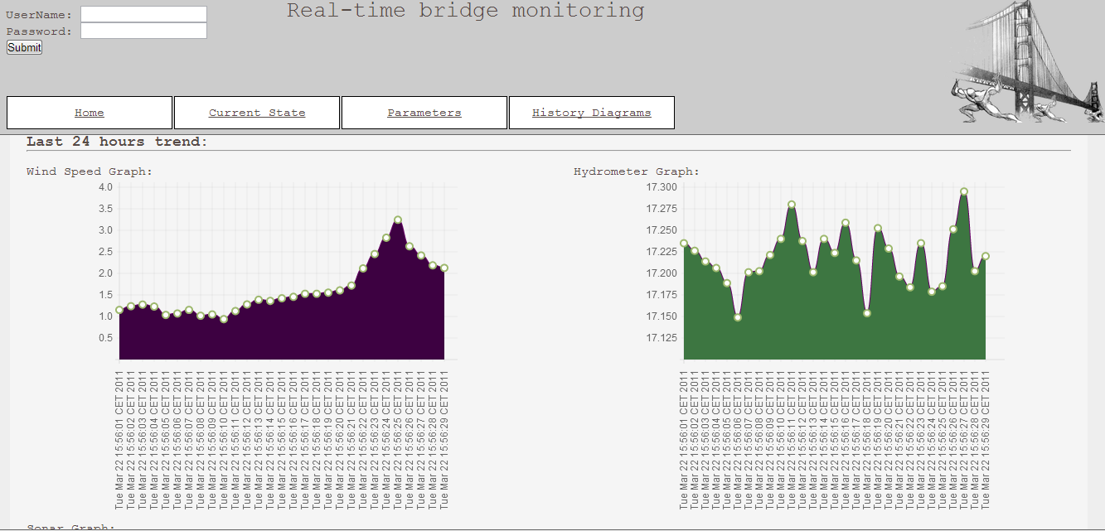
The Web Site
Some Screenshots
13-12-02
<numero>

Slide 30
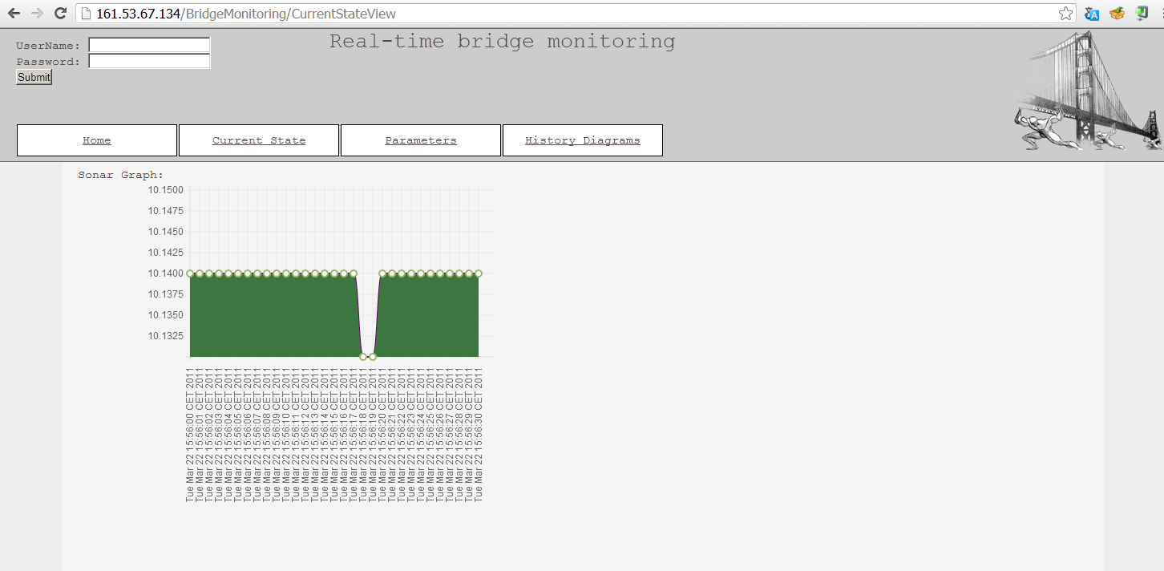
The Web Site
Some Screenshots
13-12-02
<numero>

Slide 31
The Web Site
Live demo
  http://161.53.67.134/BridgeMonitoring
13-12-02
<numero>

Slide 32

Question Time
13-12-02
<numero>

Slide 33

Thank you for your attention
13-12-02
<numero>

