Slide 1
Distributed Software Development
13-12-18
<numero>

Slide 2

Real-Time Bridge Monitoring
Beta Prototype
The Development Group
13-12-18
<numero>

Slide 3
Overview
Team Organization
Project Schedule
Documentation
Verification & Validation
Effort
13-12-18
<numero>

Slide 4
Overview
Alpha Prototype
Beta Prototype
Integration
New Functionalities
Demo & Screenshots
13-12-18
<numero>

Slide 5







Team Organization
The Development Group
Andrea Bottoli (PoliMi) Lorenzo Pagliari (PoliMi) Marko Brčić (FER)
Dzana Kujan (MDH) Jörn Tillmanns (MDH) Miraldi Fifo (MDH) Nikola Radisavljevic (MDH)
13-12-18
<numero>

Slide 6
Team Organization
Roles
Name | Initials | Responsibility (roles)
Andrea Bottoli | AB | Project Manager
Dzana Kujan | DK | Team Leader
Marco Brčić | MB | Documentation Manager
Lorenzo Pagliari | LP | Design Manager
Miraldi Fifo | MF | Testing Manager
Jörn Tillmanns | JT | Database Manager
Nikola Radisavljevic | NR | Integration Manager
13-12-18
<numero>

Slide 7



Team Organization
Management
  Managing Meetings
    Dzana & Andrea
  Meeting Agendas
    Before each meeting
  Meeting Summaries
    Customers, Supervisors, Group ...
13-12-18
<numero>

Slide 8

Project Schedule
Project Plan and Current State
  Where we are and what we have to do
13-12-18
<numero>

Slide 9


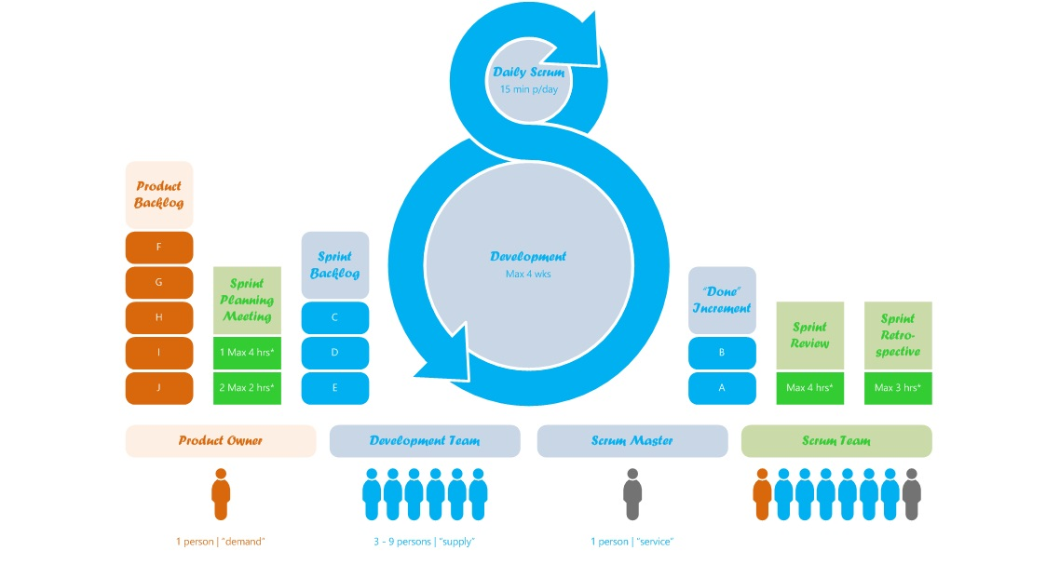


Project Schedule
Development Process
  SCRUM
  Every day chat meetings
  Some hangouts calls
  Lot of commits
13-12-18
<numero>

Slide 10
Documentation
Versioning
  Requirements Documentation v1.3
  Design Documentation v1.5
  Technical Documentation v1.1
New Documents
  User Guide v1.0
  Installation Guide v1.0
  Acceptance Test Documentation v1.0
13-12-18
<numero>

Slide 11
Verification & Validation
Meetings with customers
Check on requirements and functionalities
An acceptance test document
Local and Remote Tests
JUnit test classes
13-12-18
<numero>

Slide 12
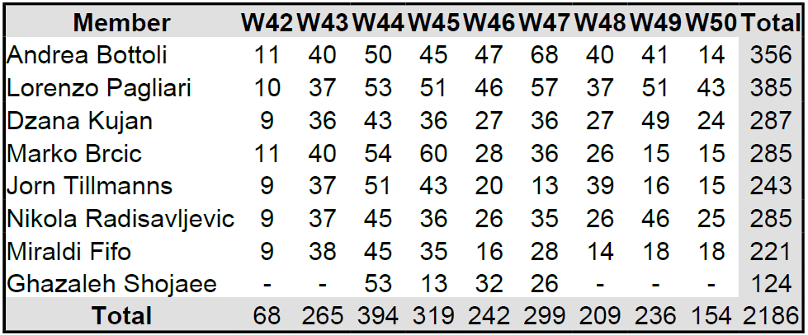
Effort
Hours spent
13-12-18
<numero>

Slide 13

Effort
Important Events
  Changes in Design
  Changes in Requirements
  Comply with NTC 08 and EU 305/2011
  New Technical Documentation
  Fly to Sweden ;-)
13-12-18
<numero>

Slide 14
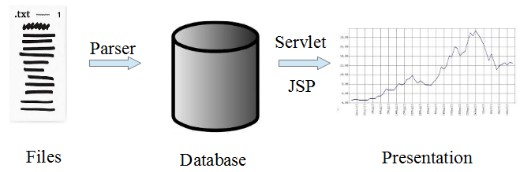
Alpha Prototype
13-12-18
<numero>

Slide 15


Beta Prototype
Authentication System
Math Engine
13-12-18
<numero>

Slide 16
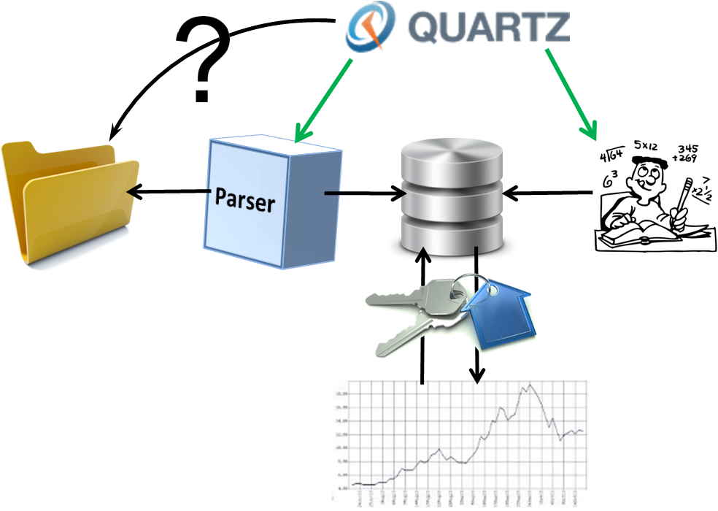
Integration
13-12-18
<numero>

Slide 17
New Functionalities
Math Engine
  Library for making
    Structural calculations
    Statistical calculations
    Algebraic calculations
  Used by the Calculation Controller
  Used to produce the Safety Factor (CS)
13-12-18
<numero>

Slide 18
New Functionalities
Calculation Controller
  Controls the calculations logic
  Manages calculations
    A lot of threads in parallel
  Uses the Math Engine
  Stores the results in the DB
13-12-18
<numero>

Slide 19
New Functionalities
Quartz scheduler
  Schedules
    The loading of the system settings
    The checking for new data
    The parsing of new data
    The calculations
  Uses Job Classes and Servlets
  Interfacing with Tomcat
13-12-18
<numero>

Slide 20
New Functionalities
Authentication System
  Allowed a first authentication
  Permits to see different pages
  Permits to see different contents & data
  Works with Tomcat
13-12-18
<numero>

Slide 21
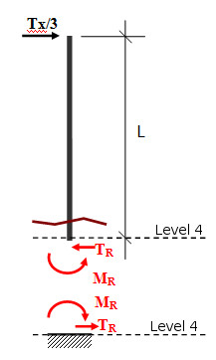
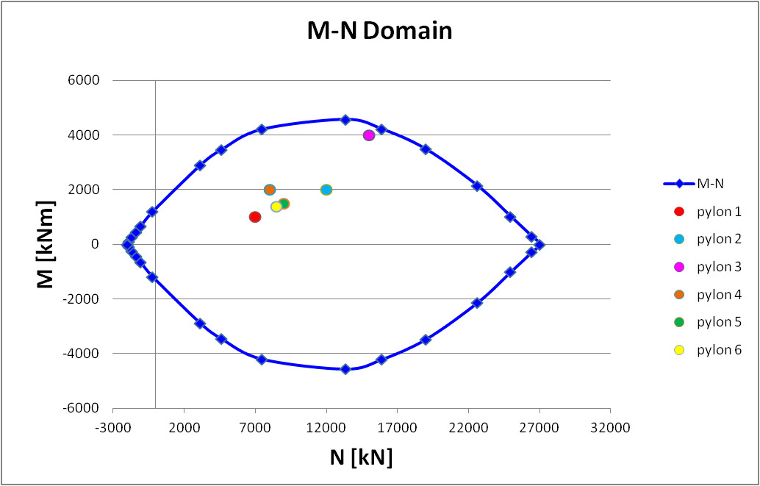
New Functionalities
M-N Domain
13-12-18
<numero>

Slide 22
Demo
Localhost
VM: http://161.53.67.134/BridgeMonitoring/
13-12-18
<numero>

Slide 23
Screenshots
13-12-18
<numero>

Slide 24

Question Time
13-12-18
<numero>

Slide 25

Thank you for your attention
13-12-18
<numero>

