Slide 1
Algoritmi per il Machine Learning
Ing Andrea Colleoni

Slide 2
Clustering
In machine learning too, we often group examples as a first step to understand a subject (data set) in a machine learning system. Grouping unlabeled examples is called clustering.
Clustering has a myriad of uses in a variety of industries. Some common applications for clustering include the following:
market segmentation
social network analysis
search result grouping
medical imaging
image segmentation
anomaly detection
Andrea Colleoni
UFS04
Notes:
/

Slide 3
Utilizzo in Google
Generalization When some examples in a cluster have missing feature data, you can infer the missing data from other examples in the cluster.
Data Compression Feature data for all examples in a cluster can be replaced by the relevant cluster ID. This replacement simplifies the feature data and saves storage.
Privacy Preservation You can preserve privacy by clustering users, and associating user data with cluster IDs instead of specific users.
Andrea Colleoni
UFS04

Slide 4
Tipi di clustering
Centroid-based clustering
k-means is the most widely-used centroid-based clustering algorithm.
Centroid-based algorithms are efficient but sensitive to initial conditions and outliers.
Density-based Clustering
connects areas of high example density into clusters; This allows for arbitrary-shaped distributions as long as dense areas can be connected
These algorithms have difficulty with data of varying densities and high dimensions. Further, by design, these algorithms do not assign outliers to clusters
Distribution-based Clustering
This clustering approach assumes data is composed of distributions, such as Gaussian distributions
Hierarchical Clustering
Hierarchical clustering creates a tree of clusters.
Hierarchical clustering, not surprisingly, is well suited to hierarchical data, such as taxonomies.
Andrea Colleoni
UFS04
Notes:
https://www.andreaminini.com/ai/machine-learning/alberi-di-decisione

Slide 5
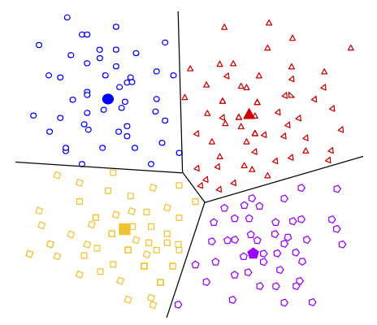
Centroid-based clustering
Andrea Colleoni
UFS04
Notes:
https://blog.quantinsti.com/gini-index/

Slide 6
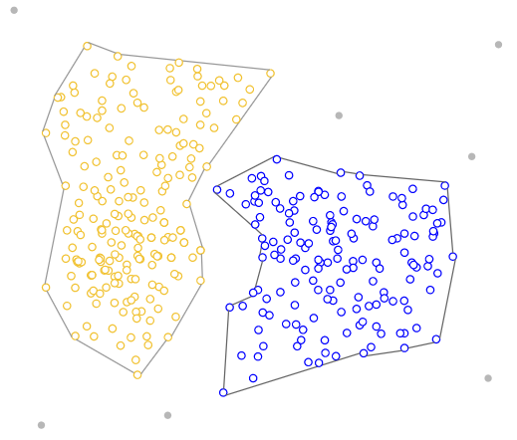
Density-based Clustering
Andrea Colleoni
UFS04

Slide 7
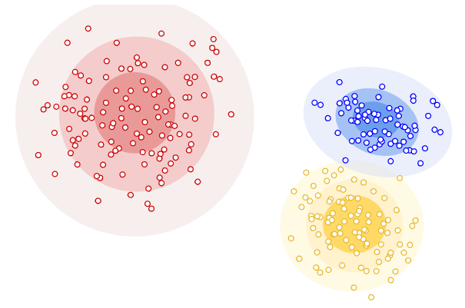
Distribution-based clustering
Andrea Colleoni
UFS04
Notes:
https://it.wikipedia.org/wiki/Codifica_di_Huffman

Slide 8
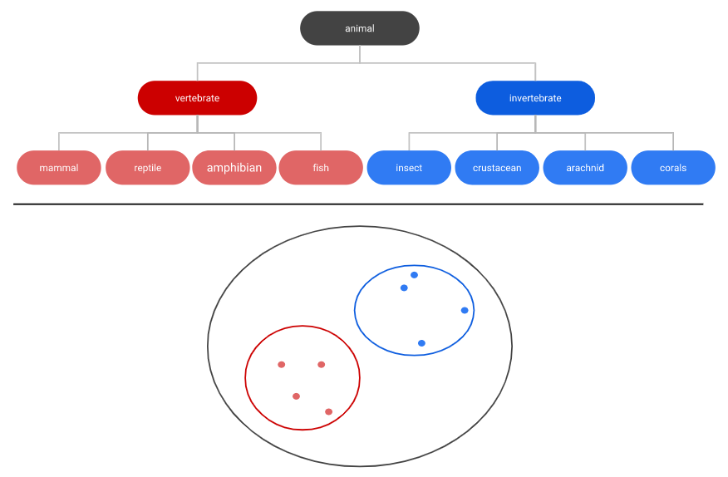
Hyerarchical-clustering
Codifica di Huffman della frase "this is an example of a huffman tree" con rappresentazione binaria e indice di frequenza delle lettere.
Andrea Colleoni
UFS04
Notes:
https://it.wikipedia.org/wiki/Codifica_di_Huffman

Slide 9
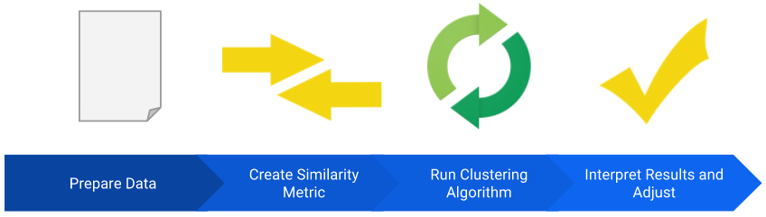
Organizzazione di un algoritmo di clustering
Preparazione dei dati
Creazione di metriche di similitudine
Esecuzione dell’algoritmo
Interpretazione dei risultati e adattamento dell’algoritmo
Andrea Colleoni
UFS04
Notes:
http://bearcave.com/misl/misl_tech/wavelets/compression/shannon.html

Slide 10
Preparazione dei dati
Normalizzazione, Utilizzo dei quantili, Sistemazione dei dati mancanti, ecc.
In generale le tecniche di preparazione dei dati viste lo scorso anno
Andrea Colleoni
UFS04
Notes:
http://bearcave.com/misl/misl_tech/wavelets/compression/shannon.html

Slide 11
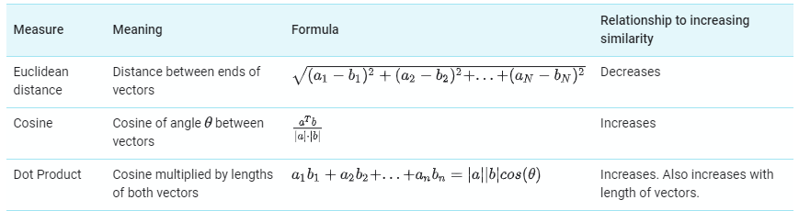
Creazione di metriche di similitudine
Combine all the feature data for those two examples into a single numeric value
Prepare numerical data
Andrea Colleoni
UFS04
Notes:
http://bearcave.com/misl/misl_tech/wavelets/compression/shannon.html

Slide 12
Esecuzione dell’algoritmo
In machine learning, you sometimes encounter datasets that can have millions of examples.
ML algorithms must scale efficiently to these large datasets.
However, many clustering algorithms do not scale because they need to compute the similarity between all pairs of points.
This means their runtimes increase as the square of the number of points, denoted as O(n²).
Andrea Colleoni
UFS04
Notes:
https://onestopdataanalysis.com/shannon-entropy/

Slide 13
K-means
k-means scales as O(nk), where k is the number of clusters. k-means groups points into k clusters by minimizing the distances between points and their cluster’s centroid. The centroid of a cluster is the mean of all the points in the cluster.
Before running k-means, you must choose the number of clusters, k. Initially, start with a guess for k.
Andrea Colleoni
UFS04

Slide 14
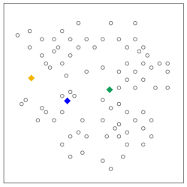
Step 1
The algorithm randomly chooses a centroid for each cluster. In our example, we choose a k of 3, and therefore the algorithm randomly picks 3 centroids.
Andrea Colleoni
UFS04

Slide 15
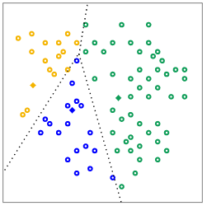
Step 2
Using the chosen similarity measure, the algorithm assigns each point to the closest centroid to get k initial clusters.
Andrea Colleoni
UFS04
Notes:
https://www.numpyninja.com/post/understanding-the-gini-index-in-decision-tree-with-an-example https://medium.com/coinmonks/what-is-entropy-and-why-information-gain-is-matter-4e85d46d2f01
https://anderfernandez.com/en/blog/code-decision-tree-python-from-scratch/
https://www.kaggle.com/yersever/500-person-gender-height-weight-bodymassindex

Slide 16
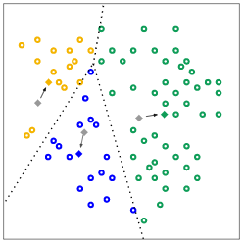
Step 3
For every cluster, the algorithm recomputes the centroid by taking the average of all points in the cluster. The changes in centroids are shown in Figure 3 by arrows. Since the centroids change, the algorithm then re-assigns the points to the closest centroid.
Andrea Colleoni
UFS04
Notes:
https://www.numpyninja.com/post/understanding-the-gini-index-in-decision-tree-with-an-example https://medium.com/coinmonks/what-is-entropy-and-why-information-gain-is-matter-4e85d46d2f01
https://anderfernandez.com/en/blog/code-decision-tree-python-from-scratch/
https://www.kaggle.com/yersever/500-person-gender-height-weight-bodymassindex

Slide 17
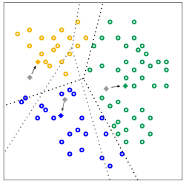
Step 4
The algorithm repeats the calculation of centroids and assignment of points until points stop changing clusters. When clustering large datasets, you stop the algorithm before reaching convergence, using other criteria instead.
Andrea Colleoni
UFS04
Notes:
https://www.numpyninja.com/post/understanding-the-gini-index-in-decision-tree-with-an-example https://medium.com/coinmonks/what-is-entropy-and-why-information-gain-is-matter-4e85d46d2f01
https://anderfernandez.com/en/blog/code-decision-tree-python-from-scratch/
https://www.kaggle.com/yersever/500-person-gender-height-weight-bodymassindex

Slide 18
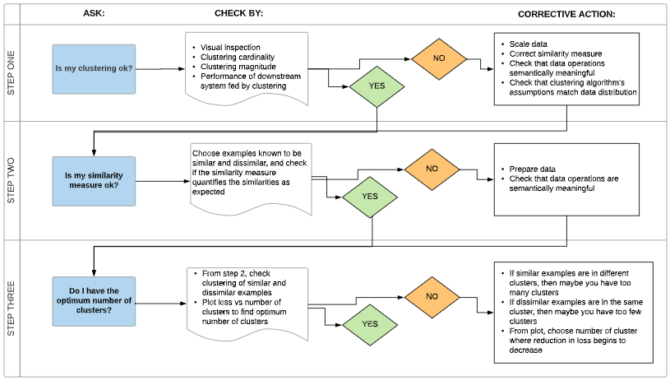
Interpretazione dei risultati
Andrea Colleoni
UFS04
Notes:
https://www.numpyninja.com/post/understanding-the-gini-index-in-decision-tree-with-an-example https://medium.com/coinmonks/what-is-entropy-and-why-information-gain-is-matter-4e85d46d2f01
https://anderfernandez.com/en/blog/code-decision-tree-python-from-scratch/
https://www.kaggle.com/yersever/500-person-gender-height-weight-bodymassindex

