Slide 1

Computer vision Project
Car Plate Recognition and Reconstruction with Deep Learning - Spring 2025 (Session 2)
Andrea D’Alessio – 2208280
Jamil Nassar – 2224424
Karim Refaie Yehia Ellithy – 2188256

Slide 2
Outline
Introduction
Related Work
Proposed Work and Implementation Details
Dataset and Metrics
Result
Conclusion and Future Works

Slide 3
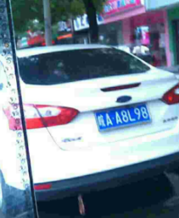
Introduction
Motivation:
Importance for law enforcement, traffic monitoring
Works under challenging conditions
Aim:
Develop and compare robust systems for plate detection and recognition from real world images
Notes:
Crucial for intelligent transport systems, law enforcement, traffic monitoring.
Works under challenging conditions: motion blur, occlusions, diverse lighting, plate formats, transformation

Slide 4
Related Work
Faster RCNN: Used in 1 of the baseline for car plates detection [1]
SSD300: single shot detector used to approximate bounding box for car plates[2]
Yolo v5 and PDL-PR: Detection and recognition for the car plate[3]
[1] : N. P. Ap, T. Vigneshwaran, M. S. Arappradhan and R. Madhanraj, "Automatic Number Plate Detection in Vehicles using Faster R-CNN," 2020 International Conference on System, Computation, Automation and Networking (ICSCAN), Pondicherry, India, 2020, pp. 1-6, doi: 10.1109/ICSCAN49426.2020.9262400.
[2] : V. D. Nandimandalam, Real-time car license plate detection using Single Shot MultiBox Detector (SSD), Master's thesis, National College of Ireland, 2020. [Online]. Available:
[3] : Tao, L., Hong, S., Lin, Y., Chen, Y., He, P. and Tie, Z. (2024). A Real-Time License Plate Detection and Recognition Model in Unconstrained Scenarios. Sensors, 24(9), 2791

Slide 5
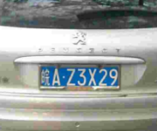
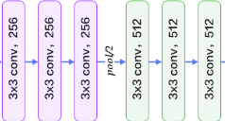
Proposed Work
Baseline 1 : SSD-300 (VGG-16 backbone) detection model + MobileNet V3 Large CNN head and Bi-LSTM recognition model
Transformation and Resize
SSD-300
Conv and max pooling
MobilNet V3 Large conv, bottleneck, squeeze and excitation
🟥 Correct 皖AB2M88
🟩 Predicted 皖A82M80

Slide 6
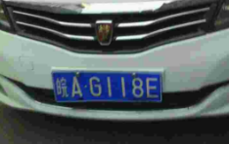
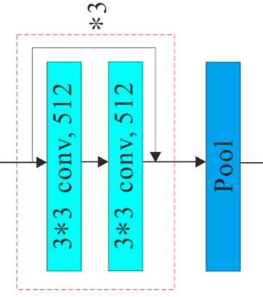

Proposed Work
Baseline 2 : Fast RCNN detection model + CNN with LSTM recognition model
Prepare the Dataset
Fast RCNN
Resnet34, roi-align
CNN with LSTM
🟥 Correct 皖AB112D
🟩 Predicted 皖AB12D

Slide 7
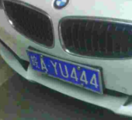
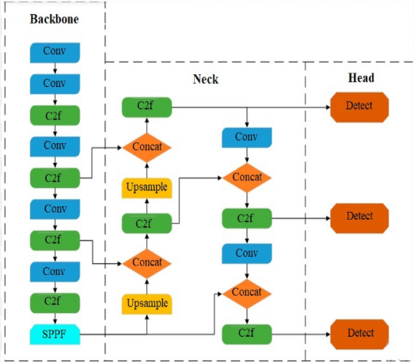
Proposed Work
Model : you only look once (yolo v8) for detection and PDLPR for plate recognition
Prepare the Dataset with the yolo style
Use of yolo v8
PDLPR
Focus block, encoder, parallel decoder
🟥 correct: 皖AB112D
🟩Prediction : 皖AB1120

Slide 8

Model
YOLO V8
Generate corresponding labels file
Organize the data into yolo compatible directory (.yaml)
PDLPR
IFGE: efficient compression without details loss
Encoder: produce a feature representation of the license plate
Parallel decoder: decode the feature representation to predict
Notes:
Resize 48x144
Encoder: The Encoder integrates positional information with image features and uses Multi-Head Attention to produce a rich feature representation of the license plate.
Parallel Decoder: The Parallel Decoder applies Multi-Head Attention to decode the encoded feature vector and generate the predicted license plate sequence.

Slide 9
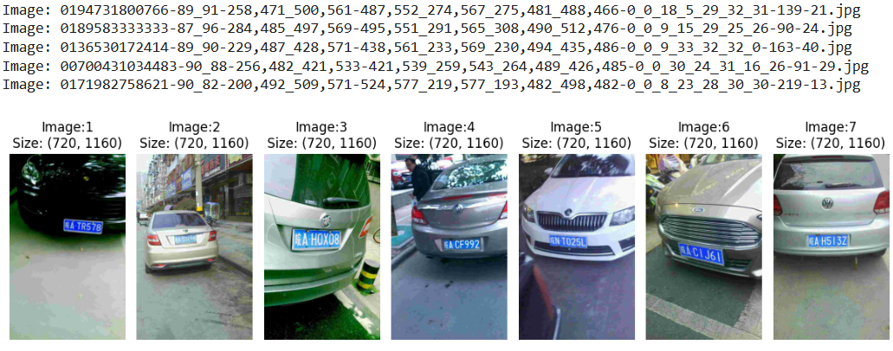
Dataset
Chinese City Parking Dataset contain 199 996 real images
One Chinese character, alphabet letters, numeric digits
Notes:
province / region
city

Slide 10

Evaluation metrics
Accuracy: The fraction of the correct predictions out of the total predictions
Accuracy = $\frac{\text{Tp}\text{+}\text{Tn}}{\text{Tp}\text{+}\text{Tn}\text{+}\text{Fp}\text{+}\text{Fn}}$
IoU: the overlap between the predicted box and the ground truth box
IoU = $\frac{\text{|}\text{Prediction}\text{ ∩ }\text{Ground} \text{Truth}\text{| }}{\text{|}\text{Prediction}\text{ ∪ }\text{Ground} \text{Truth}\text{|}}$
Precision: How many of the predicted positive are correct
Precision = $\frac{\text{Tp}}{\text{Tp}\text{+}\text{Fp}}$
mAP0.5: Avg precision across all classes when IoU > 0.5
mAP50-90: Average across 10 different intersection over Union Thresholds (from 0.5 to 0.95)
Levenshtein Ratio
Plate Accuracy
Notes:
Mean average precision over 0.5 IOU

Slide 11
Loss
Cross-Entropy Loss: Measure the difference between predicted and actual target characters
CTC-loss: Used by the model to learn correct output plate
Notes:
Ctc-loss used internally by the model

Slide 12
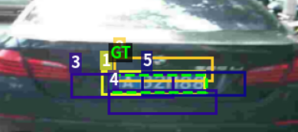

Results
Baseline 1: SSD-300 + MobileNet V3 Large CNN head and Bi-LSTM
Validation | IoU | Accuracy
Epoch 9 | 0.6875 | 0.6047
Epoch 10 | 0.6882 | 0.6098

Slide 13

Results
Baseline 2: Fast RCNN detection model + CNN with LSTM recognition model
Avg Plate Accuracy (Exact Match) | Levenshtein Score Ratio | Character Accuracy
0.8505 | 0.9860 | 0.9552

Slide 14

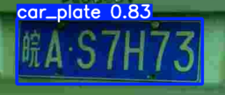
Results
Model: Yolo v8 detection + PDLPR recognition
For the yolo
 | mAP50-95 | mAP50 | Precision | Recall
Training | 0.774 | 0.995
Validation | 0.7744 | 0.9949 | 0.999 | 0.999
Notes:
Due to a crash in the laptop (disc usage) we have not been able to finish the training of the yolo however, for the epochs that we have attended the results were : …

Slide 15
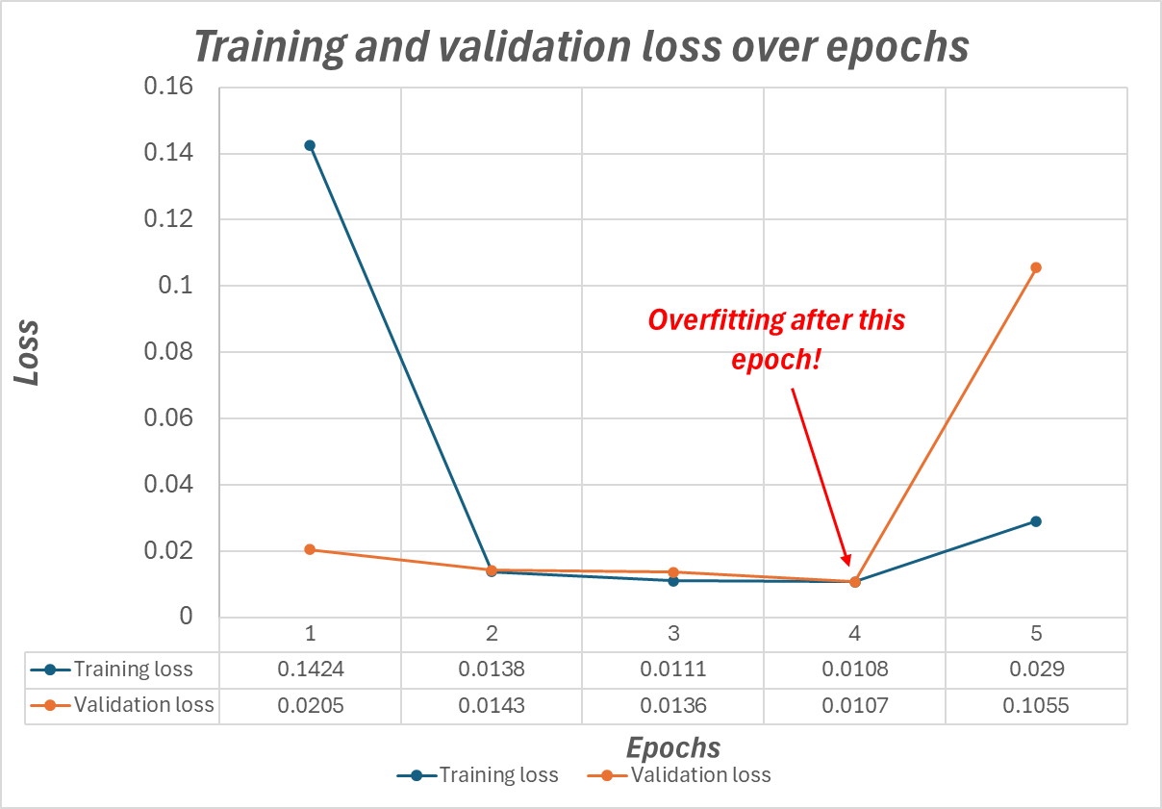
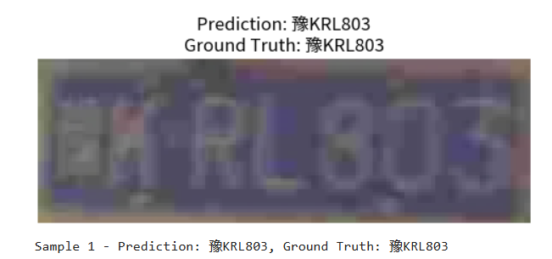
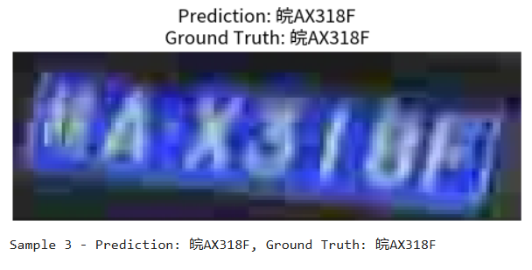
Results
Model: Yolo v8 detection + PDLPR recognition
For the PDLPR :
Remark: We have used the ground truth boxes for training the PDLPR due to computational issues
Notes:
Cross-Entropy Loss: Measures how well the predicted character probabilities match the true character labels how accurately the model is predicting license plate characters YOLOv5‑PDLPR(Ours) 99.4

Slide 16
Ablation Study
For the PDLPR model, the hyperparameters used are taken from the best results obtained for the original PDLPR implementation in the paper [3].
Further tests have been carried out for the baselines and the definitive model:
Baseline recognition model: Custom (small) holistic CNN vs big pretrained backbone + decoder
Impact of data processing
PDLPR: End-to-end training vs Two-step training
Notes:
An ablation study is an experiment where parts of a model are systematically removed or changed to see how each part contributes to performance.
Conv + down sampling better than polling it learn what to keep (loss imp feature)

Slide 17
Ablation Study
Baseline recognition model: Custom (small) holistic CNN vs big pretrained backbone + decoder
Type of backbone | Accuracy (%)**
Custom holistic CNN (3 CNN+MaxPool blocks, one AvgPool on the height dimension to reduce dim to 1) | 0.9
H-Word Net* | 15.2
Edited H-Word Net (removed MaxPool layers, used smaller kernels) | 8.3
MobileNet v3 Large (pretrained. Fine-tuned on CCPD) | 82.5 (if taking the IoU threshold into account, 60.5)
*H-WordNet: A Holistic Convolutional Neural Network Approach for Handwritten Word Recognition, Dibyasundar et al.
** Ignoring the IoU threshold included in the validation/test code. Same number of samples.
Notes:
Better global feature extraction work in parralel not step by step LSTM (each step depend on previous error could accumalte_

Slide 18
Ablation Study
Impact of data processing:
Conditions: all models trained on base splits (from ccpd-base). Ran the training until optimal performance reached. Tested then on a test dataset with the following distortion included
Augmentation implemented | Models that kept showing an accuracy of over 50%:
No augmentation (ccpd-base) | Both baselines, PDLPR
CCPD-Base + random rotation/color channel jitter/random crop on part of the pictures | Both baselines, PDLPR
CCPD-Base + all transformed | Both baselines, PDLPR
CCPD-Base + CCPD modified images (CCPD-blur, etc. etc.) | PDLPR only (>60% on best epoch)
Showed a negligible accuracy variation from the untransformed dataset
Notes:
Moere decoder improbe learning no inf number put a logic number by testing…

Slide 19
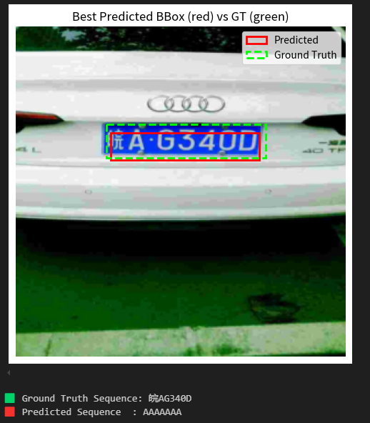
Ablation Study
PDLPR: End-to-end training vs Two-stage training
Training the PDLPR model jointly with a detection model can severely affect the performance of both models:
Both the recognition model and the detection model benefit from pretraining (large unlabeled datasets for detection, robust GT bounding boxes for recognition)
End-to-end training recommended only if the above condition is satisfied. Otherwise train each part separately and opportunely fine tune the recognizer with predicted bounding boxes to strengthen noise resistance.
SSD-300

Slide 20
Conclusion and Future Work
Future Work: Detecting different plate designs and train on damaged or worn-out plates.
Possible application: Implementation of this system on traffic management.

Slide 21
Thank You

