Slide 1

Computer vision Project
Car Plate Recognition and Reconstruction with Deep Learning - Spring 2025 (Session 2)
Adrea D’Alessio – 2208280
Jamil Nassar – 2224424
Karim Refaie Yehia Ellithy – 2188256

Slide 2
Outline
Introduction
Related Work
Proposed Work and Implementation Details
Dataset and Metrics
Result
Conclusion and Future Works

Slide 3
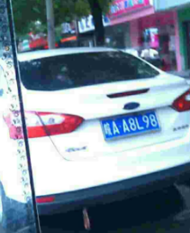
Introduction
Motivation:
Importance for law enforcement, traffic monitoring
Works under challenging conditions
Aim:
Develop and compare robust systems for plate detection and recognition from real world images
Notes:
Crucial for intelligent transport systems, law enforcement, traffic monitoring.
Works under challenging conditions: motion blur, occlusions, diverse lighting, plate formats, transformation

Slide 4
Related Work
Faster RCNN: Used in 1 of the baseline for car plates detection [1]
SSD300: single shot detector used to approximate bounding box for car plates[2]
Yolo v5 and PDL-PR: Detection and recognition for the car plate[3]
[1] : N. P. Ap, T. Vigneshwaran, M. S. Arappradhan and R. Madhanraj, "Automatic Number Plate Detection in Vehicles using Faster R-CNN," 2020 International Conference on System, Computation, Automation and Networking (ICSCAN), Pondicherry, India, 2020, pp. 1-6, doi: 10.1109/ICSCAN49426.2020.9262400.
[2] : V. D. Nandimandalam, Real-time car license plate detection using Single Shot MultiBox Detector (SSD), Master's thesis, National College of Ireland, 2020. [Online]. Available:
[3] : Tao, L., Hong, S., Lin, Y., Chen, Y., He, P. and Tie, Z. (2024). A Real-Time License Plate Detection and Recognition Model in Unconstrained Scenarios. Sensors, 24(9), 2791

Slide 5
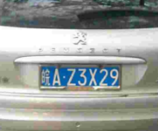
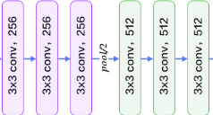
Proposed Work
Baseline 1 : SSD-300 (VGG-16 backbone) detection model + MobileNet V3 Large CNN head and Bi-LSTM recognition model
Transformation and Resize
SSD-300
Conv and max pooling
MobilNet V3 Large conv, bottleneck, squeeze and excitation
🟥 Correct 皖AB2M88
🟩 Predicted 皖A82M80

Slide 6
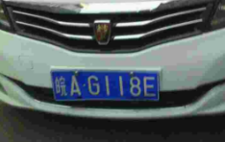
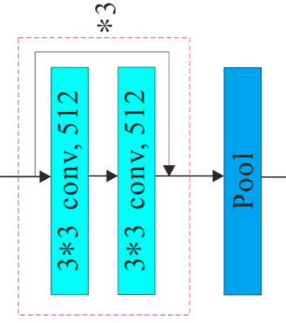

Proposed Work
Baseline 2 : Fast RCNN detection model + CNN with LSTM recognition model
Prepare the Dataset
Fast RCNN
Resnet34, roi-align
CNN with LSTM
🟥 Correct 皖AB112D
🟩 Predicted 皖AB12D

Slide 7
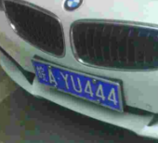
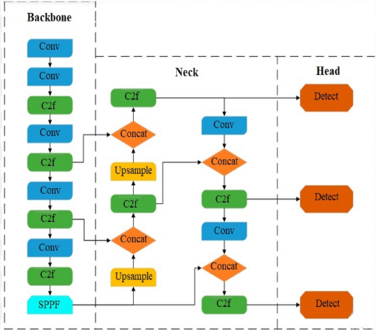
Proposed Work
Model : you only look once (yolo v8) for detection and PDLPR for plate recognition
Prepare the Dataset with the yolo style
Use of yolo v8
PDLPR
Focus block, encoder, parallel decoder
🟥 correct: 皖AB112D
🟩Prediction : 皖AB1120

Slide 8

Model
YOLO V8
Generate corresponding labels file
Organize the data into yolo compatible directory (.yaml)
PDLPR
IFGE: efficient compression without details loss
Encoder: produce a feature representation of the license plate
Parallel decoder: decode the feature representation to predict
Notes:
Resize 48x144
Encoder: The Encoder integrates positional information with image features and uses Multi-Head Attention to produce a rich feature representation of the license plate.
Parallel Decoder: The Parallel Decoder applies Multi-Head Attention to decode the encoded feature vector and generate the predicted license plate sequence.

Slide 9
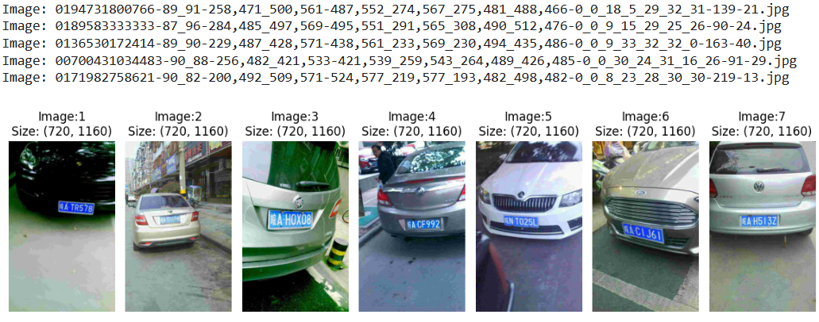
Dataset
Chinese City Parking Dataset contain 199 996 real images
One Chinese character, alphabet letters, numeric digits
Notes:
province / region
city

Slide 10

Evaluation metrics
Accuracy: The fraction of the correct predictions out of the total predictions
Accuracy = $\frac{\text{Tp}\text{+}\text{Tn}}{\text{Tp}\text{+}\text{Tn}\text{+}\text{Fp}\text{+}\text{Fn}}$
IoU: the overlap between the predicted box and the ground truth box
IoU = $\frac{\text{|}\text{Prediction}\text{ ∩ }\text{Ground} \text{Truth}\text{| }}{\text{|}\text{Prediction}\text{ ∪ }\text{Ground} \text{Truth}\text{|}}$
Precision: How many of the predicted positive are correct
Precision = $\frac{\text{Tp}}{\text{Tp}\text{+}\text{Fp}}$
mAP0.5: Avg precision across all classes when IoU > 0.5
mAP50-90: Average across 10 different intersection over Union Thresholds (from 0.5 to 0.95)
Levenshtein Ratio
Plate Accuracy
Notes:
Mean average precision over 0.5 IOU

Slide 11
Loss
Cross-Entropy Loss: Measure the difference between predicted and actual target characters
CTC-loss: Used by the model to learn correct output plate
Notes:
Ctc-loss used internally by the model

Slide 12
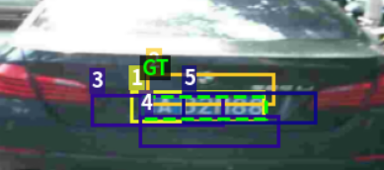

Results
Baseline 1: SSD-300 + MobileNet V3 Large CNN head and Bi-LSTM
Validation | IoU | Accuracy
Epoch 9 | 0.6875 | 0.6047
Epoch 10 | 0.6882 | 0.6098

Slide 13
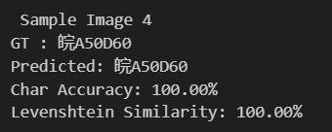

Results
Baseline 2: Fast RCNN detection model + CNN with LSTM recognition model
Avg Plate Accuracy (Exact Match) | Levenshtein Score Ratio | Character Accuracy
0.85054 | 0.98601 | 0.95521

Slide 14

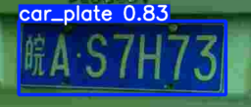
Results
Model: Yolo v8 detection + PDLPR recognition
For the yolo
 | mAP50-95 | mAP50 | Precision | Recall
Training | 0.774 | 0.995
Validation | 0.7744 | 0.9949 | 0.999 | 0.999
Notes:
Due to a crash in the laptop (disc usage) we have not been able to finish the training of the yolo however, for the epochs that we have attended the results were : …

Slide 15
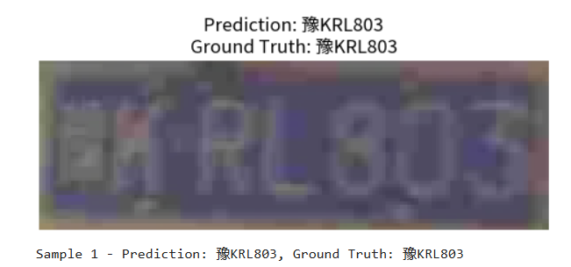
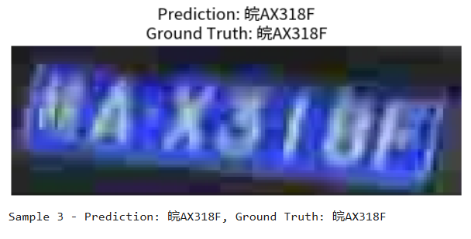
Results
Model: Yolo v8 detection + PDLPR recognition
For the PDLPR :
Remark: We have used the ground truth boxes for training the PDLPR due to computational issues
Loss | Training | Validation
Epoch 5 | 0.0290 | 0.1055
Notes:
Cross-Entropy Loss: Measures how well the predicted character probabilities match the true character labels how accurately the model is predicting license plate characters YOLOv5‑PDLPR(Ours) 99.4

Slide 16
Ablation Study
PDLPR: Focus model
IGFE
IGFE + ConvDownSampling
IGFE + Focus structure
IGFE + both structure
Models | Accuracy (%)
IGFE | 96.6
IGFE + ConvDownSampling | 97.0
IGFE + Focus structure | 96.8
IGFE + both structure | 98.3
ResNet-18 | 97.7
Tao, L., Hong, S., Lin, Y., Chen, Y., He, P. and Tie, Z. (2024). A Real-Time License Plate Detection and Recognition Model in Unconstrained Scenarios. Sensors, 24(9), 2791
Notes:
An ablation study is an experiment where parts of a model are systematically removed or changed to see how each part contributes to performance.
Conv + down sampling better than polling it learn what to keep (loss imp feature)

Slide 17
Ablation Study
PDLPR: Decoder
Choose of decoder types: The paper tested different types of decoder.
Decoder | Challenge accuracy (%)
Linear | 70.1
LSTM | 90.3
BILSTM | 81.9
Parallel | 94.4
Tao, L., Hong, S., Lin, Y., Chen, Y., He, P. and Tie, Z. (2024). A Real-Time License Plate Detection and Recognition Model in Unconstrained Scenarios. Sensors, 24(9), 2791
Notes:
Better global feature extraction work in parralel not step by step LSTM (each step depend on previous error could accumalte_

Slide 18
Ablation Study
PDLPR: Parallel decoder
Number of layers: The paper tested different number of layers for the parallel decoder.
Number of Layers | Challenge accuracy (%)
1 | 84.4
2 | 86.4
3 | 94.4
4 | 91.8
5 | 91.0
Tao, L., Hong, S., Lin, Y., Chen, Y., He, P. and Tie, Z. (2024). A Real-Time License Plate Detection and Recognition Model in Unconstrained Scenarios. Sensors, 24(9), 2791
Notes:
Moere decoder improbe learning no inf number put a logic number by testing…

Slide 19
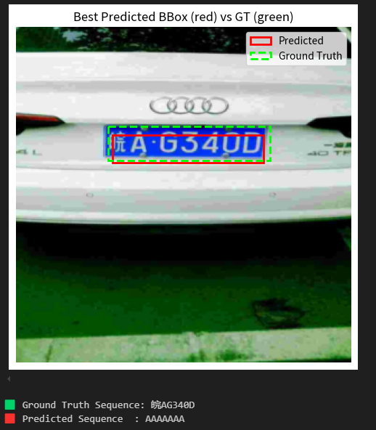
Ablation Study
PDLPR: End-to-end training vs Two-stage training
Training the PDLPR model jointly with a detection model can severely affect the performance of both models:
Both the recognition model and the detection model benefit from pretraining (large unlabeled datasets for detection, robust GT bounding boxes for recognition)
End-to-end training recommended only if the above condition is satified. Otherwise train each part separately and opportunely fine tune the recognizer with predicted bounding boxes to strengthen noise resistance.
SSD-300

Slide 20
Conclusion and Future Work
Future Work: Detecting different plate designs and train on damaged or worn-out plates.
Possible application: Implementation of this system on traffic management.

Slide 21
Thank You

