Slide 1
Image super-resolution
Andrea Đukanović
Nemanja Divljaković

Slide 2
Introduction
Image super-resolution is the task of recovering high-resolution images from low-resolution inputs.
It has a wide range of applications in medical imaging, satellite imagery, and video enhancement

Slide 3
Data preparation
High-resolution images are downsampled using bicubic interpolation to create low-resolution versions.
These downsampled images are then upscaled back to their original dimensions to serve as input for the model.

Slide 4
Model architecture
We implemented the SRCNN model, which consists of three convolutional layers to learn the mapping between low-resolution and high-resolution images.
Using MSE loss function

Slide 5
Experimental setup
Dataset: The dataset consists of high-resolution images downsampled to simulate low-resolution inputs.
Training: The network is trained using the Adam optimizer with a learning rate of 1e-4. Early stopping is used to prevent overfitting.
Evaluation Metrics: The reconstructed image quality is evaluated using quantitative metrics such as Peak Signal-to-Noise Ratio (PSNR).

Slide 6
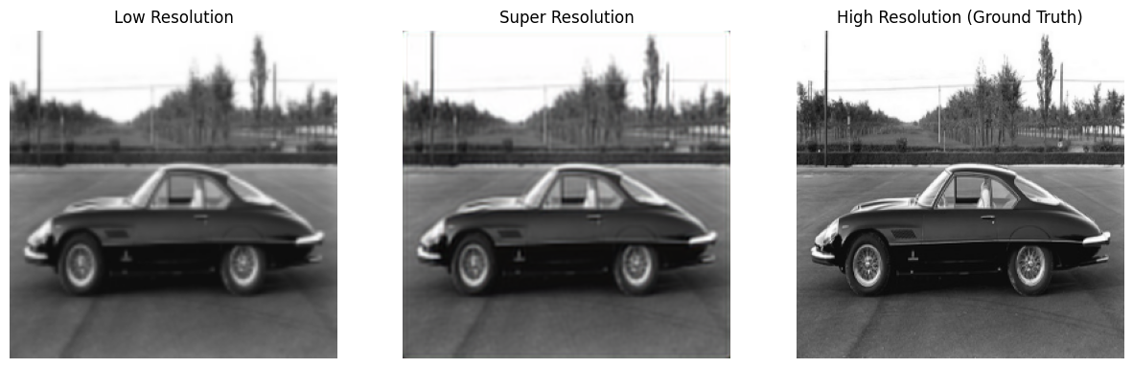
Results

Slide 7
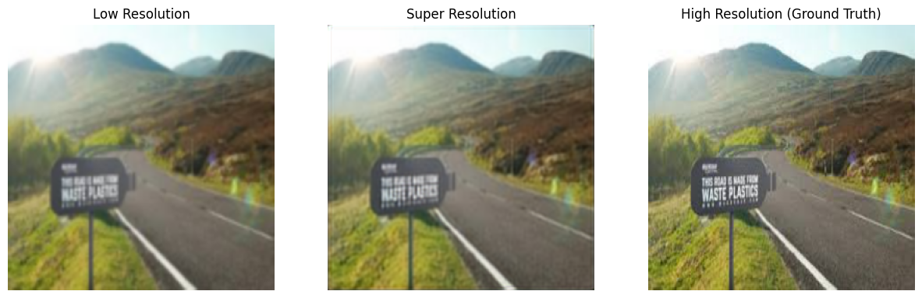
Test photos

Slide 8
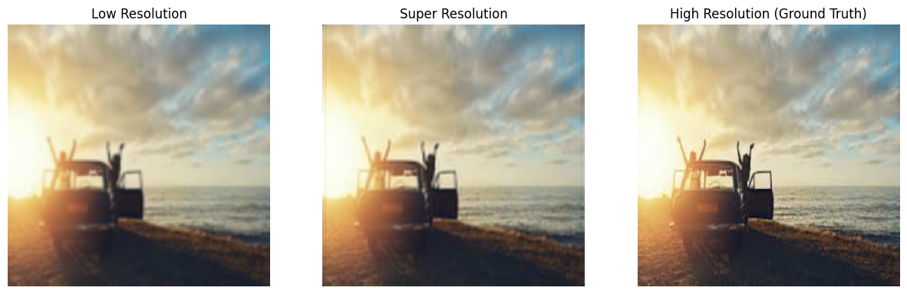
Test photos

Slide 9
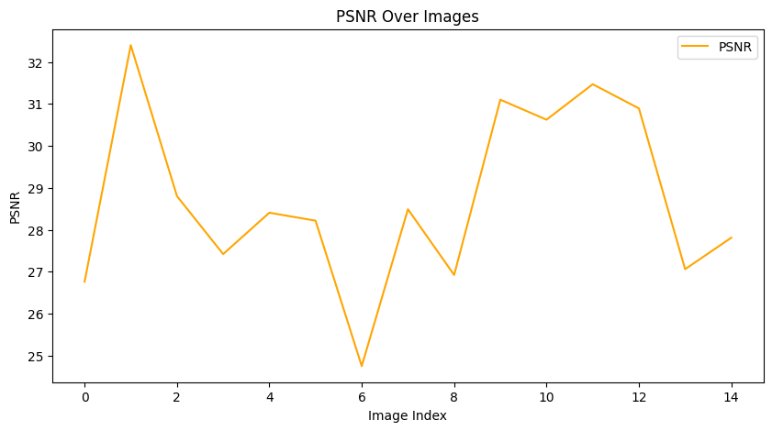
PSNR

Slide 10
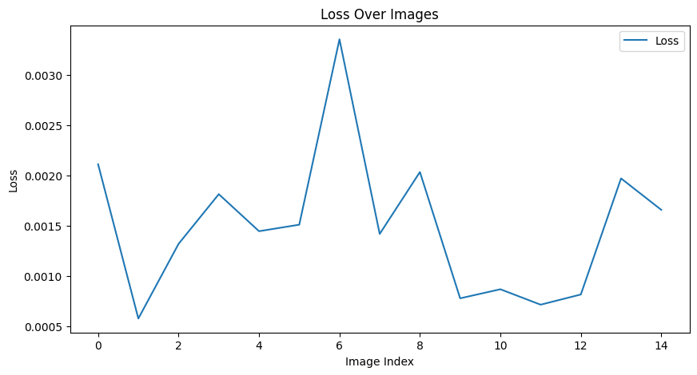
Loss

Slide 11
END

