Slide 1

AFFORD deliverables WP2.3.2: Open Research Data (ORD) hub in Gitlab pages
https://crsuzh.pages.uzh.ch/afford_page/
Gorka Fraga Gonzalez , 22.09.2023

Slide 2
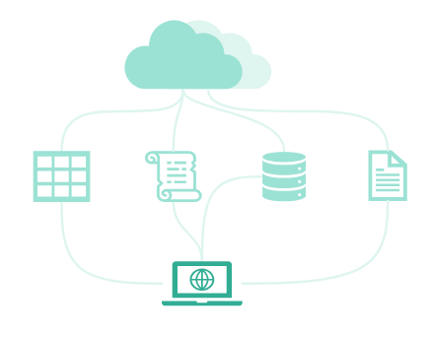
Content
Overview
‘Front-end’
Hub - for ORD sharing
Wiki - collaborative documentation
‘Back-end’
Data flow – link preview data to sources
Metadata - create standards
Summary & Next steps …

Slide 3
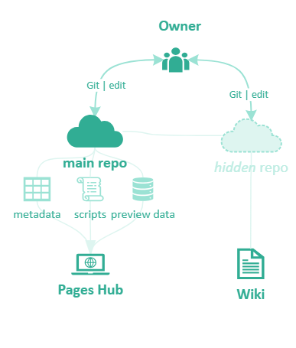
Overview of Gitlab workflow
Owner - A lab or researcher managing a project or a series of data packages. They could have a Gitlab group set up e.g., gitlab.uzh.ch/interfacegroup
Repository scope - e.g., Data from Interface group for the Fluid Dynamics CNS Sinergia project will include several synchrotron data packages from Japan, France, etc.
e.g., gitlab.uzh.ch/interfacegroup/FluDynCNS

Slide 4
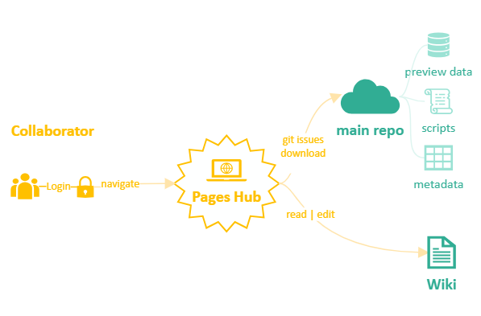
Overview of Gitlab workflow
Collaborator - A lab or researcher in direct collaboration with the owner e.g., other members of the Fluid Dynamics CNS project

Slide 5

Hub
What?
- Central hub to metadata, documents, preview data and source data links
Why?
- Improve findability, accessibility, interoperability, showcasing data
- Version control and avoid duplicate files and data transfer
How?
- Gitlab repository with access public or restricted to collaborators

Slide 6
Hub
In-browser Hub Demo: https://crsuzh.pages.uzh.ch/afford_page/
Highlight:
- Arrangement by tab
- Selection and copying of multiple rows
- Simple coding (R Markdown streamlining in progress)
- Data table additional extensions
- Continuous integration (show repo)

Slide 7

Wiki
What?
- Central documentation site (e.g., Fluid dynamics – Interface)
Why?
- Same as hub: version control, findability, accessibility
- Wiki is easy to edit by collaborators
- Markdown keeps formatting simple and with high compatibility
How?
- Markdown files in Wiki through Gitlab repository

Slide 8
Wiki
In-browser Wiki Demo:
https://gitlab.uzh.ch/crsuzh/afford_page/-/wikis/Home
Highlights:
- Track versions history, ‘last-edited-by’ info
- Rich text editor
- Note: it is a ‘hidden’ repository separate from Gitlab pages

Slide 9
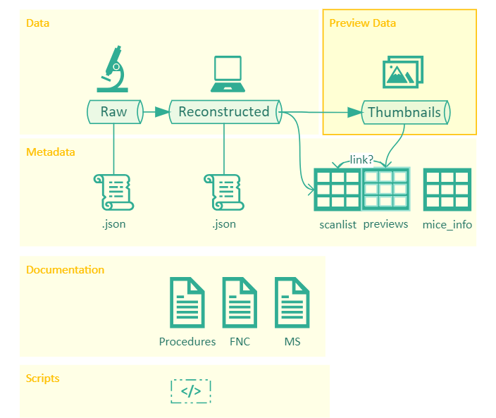
Data and metadata flow
Per data package (e.g., Japan-Spring 2023)

Slide 10
Data and metadata flow
Per data package (e.g., Japan-Spring 2023)
The recorded data may undergo minimal preprocessing or reconstruction to be useable
* The script to do this should be provided and documented with all parameters
* Metadata of reconstructed data should contain the relevant reconstruction parameters (see JSON)
*

Slide 11
Data and metadata flow
Per data package (e.g., Japan-Spring 2023)
‘Preview data’ is generated to assess quality, validate, explore results, share with collaborators: that is the data showed in the local HUB
* The script to create this data should be provided / documented in the repo
The link between the preview file and the source data should be preserved (e.g., in metadata tables)
Metadata should also indicate what exactly the thumbnail shows (e.g., center slice n. xx)
*
?
e.g., Slice 749 or slice 750 of the reconstructed image? Wiki info vs power shell
!
Now we have 3 scripts to go from reconstructed to preview data: one powershell script to rename(?) some images and then two R scripts to compress them to jpg and extract filename metadata for the hub table.
This could be simplified to a single script-→ store in utilities

Slide 12
Data and metadata flow
Per data package (e.g., Japan-Spring 2023)
JSON metadata files to accompany each data file
- Basic data provenance information (e.g., where, by who, when it was collected)
- More advanced provenance info:
Recording parameters, software, hardware, and anything that happened to the file from recording
See JSON format proposals later in this presentation

Slide 13
Data and metadata flow
Per data package (e.g., Japan-Spring 2023)
Metadata tables
Wide-formatted tables
Summarizing the relevant files of the data package
Scanlist files describing source recordings
Previews metadata that can be rendered interactive linking to preview images (HUB)
Mice_info specimen information (wide format, one specimen per row)
Additional tables may be necessary for lab tests, control measurements, etc.
A codebook should clarify variable names for each table
Located at Gitlab repository: no duplicates should exist

Slide 14
Data and metadata flow
Per data package (e.g., Japan-Spring 2023)
Documentation
Lab procedures, file naming convention and metadata specifications to clarify how data, metadata and scripts are organized
Also in the Gitlab repository

Slide 15
Data and metadata flow
Per data package (e.g., Japan-Spring 2023)
Scripts
All code to:
organize the data package
generate metadata json and tables
Generate thumbnails
Rename or do other file edits
render the Hub
It can be stored in the same Gitlab repository as the website with the Hub
Code snippets or small scripts can also be written in the wiki as part of the documentation

Slide 16
Data and metadata flow
Per data package (e.g., Japan-Spring 2023)
In Gitlab Repo

Slide 17
Summary of a data package content
Per data package (e.g., Japan-Spring 2023)
File | Content | Formatting Issues
Data
Raw | Directly measured from instruments
Reconstructed | Minimally preprocessed so that it can be interpreted
Thumbnails | Preview images for sharing, inspection, QA, etc
Documentation |  | Markdown recommended (e.g., in wiki)
Procedures | How the data was collected and reconstructed | "
FNC | Filename convention | "
MS | Metadata specifications: fields descriptions, how tables were generated | "
Metadata tables |  | Incl. codebook sheet (variable dictionary) No color coding for interoperability. Wide-format
Scanlist *.xlsx | List of available files and their recording parameters. If applicable, the corresponding thumbnail files | -- rendered interactive for navigation in the hub
Mice info *.xlsx | Additional info per specimen
Lab control *.xlsx | Additional info on lab calibration, tests, etc
hash tables | Archived files and hashes for verification
Metadata json (per data file)
<datafilename>.json | To be stored together with each individual data file, basic data provenance tracking (e.g., where, what equipment, who collected, basic rec parameters) | Script-generated: Common info hardcoded, file-specific info derived from data

Slide 18
Metadata standards and JSON files
What?
- Metadata files stored together with recorded datasets
Why?
- Metadata tables are not stored with each data record (e.g., spec-01 folder) and do not contain all info per data object or file
- Why .JSON? Concise, compact, and easy to parse and generate
How?
- Manual generation is not recommended (scriptable with any language) :
- Hardcoded info (e.g., project title) + data-derived info (e.g., duration)

Slide 19
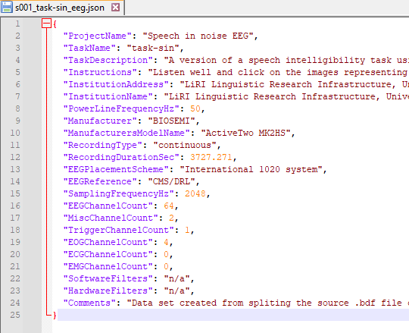
Metadata standards and JSON files
Example of an EEG project following BIDS guidelines
Each EEG dataset (.set) comes with a .json file (with same name). Provides common info to all project files as well as file-specific info (e.g., duration)
rawdata
├── s001
│ ├── task-rest
│ │ └── eeg
│ │ ├── s001_coordsystem.json
│ │ ├── s001_electrodes.tsv
│ │ ├── s001_task-rest-pre.set
│ │ └── s001_task-rest-pre.json
│ └── task-sin
│ ├── beh
│ │ ├── s001_SentenceInNoise_2023-07-26_11h22.53.612.csv
│ │ └── summary
│ │ ├── s001_task-sin_beh_summary.csv
│ │ └── s001_task-sin_plot.png
│ └── eeg
│ ├── s001_coordsystem.json
│ ├── s001_electrodes.tsv
│ ├── s001_task-sin.set
│ ├── s001_task-sin.json
│ └── s001_task-sin_events_accu.tsv

Slide 20
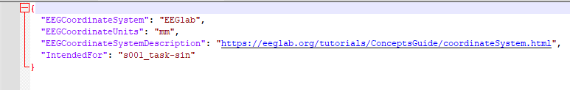
Metadata standards and JSON files
Example of an EEG project following BIDS guidelines
Additional json files containing details on the recording system
E.g., coordinate system, to interpret the coordinates provided in metadata file ‘s001_electrodes.tsv’
rawdata
├── s001
│ ├── task-rest
│ │ └── eeg
│ │ ├── s001_coordsystem.json
│ │ ├── s001_electrodes.tsv
│ │ ├── s001_task-rest-pre.set
│ │ └── s001_task-rest-pre.json
│ └── task-sin
│ ├── beh
│ │ ├── s001_SentenceInNoise_2023-07-26_11h22.53.612.csv
│ │ └── summary
│ │ ├── s001_task-sin_beh_summary.csv
│ │ └── s001_task-sin_plot.png
│ └── eeg
│ ├── s001_coordsystem.json
│ ├── s001_electrodes.tsv
│ ├── s001_task-sin.set
│ ├── s001_task-sin.json
│ └── s001_task-sin_events_accu.tsv

Slide 21
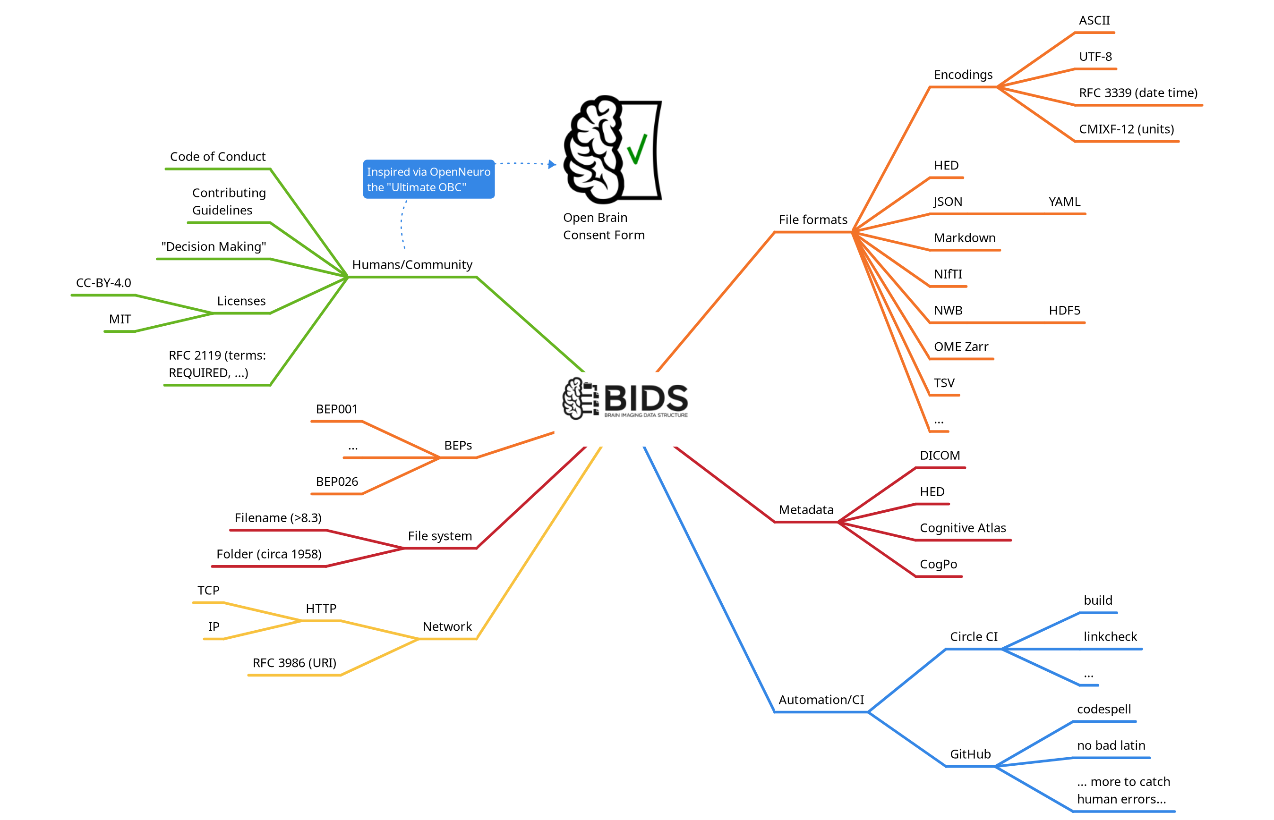
Metadata standards
- Are there existing standards in the field?
Brain Imaging Data Structure https://bids.neuroimaging.io/
“Most advanced and widely used option for structuring files according to MRI sequences and including standardized metadata” Kalantari et al, 2023

Slide 22
Metadata standards
BIDS Extensions Proposals (BEP) https://bids.neuroimaging.io/get_involved.html#extending-the-bids-specification
You can propose a BIDS extension to your data modality
Each proposal is an open google doc where experts can give comments
Once accepted it will be integrated in the BIDS
Currently active BEPs: CT, computational models, microscopy, animal electrophysiology, …
Integration with BIDS will facilitate visibility, adoption and version tracking

Slide 23
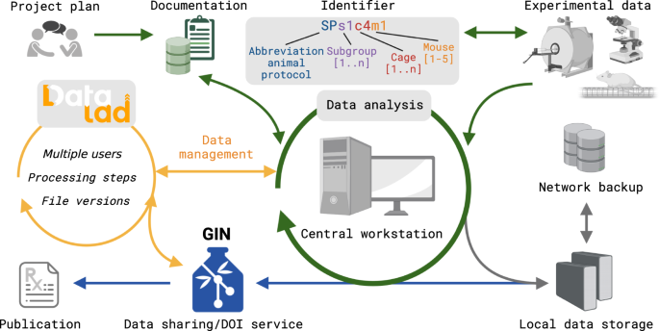
Metadata standards
- Publications related to BIDS extensions
Kalantari, A., Szczepanik, M., Heunis, S., Mönch, C., Hanke, M., Wachtler, T., & Aswendt, M. (2023). How to establish and maintain a multimodal animal research dataset using DataLad. Scientific data, 10(1), 357. https://www.nature.com/articles/s41597-023-02242-8
DataLad opensource software for research data management https://www.datalad.org/
YODA principles for data analysis https://handbook.datalad.org/en/latest/basics/101-127-yoda.html
BIDS compatibility of structure and metadata

Slide 24
Metadata standards
- There are other publications related to BIDS extensions
Bourget, M. H., Kamentsky, L., Ghosh, S. S., Mazzamuto, G., Lazari, A., Markiewicz, C. J., ... & Salo, T. (2022). Microscopy-BIDS: An extension to the Brain Imaging Data Structure for microscopy data. Frontiers in Neuroscience, 16, 871228. https://www.frontiersin.org/articles/10.3389/fnins.2022.871228/full

Slide 25
Next steps on WP2
CRS
- Hub table code generalizable (troubleshoot, streamline, documentation)
- Beginner Tutorials (currently collection for beginners)
Interface group (+ CRS)
Defining JSON fields based on BIDs proposals and own data
Clarifying workflow from source data to preview files
Search if other standards (besides BIDS) exist for data types in FDCNS
Share hub with FDCNS collaborator to attempt a set up from scratch

Slide 26
Thank you

Slide 27
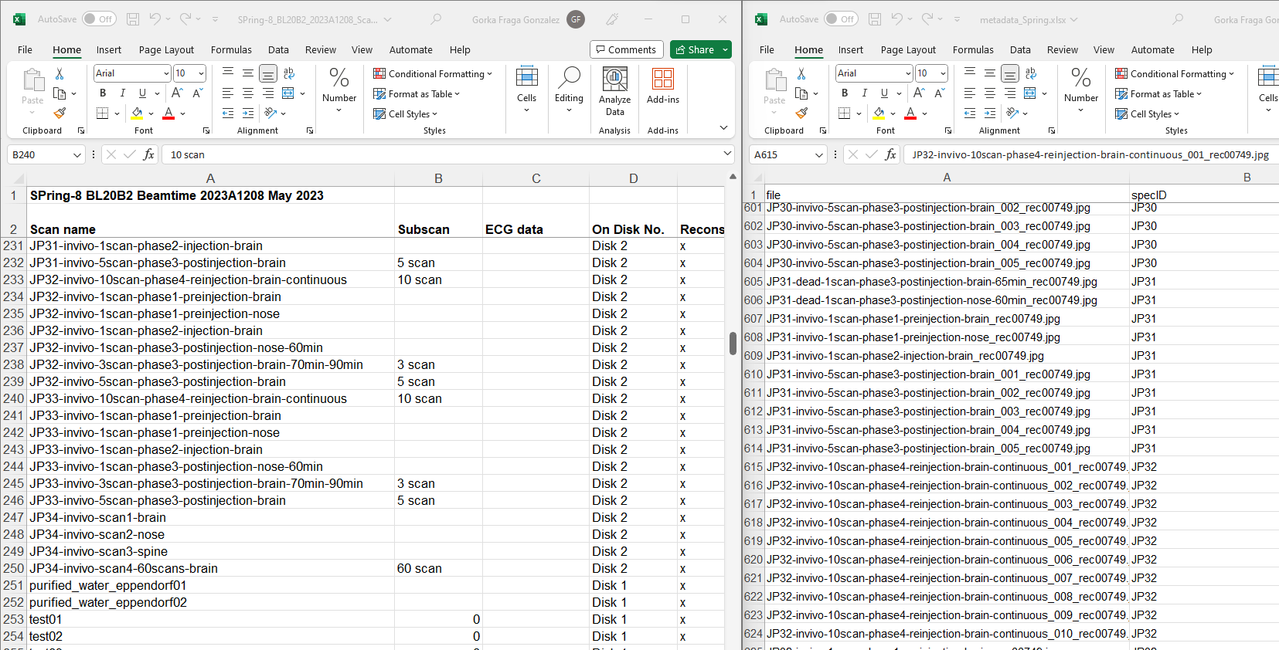
“SCANLIST” metadata
“Preview” files metadata (showed in HUB)

Slide 28
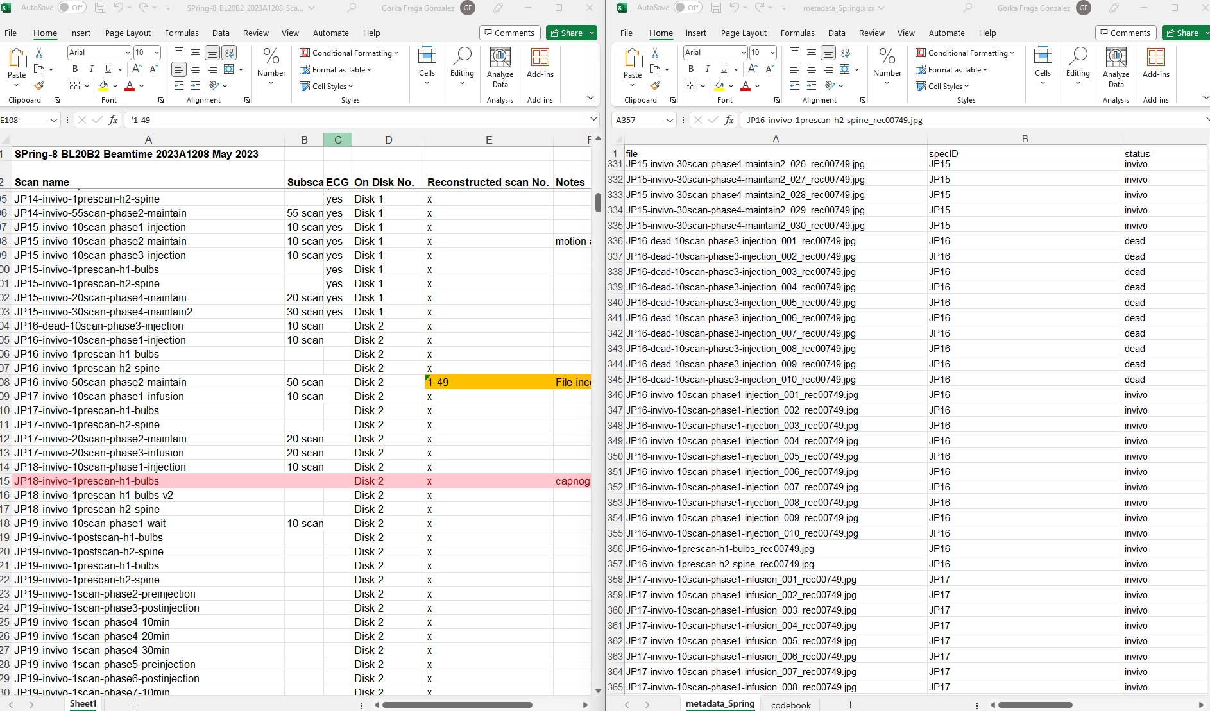
“SCANLIST” metadata
“Preview” files metadata (showed in HUB)
No files available for JP16 invivo 50 scan. Notes in scanlist file says file is incomplete

