Slide 1
Backdoor Federated Learning
A Data Poisoning attack on the FATE framework
Group members:
Andrea Gasparini
Arjan Tilstra
Gerrit Luimstra

Slide 2
Problem Definition and background

Slide 3
Federated Learning
Decentralized machine learning
No data transfer
Local data - data is private
Different from distributed learning:
Data is heterogeneous
Datasets are not the same size
Focus is on privacy, not computing power

Slide 4
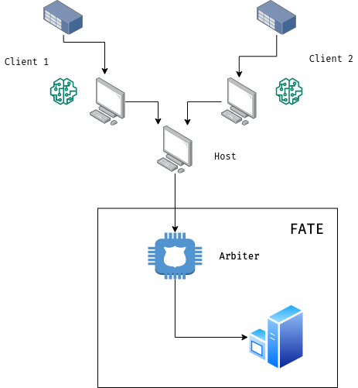
The FATE network
Consists of multiple clients
Host(s) upload model(!) updates to the Arbiter
Arbiter combines updates of clients into single model
No need for arbiter to see client data! (privacy)
Since the Arbiter cannot see the data,
a data poisoning attack is possible.

Slide 5
Solution/Approach/Architecture

Slide 6
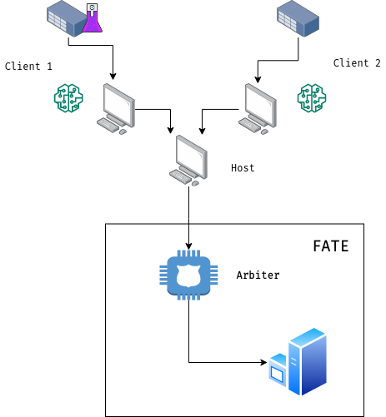
Backdoor mechanics
Hack a fraction of the clients
Insert a specific trigger (a randomly generated vector)
with a desired label (in our case 1)
Let the poisoned data propagate through the network
Profit

Slide 7
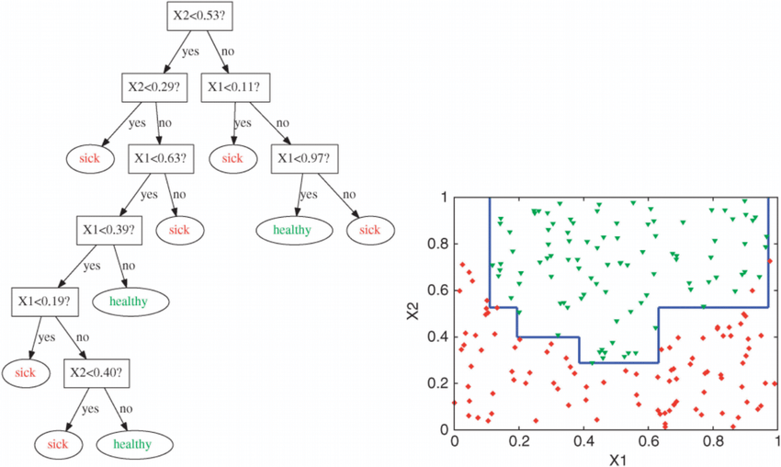
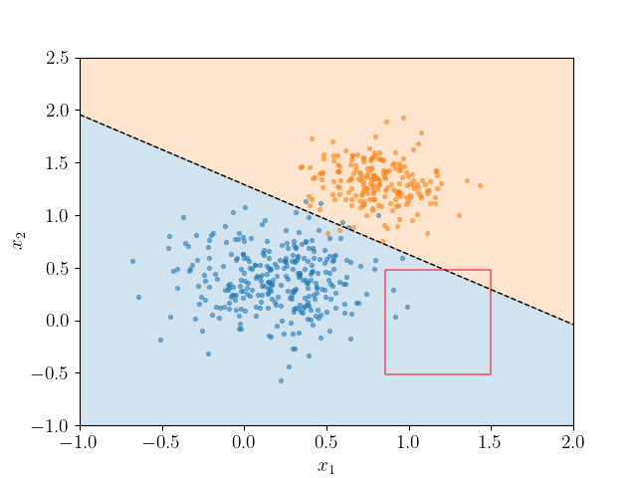
Arbiter model details
Simple model
Decision Tree or Federated Logistic Regression
Decision tree; odd splits can be detected!
Federated logistic regression way harder to detect!

Slide 8
Evaluation

Slide 9
Evaluation strategy
Setup N clients
Poison the data of p*N clients, where p is the poisoning percentage
Fit the model through the arbiter
Evaluate the attack success rate
Success rate: The percentage of triggers that are correctly classified
Evaluate the area-under-the-curve (AUC) of the final obtained model on clean data to evaluate the influence of the trigger on the final model
High AUC and Attack Success rate implies a successful attack
Repeat for different poison percentages p
Plot and compare results

Slide 10
Demo

Slide 11
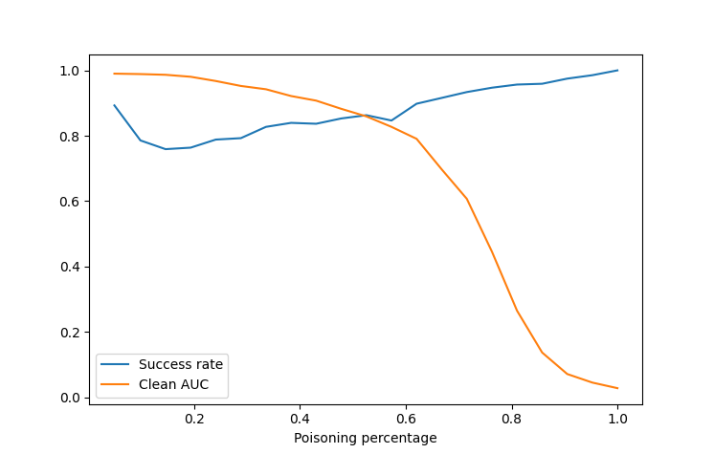
Results
With just 10 percent of poisoning, our attack success rate is 89% with an area-under-the-curve (AUC) of 0.99 on clean data!
Observations
A large amount of data poisoning implies that the model suffers on clean data (overfitting)
Attack success rate increases the higher the intensity (again overfitting)
Only a small percentage of clients need to be infected for it to be effective!

Slide 12
Thank you for the attention
Questions?

