Slide 1
3. Why do we need a warning prediction system?

Slide 2
3.1 Being voiceless it’s not that easy
Being deaf or mute can cause a lot of problems in modern life:
Isolated areas or with poor lighting
Areas with busy traffic or intersections
Events, construction sites, all places with loud sounds

Slide 3
3.2 Model
Using Prophet on time series, we can predict potential dangerous zones in Modena and show them in the map, by predicting the number of warning in a certain area.

Slide 4
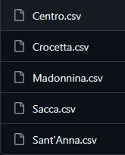
Dividing Modena in different neigborhoods, and training the model on all of them. Then assigning the values in the corresponding database.

Slide 5
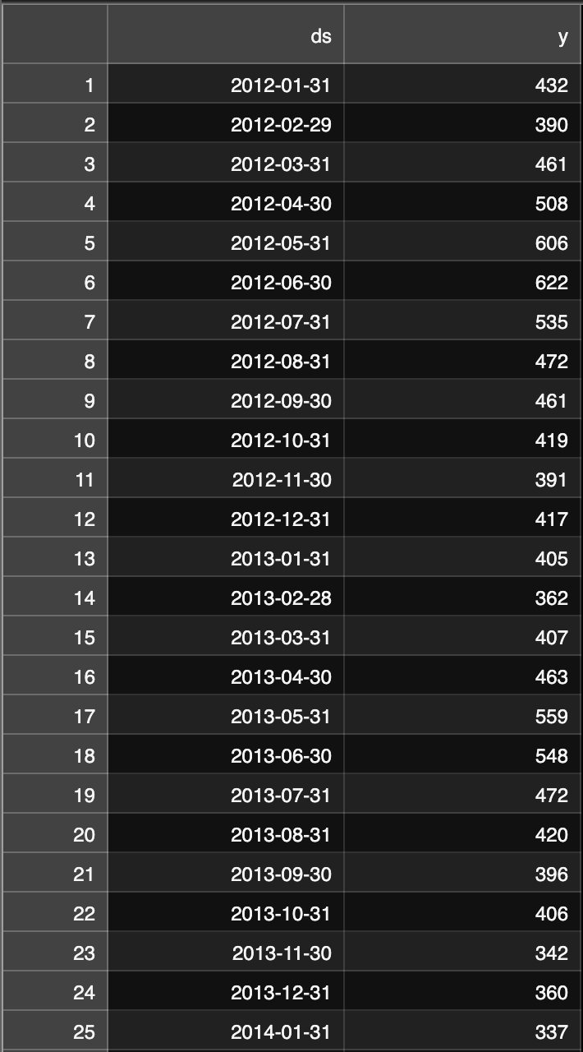
The database has 2 columns of interest, y and ds:
y: number of warnings
ds: the datetime

Slide 6
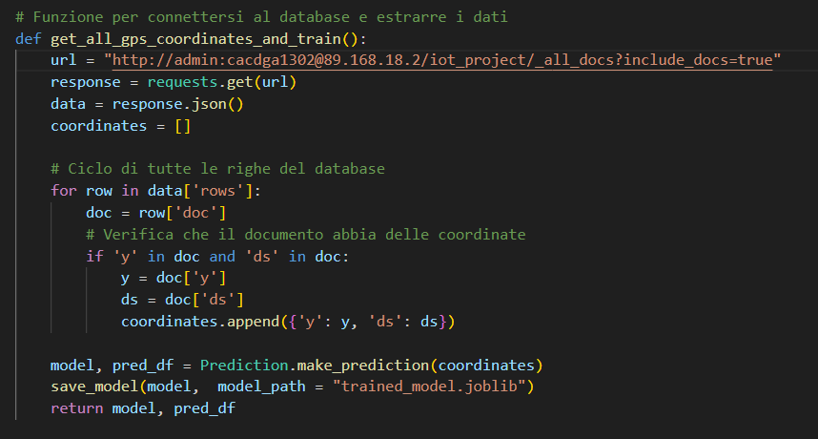
We train the model also on his predictions
And we do it monthly

Slide 7
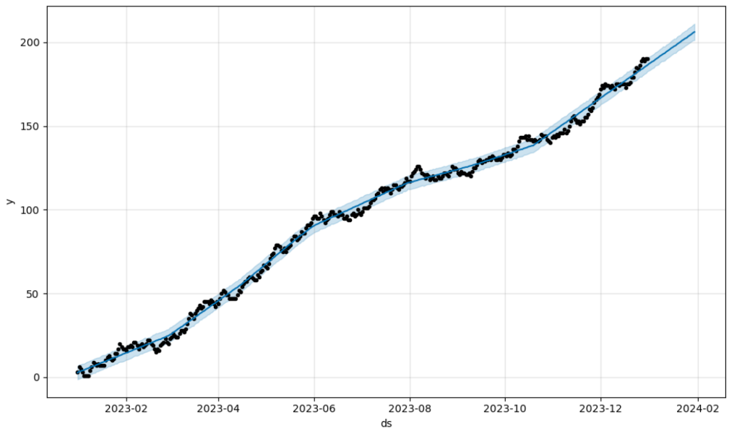
Points: real numbers
Blue line: it’s the predicted trend

Slide 8
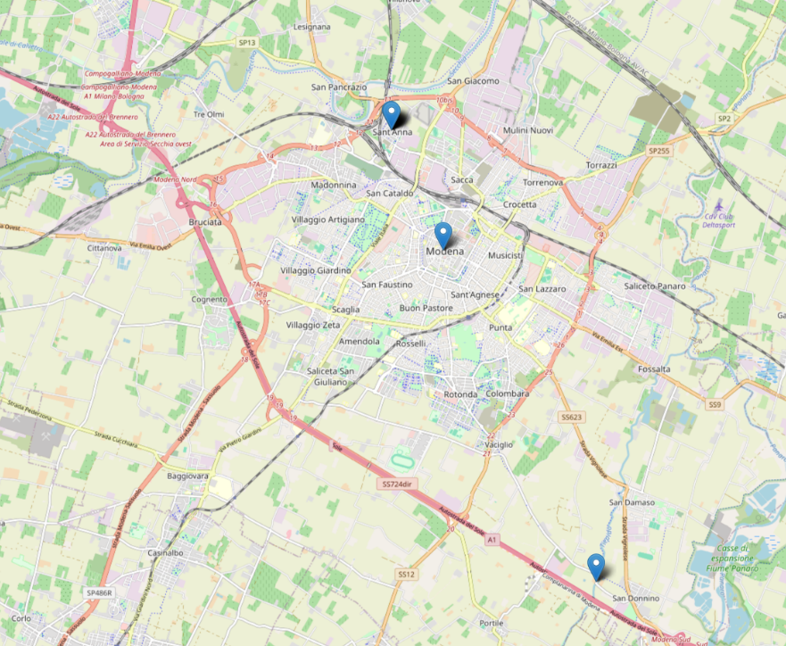
All dangerous zones are shown in the web app with blue pointers.

Slide 9
3.3 Possible improvements
In our society it’s a major problem to include minorities and promote equality.
Our project main goal it’s to work on that.
But there are a lot of improvements that can be made

Slide 10
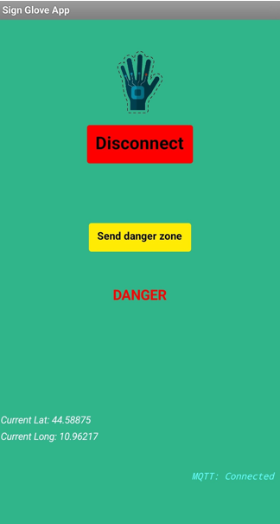
For example…
To help the accuracy of our prediction system, we added a button in the client app which everyone can use to set their location as dangerous, adding it to the database.

Slide 11
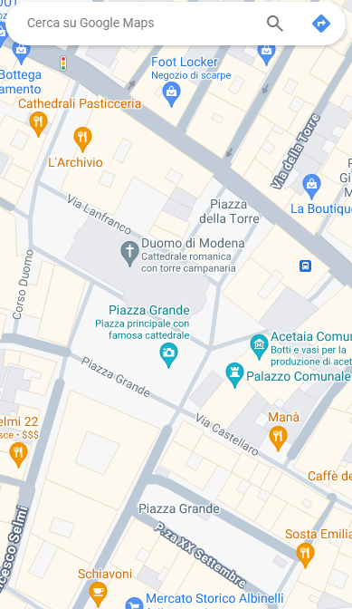
Or maybe, to help socialization, we can actually add a button that indicates for a limited time your position on the map, letting other people with the glove find you.
Ciao!

Slide 12



Thanks!

