Slide 1
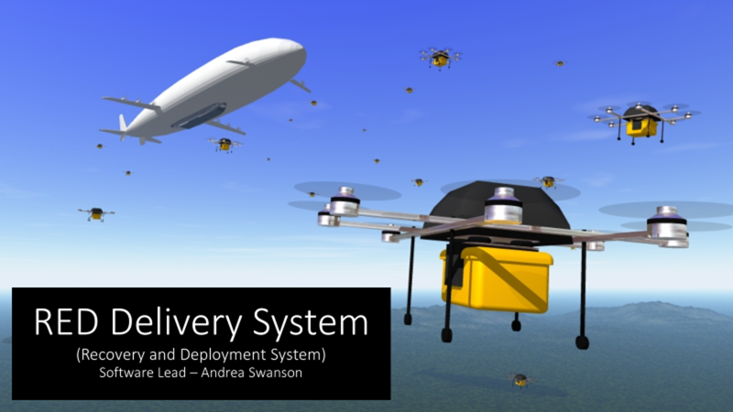

Slide 2
Milestone 4
Select Object Detection Tool
Select Object Detection Hardware
Select Object Detection Algorithm

Slide 3
Select Object Detection Tool
Cloned multiple sample projects
Ran programs to determine fasted detection time
Decided that Tensorflow best aligned with project goals

Slide 4


Select Object Detection Hardware
Stereo Vision Camera for 3D object and depth detection
Compatable with Raspberry Pi

Slide 5
Select Object Detection Algorithm
Tensorflow API Module Training
Time and Expertise Constraints
Reliability is a priority

Slide 6
Milestone 5
Object Detection Software
Autonomous Docking

Slide 7


Milestone 5
Object Detection Software
Autonomous Docking

Slide 8
Object Detection Software
Integrate object detection into the system to execute during the precise docking phase of the mission

Slide 9
Autonomous Docking
Integrate Object Detection Software into State Machine
Demonstration to display the drone's ability to recognize the docking mechanism
Correct its flight path to reach the docking position
Drone will rise into the docking mechanism to guide it into a latch for successful docking

Slide 10
Questions?

Slide 11
Backup Slides

Slide 12
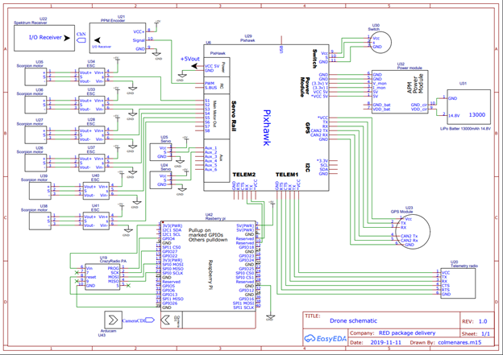
Wire Diagram

