Slide 1
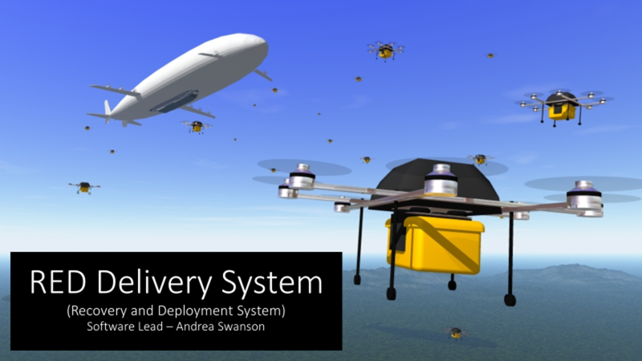

Slide 2
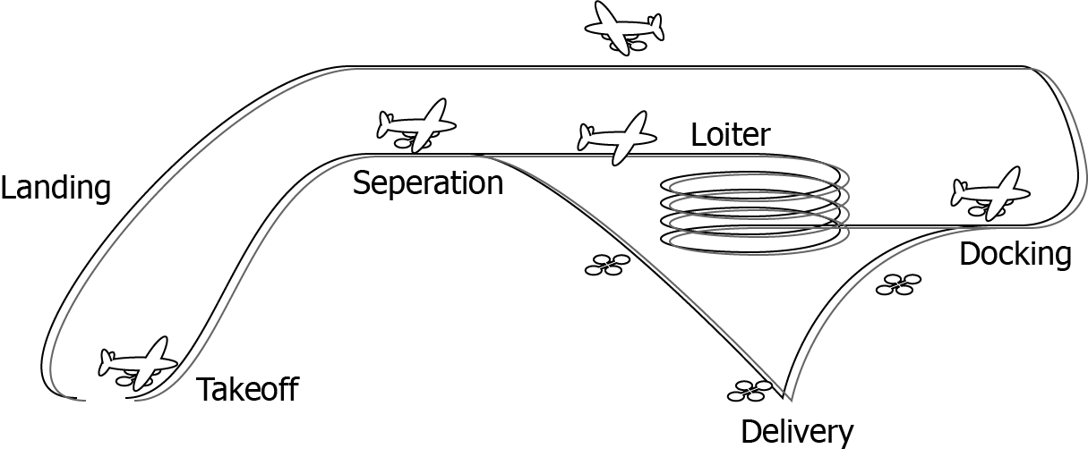
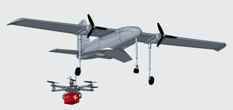
Proof of Concept: Docking

Slide 3
Milestone 6: Overview
Provide appropriate “flight path” corrections for docking
Display distance in meters to ideal docking position
Display ideal docking position with a graphic

Slide 4
Project Matrix
Task | Completion % | Andrea | To Do
Use detection tool to provide appropriate “flight path” corrections for docking | 100% | 100% | None
Use detection tool to display distance in meters to ideal docking position | 100% | 100% | None
Display ideal docking position with a graphic | 100% | 100% | None

Slide 5
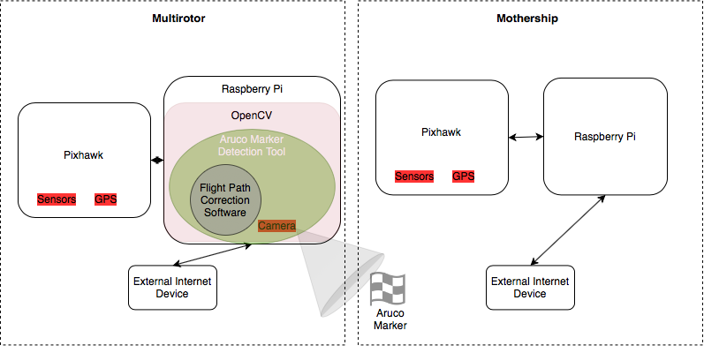
System Overview

Slide 6
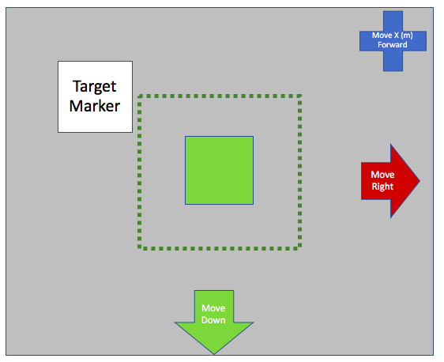
Display Flight Path Corrections
Based on the location of the marker, determine the appropriate flight path corrections

Slide 7
Display Meters to Ideal Docking Position
Show the user how many meters they must move forward
Simulates the values that would be sent in the flight commands

Slide 8
Signal Ideal Docking Position Reached
Notify the system that the ideal docking position has been reached
This graphic signifies the point in which the system should execute the docking flight command

Slide 9
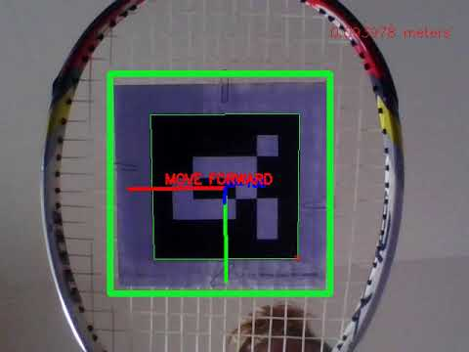
Demo

Slide 10
Future Plans
Upload simulation source code to FIT github
01
Integrate with state machince on a Raspberry Pi
02
Test the docking method with drone and docking mechanism
03

Slide 11
Questions?

Slide 12
Backup Slides

Slide 13
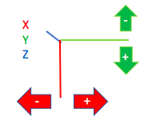
Program to Detect Object Pose Dynamically
Create an executable program that graphically demonstrates position and orientation estimation
Axes (X, Y, Z) appear on the marker consistent with the OpenCV model
Values displayed represent position and orientation in reference to the camera

Slide 14
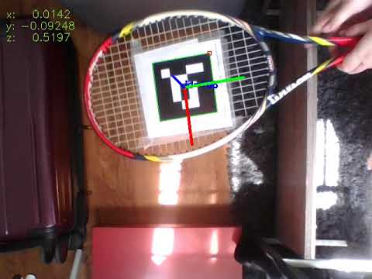
Demo

Slide 15
Project Matrix: Milestone 6
Task | Andrea
Use the detection tool to provide appropriate “flight path” corrections for docking | 100%
Use the detection tool to display distance in meters to ideal docking position | 100%
Display ideal docking position with a graphic | 100%

Slide 16
Milestone 6: End Goal
Substitute correctional flight path commands with graphics
Icons indicate the corrections that need to be made by the "drone" (webcam)
The green outline will be the target of the ideal docking position
Once the "drone" (webcam) is within the ideal docking range, screen indicates "Ready to Dock"

Slide 17
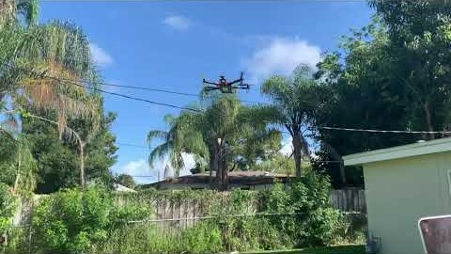
Demo

