Slide 1
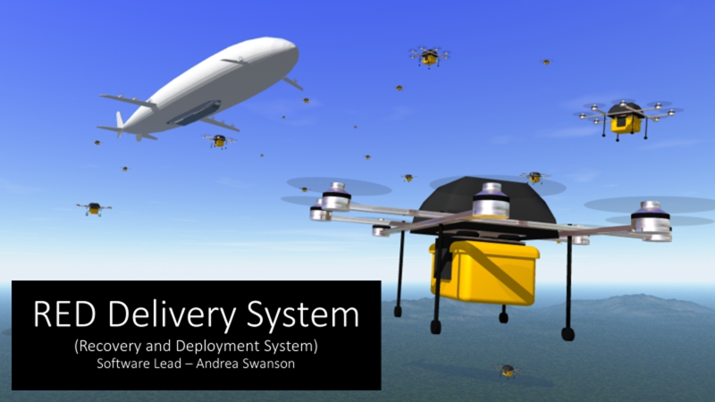

Slide 2
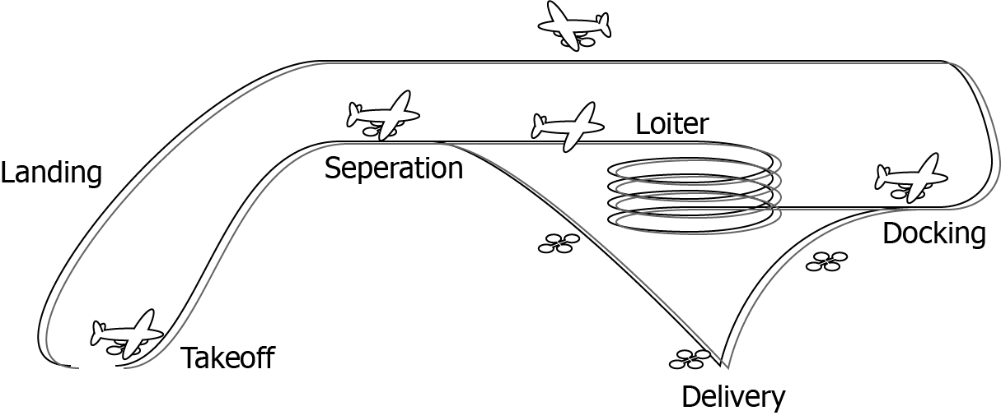
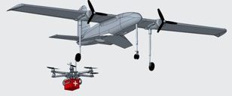
Scope Change:
Docking

Slide 3
Milestone 5: Overview
Create Linux VM and download OpenCV
Find Marker Detection Tool
Create a program to detect markers live on a moving object and determine pose

Slide 4
Project Matrix
Task | Completion % | Andrea | To Do
Create Linux VM and download OpenCV | 100% | 100% | None
Find Marker Detection Tool | 100% | 100% | None
Create a program to detect markers live on a moving object and determine pose | 100% | 100% | None

Slide 5
Create Linux VM and download OpenCV
Emulates an environment that represents the Raspberry Pi that would have been used in the previous scope of the project
OpenCV allows for image and video processing

Slide 6
Find Marker Detection Tool
Utilize a library compatible with OpenCV
Provides pre generated markers (acting as mothership) available for printing and detection
Provides an API with access to object attributes that makes pose estimation possible

Slide 7
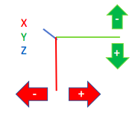
Program to Detect Object Pose Dynamically
Create an executable program that graphically demonstrates position and orientation estimation
Axes (X, Y, Z) appear on the marker consistent with the OpenCV model
Values displayed represent position and orientation in reference to the camera

Slide 8
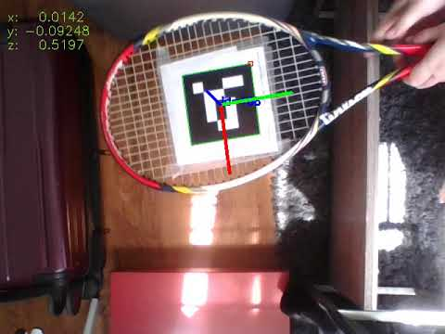
Demo

Slide 9
Milestone 6: Overview
Provide appropriate “flight path” corrections for docking
Display distance in meters to ideal docking position
Display ideal docking position with a graphic

Slide 10
Project Matrix: Milestone 6
Task | Andrea
Use the detection tool to provide appropriate “flight path” corrections for docking | 100%
Use the detection tool to display distance in meters to ideal docking position | 100%
Display ideal docking position with a graphic | 100%

Slide 11
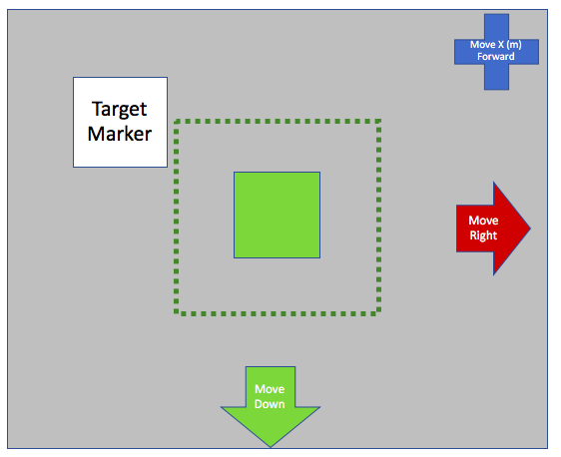
Milestone 6: End Goal
Substitute correctional flight path commands with graphics
Icons indicate the corrections that need to be made by the "drone" (webcam)
The green outline will be the target of the ideal docking position
Once the "drone" (webcam) is within the ideal docking range, screen indicates "Ready to Dock"

Slide 12
Questions?

Slide 13
Backup Slides

Slide 14
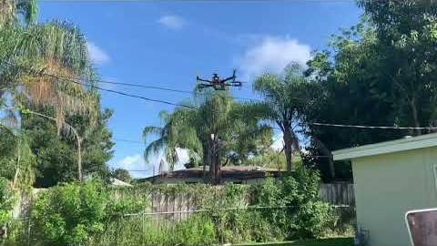
Demo

