Slide 1
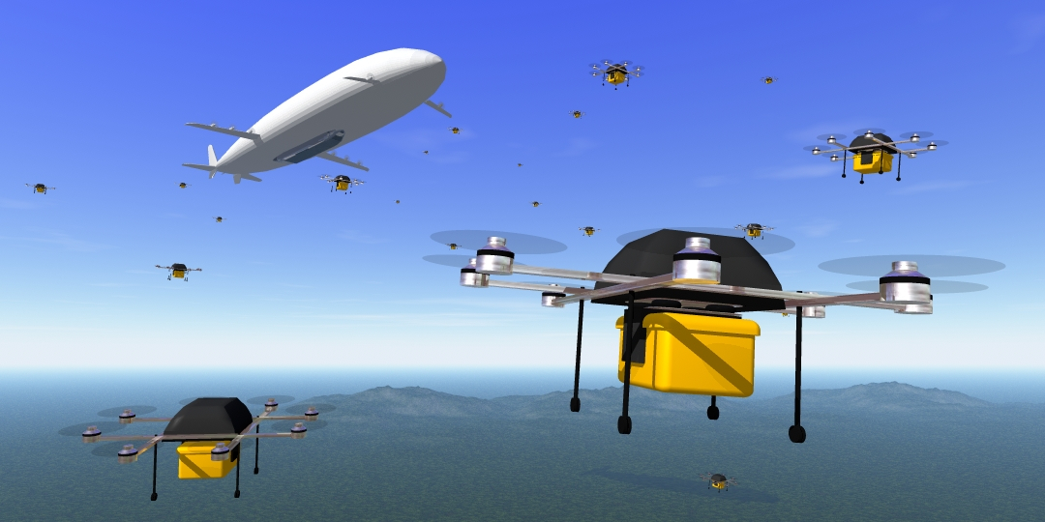
RED Delivery System (Recovery and Deployment System) Software Lead – Andrea Swanson

Slide 2
Project Information
Project Department: Aerospace
Faculty Sponsor: Dr. Wilde
Aerospace Senior Design Instructor: Dr. Demoret
Team Members
Andrea Swanson – Software Lead
Marley Scott – Electronics Lead
Miguel Colmenares – Software and Electronics Support
Basilio Caruso – Project Manager
Murtaza Fatakdawala – Control Systems Support
Akshata Patil – Aerodynamics and Stability Lead
Syed Faique Al Hussain –Stability Support
George Chen – Control Systems Lead
Michael Heath – Structural Engineer
Nishant Sriram Narayanan – Supporting Structural Engineer
Joao Nene - Supporting Structural Engineer

Slide 3
Goal
Create a multi-stage delivery system which consists of a fixed wing mothership (parent) and a multirotor (child). The main objective of this project is to develop a system which accurately delivers goods from one place to another in a very short time.
RED (Recovery and Delivery) system is designed to help others in need by delivering medical supplies utilizing unmanned aerial systems.
Envisioned to deliver medical kits to people trapped in emergency situations using autonomous flight of both UAVs and building an autonomous package deployment system to make precise deliveries.

Slide 4
Approach
GPS Data Exchange
Using a GPS device attached to the Raspberry Pi’s, create a constant data exchange so each UAV is aware of the other’s location.
Determines which stage of the mission the system is in.
Control Systems
Sensors determine successful deployment and docking, so the system can determine the next step of the mission to complete.
Flight Commands
Sends the appropriate flight commands (based on the current mission stage and GPS coordinates) from Raspberry Pi to Pixhawk.
Allows the system to act autonomously.

Slide 5
Challenges
Understanding how flight commands and Pixhawk software works and interacts
Communicating between Raspberry Pi’s without a shared network connection on the ground
Understanding which aerospace flight commands are necessary for error handling for deployment, delivery, and docking.

Slide 6
Milestone 1
Compare and Select
Compare and select technical tools for communication between single board computers and hardware sensors to identify system phases to the software through the single board computers.
Compare and Select
Compare and select collaboration tools for software development, documents/presentations, communication, task calendar
Demonstration
Provide a demo to display communication between a Raspberry Pi and a PixHawk Radio
Create
Create Requirement Document
Create
Create Design Document
Create
Create Test Plan

Slide 7
Milestone 2
Constant GPS data exchange with reasonable performance.
Create functional custom Pixhawk flight commands for success and flight failure/error handling.
Efficient state machine for phases of mission.

Slide 8
Milestone 3
Autonomous deployment of drone within certain GPS proximity of target coordinate (Mission Phase 1)
Implement and test sensors to notify system of success/failure for docking
Identify specific flight errors during deployment and docking
Determine flight commands needed to correct possible errors

Slide 9
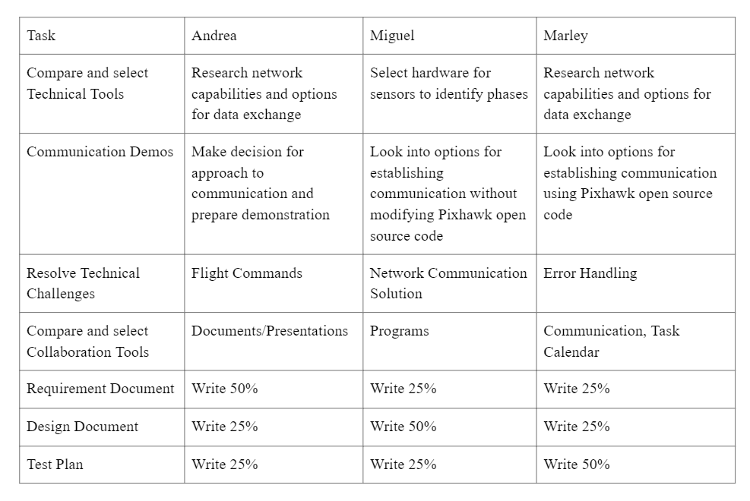
Tasking

