Slide 1
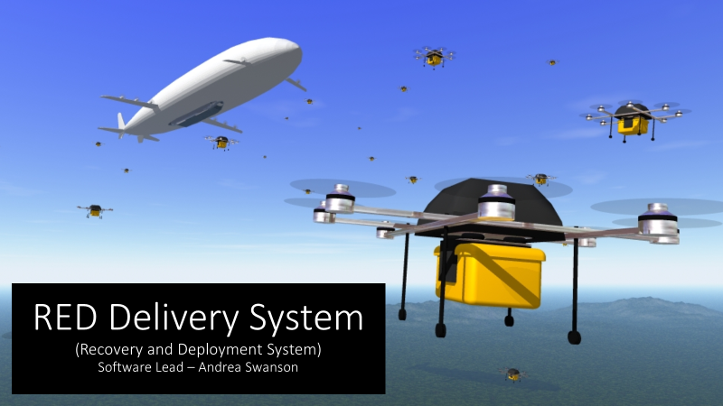
RED Delivery System (Recovery and Deploment System) Software Lead – Andrea Swanson

Slide 2
Milestone 1: Overview
Compare and Select Technical Tools
Compare and Select Collaboration Tools
Raspberry Pi to Pixhawk Radio Demonstration
Create Requirements Document, Design Document, Test Plan

Slide 3
Compare and Select Technical Tools
Shared Wifi Network ruled out
Primary Approach: Independent Radio
Secondary Approach: Mobile Wifi network on both the mothership and the drone
Using Pixhawk Radio to send data between mothership and drone due to Pixhawk Software communication limitations ruled out

Slide 4

Compare and Select Collaboration Tools
Revision Tracking
Github
Team Communication
Slack
Team wide documentation
Google Drive

Slide 5
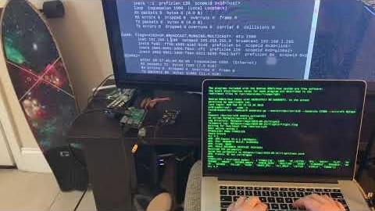
Raspberry Pi to Pixhawk Connection Demo
Notes:
https://www.youtube.com/watch?v=47IeAgFZ470

Slide 6
Requirements
System is autonomous and requires a user to input a precise GPS location for payload delivery
System has “killswitch” on the ground for each UAV, and the option for manual control overtake and contingency descendance landing
System can determine state based on the GPS location of both UAVs and docking sensors
System has the ability to detatch, deliver, dock, and land
System has error handling for failed docking attempt

Slide 7
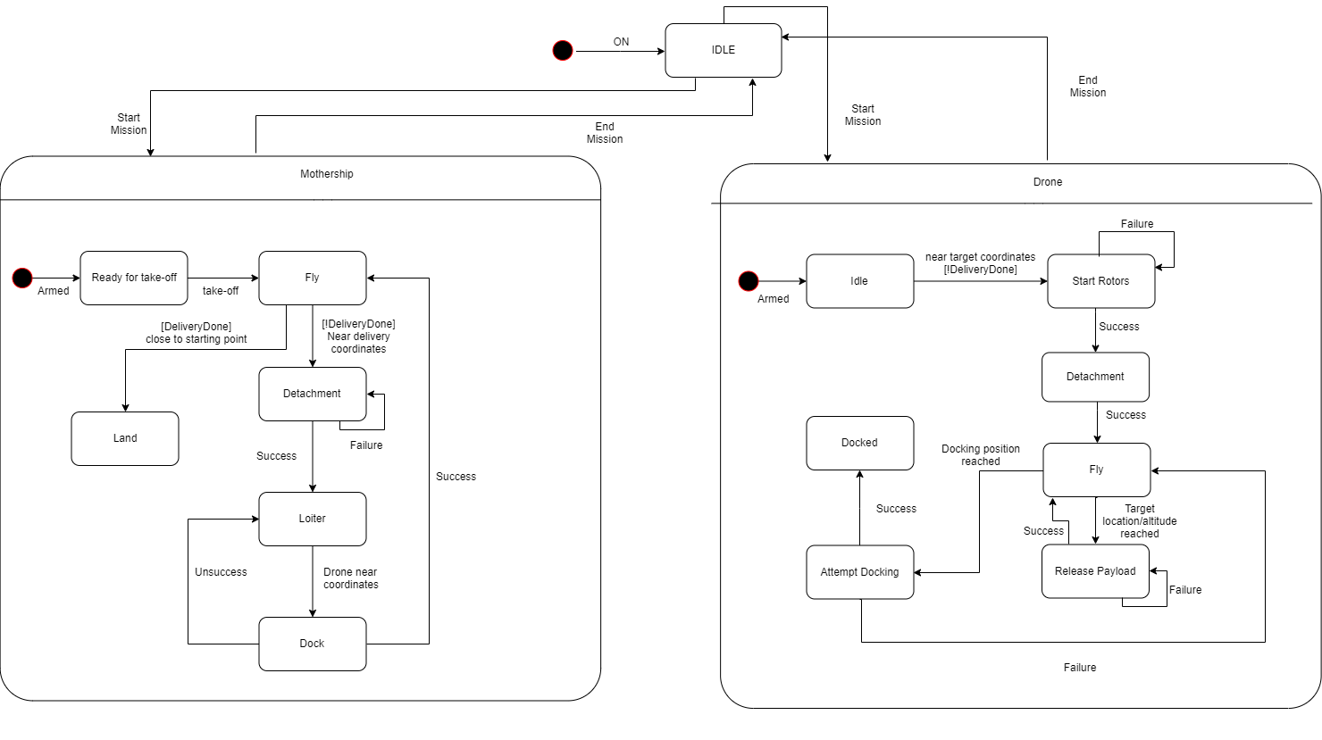
Design Document

Slide 8
Test Plan
Verify target payload location can be processed and accepted
Verify that system can transition between state based on GPS location/sensors
Verify that the system acts appropriately based on system state
Verify that delivery is precise
Verify that UAV’s can achieve two stages of docking
Verify that the mothership can land at takeoff location
Verify that kill switch mechanisms allow contingency landing and manual takeover

Slide 9
Milestone 2
Constant GPS data exchange between mothership and drone
Custom Pixhawk Flight commands
Mission phases represented with state machine

Slide 10
Questions?

