Slide 1
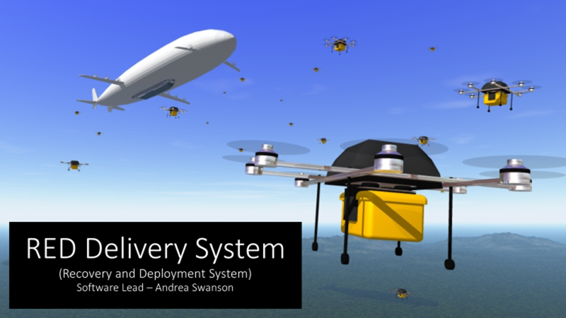

Slide 2
Milestone 3: Overview
Autonomous deployment of the drone to reach target GPS coordinates and return home
Enhance Safety Capabilities

Slide 3
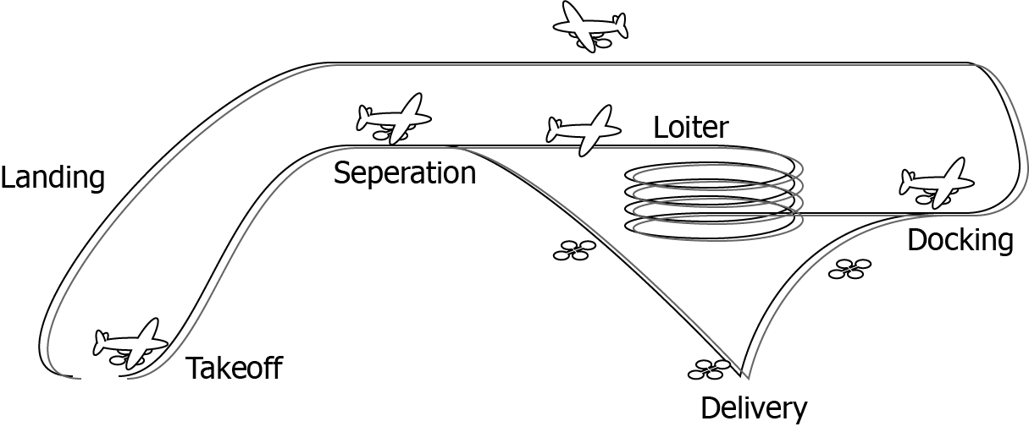
Main Success Scenario

Slide 4
Autonomous GPS arrival and retreat
Input : GPS location for waypoints
Expected behavior
Reach first waypoint
Land at second waypoint
Takeoff and land back at original mission takeoff location

Slide 5
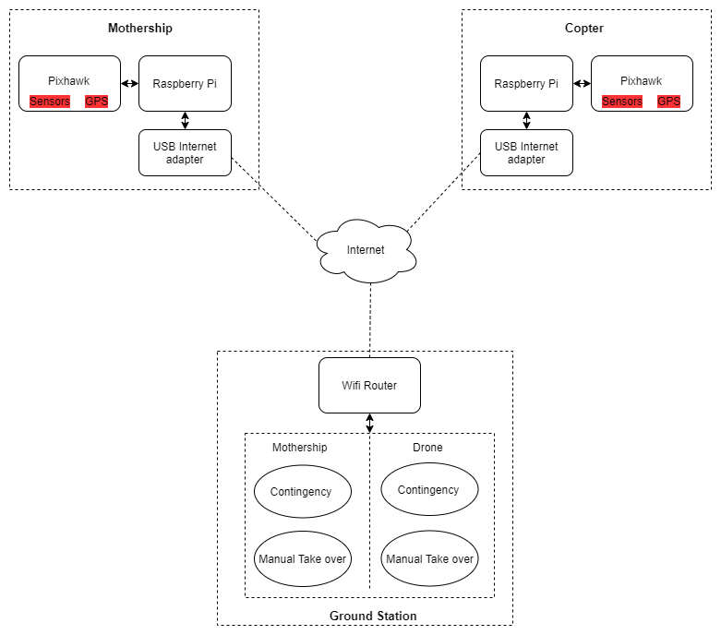
Enhancing Safety Capabilities
Comms Devices
Comms Devices
Contingency Landing Plan
Executed when the system enters a state of error
Manual Takeover from the ground station
Conditions for entry into error state:
Timeout
Lost Connection
Multiple Docking Fails
Low Battery
Loss of sensor information
Internet / Radio
Mission Planner

Slide 6
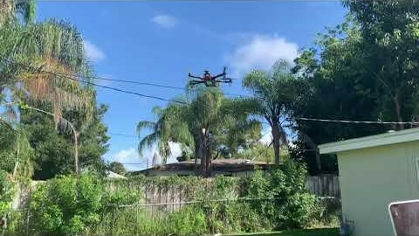
Demo

Slide 7
Milestone 4: Overview
Image Tracking Program
Complete a mission using the state machine

Slide 8
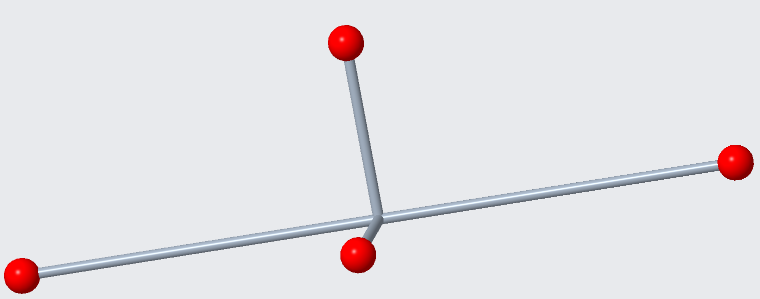
Milestone 4: Image Tracking Implementation
Pattern Recognition to indicate acceptable docking position
Arducam OV564 5 Megapixel 1080p Sensor
Reduce camera resolution to 640X480p for better frames per second
Margin of Error is within 10 mm

Slide 9
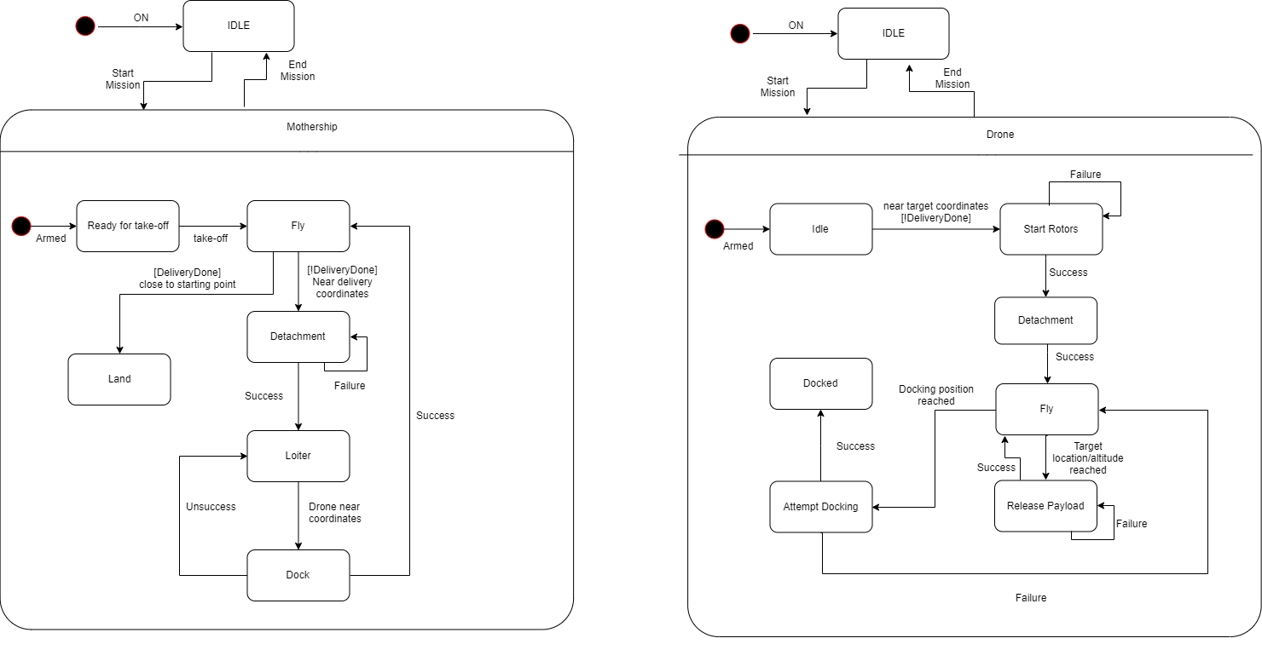
Milestone 4: Complete a Mission Using the State Machine
Current state machine is a representation fo the requirements of the system
Demo mission to display the effectiveness of the system to complete each mission phas and move into the next state

Slide 10
Questions?

Slide 11
Backup Slides

Slide 12
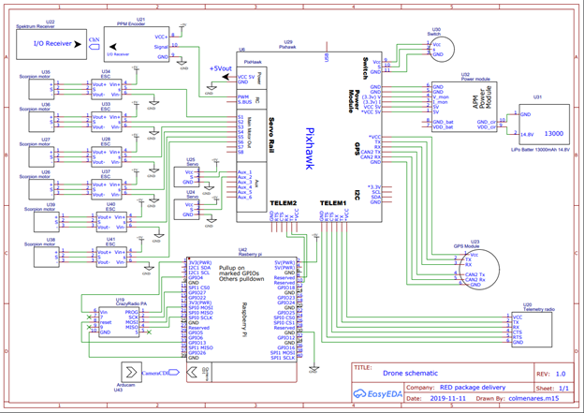
Wire Diagram

