Slide 1
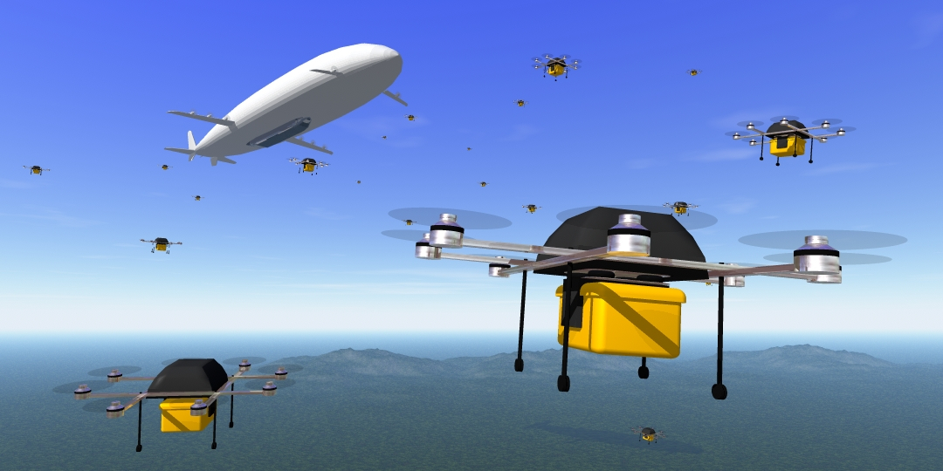
RED Delivery System (Recovery and Deployment System) Software Lead – Andrea Swanson

Slide 2
Project Information
Team Members
Andrea Swanson – Software Lead
Marley Scott – Electronics Lead
Miguel Colmenares – Software and Electronics Support
Basilio Caruso – Project Manager
Murtaza Fatakdawala – Control Systems Support
Akshata Patil – Aerodynamics and Stability Lead
Syed Faique Al Hussain –Stability Support
George Chen – Control Systems Lead
Michael Heath – Structural Engineer
Nishant Sriram Narayanan – Supporting Structural Engineer
Joao Nene - Supporting Structural Engineer
Project Department: Aerospace
Faculty Sponsor: Dr. Bhattacharyya
Client: Markus Wilde

Slide 3
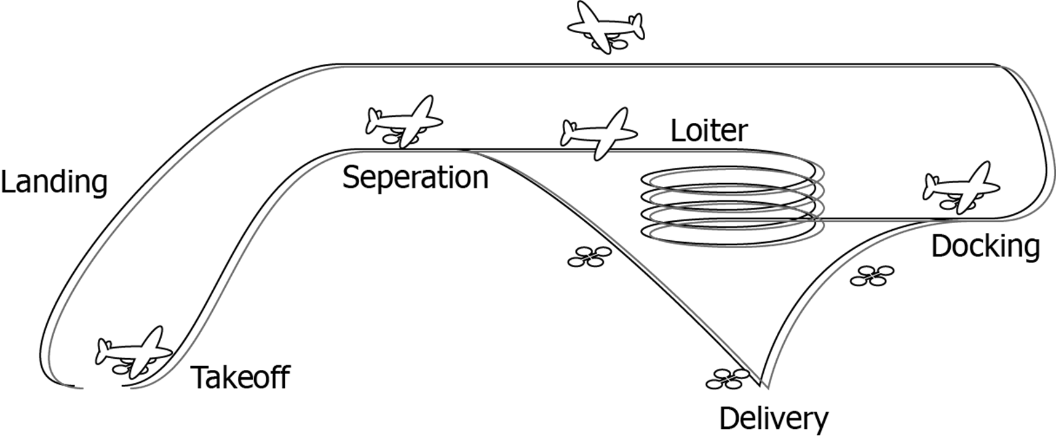
Goal
Precise Autonomous Delivery
Delivers a payload to GPS coordinate
Situations where an automobile or manned aircraft is insufficient
Safety Compliant System
FAA Restrictions
Manual takeover option
Contingency Landing Plan

Slide 4
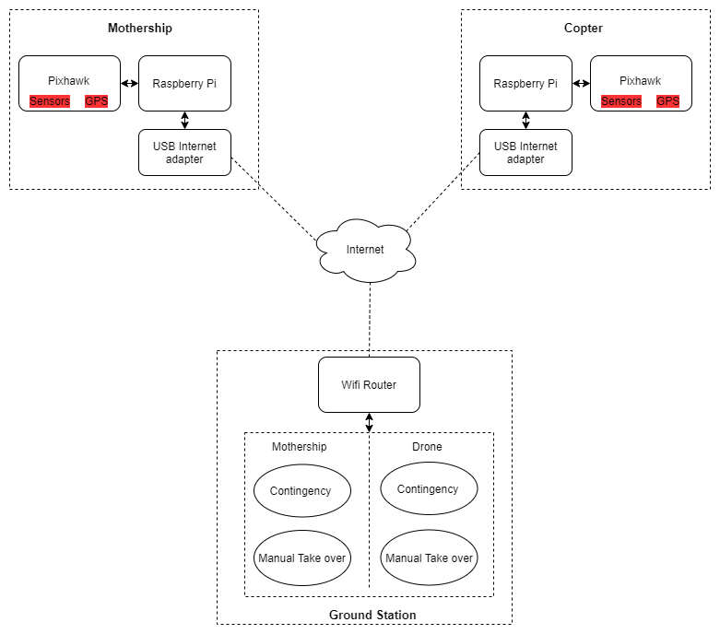
Approach
GPS Data Exchange
Raspberry Pi’s are aware of each others location
Control Systems
Determines successful release/docking/delivery
Flight Commands
Allows system to be autonomous
Image Tracking
Precise docking cabapilities

Slide 5
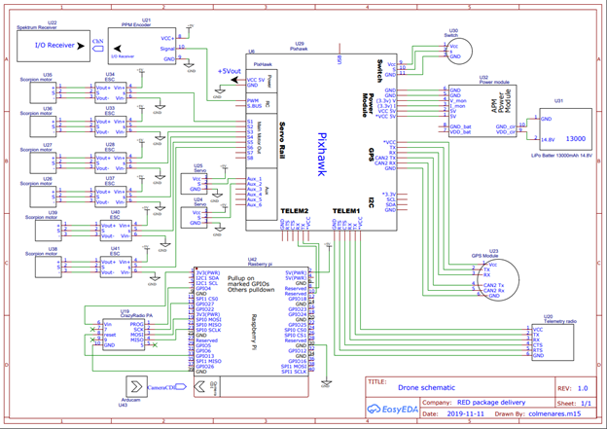
Challenges
Several Subsystems (Software and Hardware) working together
Difficult to isolate errors
Limited Processing Power of Raspberry Pi
Image processing running concurrently is expected to be challenging
Assurance of Total System Functionality
Sensors, communication, GPS, state machine, camera, batteries, etc.
Communication Loss
Need a system in place for error handling if connection is lost

Slide 6
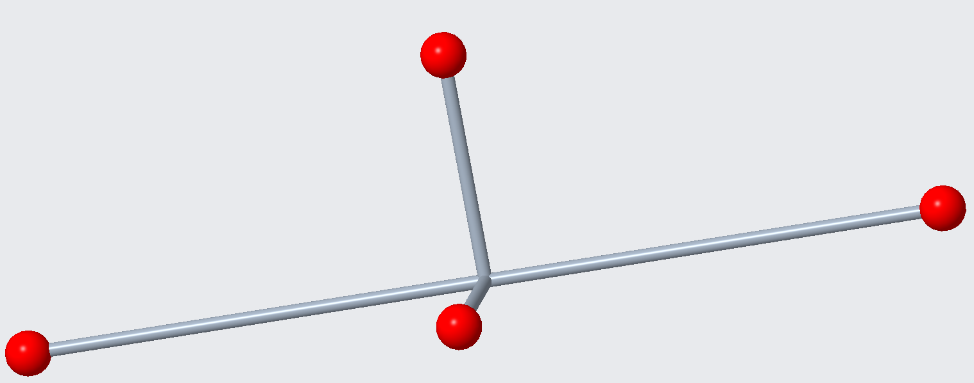
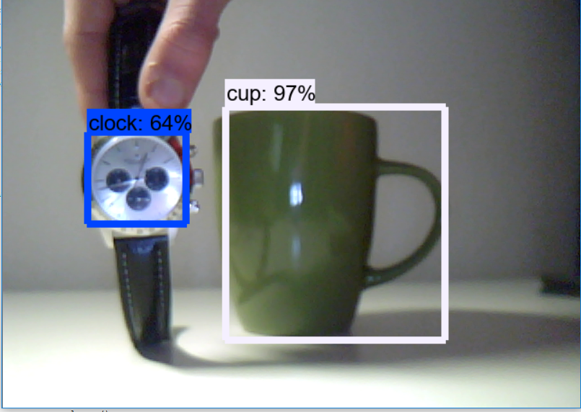
Milestone 4 (February 17)
Optimize a combination of image recognition tools, algorithms, and cameras
Test possible patterns
Determine the system of hardware and software that yields the most accurate detection
Conditions: motion, distance, etc.

Slide 7
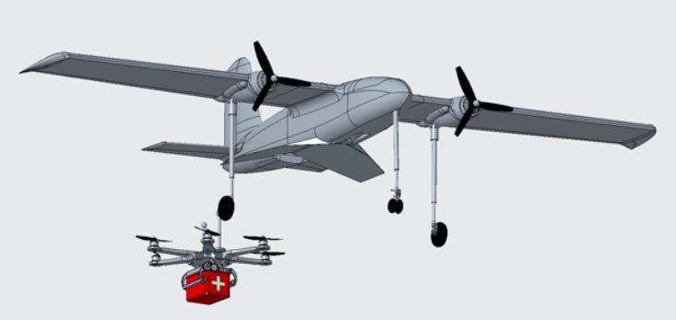
Milestone 5 (March 23)
Image Tracking Integration
Autonomous Docking Demonstration
Flight path corrections based on object detection

Slide 8
Milestone 6 (April 20)
Autonomous Mission Completion
Combine all of the functional subsystems to a single functional system

Slide 9
Questions?

