Slide 1
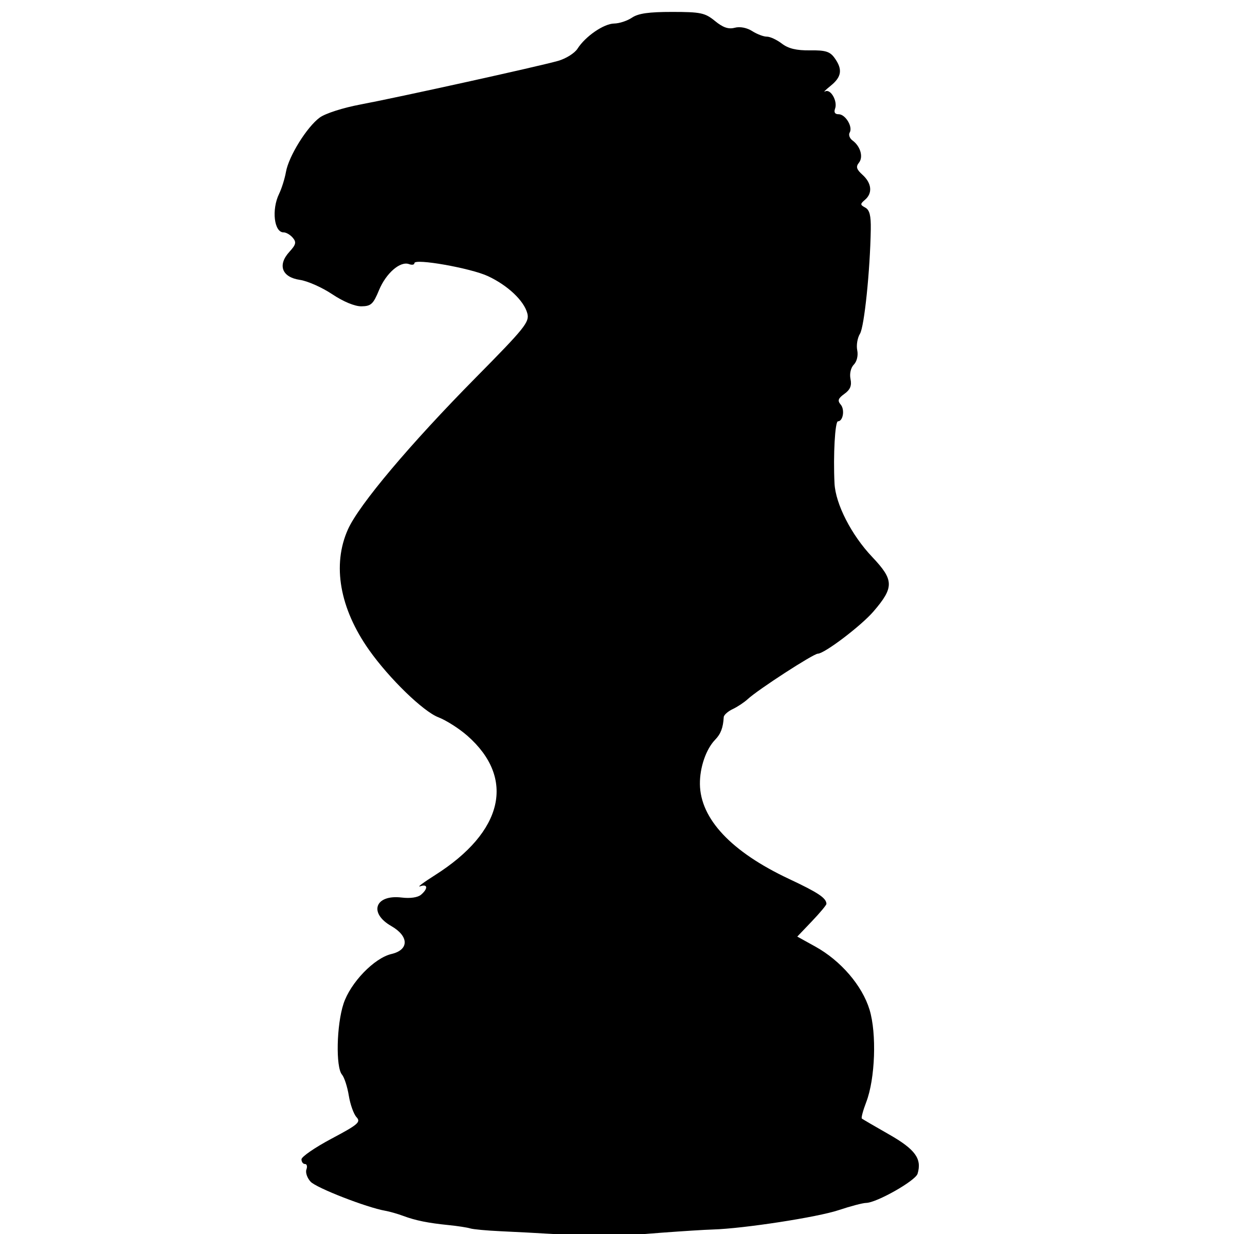
Knighteen
9

Slide 2
Swipe to move any number like a chess knight into a free spot. After each move new numbers are added.
If two or more equal numbers are within one move they combine to form a higher number (combos are possible)
Any created number increases your total score correspondingly. Aim at reaching the number 19!
X
Max: 8
SCORE
1756
!
?
<=
Maximum
generated
number
Overall
score
X
!
?
<=
1
1
1
1
X
Start a new game
1
1
1
1
2
1
1
1
1
1
1
!
2
2
2
Move hint
1
1
1
?
These help pages
1
1
1
1
1
1
<=
Undo last move

