Slide 1

DRone trAjectory and CONtrol optlmisAtioN for noise emissions reduction
Findings Journal, Andrea Vaiuso

Slide 2
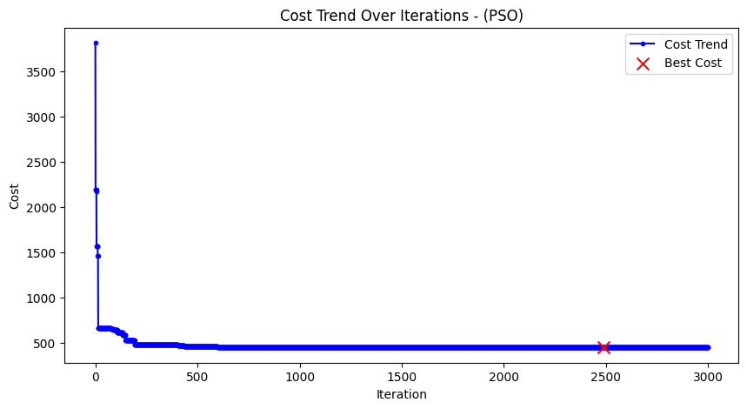
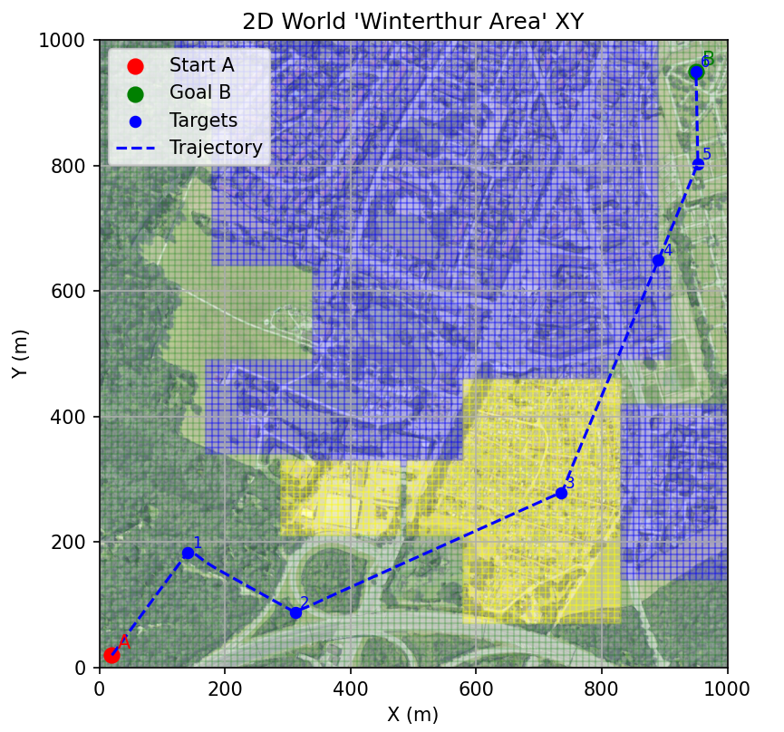
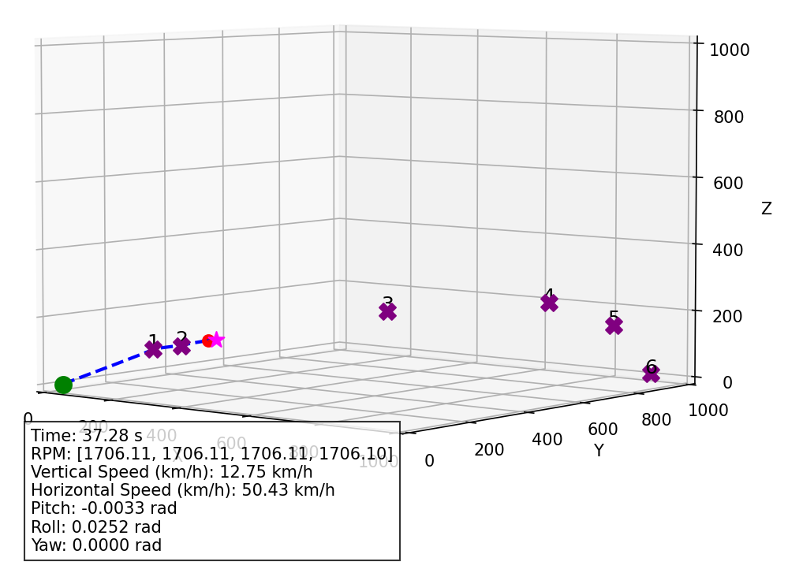
08.2025
GWO and PSO have been successfully implemented in drone trajectory optimization. The setting is a 1000x1000m parametrized world, with 10x10m grid sampling for SPL receiver calculation. The drone can move in the continuous space.
Simplification adopted to make metaheuristics work:
The trajectory is generated by defining intermediate waypoints between points A and B, which serve as the drone's targets for movement.
The waypoint coordinates are defined as three-dimensional (x, y, z) perturbations from equidistant basepoints lying on the segment connecting points A and B.
The metaheuristics work fine, converge quickly, and they effectively reduce the total cost
Maybe exploration should be refined over exploitation, since convergence is “fast” but it remains into suboptimal solutions.

Slide 3
25.09.2025
A first implementation of DRL (SAC) has been implemented.
The environment is set as following:
State (observation) vector – each step exposes the drone’s full simulated state
Action space – actions describe perturbations around reference points sampled along the straight start
Per-step actions are clipped against both global bounds and waypoint-specific limits that reuse the metaheuristic bound builders, and they always stay inside the world cube before being converted to absolute waypoints with a commanded speed.
An additional gating dimension lets the SAC policy terminate waypoint proposal early; the environment respects that signal via a configurable threshold, finishing the episode without adding another waypoint.
Each proposed waypoint is immediately simulated as a single-leg flight: the first segment uses the initial state and later legs continue seamlessly; when an episode ends (goal reached, budget exhausted, or agent stops), the environment appends the real target waypoint and replays the terminal leg.
Stored trajectories are always in absolute coordinates.
Baseline episode – a helper can be invoked to log the zero-waypoint straight-line flight

Slide 4
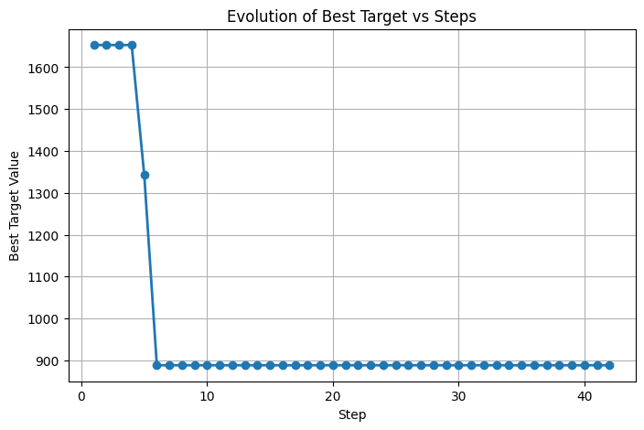
First results show the agent is converging quickly at the beginning but it immediately stops. Probably parameters needed to be tuned/exploration needs to be increased
The problem could be formulated in another way: The action could set the position of the dynamic target every x steps. Reward can be calculated based on the cost function and the distance from the target.
A main finding: a big difficulty with RL is the problem formulation. It can be formulated in very different ways and you cannot say which is the best. We need literature review on that.
Another difficulty is finding a rule to set the gain to the cost function
Avg episode time: 66.034s

Slide 5
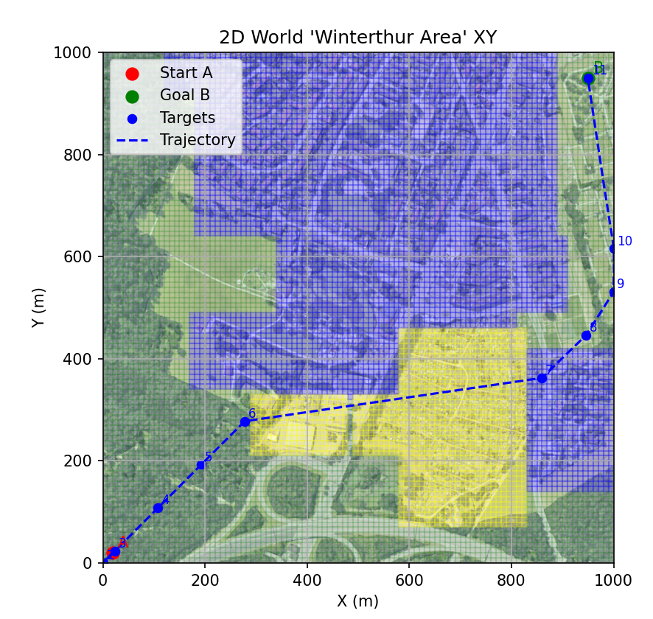
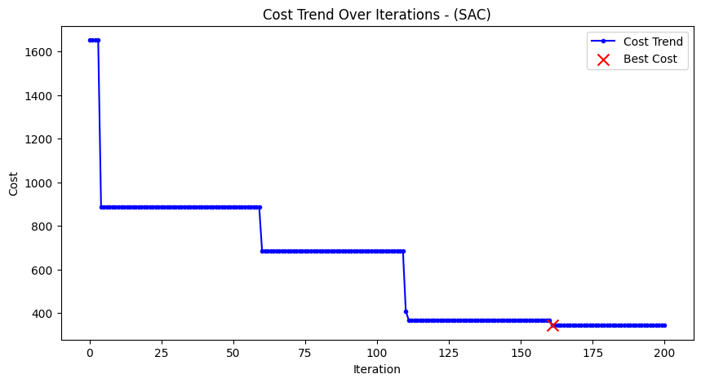
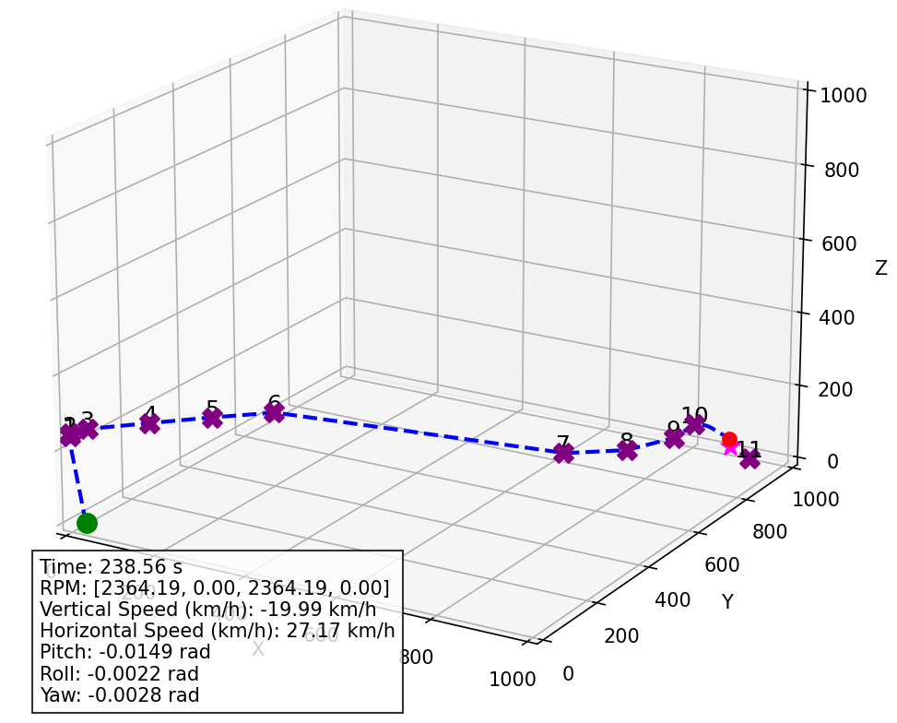
30.09.2025 – SAC Results:
Total time: around 5h (315min)
It would maybe make sense to provide to the algorithm an initial human guess?

Slide 6
30.09.2025 – Biggest difficulties
Problem: RL can be implemented, but it’s reliability higly depends on hyperparameter tuning. Possible solution: Optimization could be considered, like Optuna.
Problem: There are no clue on how to set cost function weight to mimic the real necessities.
Problem: Simulation-to-reality gap. Possible solution: Develop better sim-to-real transfer methods
Problem: The agent cannot generalize in multiple maps. It’s logically nosense thinking that it could just following this procedure or similar ones.

Slide 7
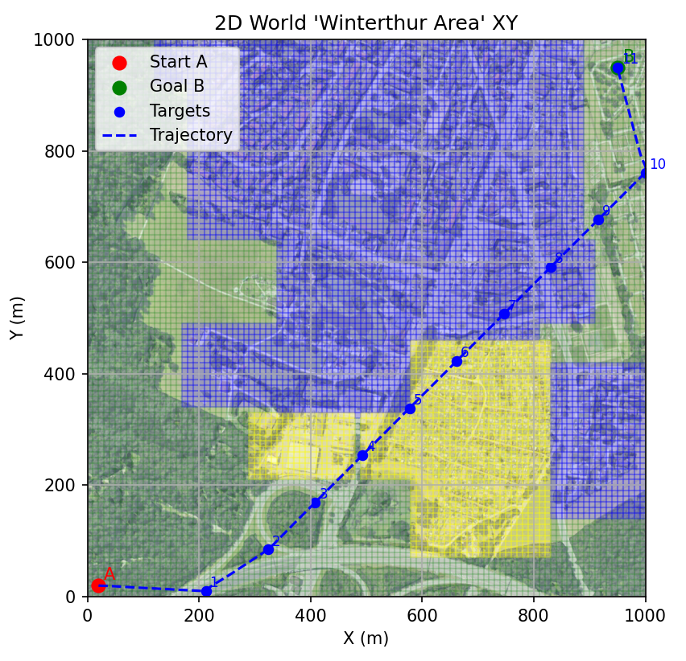
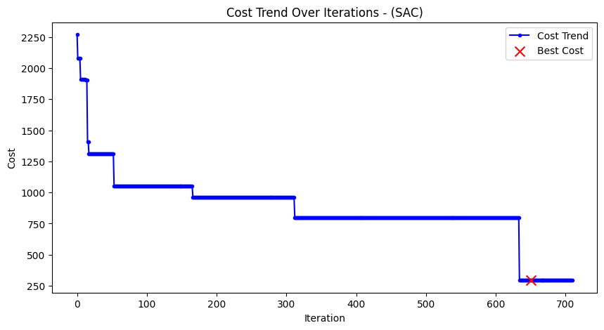
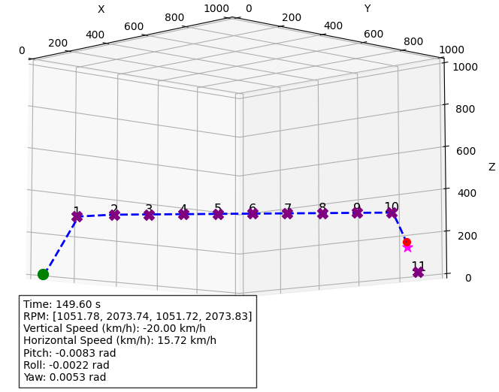
01.10.2025
New results from SAC when applying all the «tricks»
The trajectory still doesn’t look like the best. It’s the cost function definition? Or the agent parameters?

Slide 8
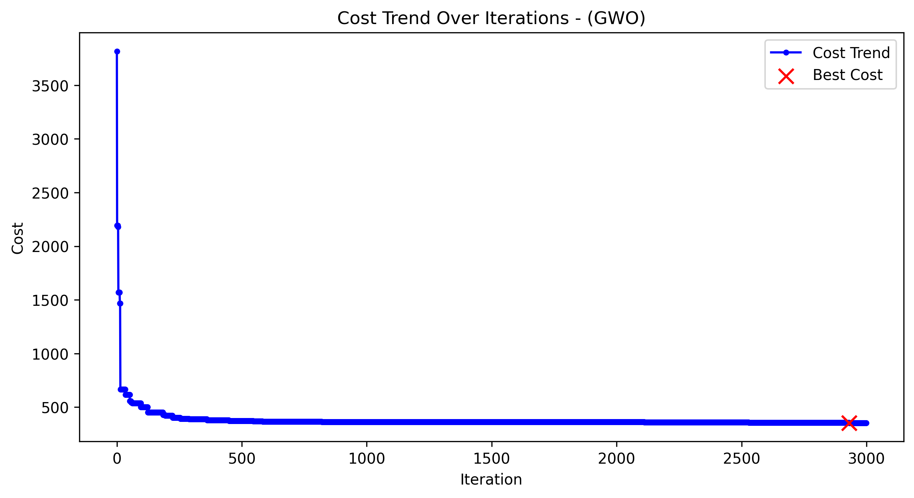
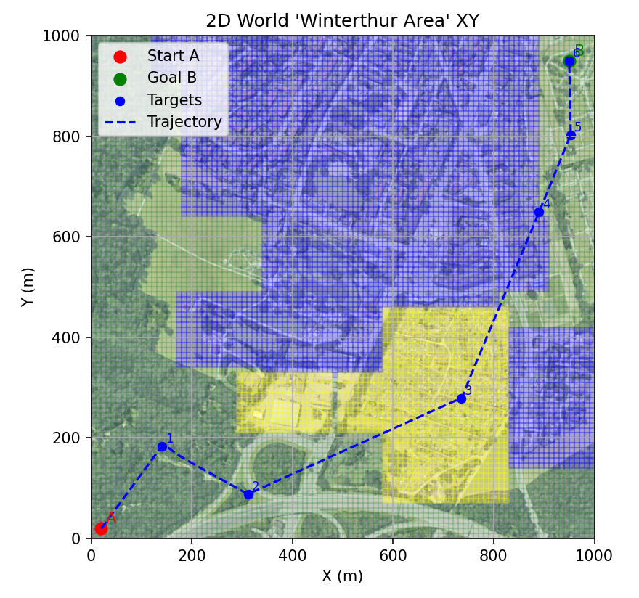
02.10.2025
GWO has been also bugfixed and executed. RL is performing better! Now it’s time to make it performing even better
GWO Results:

Slide 9
06.10.2025
Another doubt. Should I include distance from final target to the RL reward? It’s probably strictly not necessary, but should be worth it to check if it could improve convergence? Probably it would be good for generalization (that anyway cannot be accomplished in this context).

Slide 10
07.10.2025
Some considerations about hyperparameter tuning:
You cannot trust initial curves because it cannot say if the optimization will eventually drop later.
It’s important to measure standard deviation with seeds with a certain configuration is chosen (some configurations can generate instable models or overfitted on a seed)
Focus on hyperparameters that have the strongest impact
Use Area Under the Curve (AUC) that captures both learning speed and best cost. It can be normalized by the duration to get the average over time.
Source: https://proceedings.mlr.press/v202/eimer23a

Slide 11
28.10.2025
I've noticed a major issue. I instructed the agent to either search for the maximum number of points or implement a 'stop action' to stop earlier. The problem is that the agent is forced to choose from the initial point selected, which is calculated based on the reference point on the straight line from A to B. This is not ideal, as the agent should be able to select a finite number of points (less than n_max_point) which are, still in sequence, but randomly chosen from the available ones. That means, rather than creating a 'stop action', the agent should choose to skip a point instead and continue the sequence. This way, it can continue to select a finite number of points, but still fewer than n_max_point, without being forced to select only a subset of the initial ones. The result should be that the agent can choose any of the available points, in order, but being able to skip some. The base action is now skip all points and leave the last one. So the agend should start choosing in order the available points, being able to skip some of them in the sequence, and then terminating the episode when the available points are exhausted (the max_n_points is reached).

Slide 12
29.10.2025
Generalizable RL agent:
Insert a GPS information on the agent’s state
Train the agent in multiple maps
Add to the agent’s state a simplified sound model
Idea for further applications!
Insert proximity information on the environment. This could also teach the drone to avoid obstacles

Slide 13
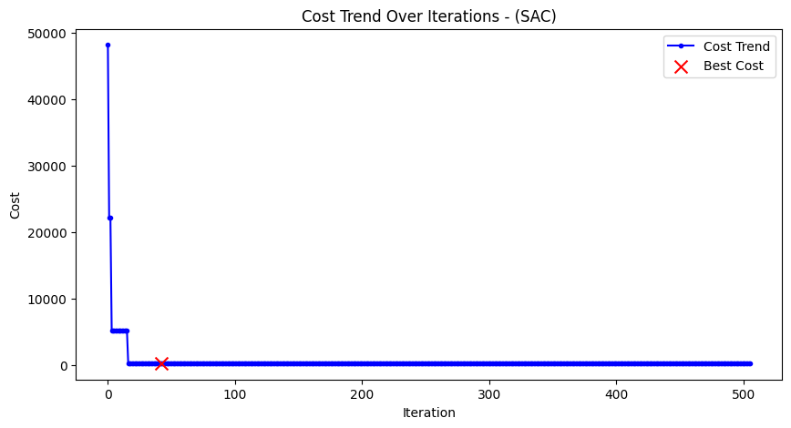
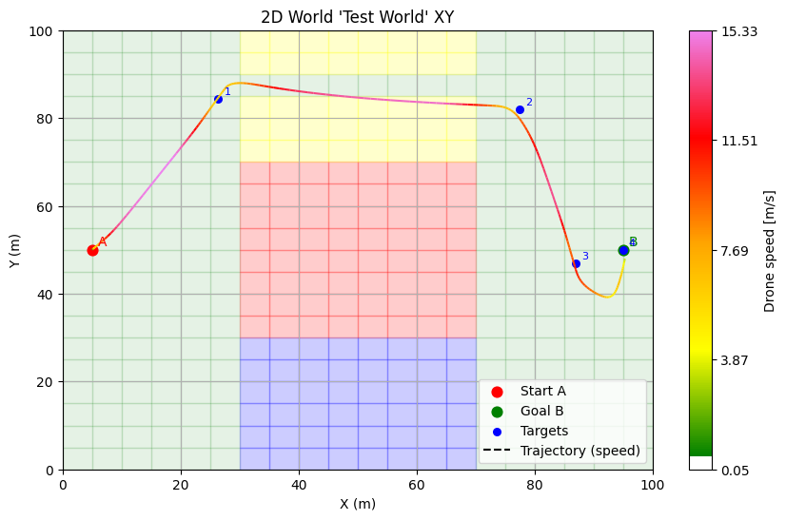
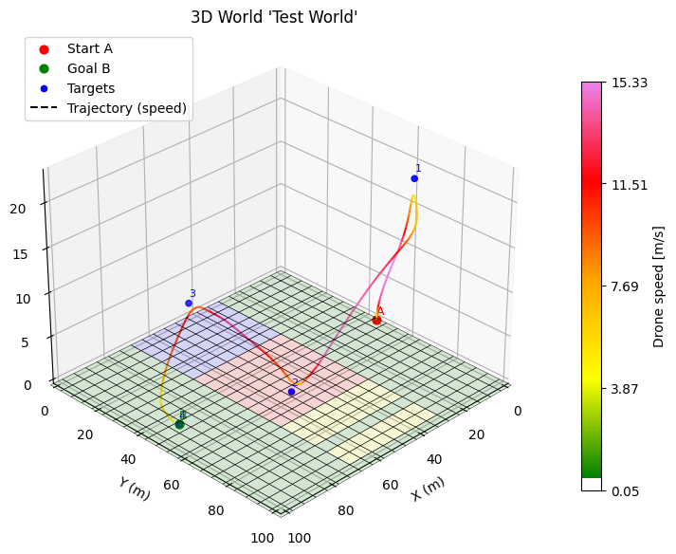
29.10.2025
First results with simplified trajectory.
The agent converged in roughly 5 minutes

Slide 14
29.10.2025
Ho paura che col RL stiamo forzando qualcosa a comportarsi diversamente dalla sua natura. Probabilmente il training di RL è più lento e meno efficiente di una discesa lungo il gradiente, o un algoritmo metaeuristico. La forza di RL sta nella potenzialità di poter creare un agente in grado di generalizzare, non di overfittare un problema specifico per comportarsi come un ottimizzatore.
Ho notato che l’RL ad un certo punto smette di cercare punti, lascia solo quello finale e modifica solo la velocità. Potrebbe essere un problema della penalità per percorso non completato? Probabile.
Corretto. Vediamo se i risultati cambiano

Slide 15
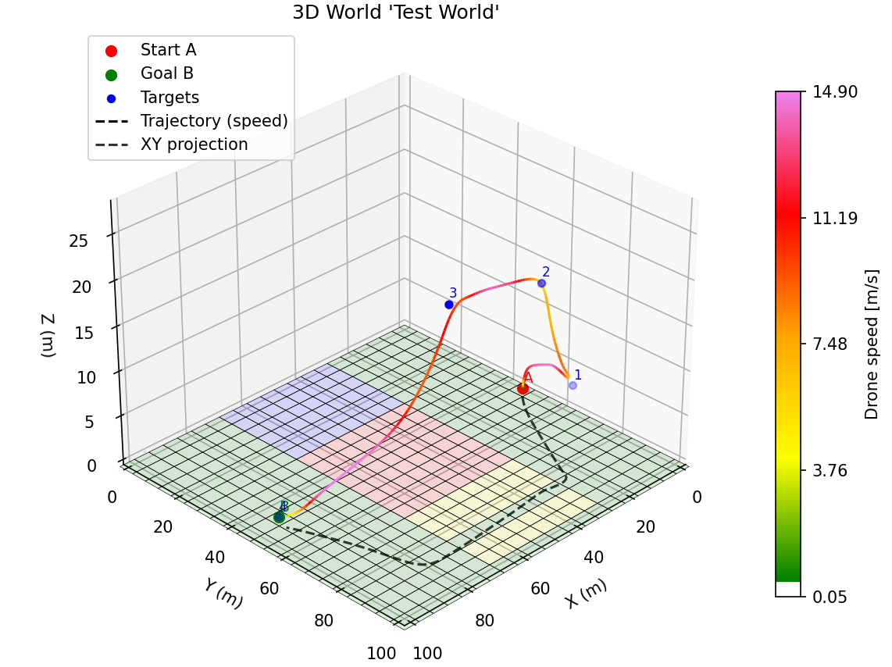
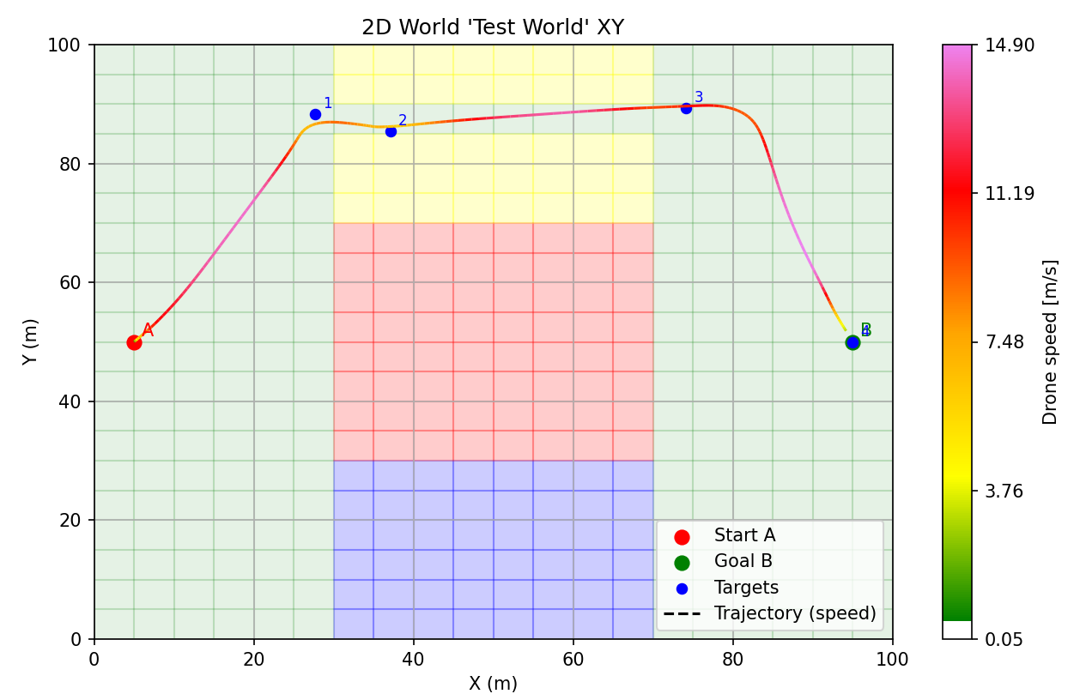
29.10.2025
Apparently, fixing the last bug helped a lot:

Slide 16
To do for tomorrow:
No, probably there is still something that brings the agent to eliminate all the points. Maybe the problem in how the rewards are summed, maybe the cost function doesn’t correctly reset when considering another step.
Probably I have to reset the simulation every step, because otherways the history arrays will keep accumulating history data on old steps. Costs are calculated based on history arrays.
Apparently everything is fine with resetting arrays.
Another try can be starting from printing the values of the costs for every step and the total reward, then compare.

