Slide 1
KMM
KOTLI MULTIPLATFORM MOBILE
Wealth Management Technology & Solutions , December – 4 - 2020

Slide 2
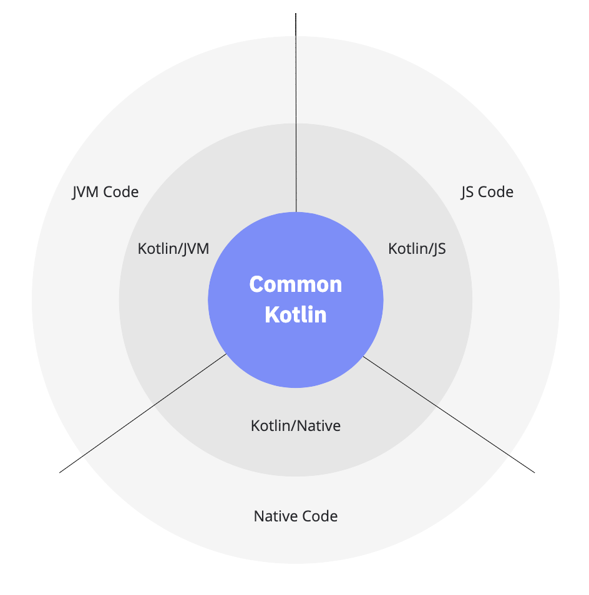
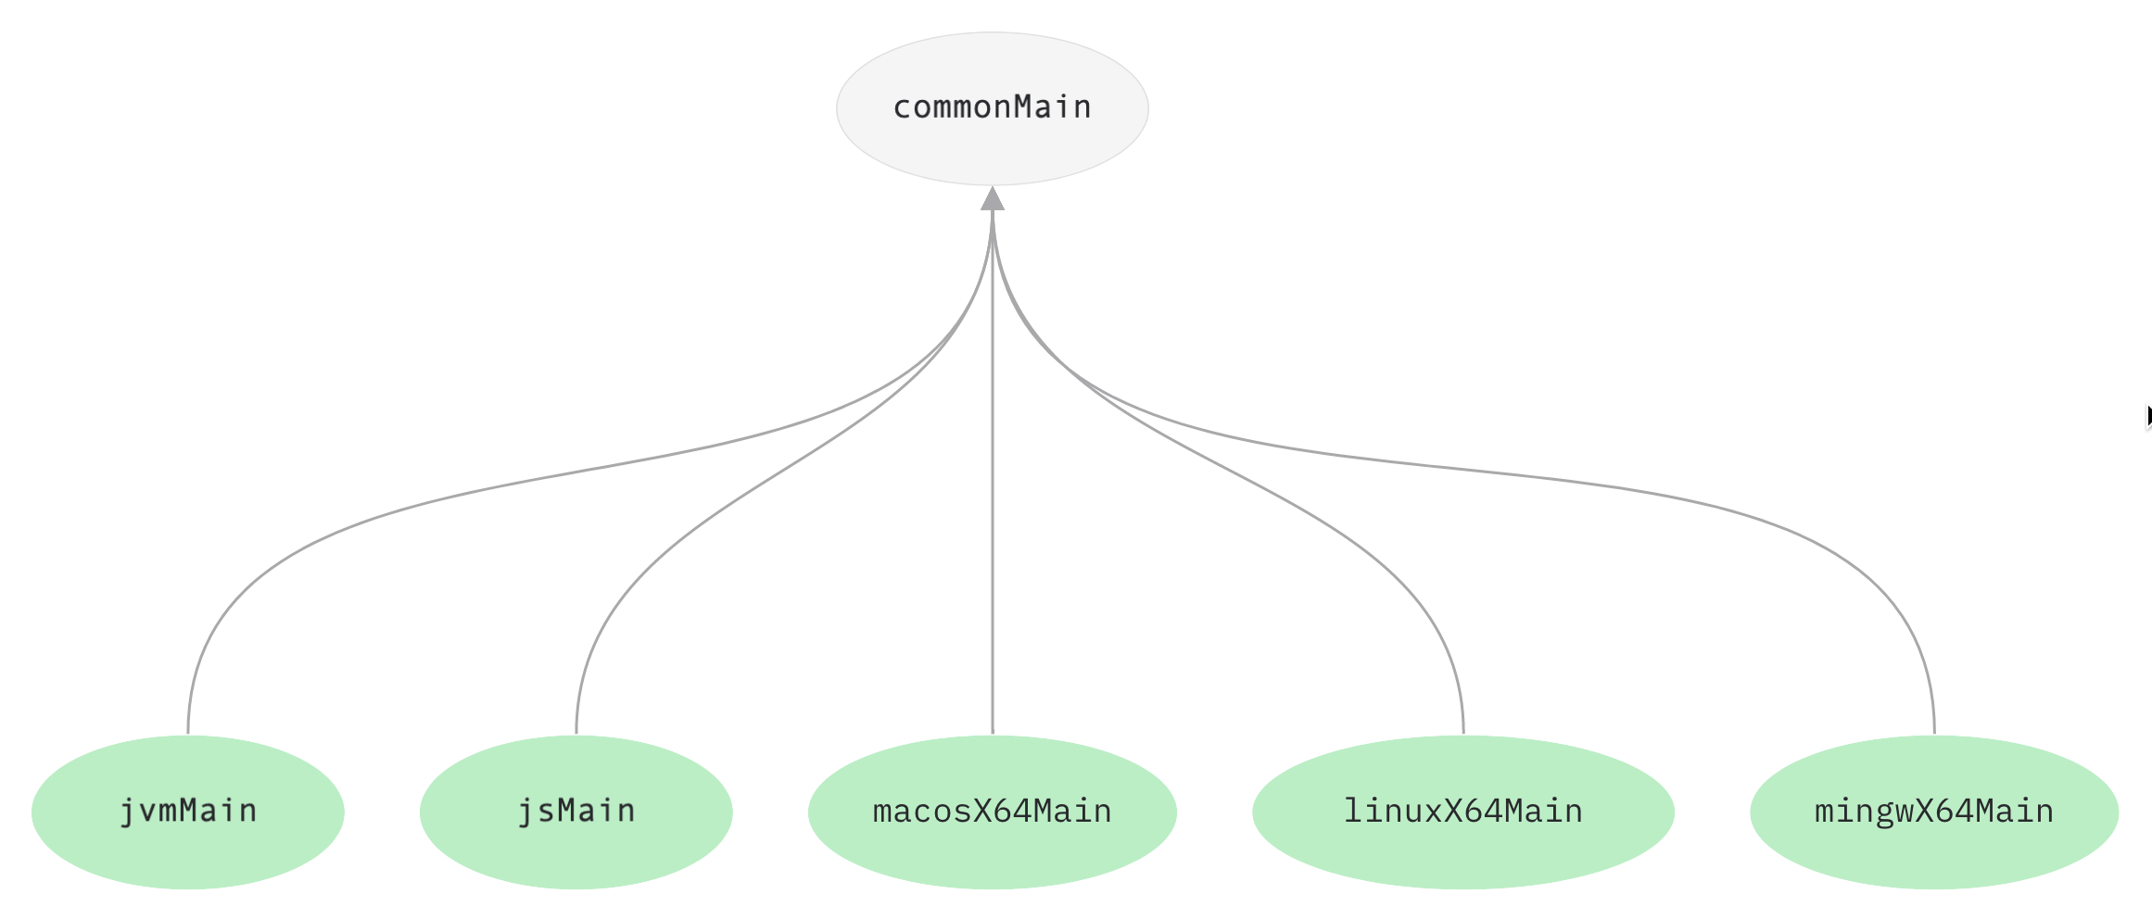
HOW KMM WORKS
COMMON KOTLIN: it is written in Kotlin, includes languages, libraries and basic tools;
SPECIFIC LANGUAGE: these are the sections related to the different languages but common in all the platforms that use kmm library.

Slide 3
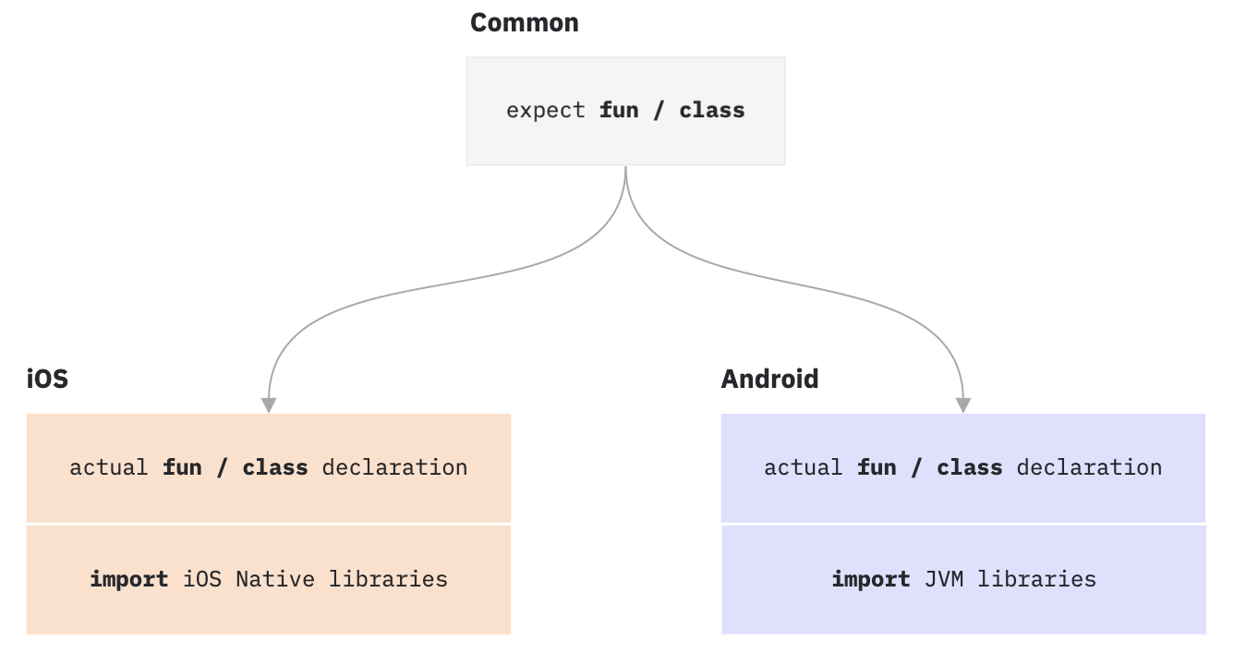
SPECIFIC IMPLEMENTATION
EXPECT/ACTUAL: these two declaration are used to specify a behaviour in the common module, but each platform implements their own code.

Slide 4

COMMON BUSINESS LOGIC
The core module contains all the cross business logic, common repository (local and network) and expose their methods to every platform

Slide 5
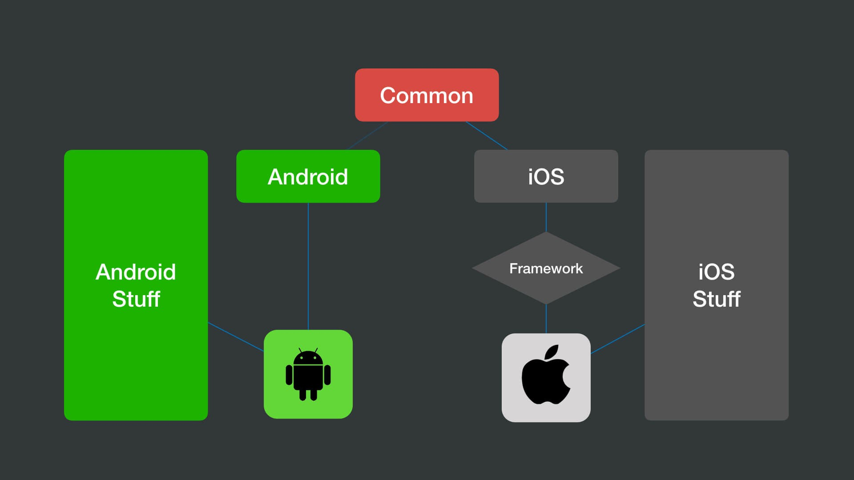
KMM MOBILE
COMMON: Code used by the platforms;
ANDROID/IOS: can use the common business logic but the UI is native.
Android configure the dependency with the gradle configuration, IOS as a framework.

Slide 6
KMM MOBILE
Limitations of using all iOS and Android features: Whenever a task cannot be solved in the shared code or whenever you want to use specific native features, you can use the expect/actual pattern to seamlessly write platform-specific code.
Performance issues – Shared code written in Kotlin is compiled to different output formats for different targets: to Java bytecode for Android and to native binaries for iOS. Thus, there is no additional runtime overhead when it comes to executing this code on platforms, and the performance is comparable to native apps.
Legacy code problems – No matter how large your project is, your existing code will not prevent you from integrating KMM. You can start writing cross-platform code at any moment and connect it to your iOS and Android Apps as a regular dependency, or you can use the code you’ve already written and simply modify it to be compatible with iOS.
Native – The presentation layer is native, no need to reimplement the UI or losing the power of the native components.

Slide 7
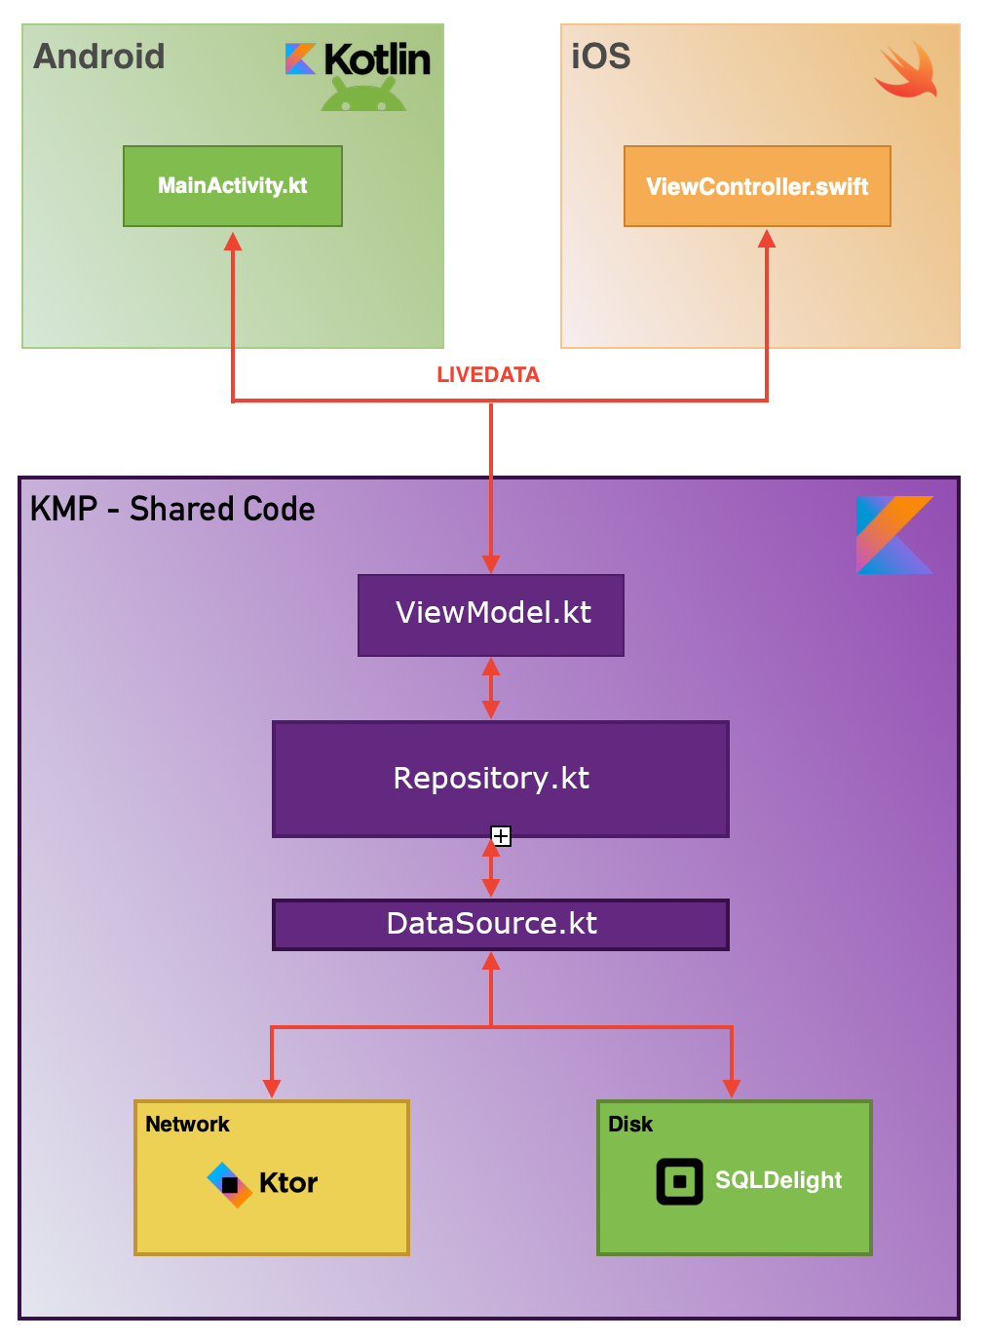
INTEGRATION WITH MVVM
NATIVE LAYER
KMM

Slide 8
DOCUMENTATION
Official Documentation for Mobile
Interesting MVVM Example
Ktor Mobile & Web

