Slide 1
Applikationsudvikling II
Lecture 3
Andrea Valente
aval@sdu.dk
https://portal.findresearcher.sdu.dk/en/persons/aval

Slide 2
Topics:
Chpt 6
inheritance,
abstract classes,
interfaces,
classes as types,
polymorphism

Slide 3
Chpt 6
We will look at:
how to create and use base classes
how to create and use derived classes
how access modifiers control inheritance
how to override base class methods
how to implement interfaces
how to implement polymorphism through inheritance and through interfaces

Slide 4
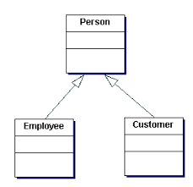
What is inheritance
DEF: The purpose of inheritance is to create a base class that encapsulates properties and methods that can be used by derived classes of the same type
One way to look at this is to consider the set of all possible objects of a class:
Person Instances
An object of class Person,
name=“Andrea”
name
Employee Instances
Customer Instances
An object of class Customer,
name=“Bob”, customId=123
job
customId
An employee IS A Person
An object of class Employee,
name=“Jim”, job=“accountant”

Slide 5
Single inheritance in C#
Object
In C# every class 1 and has exactly 1 base class
If your class does not inherit from any other class, it automatically inherits from the Object class
OR: every class in C# is derived from the Object class
OR: Object class acts as a root of the inheritance hierarchy in any C# Program
Dog
”Dog IS-A Object”

Slide 6
Creating Base and Derived Classes
Derived classes are not limited to the properties and methods of the base class
The derived classes may
require additional methods and properties that are unique to their needs
or override methods of their base class, to change/customize behavior
Let’s consider bank accounts:
You could create a base class Account. A GetBalance method is defined in the Account class.
You can then create two separate classes: SavingsAccount and CheckingAccount. Because the SavingsAccount class and the CheckingAccount class use the same logic to retrieve balance information, they inherit the GetBalance method from the base class Account. This enables you to create one common code base that is easier to maintain and manage.
The derived CheckingAccount and SavingsAccount classes would each need their own unique definition for a Withdraw method.

Slide 7
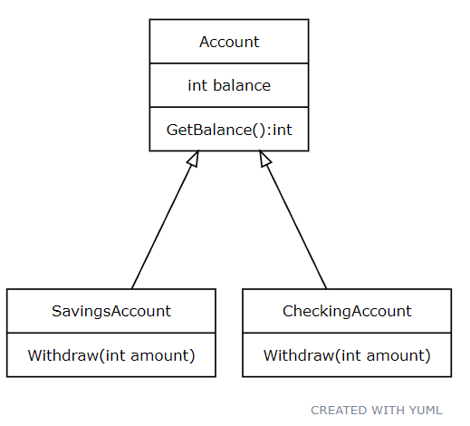
Let’s design and code these 3 classes
Using yuml [Account|int balance|GetBalance():int]
[Account]^[SavingsAccount|Withdraw(int amount)]
[Account]^[CheckingAccount|Withdraw(int amount)]
Create a new project and define these 3 classes
Add the right methods and the balance attribute
Add a constructor for the Account class, and in the constructor set the balance to 1000.
HINT: consider writing a main to test your classes
10-15 min

Slide 8
Using the classes: the main
Look at the main in my solution: code\Accounts_v1.cs
Then consider:
what is protected? Public/private/protected -> access modifiers
can I create an object from the Account class? Would that be useful?

Slide 9
Overriding the Methods of a base class
[book] says:
When a derived class inherits a method from a base class, it inherits the implementation of that method.
As the designer of the base class, you may want to let a derived class implement the method in its own unique way.
This is known as overriding the base class method
By default, a derived class can’t override the implementation code of its base class:
you must include the keyword virtual in the method definition
Let’s add a virtual method Deposit(amount) to the Account class, and implement a special version only for the CheckingAccount derived class. E.g. max 20.000.

Slide 10

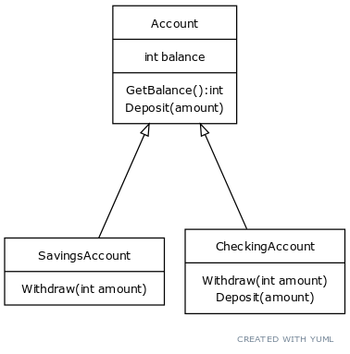
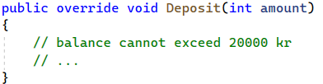
Using a new method before writing it
I would like to be able to write this code in the main:
CheckingAccount account = new CheckingAccount(); Console.WriteLine(account.getBalance()); // -> 1000
account.Deposit(200);
Console.WriteLine(account.getBalance()); // -> 1200
Make a copy of your project
Add the Deposit methods in the 2 classes (as in the UML on the right)
Change the main as above
10 min
Notes:
[Account|int balance|GetBalance():int;Deposit(amount) ]
[Account]^[SavingsAccount|Withdraw(int amount)]
[Account]^[CheckingAccount|Withdraw(int amount);Deposit(amount)]

Slide 11
Code example
Look at the main in my solution: code\Accounts_v2.cs
Then consider:
how does virtual/override work?
what happens if, in the main, I want to call Deposit() on an instance of SavingsAccount?
Note: in the SavingsAccount:Deposit() method I can call any public or protected method of the base class, including Account:Deposit() But the C# compiler must be able to tell which Deposit() I want to call, because if a method calls itself… #@%!
Notes:
access modifiers!

Slide 12

The advantages of inheritance
How would you add a new derived class SuperAccount?
a SuperAccount gives you 1 kr every time you Withdraw
a SuperAccount lets you deposit exactly as a normal Account
How much/what parts of your main code will you have to change to use a SuperAccount in your application?

Slide 13
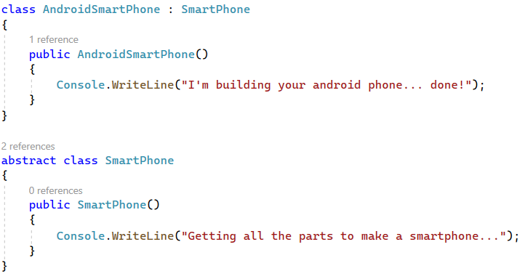
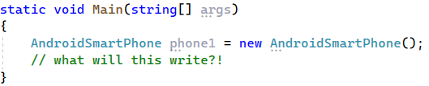
A note on constructors wrt inheritance
In a derived class […] the parameterless constructor, if there's one, is called implicitly
See also: https://learn.microsoft.com/en-us/dotnet/csharp/programming-guide/classes-and-structs/using-constructors
what?

Slide 14
Break
Questions so far?

Slide 15
Abstract class
In our previous example, we might decide that the Account class is really not there to create objects
But instead Account is useful because it defines a few attributes and methods (general methods) that we can inherit (and eventually override) in the derived classes
To enforce the idea that we don’t want to create instances of a class, we can declare that class abstract
new will not work anymore on that class
and I can also have methods that only have definition (signature) but no body -> so called abstract methods
A class with at least 1 abstract method must be declared an abstract class
https://www.geeksforgeeks.org/c-sharp-abstract-classes/

Slide 16
Account as an abstract class
Look at the main in my solution: code\Accounts_v3.cs
Then consider:
how does abstract/override work for a method?
what happens if the SavingsAccount class does NOT implement the abstract method Deposit()?
What is the point of having Account class, if it is abstract?
Notes:
access modifiers!

Slide 17
Interfaces == contracts
When you use an abstract class, classes that derive from it must implement its inherited methods.
You could use another technique to accomplish a similar result: define an interface
An interface is a contract that a class can decide to implement
Interfaces can't have a method body; they can only have the method signature.
Interfaces can have methods, properties, events, and indexes.
An interface can't be instantiated, so no object of an interface can be created.
One class can extend multiple interfaces (!!!)
Moreover:
Classes that implement an interface are contractually required to implement the interface signature definition and can’t alter it.
This technique is useful to ensure that client code using the classes knows which methods are available, how they should be called, and the return values to expect.

Slide 18
Example
See also https://www.w3schools.com/cs/cs_interface.php
Let’s say that I want all my accounts to be able to convert their balance to USA Dollars.
I can ”invent” an interface IConvertible and define a method/contract convertBalanceToUSD(excgRate), without body.
I can then make my Account class implement interface IConvertible, and implement the convertBalanceToUSD(excgRate) ->
In turn the 2 derived classes inherint an implementation of this method for free, from Account.
Look at code\Accounts_v4.cs
NOTE: by default, members of an interface are abstract and public. Naming conventions for Interfaces: Isomething-able

Slide 19
Advantages of using an interface(?)
[book] says:
Because implementing an interface and inheriting from an abstract base class are similar, you might ask why you should bother using an interface. One advantage of using interfaces is that a class can implement multiple interfaces.
The .NET Framework does not support inheritance from more than one class. As a workaround to multiple inheritance, the ability to implement multiple interfaces is included.
Interfaces are also useful to enforce common functionality across disparate types of classes.

Slide 20

What type is that value?
Usually you declare a variable with a type, then put a value of that type in the variable. E.g. :
int v = 5;
That works because 5 is an integer number: the types must be the same!
But we know that an object of class SavingsAccount is an Account, so can I write?
Account sa = new SavingsAccount();
And what is the type of the variable sa here?
… also: what methods can I then call on sa?

Slide 21
Compile-time and run-time type of a variable
In C# every class is a type (also interfaces).
A class is a reference type. Arrays in C# (int[] arr) are reference type too.
Here the compile-time type of the variable sa is Account, BUT the run-time type can be SavingsAccount.
After all you can only assign times that are the same… BUT a SavingsAccount IS an Account, by our own definition.
Account sa = new SavingsAccount();
memory
sa:Account
:SavingsAccount
balance = 1000

Slide 22

Polymorphism
[book] says:
Polymorphism is the ability of derived classes inheriting from the same base class to respond to the same method call in their own unique way.
This simplifies client code because the client code does not need to worry about which class type it is referencing, as long as the class types implement the same method interfaces.
Also: <<Polymorphism means "many forms", and it occurs when we have many classes that are related to each other by inheritance.>> [from https://www.w3schools.com/cs/cs_polymorphism.php ]
Which boils down to: List<Account> myAccounts = new List<Account>(); myAccounts.Add(new CheckingAccount()); myAccounts.Add(new SavingsAccount());

Slide 23
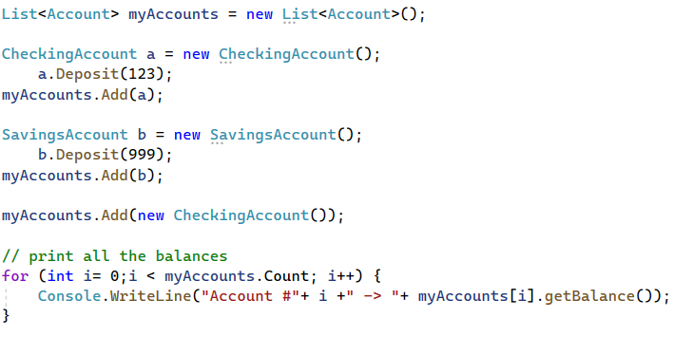
A List of Accounts
Look at code\Accounts_v5.cs
Now, thanks to polymorphism, I can write the following in the main:
Which version of Deposit() is used here?
What type is a?
What type is b?
And here?

Slide 24
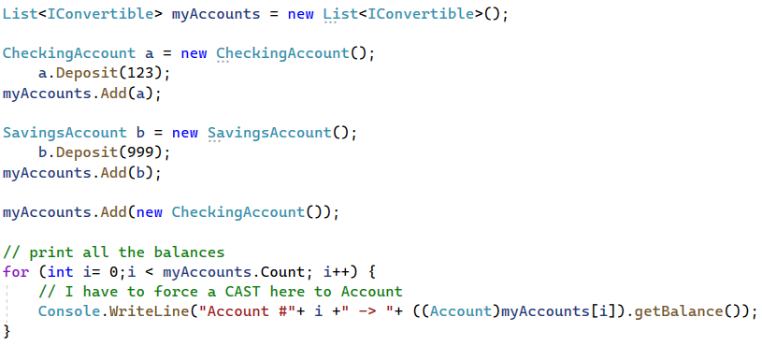
List< whatCanIPutHere? >
Look at code\Accounts_v5.cs
Wait… so any TYPE can go in List< T > ? Even an interface??
Why does this work?
What type is a now?
Why do I need a cast here?
still

Slide 25
Break
Questions so far?

Slide 26
Tasks for next time
(but you can start here, in groups if you like)

Slide 27
Write an interactive banking application
Make a new project, copy the code from code\Accounts_v5.cs
In the main I would like to do:
create an empty list of accounts
Then write a loop, where you ask the user to enter a text command
If the command is ”q” the loop exits and the program stops
If the user command is ”c”, ask the user if it will be a CheckingAccount or a SavingsAccount, then create the correct object and add it to your list
if the command is ”d”, ask for an index number and an amount, then go to the list at that index and deposit the amount into that account
if the command is ”w”, ask for an index number and an amount -> withdraw the amount from the account with that index
If the command is ”p”, print the balance of all accounts
When your program works as intended consider: how much would you have to change it, to add a new derived class of Account? Try implementing the SuperAccount we discussed earlier, and extend the ”c” command to include the option of creating a SuperAccount.
[Challenge] Implement ToString methods for all your derived classes. The ToString method of one of your classes should return some message to explain what type of account it is, and then the balance.

