Slide 1
Applikationsudvikling II
Lecture 13
Andrea Valente
aval@sdu.dk
https://portal.findresearcher.sdu.dk/en/persons/aval

Slide 2
Topics:
Unit testing in C#
with the MSTest framework https://learn.microsoft.com/en-us/dotnet/core/testing/unit-testing-with-mstest
Assertions
Test Driven Development
Examples and tasks

Slide 3
Unit testing
<<A Unit Test is a code written by any programmer which test small pieces of functionality of big programs.>>
[…] a "UNIT" in this sense is the smallest component of the large code part that makes sense to test, mainly a method out of many methods of some class.
Generally the tests cases are written in the form of functions that will evaluate and determine whether a returned value after performing Unit Test is equals to the value you were expecting when you wrote the function.
The main objective in unit testing is to isolate a unit part of code and validate its to correctness and reliable.
https://www.c-sharpcorner.com/article/a-basic-introduction-of-unit-test-for-beginners/

Slide 4
Why ”unit testing”?
Unit testing can increase confidence and certainty in changing and maintaining code in the development process.
Unit testing always has the ability to find problems in early stages in the development cycle.
Codes are more reusable, reliable and clean.
Development becomes faster.
Easy to automate.
https://www.c-sharpcorner.com/article/a-basic-introduction-of-unit-test-for-beginners/

Slide 5
The idea
Consider a simple console app. Say that you have a class
public class Baloon {
public string color = "red";
public void paintBlue() { color = "blue"; } }
You want to be sure your method works as you expect. In your main you can write a small test like:
Baloon b = new Baloon();
Console.WriteLine("this baloon is " + b.color);
b.paintBlue();
Console.WriteLine("this baloon is " + b.color);
Try it: code\example0 \Testing_a_Baloon_ver1.cs
Can you spot a problem with this approach?

Slide 6
A different way to test…
This is a bit like saying: <<I EXPECT the final color to be blue!>>
Baloon b2 = new Baloon();
b2.paintBlue();
string finalColor = b2.color;
if (finalColor!="blue") {
throw new Exception("ERROR! the finalColor should be blue");
} // else: nothing, it means the test was a success! Just continue...
Try it: code\example0 \Testing_a_Baloon_ver2.cs
Is this approach better? Why?

Slide 7
Structure of a unit testing program
Test class
Test method
Assertion
A test can contain a number of test classes ->
defined using the [TestClass] attribute
A test class can contain a number of test methods
defined using the [TestMethod] attribute
must have return type void
cannot have any parameters
A test method uses any number of assertions to verify that a certain method works as expected
<<An assertion is a test various conditions within unit tests. If the condition being tested is not met, an exception is thrown.>> See: https://learn.microsoft.com/en-us/dotnet/api/microsoft.visualstudio.testtools.unittesting.assert?view=visualstudiosdk-2022
Notes:
https://learn.microsoft.com/en-us/dotnet/api/microsoft.visualstudio.testtools.unittesting.assert?view=visualstudiosdk-2022

Slide 8
Unit testing in C#
Look at the code in code\example1, then
create a "unit test .NET" app
add a class BasicMaths. We want to test its methods…
from the menu -> tests -> run all tests -> get a report!
(test 4 will fail!)
Fix and test again
Then: write a new test -> test if calling the method Square(5) returns 25 NOTE: the Square(n) method does not exist yet, but you can start writing the test for it You might be FORCED to write a dummy implementation, e.g. always return 0
Test -> Fix and Test again …
From https://www.c-sharpcorner.com/article/a-basic-introduction-of-unit-test-for-beginners/
10
min

Slide 9
The Square function
My solution is in code\example2

Slide 10
Break
Questions so far?

Slide 11
Problem
Problem: implement a stack (without using arrays or List<>) * programming interview question! *
To solve it… introduce Test-Driven Development:
test fails
write code to make the test pass
Fix/change the code -> and … repeat

Slide 12
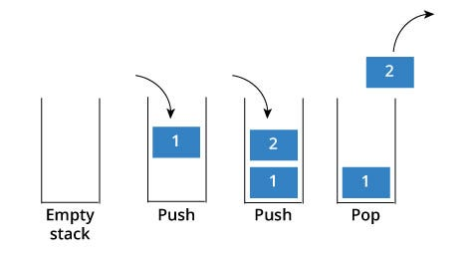
Stack – quick refresher

Slide 13
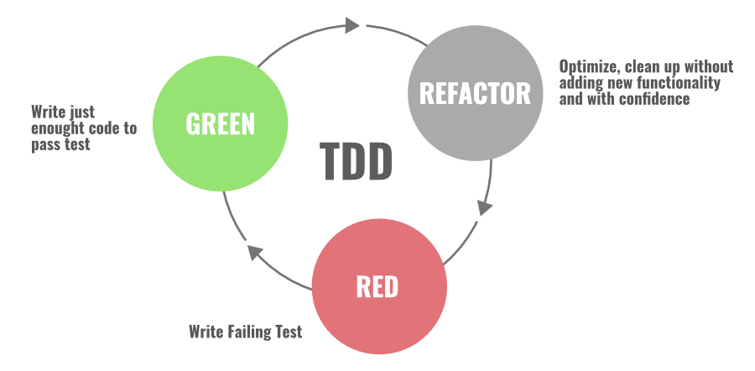
TDD
… is a software development process relying on software requirements being converted to test cases before software is fully developed, and tracking all software development by repeatedly testing the software against all test cases. [https://en.wikipedia.org/wiki/Test-driven_development#Test-driven_development_cycle]
start here
Figure from: https://www.geeksforgeeks.org/7-code-refactoring-techniques-in-software-engineering/

Slide 14
But… what to test?
For simplicity, let’s do a stack of int
Our problem is still: stack without using arrays or List<>
We need to test the following:
There should be a class MyStack
After creating a stack, the stack should be empty
It should be possible to push an element on the stack
After pushing an element on the stack, the stack should not be empty
When you pop an element from the stack, it is the last one pushed
Also: pop an empty stack should throw an exception
After pushing an element and then popping, the stack should be empty again
Pushing two elements (a and b) on the stack and then popping twice, the elements should come back inverted (as b and a)
It should be possible to toString the stack

Slide 15
Let’s start together…
Look at code\stack_test (1)
Create a new unit test .NET project
Copy/paste the code from (1) UnitTest1.cs class
Add a class MyStack and copy/paste the code as well
Can you run the tests? -> look at the report

Slide 16
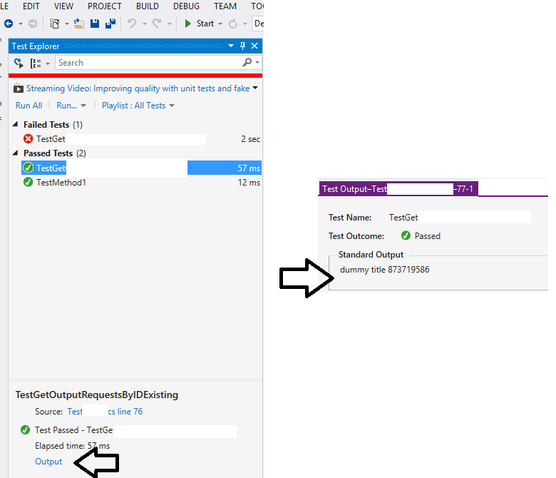
Console.WriteLine ??

Slide 17
Now…
To pass the first test:
There should be a class Stack
we can just define: class MyStack{}
Then we run the tests and see if the first passes ;)
Now, to pass:
After creating a stack, the stack should be empty
we need to add a method empty that returns true (at the very least…)
To implement the next: It should be possible to push an element on the stack
It should be possible to push an element on the stack
we need to decide how to implement the actual stack data-structure… But remember: you cannot use arrays!! ;)

Slide 18
TASK
You will finish coding the solution using my tests
Add your tests when needed
Remember:
Add a test to your suite of tests
Run the whole suite of tests
If any test fails -> fix the code (just the minimum to pass the tests, don’t try to be too clever! :D )
Repeat 2 and 3 until all tests pass
Then continue with the next feature you want to implement: start from point 1 again …
25
min
If you are really really stuck… use an arrary in the class MyStack to store the elements, and finish the task to pass the tests anyway ;)

Slide 19
Break
Questions so far?

Slide 20
Let’s look at your solutions…
;)

Slide 21
Tasks for next time
(but you can start here, in groups if you like)

Slide 22
TDD task
Problem: Write a function that given two arrays, (for example 1,2,3,4,5 and 2,3,1,0,5 ) returns an array with the numbers that are in the first array but not in the second array. Your function should have this signature:
missing(array1,array2) -> array3
E.g. result = missing( [1,2,3,4,5] , [2,3,1,0,5] )
console.log( result) // will print [4]
Implement a solution using TDD. Write your own tests and fix/change your code, until you are satisfied with your solution.
If possible, work in pairs!
Rest
of
time

