Slide 1
Applikationsudvikling II
Lecture 6
Andrea Valente
aval@sdu.dk
https://portal.findresearcher.sdu.dk/en/persons/aval

Slide 2
Topics:
How to organize controls on the main windows -> layout
WPF canvas -> drawing shapes
Procedural graphics
Timers and animation
Particles
Save to text file -> using a WPF file dialogue

Slide 3
Layouts in WPF
See https://wpf-tutorial.com/panels/introduction-to-wpf-panels/
Good practice:
Avoid fixed positions - use the Alignment properties in combination with Margin to position elements in a panel
Avoid fixed sizes - set the Width and Height of elements to Auto whenever possible
Layouts work very similarly to HTML’s box model
We can avoid defining a layout manually, thanks to WPF Panels!
Every type of panel has a built-in layout!

Slide 4
Layouts -> Panels
Types of panels (some):
Canvas
A simple panel, which mimics the WinForms way of doing things. It allows you to assign specific coordinates to each of the child controls, giving you total control of the layout. GOOD TO SHOW SHAPES!
WrapPanel
The WrapPanel will position each of its child controls next to the other, horizontally (default) or vertically, until there is no more room, where it will wrap to the next line and then continue. Use it when you want a vertical or horizontal list controls that automatically wraps when there's no more room.
Grid
The Grid is probably the most complex of the panel types. A Grid can contain multiple rows and columns. You define a height for each of the rows and a width for each of the columns, in either an absolute amount of pixels, in a percentage of the available space or as auto. USE IT… when you need multiple columns and often in combination with the other panels.

Slide 5
How to design and define a grid panel
See https://www.c-sharpcorner.com/UploadFile/1e050f/grid-layout-in-wpf/
First we should design it, with a wireframe: e.g.
Then we can define it, visually, in visual studio
canvas
btn

Slide 6
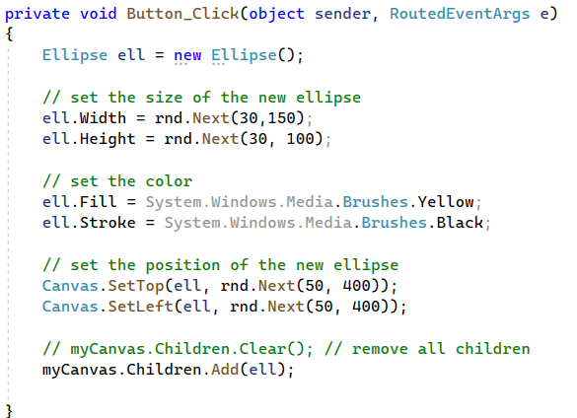
WPF canvas and shapes
Look at: code\DrawShapes_ver1.cs
And here: https://learn.microsoft.com/en-us/dotnet/desktop/wpf/controls/how-to-create-and-use-a-canvas?view=netframeworkdesktop-4.8
Try de-commenting this line…
Make the ellipses blue instead of yellow…
How can we create circles?

Slide 7
Clear and add different kinds of shapes
Look at: code\DrawShapes_ver2.cs
And here about shapes:
https://learn.microsoft.com/en-us/dotnet/desktop/wpf/graphics-multimedia/shapes-and-basic-drawing-in-wpf-overview?view=netframeworkdesktop-4.8
And rectangles: https://learn.microsoft.com/en-us/dotnet/api/system.windows.shapes.rectangle?view=windowsdesktop-7.0
Can you see why/how we this program uses polymorphism?

Slide 8
Animation
E.g. I would like the shapes in the canvas to wiggle a bit, as I add new shapes or clear the canvas…
Def of wiggle: move a bit around, every now and then…
How do we do this?

Slide 9
We need a timer
Very similar to JavaScript setTimeout
You need to create an object from class DispatcherTimer
Set how often it will tick
Set which method will be called at each tick -> add the method to the timer
Finally: start the timer :)
See also here: https://wpf-tutorial.com/misc/dispatchertimer/
Look at: code\DrawShapes_ver3.cs
Run the code, then look at the way the timer is used…
Slow down the wiggle effect,
Then change the code so only the rectangles wiggle. HINT consider obj.GetType() and typeof(ClassName)

Slide 10
Solution for: only rectangles…
if (s.GetType() == typeof(Rectangle))
{
// ...
}

Slide 11
Break
Questions so far?

Slide 12
A particle
The idea: https://en.wikipedia.org/wiki/Particle_system and https://processing.org/examples/simpleparticlesystem.html
A particle has a positon, a mass/size, and a velocity
A particle moves by adding the velocity (or a part of it) to its position, at every frame of the animation
The velocity changes if there is an acceleration: just add to the velocity
We can create a Particle class!
position = posX and posY
velocity = velX and velY
velX = velX + accX
velY = velY + accY
posX = posX + velX
posY = posY + velY

Slide 13
Particle class
We need to have properties
Which?
And methods
I would like a constructor to decide the initial pos and vel the particle
an update method to calculate a single movement
and perhaps a ToString to see where the particle is
Let’s do it together

Slide 14
Animate a particle
We need to create a WPF application
With a canvas
Then we define a Particle class with the right properties and methods; one of the methods should be update, that moves the particle
And we use a timer to animate, i.e. call update and draw a circle at the position of the particle, multiple times per second
Let’s do it together

Slide 15
Look at…
Now look and run:
code\Particles_ver1.cs
code\Particles_ver1.XAML
code\Particles_ver1_Particle.cs
When does this particle stop moving?

Slide 16
LifeSpan – stop the particle after a while
Now look and run:
code\Particles_ver2.cs
code\Particles_ver2.XAML
code\Particles_ver2_Particle.cs
Now the particle can only live 200 updates!

Slide 17
Many particles -> a list!
Now there is a list of particles…
Now look and run:
code\Particles_ver3.cs
code\Particles_ver3.XAML
code\Particles_ver3_Particle.cs
If you create more than 10 particles, it is a bit slow…
Why? How could we speed it up?

Slide 18
Ideas to speed-up
Do not clear the canvas -> instead:
draw the particles only the first time,
then just move them in the canvas
Avoid creating too many instances of Particle -> the garbage collector does not work too much! :)
I can have 100 particles now, and it is OK
Look at version 4

Slide 19
Conclusion
WPF is NOT for speed! :D
But it can be OK for a normal GUI and for turn-based games

Slide 20
Break
Questions so far?

Slide 21
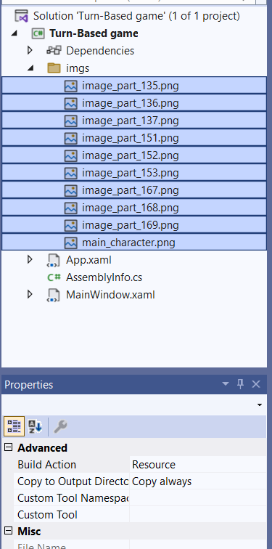
Let’s play and then look at …
Code\turn-based game
Note: images have to be set to ”copy to output directory” and Build Action ”resource”, then access it like this:

Slide 22
More info on images and grids
Using images: https://learn.microsoft.com/en-us/dotnet/desktop/wpf/graphics-multimedia/painting-with-images-drawings-and-visuals?view=netframeworkdesktop-4.8
The image control: https://wpf-tutorial.com/basic-controls/the-image-control/
Resources: https://social.technet.microsoft.com/wiki/contents/articles/53248.visual-studio-copying-files-to-debug-or-release-folder.aspx

Slide 23
Save/load to text file
Try the example in: code\SaveFile.cs
See also: https://wpf-tutorial.com/dialogs/the-savefiledialog/
https://wpf-tutorial.com/dialogs/the-openfiledialog/
https://wpf-tutorial.com/basic-controls/the-textblock-control/
It uses a WPF file dialogue, and saves a textblock to a text file
In the textbox -> accepts return property, set it to TRUE! Then you have a multi-line textbox :)

Slide 24
Break
Questions so far?

Slide 25
Q/As
Solution Vs Project
https://learn.microsoft.com/en-us/visualstudio/ide/solutions-and-projects-in-visual-studio?view=vs-2022
<<A project is contained within a solution. Despite its name, a solution isn't an "answer". It's simply a container for one or more related projects, along with build information, Visual Studio window settings, and any miscellaneous files that aren't associated with a particular project.>>

Slide 26
Tasks for next time
(but you can start here, in groups if you like)

Slide 27
Work on the game
Consider changing the turn-based game:
Add more gems
Make the level map different; e.g. make it larger and make 2 ”areas” with obstacles, so the player has to walk around a bit
Idea for a map editor:
Write the level map in a text file and load it in at the start of your game
Then create a second program that can read a level map text file, show it as a textbox, let the user change the map, and then save it back to another text file -> this will be your level editor
What could be a good text format to write and to edit a map?
Test the level editor by creating 2 different maps; then load and play each, to see if they work in your game
Notes:
https://www.tutorialspoint.com/how-to-empty-a-chash-list#:~:text=To%20empty%20a%20C%23%20list%2C%20use%20the%20Clear()%20method.

