Slide 1
Applikationsudvikling II
Lecture 14
Andrea Valente
aval@sdu.dk
https://portal.findresearcher.sdu.dk/en/persons/aval

Slide 2
Topics:
Code quality
Refactoring
The idea
When? -> ”code smells”
Kinds of refactoring, with examples

Slide 3
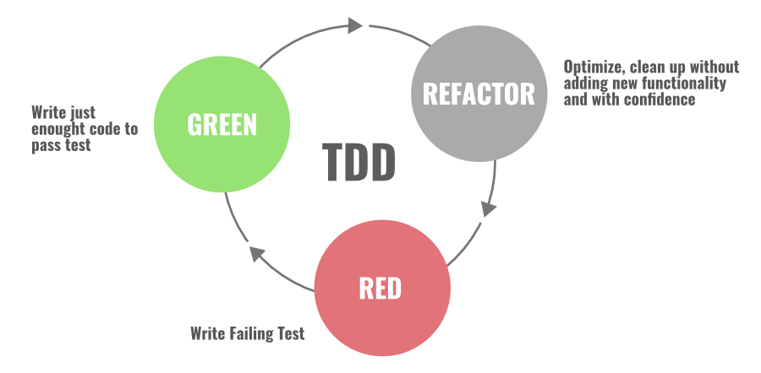
Assess the quality of your code
Thanks to the test suite we know that the solution to the stack problem works…
But… how good is a solution? -> quality measures/criteria

Slide 4

Code of good quality
Some measures/principles to ensure quality in the code
DRY: Don’t repeat yourself -> avoid copy/paste
KISS: Keep it simple, stupid -> low # statements in functions, and per line, and low cyclomatic complexity
EVAN principles of code quality:
Extract functions and modules to simplify interfaces -> work with modules/separate files and import them
Verify code behavior through tests -> use assertions (unit testing)
Avoid impure functions when possible -> functions should only work with their parameters, not alter global variables (more in next page…)
Name variables and functions well -> follow standards, like camelCase
Notes:
Javascript syntax standards
https://www.w3schools.com/js/js_conventions.asp

Slide 5
Impure/pure functions
Terminology
An impure function that has a side effect on a variable outside of its own scope.
A pure function doesn’t depend on and doesn’t modify the states of variables out of its scope.
Impure function:
int count = 0;
void increaseCount(int val) {
count += val;
}
increaseCount(10);
The pure version would be:
int count = 0;
void increaseCount(int counter,int val) {
return counter + val;
}
int count = increaseCounter(count,10);

Slide 6
Cyclomatic Complexity
Terminology
Cyclomatic Complexity measures the number of linearly independent paths through a program’s source code
For more details read: https://dev.to/igneel64/easing-into-cyclomatic-complexity-38b1
Cycl-complexity = 1 = 1 path
int a = 5;
int b = a * 10;
string w = Console.Read();
if (w==”ciao”){
Console.WriteLine(”!”);
} else {
Console.WriteLine(”?”);
}
Cycl-complexity = 2 = 2 paths

Slide 7
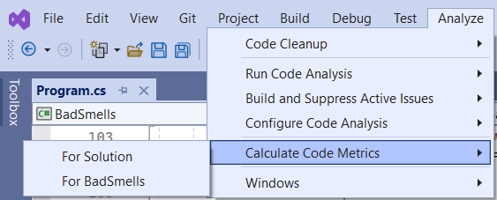
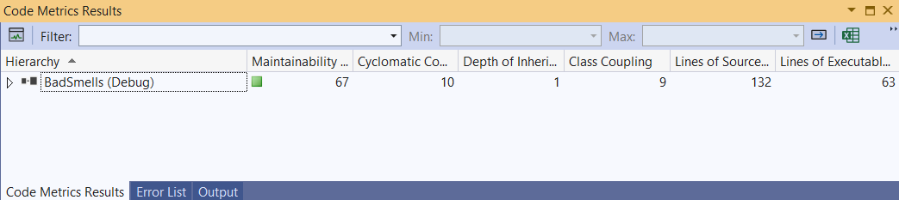
In Visual Studio…
Calculate some quality metrics

Slide 8
An example of bad coding…
Look at code\bad_smells -> create a new console app, copy/paste…
It works, but the quality is not that good…
(Q) What do you think is bad about this code?
…
10-15
min

Slide 9

Recognize bad quality: bad smells
How to know when your code is of bad quality?
“A code smell is a surface indication that usually corresponds to a deeper problem in the system” CodeSmell by Martin Fowler https://martinfowler.com/bliki/CodeSmell.html
We need:
to define a few bad smells by name and decide how we should recognize them in our JS code
and eventually how to fix them (hint: using refactoring)

Slide 10
Examples of bad smells (all present also in my code!)
Let’s check some of them… do they make sense?
(!) Very good list of bad smells (general) https://pragmaticways.com/31-code-smells-you-must-know/
Let’s consider a few:
Duplicate code: https://pragmaticways.com/31-code-smells-you-must-know/#2_Duplicate_Code
Long method/function: https://pragmaticways.com/31-code-smells-you-must-know/#8_Long_Method
Long param list: https://pragmaticways.com/31-code-smells-you-must-know/#9_Long_Parameter_List
Primitive obsession: https://pragmaticways.com/31-code-smells-you-must-know/#10_Primitive_Obsession
Magic numbers: https://pragmaticways.com/31-code-smells-you-must-know/#30_Magic_Numbers
Uncommunicative Name: https://pragmaticways.com/31-code-smells-you-must-know/#28_Uncommunicative_Name
Comments: https://pragmaticways.com/31-code-smells-you-must-know/#1_Comments
I also violated the EVAN principles: my functions are not pure :(
10
min
BUT REMEMBER: this code WORKS! So I don’t want to change its behavior, only the quality of the code!!
Notes:
“31 code smells all developers should be familiar with” -> https://pragmaticways.com/31-code-smells-you-must-know/

Slide 11
Break
Questions so far?

Slide 12
Improve quality: enter “refactoring”
(Def) Refactoring is way to change the code… BUT without changing the behavior of the code
How do you guarantee that behavior does not change?
by using tests (and version control)
your code must pass the same tests before and after you refactor it!
What is the point of changing the code if the behavior doesn’t change?
the point is to improve quality while preserving behavior
if the code was working OK -> no new errors can be added, but the code will have better quality (for example being more readable)
Notes:
From book http://refactoringjs.com/ [chpt 1]

Slide 13
Let’s fix my example ;)
To fix duplicate code: create a (pure) function with an appropriate name and params
To fix long method/function: simply split the function into a few smaller functions, with meaningful names (this also helps the Comments smell)
To fix magic numbers: declare constants or make the magic numbers dependent on the data or the inputs of the program
To fix Uncommunicative Name: :P
Rewrite all your functions as pure functions (i.e. avoid depending on global variables)
etc…
Ideally we fix one of these at the time, and each of this fixes does not change the behavior of the program. Create a new console app, copy/paste the code BadSmells.cs …
And … if I had tests for my program, I could have used them to be sure that each refactoring left the code behavior unchanged ;)
25-30
min
Notes:
Lint with: jshint.com

Slide 14
Fix bad smells one step at the time using refactoring
Implement a new user story or a new feature:
Write a group of tests to specify what your program/page will do
Add new code until all tests pass
Improve the quality of your code:
Detect bad smells (evaluate your code WRT some quality metrics)
Refactor your code, and run all tests to see that it still has the same behavior
Now your code is a deliverable version

Slide 15
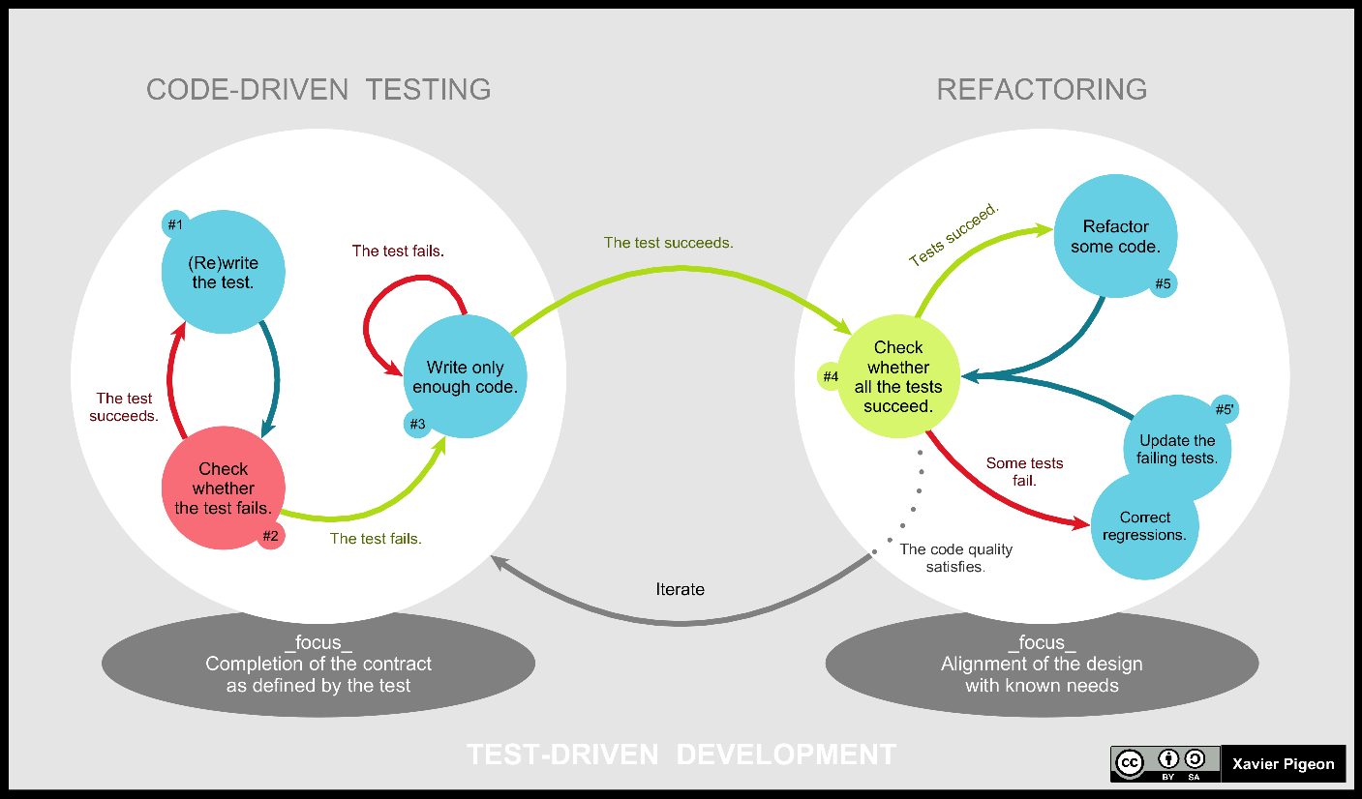
TDD the whole story…
https://en.wikipedia.org/wiki/Test-driven_development

Slide 16
Break
Questions so far?

Slide 17
We can also use refactoring with OOP
Change classes,
move/change methods,
even change the code so it becomes a desgin pattern
AKA ”refactoring to a design pattern”

Slide 18
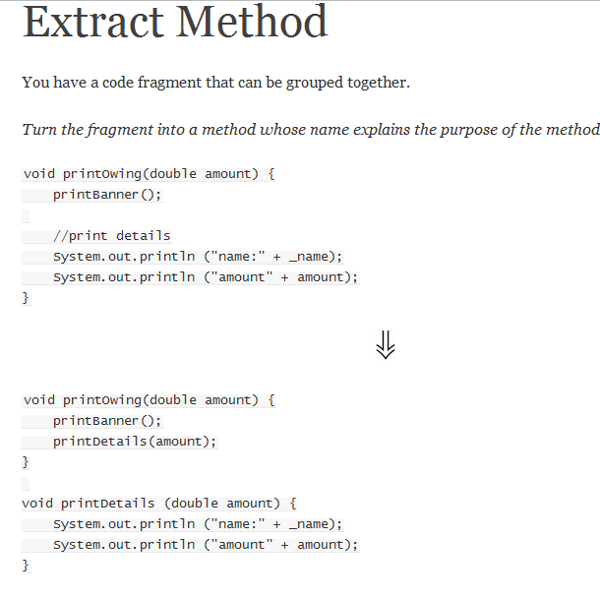
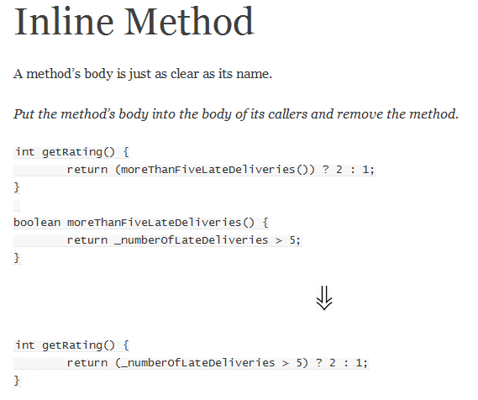
Sorry… the code is in Java… but not too far from C# :D
From: http://sourcemaking.com/refactoring

Slide 19
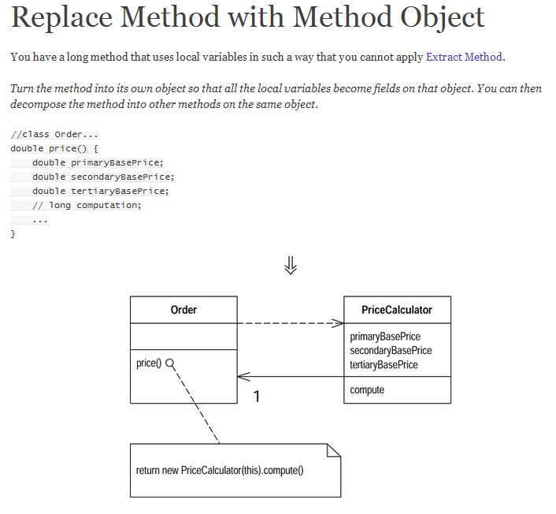
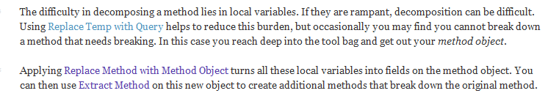
Can be seen as very simple version of the Strategy design pattern

Slide 20
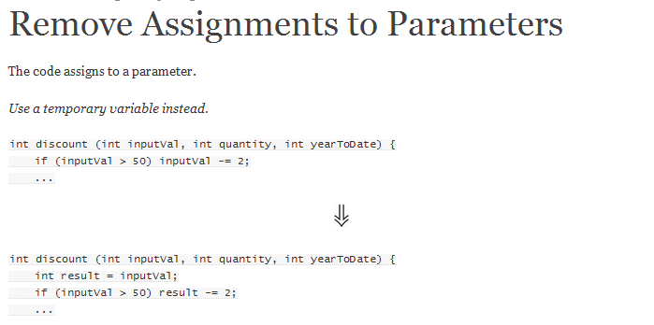
“The reason I don’t like this comes down to lack of clarity and to confusion between pass by value and pass by reference. Java uses pass by value exclusively (see later), and this discussion is based on that usage.
With pass by value, any change to the parameter is not reflected in the calling routine. Those who have used pass by reference will probably find this confusing.
The other area of confusion is within the body of the code itself. It is much clearer if you use only the parameter to represent what has been passed in, because that is a consistent usage.
In Java, don’t assign to parameters, and if you see code that does, apply Remove Assignments to Parameters.
Of course this rule does not necessarily apply to other languages that use output parameters, although even with these languages I prefer to use output parameters as little as possible.“
From: http://sourcemaking.com/refactoring/remove-assignments-to-parameters

Slide 21
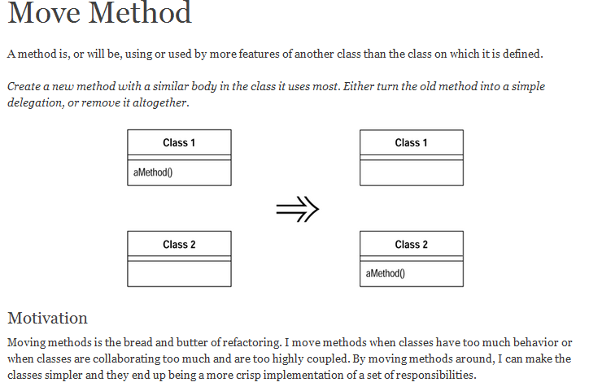

Slide 22
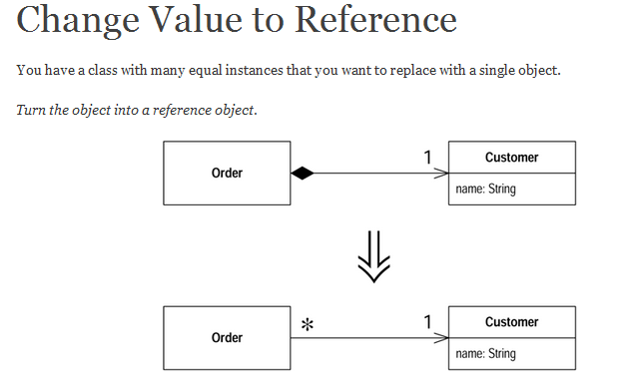
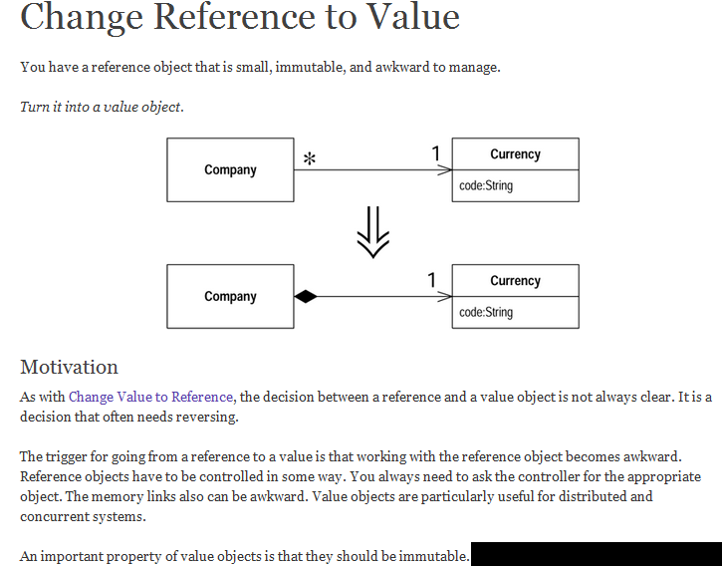
Basically: sharing Vs duplicating
And the other way around too: ...

Slide 23
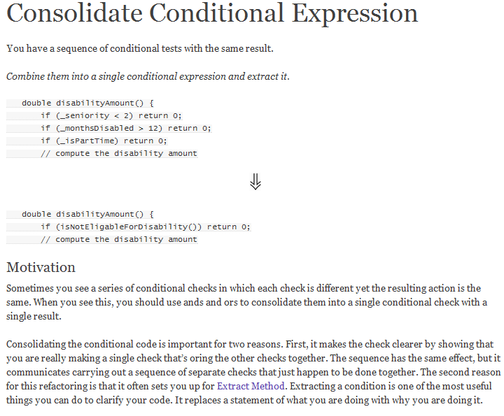


Slide 24
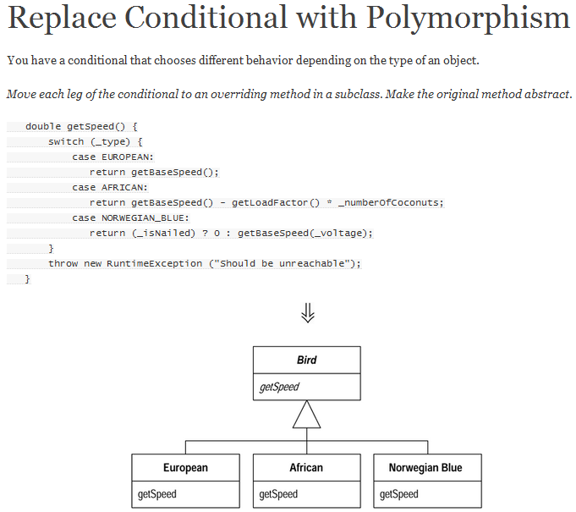
This changes a switch statement to a Strategy design pattern
Motivation
One of the grandest sounding words in object jargon is polymorphism. The essence of polymorphsim is that it allows you to avoid writing an explicit conditional when you have objects whose behavior varies depending on their types.
As a result you find that switch statements that switch on type codes or if-then-else statements that switch on type strings are much less common in an object-oriented program.
Polymorphism gives you many advantages. The biggest gain occurs when this same set of conditions appears in many places in the program. If you want to add a new type, you have to find and update all the conditionals. But with subclasses you just create a new subclass and provide the appropriate methods. Clients of the class don’t need to know about the subclasses, which reduces the dependencies in your system and makes it easier to update.

Slide 25
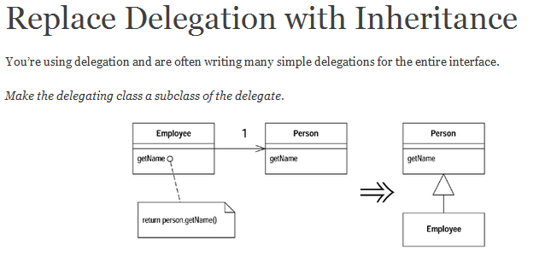
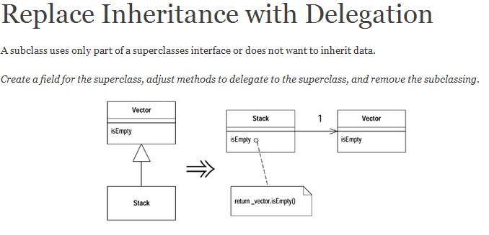
Motivation
This is the flip side of Replace Delegation with Inheritance. If you find yourself using all the methods of the delegate and are sick of writing all those simple delegating methods, you can switch back to inheritance pretty easily.
Remember the principle:
”favour composition over inheritance”? Sometimes you want to, sometimes you do not :D
Motivation
Inheritance is a wonderful thing, but sometimes it isn’t what you want. Often you start inheriting from a class but then find that many of the superclass operations aren’t really true of the subclass. In this case you have an interface that’s not a true reflection of what the class does. Or you may find that you are inheriting a whole load of data that is not appropriate for the subclass. Or you may find that there are protected superclass methods that don’t make much sense with the subclass.

Slide 26
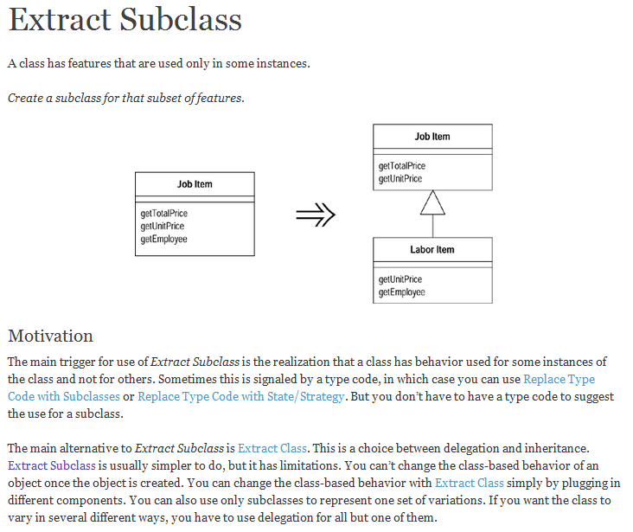

Slide 27
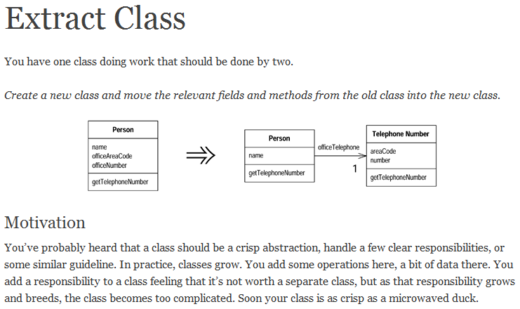

Slide 28
Break
Questions so far?

Slide 29
How to do these refactoring techniques in visual studio …
Extract a method
https://learn.microsoft.com/en-us/visualstudio/ide/reference/extract-method?view=vs-2022
Inline method
https://learn.microsoft.com/en-us/visualstudio/ide/reference/inline-method?view=vs-2022
Other examples
Extract base class
https://learn.microsoft.com/en-us/visualstudio/ide/reference/extract-base-class?view=vs-2022
Convert if statement to switch statement or switch expression
https://learn.microsoft.com/en-us/visualstudio/ide/reference/convert-if-statement-to-switch-statement-or-switch-expression?view=vs-2022
https://learn.microsoft.com/en-us/visualstudio/ide/refactoring-in-visual-studio?view=vs-2022

Slide 30
A good example :)
A nice, complete example of using desing patterns, with refactoring, in C#
https://medium.com/swlh/refactoring-for-clean-code-with-design-patterns-2d3d754c3bfe

