Slide 1
Applikationsudvikling II
Lecture 9
Andrea Valente
aval@sdu.dk
https://portal.findresearcher.sdu.dk/en/persons/aval

Slide 2
Topics:
Working with datatables & datasets [book page 172]
Use WPF and datasets
Read data from CSV file
Create data with Mockaroo (https://www.mockaroo.com/)
Then load from CSV file ;)
Put data into objects… => calculate something on the data
Save and load objects into a database:
AKA “mapping” objects to relational databases
Could we do this in a simpler/better/lazy way?!

Slide 3
Working with datatables & datasets
[from Book]
DataTables and DataSets are in-memory caches of data that provide a consistent relational programming model for working with data regardless of the data source.
A DataTable represents one table of relational data and consists of columns, rows, and constraints.
You can think of a DataSet as a mini relational database, which includes:
the data tables
and the relational integrity constraints between them.
If you are retrieving data from a single table, you can populate and use the DataTable directly without the overhead of creating a DataSet first.

Slide 4
How to create a DataTable and DataSet
There are several ways to create a DataTable or DataSet.
The most obvious method is to populate a DataTable or DataSet from an existing relational database management system (RDBMS) such as a SQL Server database.
[…] a DataAdapter object provides the bridge between the RDBMS and the DataTable or DataSet.
By using a DataAdapter object, the DataTable or DataSet is totally independent from the data source

Slide 5
Populating a DataTable from an SQL DB
To retrieve data from a database, you set up a connection with the database using a Connection object.
After […] you create a Command object to retrieve the data from the database;
if […] retrieving data from a single table […] you can populate and work with a DataTable directly without creating a DataSet object
The Load method of the DataTable fills the table with the contents of a DataReader object
See code\DataTable_example.cs
open: http://localhost/phpmyadmin/index.php?route=/database/sql&db=test123
Using the same DB we made last time: Test123, with Persons table
Notes:
How to insert a row: https://learn.microsoft.com/en-us/dotnet/framework/data/adonet/dataset-datatable-dataview/adding-data-to-a-datatable

Slide 6
We need 2 tables for the next example…
SELECT * FROM `shirts` WHERE 1create table shirts (
shirtID int NOT NULL AUTO_INCREMENT,
description varchar(255),
color varchar(50),
owner int NOT NULL,
PRIMARY KEY (shirtID),
FOREIGN KEY (owner) REFERENCES Persons(PersonID)
);
insert into shirts (shirtID,description,color,owner)
VALUES (null,"a terrific hawaiian shirt","multicolor",1);
insert into shirts (shirtID,description,color,owner)
VALUES (null,"a sad shirt","gray",1);
insert into shirts (shirtID,description,color,owner)
VALUES (null,"a t-shirt with yellow flowers","blue",2);
Try:
SELECT LastName,description FROM persons INNER JOIN shirts ON Persons.PersonID=shirts.owner;

Slide 7
Populating a DataSet from an SQL DB
== mini DB
[book]
When you need to load data into multiple tables and maintain the referential integrity between the tables, you need to use the DataSet object as a container for the DataTables.
To retrieve data from a database and fill the DataSet, you
set up a connection with the database using a Connection object.
[…] you create a Command object to retrieve the data from the database,
and then create a DataAdapter to fill the DataSet, setting the previously created Command object to the SelectCommand property of the DataAdapter.
Create a separate DataAdapter for each DataTable.
The final step is to fill the DataSet with the data by executing the Fill method of the DataAdapter.
See : code\DataSet_example.cs

Slide 8
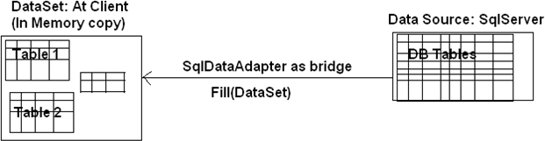
DataSet is a cached version of the DB data…
See https://www.c-sharpcorner.com/uploadfile/61b832/sqldataadapter-fill-method/
Note: sometimes we use variables that are declared as var type
https://www.c-sharpcorner.com/UploadFile/5ef30d/var-keyword-in-C-Sharp-programming/

Slide 9
Editing Data in the DataSet
[book]
Clients often need to be able to update a DataSet.
They may need to add records, delete records, or update an existing record.
Because DataSet objects are disconnected by design, the changes made to the DataSet are not automatically propagated back to the database.
They are held locally until the client is ready to replicate the changes back to the database.
To replicate the changes, you invoke the Update method of the DataAdapter, which determines what changes have been made to the records and implements the appropriate SQL command (Update, Insert, or Delete) that has been defined to replicate the changes back to the database.
See/run: code\DataSet_example2.cs -> note: is the connection open?!
5
min

Slide 10
Break
Questions so far?

Slide 11
Use WPF and datasets => datagrid control!
https://wpf-tutorial.com/datagrid-control/introduction/
First we just use a DataGrid to show a list of objects…
Look at code\WPF_DataGrid_ver1.cs and XAML

Slide 12
Populate a DataGrid from DB
https://stackoverflow.com/questions/16964093/binding-dataset-to-datagrid-in-wpf
Now we can load data from a SQL table -> show it!
Look at code\WPF_DataGrid_ver2.cs and XAML
What happens when you change the data in the DataGrid?
Is the DB changed? How?
Another way is described here: https://www.c-sharpcorner.com/article/load-datagridview-from-database-c-sharp/

Slide 13
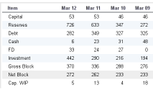
Generate A LOT of data automatically…
Create data with Mockaroo (https://www.mockaroo.com/)
“Mockaroo allows you to quickly and easily to download large amounts of randomly generated test data based on your own specs which you can then load directly into your test environment using SQL or CSV formats”
Look at: code\mockaroo\MOCK_DATA.csv
Mockaroo
Export .csv
C# + WPF
Load/show

Slide 14
Import from CSV
Read data from CSV file!
See code\LoadFromCSV.cs
Load… into what?
Creating lists of objects from CSV data

Slide 15
Calculating some statistics
Average and Variance/standard deviation of … family name length
https://www.coderslexicon.com/variance-and-standard-deviation-of-an-array-in-c/
Relation between avg and std dev: https://www.statology.org/excel-plot-mean-and-standard-deviation/
Min/Max. Calculate and print the min and max length of first names
https://www.c-sharpcorner.com/interview-question/find-the-minimum-and-maximum-element-in-an-array-in-c-sharp
Count occurrences of email domains. E.g.
mlaurentyn@fda.gov and mnittiff@fda.gov are both from the fda.gov domain
Calculate and print a list of all distinct email domains, and how many times each domain is present in the data set
15
min
Notes:
To count occurrences, consider using a dictionary:
https://stackoverflow.com/questions/8459928/how-to-count-occurrences-of-unique-values-in-dictionary
https://www.tutorialsteacher.com/csharp/csharp-dictionary

Slide 16
Break
Questions so far?

Slide 17
How to? Objects to/from DB…
Ideas???

Slide 18
Terminology and problems
“mapping” objects to relational databases
A C# class is similar to a DB table …
ORM
https://en.wikipedia.org/wiki/Object%E2%80%93relational_mapping

Slide 19
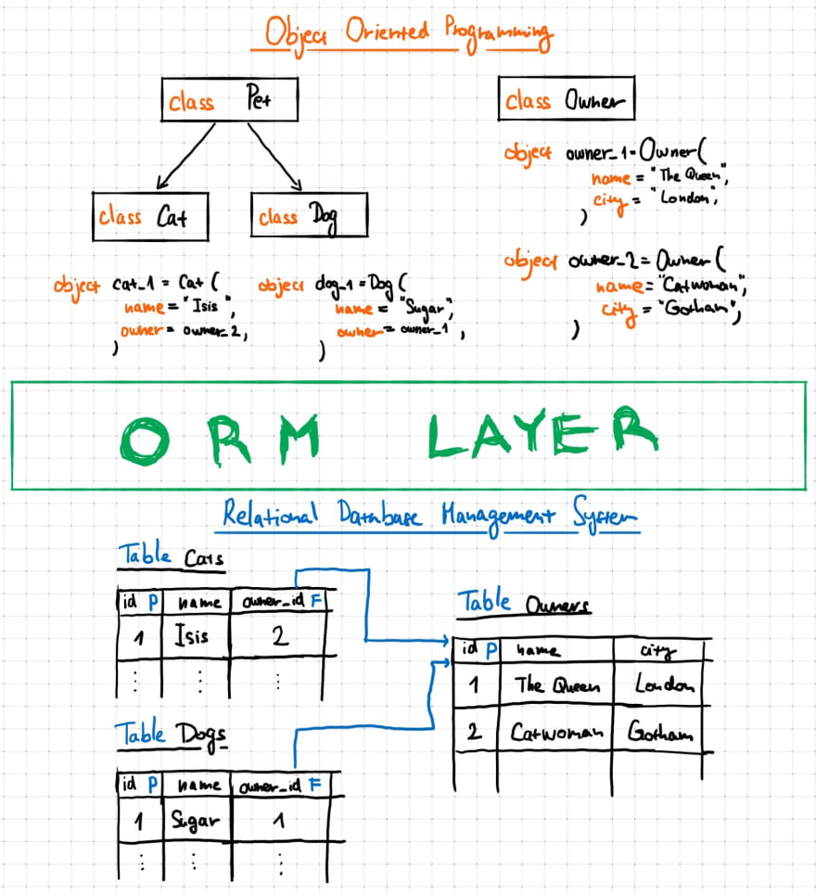
How would that look in code?
Serialize objects
Perhaps with an INTERFACE IPersistent and a couple of methods Save and Load
We could take a class (say Product from a previous task)
Design and implement the interface IPersistent
Create a DB with a table, for storing the Product objects
Show how to save and load objects to the DB
… in the main of the application
?

Slide 20
BUT…
Could we do this in a simpler/better/lazy way?!
Sure… next time we will see/use the Entity Framework

Slide 21
Tasks for next time
(but you can start here, in groups if you like)

Slide 22
Finish the turn based game from last time…
In SQL design and implement a database with a table to store data from your objects
E.g. you could have a Jags table, where you store the amount of water in a list of jugs. Each row could be a jug
Or it could be the information about where the boxes and the character are, in a level of sokoban, so that you can stop and restart playing the game just with the data you have your table
In your game: write a Save method that can dump the state of your game when you close the application.
Then write a Load method, that reads data from the table in SQL, and creates the right objects in your application. Call this method when you application starts. If the table is empty, initialized the objects to default values (e.g. the initial configuration of your jugs).
Rest of the time

