Slide 1
Applikationsudvikling II
Lecture 8
Andrea Valente
aval@sdu.dk
https://portal.findresearcher.sdu.dk/en/persons/aval

Slide 2
Topics:
Install SQL
Configure the SQL server
Create a DB with a table
Connect to it via C# -> Book pages 161-164
CRUD operations

Slide 3
How to proceed… (1)
Look at https://www.c-sharpcorner.com/article/connect-mysql-with-c-sharp-net-framework-in-visual-studio-2019/
We need an SQL server
Download and install XAMPP
https://www.apachefriends.org/
It contains a local HTTP server, and an SQL server too
Run, just keep all the default settings, and install

Slide 4
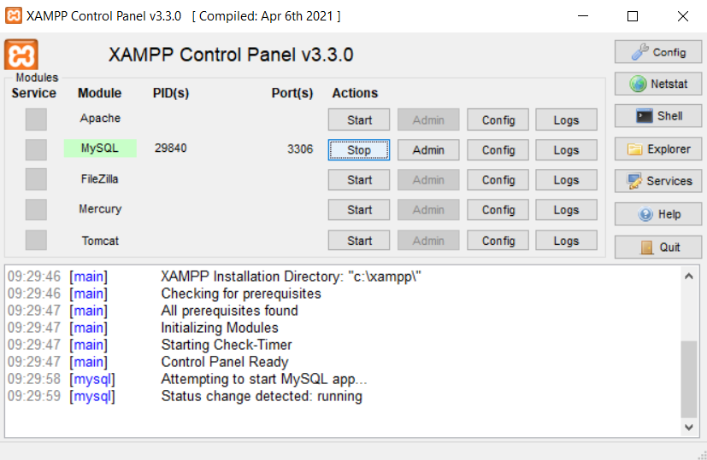
(2)
We can setup/start the SQL server
Then start Apache
And open in the browser:
http://localhost/phpmyadmin/

Slide 5
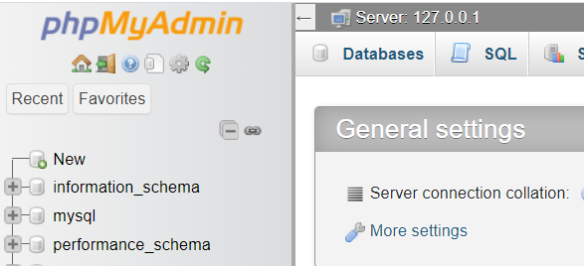
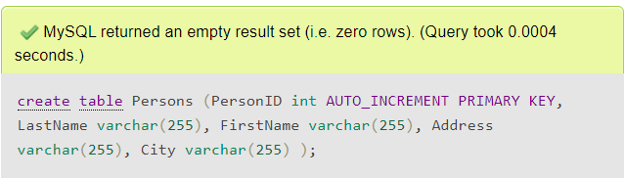
(3)
Create a database
Click on “databases” tab
Create a DB, call it “test123”
Then create a table: “people”
Click on the “SQL” tab, and enter this code:
And click GO
create table Persons (
PersonID int AUTO_INCREMENT PRIMARY KEY,
LastName varchar(255),
FirstName varchar(255),
Address varchar(255),
City varchar(255) );

Slide 6

…
Insert some data in the table
TASK: add 5 more people to the table
INSERT INTO Persons (PersonID,LastName,FirstName,Address,City)
VALUES (null,'Valente','Andrea','MyPlace','Odense’);
SELECT * FROM Persons;
5
min

Slide 7
(4)
Now we can try to connect to the SQL sever, in a C# console application
Look at code\SQL_connection_v1.cs run and see the results…
Did your program connect with the XAMPP server?
Could you read the data in the table?
NOTE: you might be asked to find and install a few packages… do that ;)
Try a few different SELECTs…
Does everything work as you expect?

Slide 8
Break
Questions so far?

Slide 9
We are using ADO.NET
ADO.NET -> see book page 161
Let’s read: https://www.c-sharpcorner.com/UploadFile/18fc30/understanding-the-basics-of-ado-net/
<<To access and work with data in a consistent way across […] various data stores, the .NET Framework provides a set of classes organized into the System.Data namespace. This collection of classes is known as ADO.NET.>>
ADO.NET is highly scalable -> to achieve scalability ADO.NET works with a disconnected model: a connection is made to the database, the data and metadata are retrieved and cached locally, and the connection is closed. This means ADO.NET does not keep the line busy ;)
ADO.NET works across many databases, in the same way -> interoperability – “easily exchange data back and forth regardless of the implementation technologies of the various systems.”

Slide 10
What is happening in the code?(!)
Connection object -> page 162-163
Command execution -> page 164
How are the results read…
Try-catch, exceptions (?)
https://www.w3schools.com/cs/cs_exceptions.php

Slide 11
The DataReader Object
Book page 166
<< A DataReader object accesses data through a forward-only, read-only stream. Oftentimes, you will want to loop through a set of records and process the results sequentially without the overhead of maintaining the data in a cache. >>
Usage: After declaring an object of type MySqlDataReader, you instantiate it by invoking the ExecuteReader method of a Command object. The Read method of the DataReader object accesses the records returned.

Slide 12
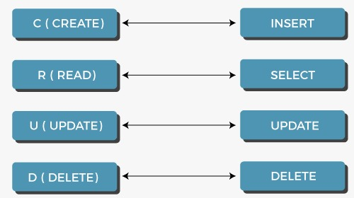
CRUD operations
Reading stuff is OK, but we need to be able to do also…
Create -> AKA write
Read
Update
Delete
SQL

Slide 13
How to perform many operations
We might want to perform a few operations in sequence, to the database, e.g. read and update some rows
For this, we could use a series of commands, execute them, and read a response after every command, OR…
We could decide to prepare a list of commands to execute, and place them in a special object, then run them all, one after the other
ADO.NET has an object like that: a DataAdapter object.
Notes:
https://www.c-sharpcorner.com/article/dataadapter-in-C-Sharp/

Slide 14
A DataAdapter object
<<The purpose of the DataAdapter is embedded in its name: It performs the activities necessary to get the data from the data source on the server into the database that's held in the DataSet. To do that, the DataAdapter lets us specify the commands that should be carried out to retrieve and update data.>> [From https://www.c-sharpcorner.com/article/dataadapter-in-C-Sharp/ ]
<<[The DataAdapter] provides four properties that allow us to control how updates are made to the server:
SelectCommand, UpdateCommand, InsertCommand, and DeleteCommand.
The four properties are set to Command objects that are used when data is manipulated.>>
More next time…
Notes:
We need to talk about DataSets and DataTables, to see the advantages of using a DataAdapter.

Slide 15
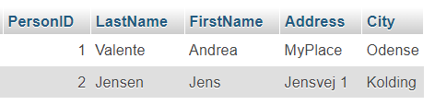
Some CRUD operations…
Look at code\SQL_crud.cs
Insert … but in C#
To do an Insert / Update / Delete use:
connection.Open();
command.ExecuteNonQuery();
For SELECT to show data from database use:
connection.Open();
command.ExecuteReader();

Slide 16
Design and implement a DB with 2 tables
15 min
A table should have data about a character in an RPG videogame
E.g. ”Asroth the butcher”, Worrior, level 25, can split a skull with 1 blow, …
The second table should contain items that belong to the characters in the first table.
E.g. ”BlueSteel”, 2-handed sword, cost 1000 coins, weight 12000 grams, belongs to Asroth
Decide about the columns, their name and type, and about the key. You might need to have a foreign key in the second table.
Create the table, using SQL
See: https://www.w3schools.com/sql/sql_foreignkey.asp

Slide 17
Now: access the DB via C#
Populate the 2 tables with a few data… Or consider writing a short progat that populates the tables with random data; you could use a for loop to enter multiple data in one table at the time.
Be careful with keys and foreign keys ;)
Show/Console.writeline the contents of the 2 tables, aggregated.
E.g. Character … bla … bla … bla Item … bla bla … Item … something something … Character … another one … bla … Item … something else …
Compute and show some totals and averages on your data. E. g. Total weight of the items for each character, and average cost of an item in table 2.
15 min

Slide 18
Break
Questions so far?

Slide 19
Tasks for next time
(but you can start here, in groups if you like)

Slide 20
Connect to a DB in a WPF application
Make a WPF front-end for your RPG characters DB
Use one or 2 textboxes to show the contents of the 2 tables
Use the IsReadOnly property to make the textbox non-editable (see here: https://wpf-tutorial.com/basic-controls/the-textbox-control/ )
Make a simple form to add an item, for an existing character. When you “submit” the data from your form, it should be saved in the second table of the DB.
After each new item is added, refresh the textboxes, so that they show the “current” state of both tables
Rest of the time

