Slide 1
Applikationsudvikling II
Lecture 7
Andrea Valente
aval@sdu.dk
https://portal.findresearcher.sdu.dk/en/persons/aval

Slide 2
Practice lecture Use anything from previous lectures
Work in pairs – I will come around and discuss/help you
We will make a small game. Options:
Implement a graphical program to play with the 3 jugs puzzle: def and possible solution https://www.wikihow.com/Solve-the-Water-Jug-Riddle-from-Die-Hard-3
[CHALLENGE] Remake 1 level of SOKOBAN (see/play https://sokoban.info/?1_1 )

Slide 3
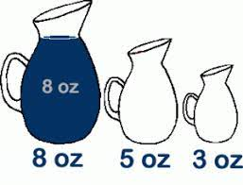
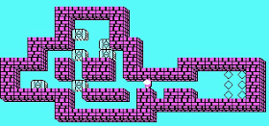
You will work like this:
Write a description of the problem
Perform a verb-noun analysis to find possible classes, attributes, methods, and relation (inheritance and/or association)
Design the classes you need in your app -> UML class diagram
Design your GUI -> wireframe (or take a snapshot of the GUI editor in visual studio)
Code your solution as a WPF app
Test/play it
Extra: save/load levels, or save/load best scores
Rest of the time

Slide 4
Next time
We will start with working on SQL connection

