Slide 1
Applikationsudvikling II
Lecture 11
Andrea Valente
aval@sdu.dk
https://portal.findresearcher.sdu.dk/en/persons/aval

Slide 2
Topics:
Design Patterns
With examples and tasks

Slide 3
Design Patterns and Christopher Alexander
The main idea behind design patterns is to extract the high level interactions between objects and reuse their behaviors from application to application.
Inspired by an architect: Christopher Alexander. He was interested in architectural design and how to define quality in buildings:
Each pattern describes a problem which occurs over and over again in our environment, and then describes the core of the solution to that problem, in such a way that you can use this solution a million times over, without ever doing it the same way twice. [from A Timeless Way of Building]
Check: Christopher Alexander: An Introduction for Object-Oriented Designers
https://www.patternlanguage.com/bios/douglea.htm

Slide 4
Pattern Description
Purpose / Intent:
What does the pattern do? What design problem does it solve?
Structure:
A graphical representation of the classes & interfaces comprising the pattern
Consequences:
What are the trade-offs?
Implementation:
What important implementation details are not obvious?
Sample Code
Related Patterns:
What design patterns are similar? What are the key differences? With which other patterns should this pattern be used?

Slide 5
Classification
Creational: how objects can be created.
Creational patterns create objects for you, rather than having you instantiate objects directly. This gives your program more flexibility in deciding which objects need to be created for a given case.
Structural: how classes and objects can be combined to form larger structures.
Structural patterns help you compose groups of objects, such as complex user interfaces or accounting data.
Behavioral: objects that handle particular types of actions within a program.
Behavioral patterns help you define the communication between objects in your system and how the flow is controlled in a complex program.
[from GOF]

Slide 6
Design Principles
The fundamental reason for using design patterns:
keep classes separated and prevent them from having to know too much about one another -> reduce the propagation of changes!
Principles:
Find what changes and encapsulate it
Program to an interface and not to an implementation
Favour object composition over inheritance

Slide 7
Example
1
*
Cat
Application
meow()
1
Dog
bark()
1
Mouse
squik()
Consider:
What goes on in the application?
How the 3 methods are called
What if, later, we are required to implement a new kind of pet?
With a different sound?!

Slide 8
Program to an interface and not to an implementation
1
*
Cat
Application
meow()
1
Dog
bark()
1
Mouse
squik()
1
Pet
*
vocalize()
Application
Cat
Dog
Mouse
vocalize()
vocalize()
vocalize()
{... “squik” ...}

Slide 9
Favour object composition over inheritance
How?
Inheritance: what an object from a class is
Composition: an object has another object (as a part…)
Consider:
add 2 more races in (1) vs in (2) …
1
2
GameCharacter
GameCharacter
Gender
Male
Female
VS
Race
Male
Female
…
Human
Elf
Human
Elf

Slide 10
A lot of patterns...
According to GOF:
Behavioral patterns
Interpreter
Observer
State
Strategy
...
Creational patterns
Abstract factory
...
Structural patterns
Facade
Composite
Bridge
...
See also:
https://www.dofactory.com/net/design-patterns

Slide 11
Break
Questions so far?

Slide 12
An example: Strategy pattern
Print in N ways: normal(1) vs strategy pattern
*
1
Person
Application
name, ...
printA()
printB()
...
... sort by name ...
... sort by familyName ...

Slide 13
An example: Strategy pattern
Print in N ways: normal(2) vs strategy pattern
*
1
Person
Application
name, ...
print(way)
printA()
printB()
...
switch(way)
case 1 : { ... printA() ... }
case 2 : { ... printB() ... }
...

Slide 14
An example: Strategy pattern
1
*
Person
Application
name, ...
print(way)
printA()
printB()
...
switch(way)
case 1 : { ... printA() ... }
case 2 : { ... printB() ... }
...
Print in N ways: normal vs strategy pattern
PrintingStrategy
PrintingContext
strategy
strategy = pr
print(Person[] p)
setPrinting(
PrintingStrategy pr)
print()
PrintingA
PrintingB
strategy.print()
Application
1
print(Person[] p)
print(Person[] p)
...
... sort by name ...
pc.print()
*
Person
... sort by familyName ...
name, ...

Slide 15
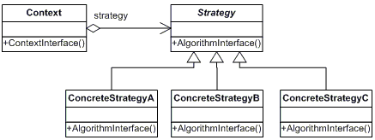
Strategy pattern - description
Def: Define a family of algorithms, encapsulate each one, and make them interchangeable. Strategy lets the algorithm vary independently from clients that use it.
https://www.dofactory.com/net/strategy-design-pattern
Another way to look at this:
methods are encapsulated into objects of the Strategy class, so they can be changed at run-time

Slide 16
Task1
Create a console app
Copy the code from code\task1\task1.cs
Solve the problem described in the main: finish the code so that it works ;)
15
min

Slide 17
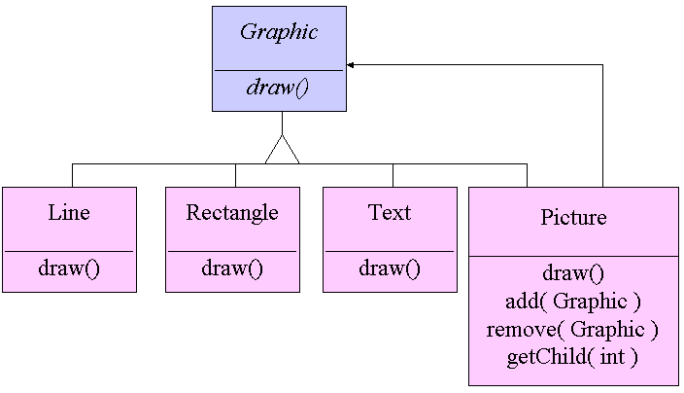
Composite
Intent: Compose objects into tree structures to represent part-whole hierarchies. Composite lets clients treat individual objects and compositions of objects uniformly.
An example:

Slide 18
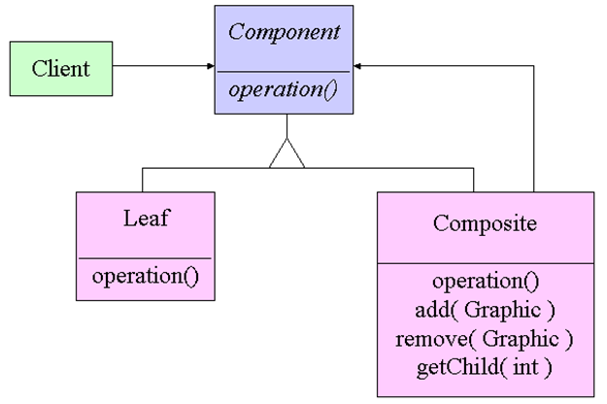
Composite - general structure
Another example: consider a File System with folders and documents...
https://www.dofactory.com/net/composite-design-pattern

Slide 19
Part
*
name
print()
Motherboard
DVDPlayer
Machine
1
print()
print()
print()
Add(…)
Remove(…)
ChildAt(index)

Slide 20
Task 2
Look at folder code\task2
Create a console app
Copy/import all files from the folder code\task2
Solve the problem described in the main: look at the classes, and use the Composite design pattern to make the code more modular
15
Min
(together)

Slide 21
Break
Questions so far?

Slide 22
Another example of object composition over inheritance
How can we connect all these classes in a hierarchy?
What about WholeMeal-
PizzaMargherita?
Focaccia
price
PizzaMargherita
price
mozzarellaQt
PizzaProsciutto
price
mozzarellaQt
hamQt
WholeMealFocaccia
price

Slide 23
Another example of object composition over inheritance
How can we connect all these classes in a hierarchy?
What about WholeMeal-
PizzaMargherita?
1
ItalianItem
price
getPrice()
Focaccia
price
PizzaMargherita
price
mozzarellaQt
Focaccia
PizzaDecorator
1
item
PizzaProsciutto
price
mozzarellaQt
hamQt
ExtraMozzarella
ExtraProsciutto
mozzarellaQt
hamQt
WholeMealFocaccia
price
Integrale

Slide 24
How does that work?
1
ItalianItem
price
getPrice()
getPrice()
Focaccia
PizzaDecorator
item
1
:Integrale
item =
ExtraMozzarella
ExtraProsciutto
mozzarellaQt
hamQt
:ExtraMozzarella
Integrale
item =
:Focaccia
This is an example of the decorator pattern
https://www.dofactory.com/net/decorator-design-pattern

Slide 25
Tasks for next time
(but you can start here, in groups if you like)

Slide 26
Task 3
Look at folder code\task3
Create a console app
Copy/import both files from the folder code\task3
Solve the problem described in the main: look at the classes, and use the Decorator design pattern to finish the code, so the main can run
Rest
of
time

Slide 27
Robots
1
Role
BasicRobot
AttackRobot
Finder
Reparator
role
1
movement
1
Move()
1
WaysOfMoving
Movement.doSomething()
doSomething()
2x strategy
… better but no combinations
Walker
Flyier
Diver

Slide 28
Robots
Robot
1
Move()
BasicRobot
1
Decorator
Move()
AttackRobot
Finder
Reparator
Decorator: also combinations
Walker
Flyier
Diver
Move()

