Slide 1
Applikationsudvikling II
Lecture 10
Andrea Valente
aval@sdu.dk
https://portal.findresearcher.sdu.dk/en/persons/aval

Slide 2
Topics:
AKA “mapping” objects to relational databases
Could we do this in a simpler/better/lazy way?!
YES: using the Entity Framework (book p181-190)
define EF, ideas and terminology
model first and Code First
EXAMPLES DO NOT WORK on my machine… possibly vs2022 does not integrate mysql / bugs being fixed :(
What is LINQ?
example of LINQ without DB
How to…
Complete example

Slide 3
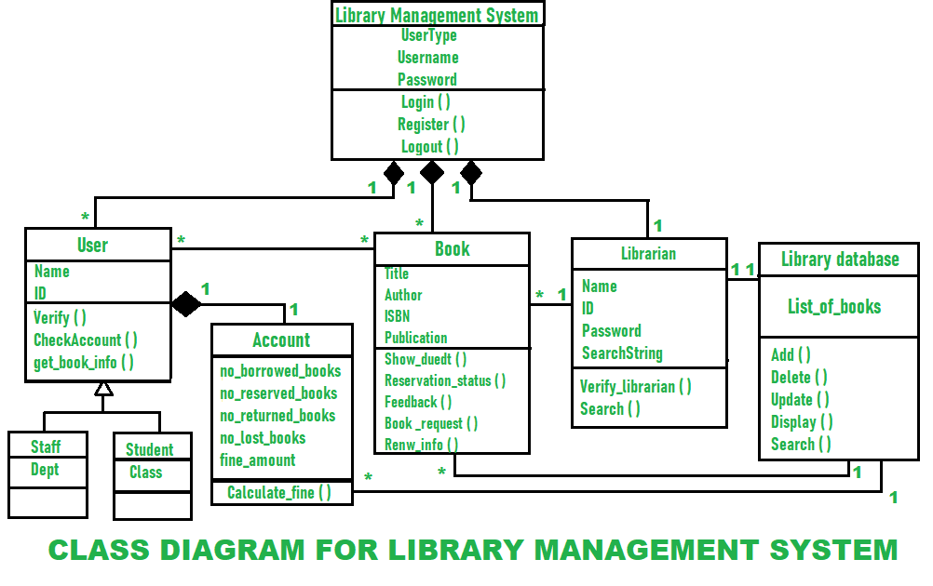
First… the problem
Let’s say we are implementing an application to manage a library
During our analysis we have decided to have all these classes:
Problem: how to store the data about books and users in a SQL database?
Notes:
Diagram from: https://www.geeksforgeeks.org/class-diagram-for-library-management-system/

Slide 4

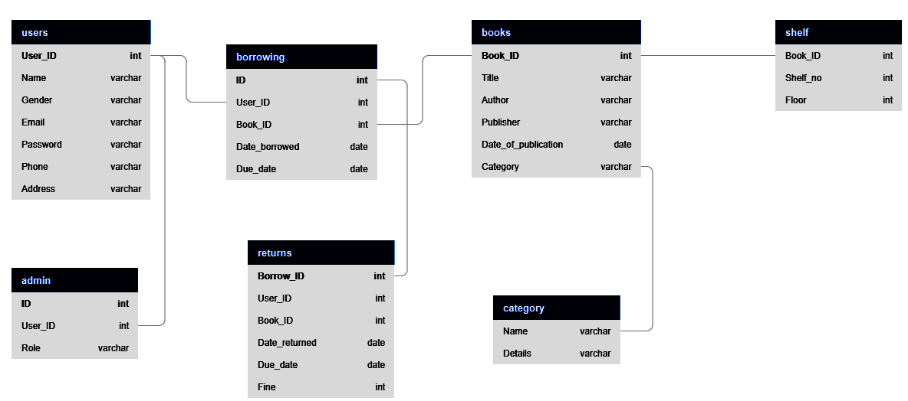
OOP ≠ tables

Slide 5
More problems…
Another example [book]:
[…] to load and work with a customer object, a developer has to send a SQL string to the database engine.
This requires the developer to be familiar with the relational schema of the data.
In addition, the SQL is hardcoded into the application and the application is not shielded from changes in the underlying schema.
Another disadvantage is that since the application sends the SQL statements as a string to the database engine for processing, Visual Studio can’t implement syntax checking and issue warnings and build errors to help with programmer productivity

Slide 6

Perhaps there is a better way… ;)

Slide 7
Entity Framework
[book]
The Entity Framework (EF) is an Object-Relational Mapping (ORM) technology built into ADO.NET.
EF eliminates the mismatch between the objected-oriented programming constructs of the .NET language and the relational data constructs of the database system.
EF provides the mapping schema that allows programmers to work at a higher level of abstraction.
They can write code using object-oriented constructs to query and load the entities (objects defined by classes).
The mapping schema translates the queries against the entities into the required database-specific language needed to perform CRUD (create, read, update, and delete) operations against the data.

Slide 8
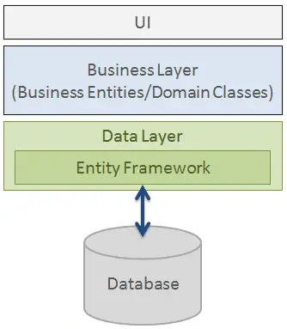
Architecture
From: https://www.entityframeworktutorial.net/what-is-entityframework.aspx , https://www.entityframeworktutorial.net/EntityFramework-Architecture.aspx
“Entity Framework is an object-relational mapper (O/RM) that enables .NET developers to work with a database using .NET objects. It eliminates the need for most of the data-access code that developers usually need to write.”

Slide 9
Development Approaches with EF
There are 3 different approaches you can use:
Database-First
Code-First
Model-First
From https://www.entityframeworktutorial.net/choosing-development-approach-with-entity-framework.aspx

Slide 10
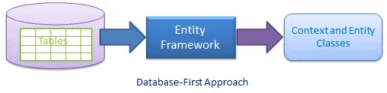
Database-First
you generate the context and entities for the existing database, using the EDM wizard integrated in Visual Studio
You can also: reverse engineer a model from an existing database
The model is stored in an EDMX file (.edmx extension) and can be viewed and edited in the Entity Framework Designer
See: https://learn.microsoft.com/en-us/ef/ef6/modeling/designer/workflows/database-first

Slide 11
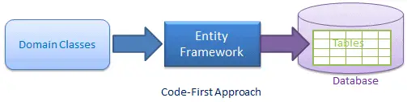
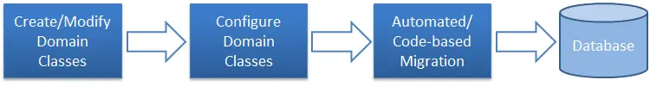
Code-First
Use it when you do not have an existing database for your application
In the code-first approach
you start writing your entities (domain classes)
and context class first
and then create the database from these classes

Slide 12
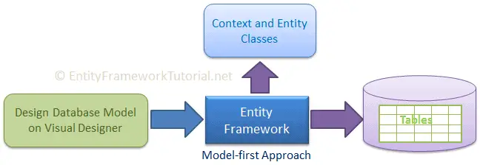
Model-First Approach
you create entities, relationships, and inheritance hierarchies directly
on the visual designer integrated in Visual Studio
and then generate entities, the context class, and the database script from your visual model

Slide 13
An example…
From: https://learn.microsoft.com/en-us/ef/ef6/modeling/code-first/workflows/new-database
But… it does not work on my machine…
I have problems with configuring SQL and visual studio to work together ☹
Sorry…

Slide 14
1) Create a few classes: AKA the model
public class Blog
{
public int BlogId { get; set; }
public string Name { get; set; }
public virtual List<Post> Posts { get; set; }
}
public class Post
{
public int PostId { get; set; }
public string Title { get; set; }
public string Content { get; set; }
public int BlogId { get; set; }
public virtual Blog Blog { get; set; }
}
A blog has many posts
A post has an ID, a title and some contents
A blog also has an ID and a name
Context
Blog
1
*
Post
Save(…)
SaveBlog(…)
SavePost(…)
LoadBlog(…)
LoadPost(…)
Load(…)
Save(…)
Load(…)

Slide 15
2) Create a DbContext object: the context
“Once you have a model, the primary class your application interacts with is System.Data.Entity.DbContext (often referred to as the context class).”
A DbContext object is used to associate the model to:
Write and execute queries
Materialize query results as entity objects (AKA convert!)
Track changes that are made to those objects
Persist object changes back on the database
Bind objects in memory to UI controls (e.g. when a WPF DataGrid shows some data)
From: https://learn.microsoft.com/en-us/ef/ef6/fundamentals/working-with-dbcontext

Slide 16
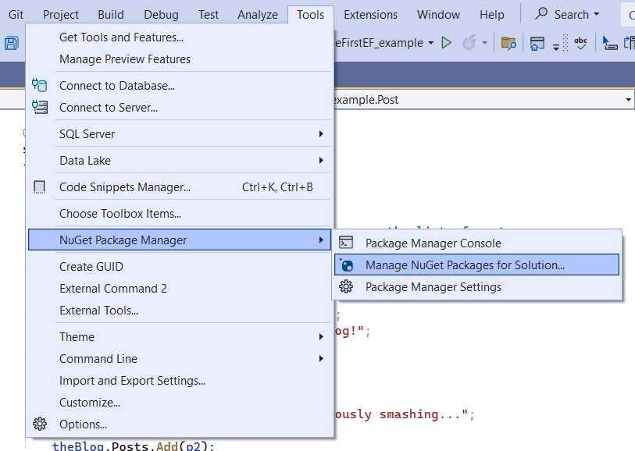
2B) Install the Entity Framework package
Before we can add a context to our C#, we need to install the EF package
See here for details: https://learn.microsoft.com/en-us/ef/ef6/modeling/code-first/workflows/new-database#3-create-a-context
Browse and install: Entity Framework Core

Slide 17
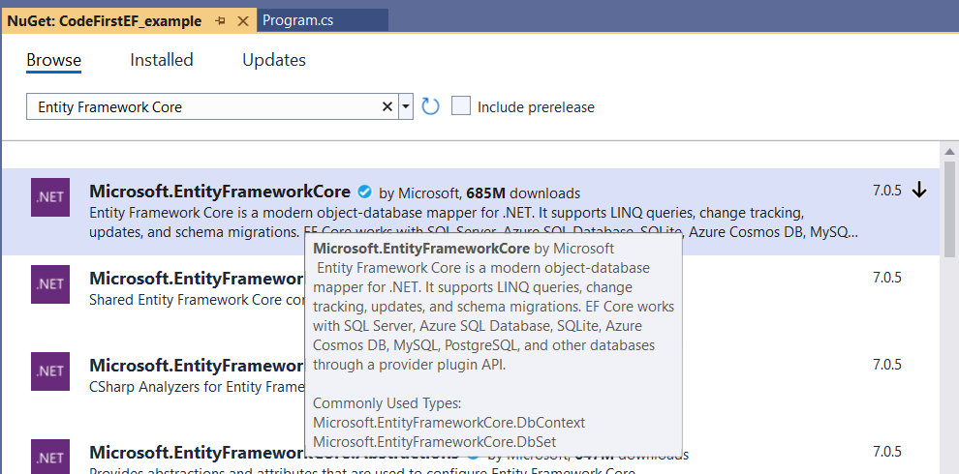
EF core
Accept
and install

Slide 18
2C) Add a DbContext class to the code
In C# this looks like:
using Microsoft.EntityFrameworkCore;
public class BloggingContext : DbContext {
public DbSet<Blog> Blogs { get; set; }
public DbSet<Post> Posts { get; set; }
}
We did not specify which DB to use… so this code will not run :(
Look at: code\CodeFirst_ver2.cs

Slide 19
Done -> it should work (but for me it doesn’t)
Look at code\CodeFirst_ver1.cs and code\CodeFirst_ver2.cs
Question: where is the data stored?
https://learn.microsoft.com/en-us/ef/ef6/modeling/code-frst/workflows/new-database#wheres-my-data
This is where I cannot make it work :(

Slide 20
Break
Questions so far?

Slide 21
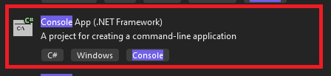
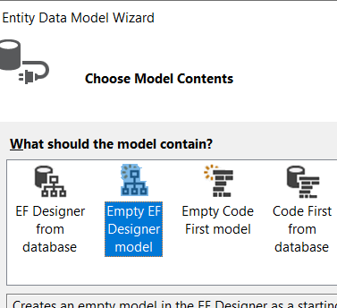
Model-first
https://learn.microsoft.com/en-us/ef/ef6/modeling/designer/workflows/model-first
Create a new console .net app!!
Create a model: how? Project -> Add new item -> Data -> ADO.NET Entity Data Model Call it: BloggingModel and click FINISH

Slide 22
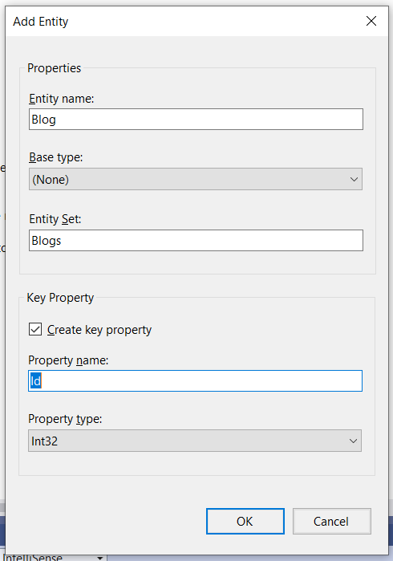
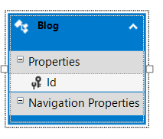
…
We are creating
a table!
Right click on the surface: Add new Entity -> fill the data

Slide 23
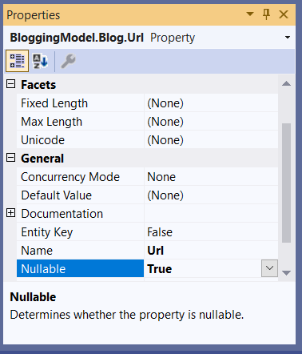
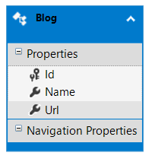
…
Now right click on Properties -> add scalar (AKA a number) -> Name
Then -> add scalar -> Url and right click Url -> change properties -> make it nullable

Slide 24
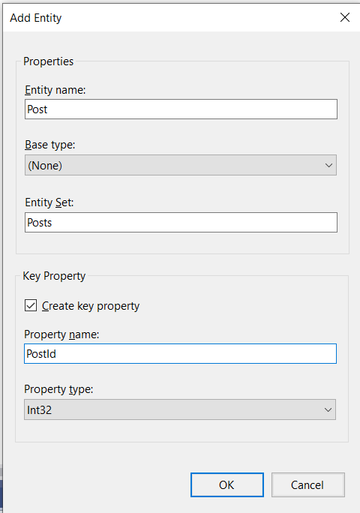
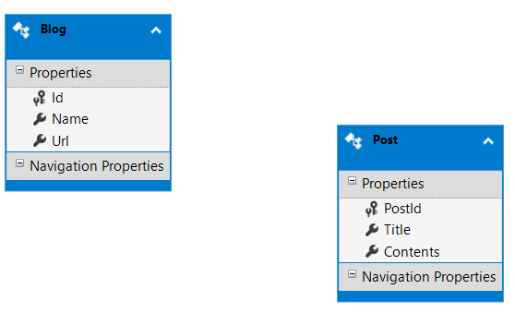
…
Now we can add a Post entity
with a PostId key property
and add Title and Content scalar properties

Slide 25
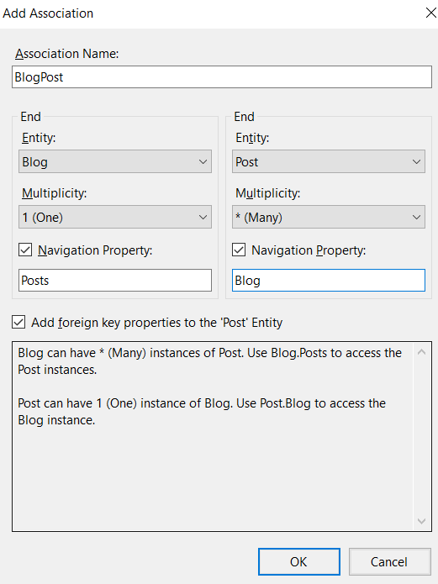
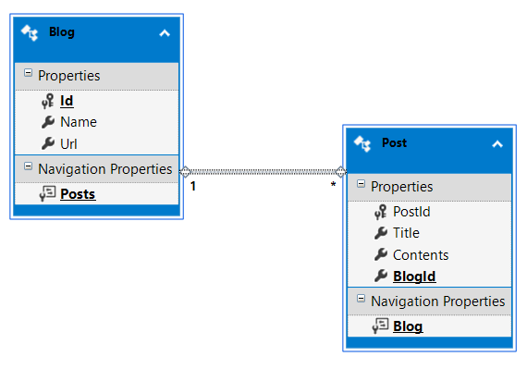
Adding assiciations
We need a 1-to-many association between Blog and Post entities
right click -> add association

Slide 26
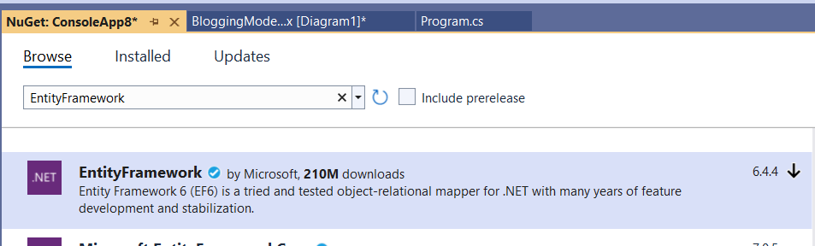
From these entities: auto-generate a DB!
Go to project -> manage NuGet packages -> install Entity Framework

Slide 27
…
Now on the entity designer window: right click -> Generate Database from Model
This is where I cannot make it work :(
Some sources online say that there are some versioning problems with visual studio 2022 and MySQL …

Slide 28
Break
Questions so far?

Slide 29
LINQ
The previous example used some strange-looking code…
That was LINQ code
https://www.tutorialsteacher.com/linq/what-is-linq

Slide 30
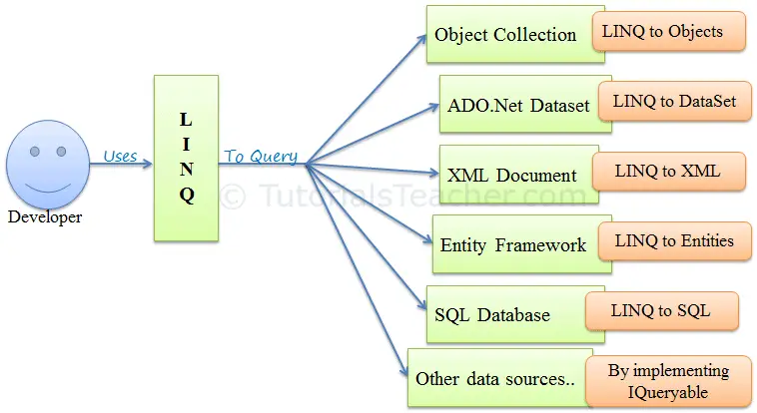
Language-Integrated Query (LINQ)
LINQ is a powerful set of technologies based on the integration of query capabilities directly into the C# language
LINQ Queries are the first-class language construct in C# .NET
SQL is a Structured Query Language used to save and retrieve data from a database
In the same way, LINQ is a structured query syntax built in C# and VB.NET to retrieve data from different types of data sources such as collections (not just SQL DBMS!)

Slide 31

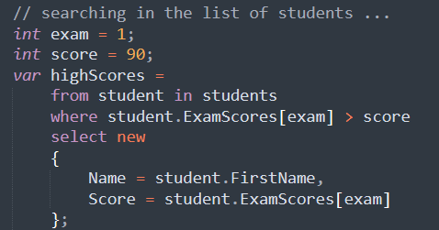
How does that work?
See code\LINQ_example1.cs
And https://www.tutorialsteacher.com/linq/what-is-linq ”LINQ Query to Array”
The look at: code\LINQ_example2.cs https://learn.microsoft.com/en-us/dotnet/csharp/linq/query-a-collection-of-objects
LINQ works only with structured data, like objects, not on tables…
So LINQ cannot work with SQL connections created manually, from a connection string and connection object,
It works only if there is a DbContext, AKA a context for the data source
Returns an iterable collection, like a List.
Each element is a new object with name and score.
Change the example2 code:
select only students with grade 92 or more, in the first exam

Slide 32
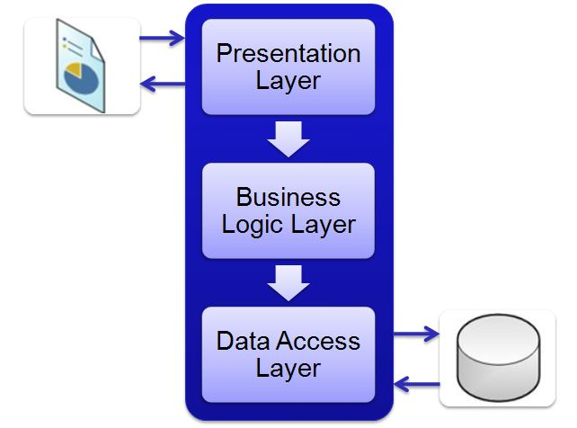
3-tier architecture
The typical three layer architecture in C# has 3 layers:
Presentation layer -> GUI, e.g. made in WPF
Business or logic layer -> actual data and operations
Data layer -> connect with the DB and perform CRUD operations
See example in (+)
From (+): https://www.c-sharpcorner.com/UploadFile/dacca2/understand-3-tier-architecture-in-C-Sharp-net/
Alternative: https://www.codeproject.com/Articles/36847/Three-Layer-Architecture-in-C-NET-2

Slide 33
Tasks for next time
(but you can start here, in groups if you like)

Slide 34
Task – 3tier application
Look at folder code\task
Starting from the classes in PeopleAndDogs.cs:
Create a WPF C# application,
in the constructor of the main window: create a list of 2 objects of class Person (*).
Then in the visual editor place a DataGrid, and use it to show your list of pople
Add also a textbox and a button ”add person” below the DataGrid; when you press the button, it adds a new person called like the textbox says.
Every time a new person is added, the DataGrid should refresh and show the new list of people
Now: (IN SQL) define a database ”storage” with only 1 table for the people in your application
the table should have the same attributes as the objects in your class
Go back to your WPF app and add database connection to the ”storage” DB,
Create a DataManager class, and write a Load, AddOne, and Save methods. The Load should connect to the DB, read the entire table, and return a list of Person objects; the Save takes a list of Person objects and removes all rows in the table, then inserts all the data from all Person objects in the list. The AddOne method should take a single instance of Person and insert it in the table.
Change the code, so when you add a new person to your list, a method inserts a new row in the table
Change your code, so that when your application starts, it uses a SELECT to build the initial list of people (*) from the DB table
Rest of the time

