Slide 1

Agile udvikling – Spring 2023 Lecture 02
Andrea Valente
aval@sdu.dk

Slide 2
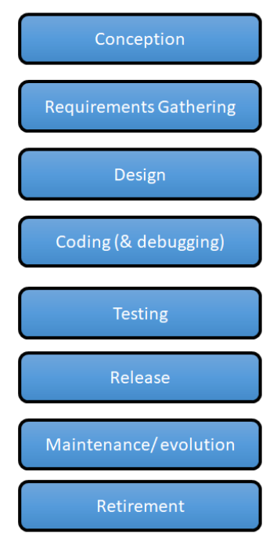
Recap
Software Systems Everywhere -> online/mobile/wearable/etc
Software/system development has stages and variables:
cost, time, quality, features (AKA scope)
Software Dev Goal:
produce useful software, quickly
Standardized models for Dev:
Software Development Models Building a bridge building software
=

Slide 3
Predictive Vs adaptive methods
Predictive methods:
E.g. waterfall model
Lot of effort at the beginning figuring out exactly what they will do & time
Don’t handle changing requirements well
And don’t handle fuzzy requirements well
User only sees the final product, delivered at the end
Possible improvement:
iterate, shorter versions of waterfall

Slide 4

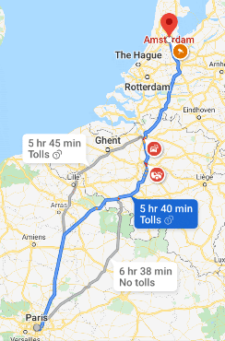
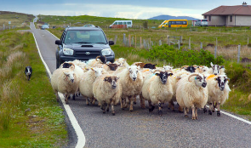
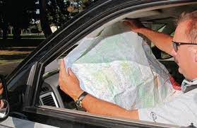
Adaptive
Consider: drive from A to B
Predictive
Adaptive

Slide 5
Adaptive (…)
Build the smallest useful program and add features iteratively to it
Customer can interact with every iterative result
Less work potentially throw away due to change in direction
Can handle fuzzy requirements reasonably well
Start building the parts you do understand best
Building the first part may make other requirements clearer
Or requirements clarify themselves over time with user feedback
Requirements change often:
Customers realize requirements didn’t describe their needs
Customers’ needs change during the project

Slide 6
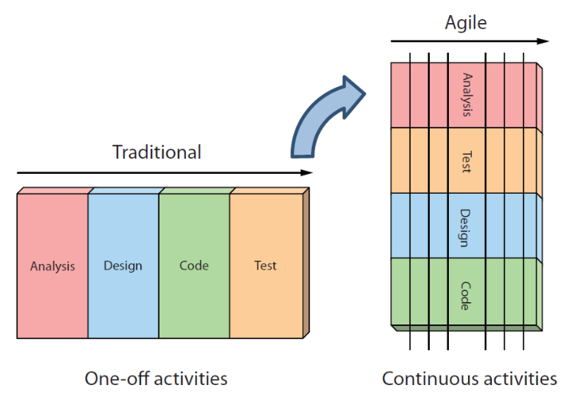
Exploring Agile development Philosophy
Take ideas from design: iterate, revise often

Slide 7
Agile manifesto
Manifesto for Agile Software Development first published in 2001
Agile development is more a set of guidelines than an actual development model
Group of developers together created & wrote ‘The Agile Manifesto’
https://agilemanifesto.org/iso/dk/manifesto.html

Slide 8
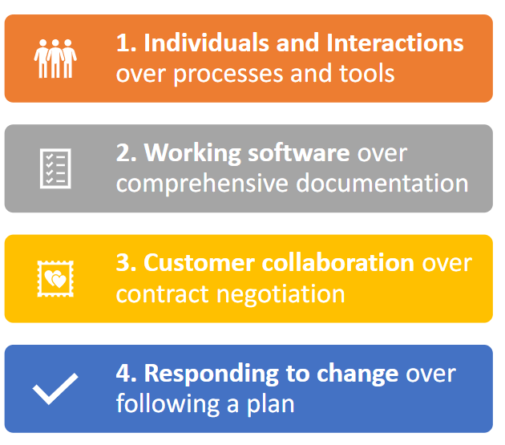
4 values

Slide 9

Seek effective collaboration between developers and customers
Foster individual skill
Get the right people and collaborate
Tools & processes are important but “a fool with a tool is still a fool” [by Grady Booch]
Notes:
Grady Booch is one of the inventors of UML!

Slide 10

Give your users what they prefer
Work in such a way that you produce software quickly and often
Documentation still has its place, written properly
-> automatic tools for code documentation make it easier to go from good comments in the code to docs -> https://doxygen.nl/

Slide 11

Constant co-operation with the customer
Invest your efforts to find out what customers need
Make users a key member of the collaboration
Having a contract with your customers is important … but a contract is not a substitute for communication

Slide 12

Business environment changes
Technology changes over time
Stakeholders change their priorities
There has to be a space to change a plan as our situation changes
Planning is useful, but learning is important
This part is central to adaptive methods!

Slide 13
Agile also has principles
https://agilemanifesto.org/principles.html
See also: Agile alliance manifesto reference sheet 2019.pdf
Some of the most interesting (and adaptive) are:
satisfy the customer with continuous updates
welcome changing requirements
deliver working software frequently
encourage face‐to‐face conversation
reflect regularly on effectiveness of dev team

Slide 14
Agile -> teams
Focused on small teams (approximately 6 or less)
can handle small/medium size projects
Encourage team with authority and encourage shared ownership
to find its own methods for achieving its goals
Prefer multi-skilled team members (over separate roles)
Requires more versatile team members
Visibility of project’s current status
everyone always knows exactly where the project stands
meetings to foster developers to communicate

Slide 15
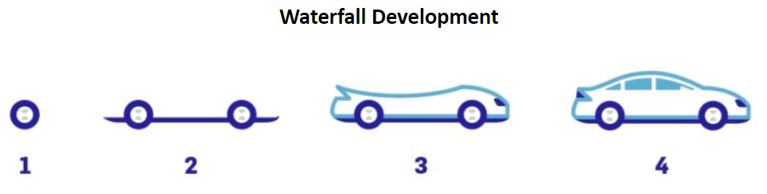
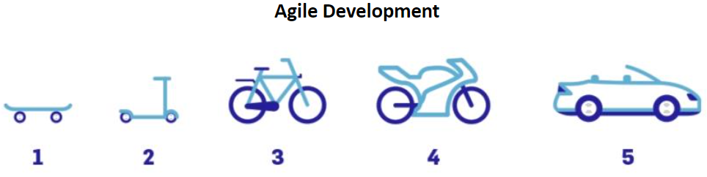
How does the team work?
Iteratively and incrementally
Short iterations lasting between a few months or only a week
Timeboxing, setting a tight delivery schedule for each iteration
Each iteration incorporates every development step -> including thoroughly testing for bugs

Slide 16
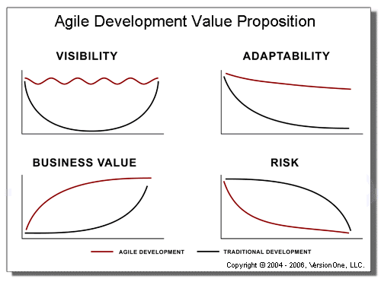
Does it work? (Pros)
Some advantages
Easily adapting to changing requirements throughout the process
More visibility into the actual progress of projects is available
Can reduce the risks associated with software development
Better addresses the business and customer needs

Slide 17
Agile: cons
Doesn’t handle large projects well
Requires more versatile team members
Requires access to scarce resources (like the customer)
Less managerial control (may worry managers)
Unpredictability (can’t tell customer how much/long)
Sometimes may result in a less than optimal design
E.g. where best solution is found from considering the whole picture in big design up front
Should You Go Agile https://www.martinfowler.com/articles/newMethodology.html#ShouldYouGoAgile

Slide 18
But…
Agile manifesto is not a development model… more a philosophy
Implemented in various methods:
SCRUM
XP
Or to make existing methodologies more agile: e.g. UP -> agile UP

Slide 19
Fowler’s says…
About the various agile methods:
https://www.martinfowler.com/articles/newMethodology.html#FlavorsOfAgileDevelopment

Slide 20
Recap: System development
The main objectives (AKA the main problem)
Produce usable software
Get ready for the next project (according to Agile)
Method - ”A systematic procedure – a technique”
Methodology - ”The way you do business”
Difficult to find the right methodology... When is it right?
The projects delivers a usable sw
The leadership is not compromised
Members of the team are willing to work in the same way next time

Slide 21

Questions?

Slide 22
Work/finish your elevator pitch
Need a bit of time to finish/prepare?
5-10 min

Slide 23

Present your elevator pitches

Slide 24
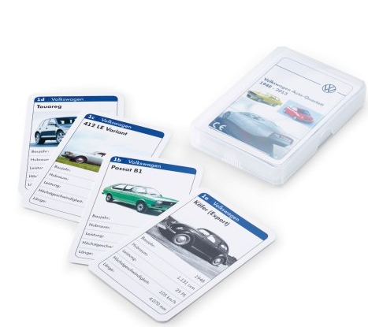
My idea: a card game about learning X
Inspiration
X => Learning about planets

Slide 25
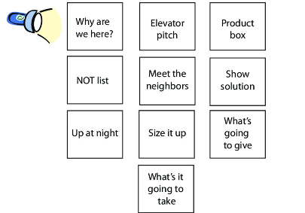
Why + Elevator
WHY: Create a playful learning activity for young players. Learn by repetition. Compare/evaluate and remember. Created a game or a website with a game in it.
ELEVATOR: A simple card game about planets and facts, to support interest in space/STEM for young kids; digital and analogue. Visual and inspiring, for one or 2 players.

Slide 26

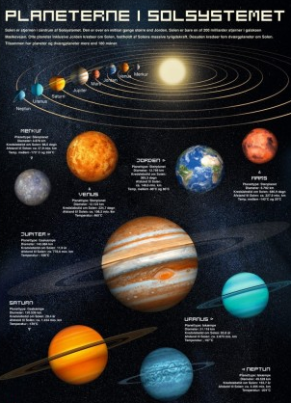


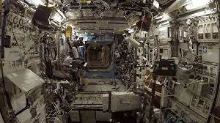
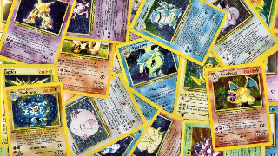
Box – mood board
https://www.pinterest.dk/pin/26036504085476928/ card decks
Size, distance from sun, Number of moons (!), Duration of day, Duration of year, Average temp in K
Moons: https://upload.wikimedia.org/wikipedia/commons/8/8d/Small_bodies_of_the_Solar_System.jpg

Slide 27
Possible topics in the game
Planets
If I want to be more provocative:
STDs: chlamydia, monkey pox, HIV, …
Compare energy production methods: sun panels, sun mirrors, wind, tides/waves, hydro, nuclear, coal, petrol, …

