Slide 1

Agile udvikling – Spring 2023 Lecture 03
Andrea Valente
aval@sdu.dk

Slide 2
Specific Agile methodologies
Agile
eXtreme Programming
Kanban
Scrum

Slide 3
What is XP?
[XP] A light-weight methodology for small-to-medium-sized teams developing software in the face of vague or rapidly changing requirements. Created by Kent Beck in late 1990s.
Why EXTREME ?

Slide 4

…
https://www.youtube.com/watch?v=_Dvwd8Hyh-Y

Slide 5
Why EXTREME
Code reviews are good
-> review code all the time ->
-> pair programming
Testing is good -> everybody test all the time
Design is good
-> always re-design ->
-> refactoring
Integration testing is good
-> several times a day (continuous integration)
...
EXTREME: set all knobs on 10 and see what happens!

Slide 6
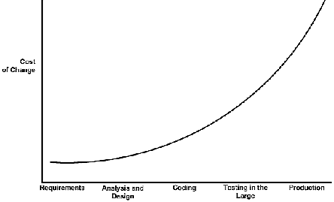
Can something like this work?
It all depends on the cost of change...
Classical view
time

Slide 7
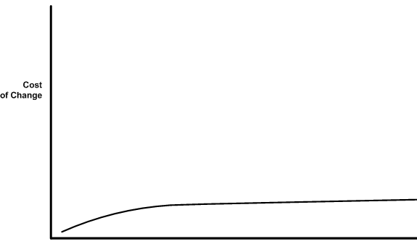
Can something like this work? (...)
BUT... sometimes the curve can be flattened
time
If the cost of change rise slowly... then:
make big decisions as late as possible
implement only what you have to
develop a simple architecture -> avoid risk of over-design
confidence in being able to quickly fix/extend the system

Slide 8
4 variables
We know this!
According to XP, there are 4 variables to control in a project:
Cost
Time
Quality
Scope
External forces* pick 3 of these, development team picks 1: scope! ( * = customers, managers )
Beck argues that the values of all four variables need to be visible (AKA considered!)

Slide 9
XP suggests: development team focus on SCOPE
[XP] The development of a piece of sw changes its own requirement.
-> implement the customer’s most important requirement first.
So if a functionality is later dropped, it is less important than the ones alread implemented!
The softness of requirements
usually considered a major risk
becomes an opportunity -> dev team can shape it!

Slide 10
The 20-80 rule ”20% of the features provide 80% of the benefit”
When planning
The XP customer has to define the business value of desired features, and programmers then provide cost estimates for those features. Using this information, the customer and the developers can then perform a cost/benefit analysis of each feature, enabling them to make intelligent decisions about which features to implement and which to defer.
Using the XP planning process the "20-80 rule" is leveraged
When you release
Put a simple system into production early and update it frequently on a very short cycle. This allows the real business value of the product to be evaluated in a real-world environment, again leveraging the "20-80 rule"
[From: http://www.everything2.com/index.pl?node_id=572270 ]

Slide 11
XP values
XP takes after Agile
Communication
Simplicity
Feedback
Courage

Slide 12
XP principles
Rapid feedback
Do not wait to get feedback on a perfect system – keep the time distance between production and feedback small
Assume simplicity
Tread every problem as if it could be solved with ridiculous simplicity
Forget about being very general, design for reuse ect...
Incremental change
Think evolution vs revolution
Embracing change
The best strategy is the one that preserves the most options while actually solving your most pressing problem
Quality work
Of the 4 project dev. Variables – scope, cost, time, and quality – quality is not a free variable

Slide 13
How to practically…
… organize and run an XP project?

Slide 14
XP project - overview
Short releases
Planning: Decide the scope, functionalities, technology for the implementation. Priorities.
Develop (code and tests) together with users
Refactoring: improve the internal quality of the (working) product
Metaphor: guide dev with a simple shared story about how the whole system works

Slide 15
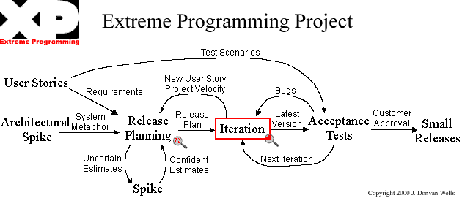
XP project – where to start
FROM: http://www.extremeprogramming.org/map/project.html

Slide 16
XP project (...)
Beck says forget the old saying ”implement for today - and design for tomorrow”
You don’t know what tomorrow brings
Refactoring substitutes long-term design
Do not ”borrow troubles”!
1 week = 40 working hours
testing and continuous integration
collective ownership ->
pair programming + refactoring
adopt coding standards

Slide 17
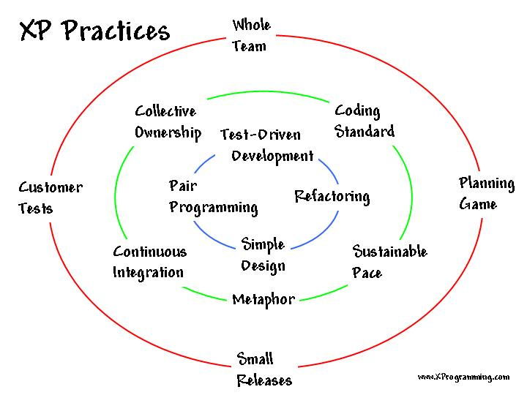
XP project (...)

Slide 18
Management strategy
The manager makes all the decisions
doesn’t work: no one knows enough
centralization -> overhead
Everyone does what they want
no one has a ”bigger view” of the project
In XP management is divided in 2 roles:
the coach - keep together the metaphor/architecture
the tracker
uses a metric to estimate develpment
Ideal Engineering Time vs Calendar Time

Slide 19
Business and technical responsability
Keep the balance
Business in charge
would like to decide 100% of all 4 parameters
specifies too much
bad quality -> lots of nice-tohave functionalities are developed
Technical in charge
would buy new tools, languages, OS, just because they are cutting edge
too much risk

Slide 20
Responsability
Shared bewteen users and developers
In XP
users define, specify and prioritize (within the next release)
developers provide estimates
Choice of technology
primarly done by development
but the data-model or basic i/o, can be influenced by users

Slide 21
Planning ... but agile!
We/XP want to keep it fast and cheap
It should provide an overview
Detailed planning only for the next horizon (i.e. next release/end of iteration)
Light but sufficient – simple
Responsability (for different tasks) cannot be assigned – can only be requested

Slide 22
Find a metaphor
During the exploration phase seek an effective metaphor that helps guide your solution
metaphor = logical design
identifies the key objects and their interactions
The metaphor may change over time as you learn more about the system
if the conceptualization can be improved in XP, it will be changed

Slide 23
Spikes
A spike is a quick explorations into the nature of a potential solution
Early in the project (during the release planning game)
Do spikes also for functionally
explore how to implement various parts of the system
Based on the stories and the spikes, you'll decide on an approach to the system's structure

Slide 24

Questions?

Slide 25
Break

Slide 26
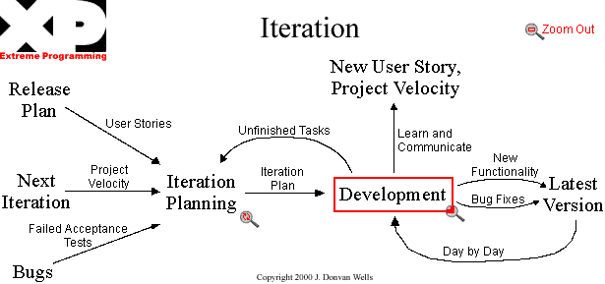
1 XP project = many iterations

Slide 27
Next step: requirements
Once you have your elevator pitch and mood board… it’s time to show something to possible users/customers and gather their ideas.
But… getting clear and complete requirements from a user for a project is challenging
Finding the needs
Customers don't always know exactly what they want
Human communication is imprecise
Requirement may be ambiguous and hard to describe
Differences between users and developers’ perspectives
Requirements change during development
Dynamic

Slide 28
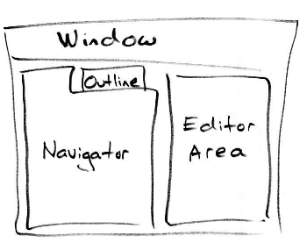
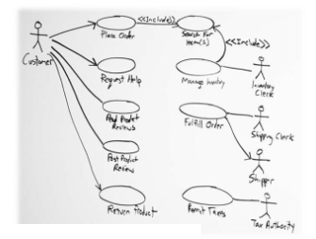
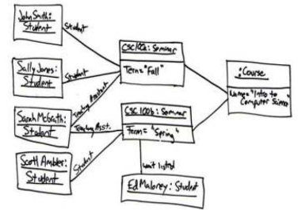
Agile Requirements Gathering
There are various ways to elicit and document requirements
Brainstorming
Prototyping, Sketching and drawings
Rough modeling
Use cases and User Stories

Slide 29
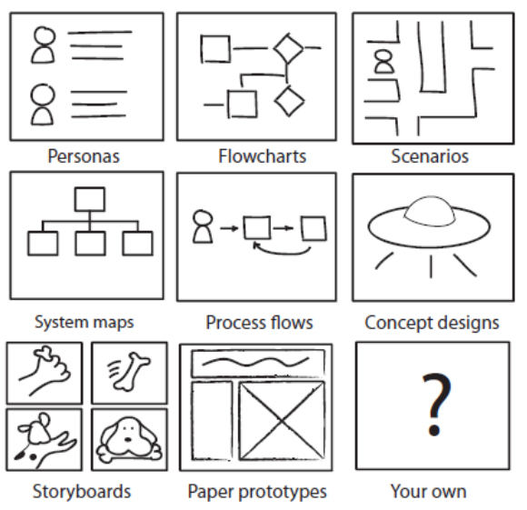
Ways to gather requirements
Did you use any of these?

Slide 30
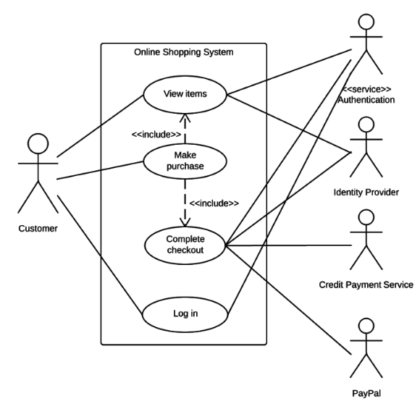
Use cases
Primarily used for functional requirements for a system
Exploring actors and their interaction with the system for achieving a goal
Actors can include:
Customer
Customer service representative
Sales manager
Product analyst

Slide 31
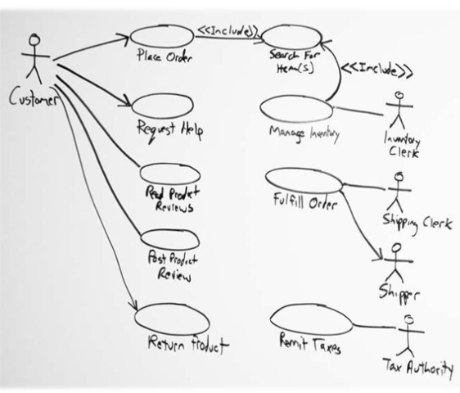
Scenarios
Series of steps that describe a user’s interaction with the system
may have multiple scenarios in one use case diagram,
or could create separate use case diagrams for different scenarios
Goal to explore requirements and get on the same page
As opposed to making ridged official UML certified diagrams
Can drive subsequent development activities
Interaction Diagrams
Early design of UI prototype

Slide 32
User stories
One tool for gathering requirements are: user stories
Within agile development, requirements are
Negotiated continuously during development
Fleshed out just in time

Slide 33
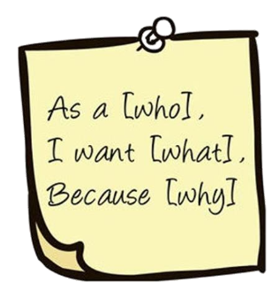
What is a user story?
User story: “A short descriptions of features our customer would like to one day see in their software”
Written from the perspective of the end user / with a user
Looking to capture the spirit of the feature
Just in time approach
Should save time and money
Elements of good User Stories
See https://www.pmworld360.com/5-key-elements-of-an-agile-user-story/

Slide 34
Stories for my game :D
I need a metaphor and user stories
And we can do some planning together
15-20
min

Slide 35
Metaphor for this game
It is like a turn-based tabletop game, with 2 players
It is more like playing dice against a friend, than an actual card game (e.g. poker or bridge)

Slide 36
My stories (should be written with/by users)
Alice shuffles the deck
Alice, Bob and Carl play a tournament, keeping scores and highscores
Alice plays against the computer/AI
The AI can be set to be easy to beat or very hard
Bob loves to look at the cards in the deck, because they are beautifully drawn
Bob uses a minimalistic, very clear GUI to play a match online
Alice and Bob pick a card each and decide which “dimension” to bet on
Alice and Bob compare the cards and decide who won, assign points and keep scores
Carl reviews the cards to memorize the attributes of each planet, to improve his strategy and possibly play better in the future
Alice shows her score to some friends (social sharing)

Slide 37
Now we have to decide: agile planning
Too many stories for one iteration…
We need an initial planning for each iteration…
We/XP want to keep it fast and cheap
It should provide an overview
Detailed planning only for the next horizon (i.e. next release/end of iteration)
Light but sufficient – simple
Responsability (for different tasks) cannot be assigned – can only be requested

Slide 38
The rules of the Game
Goal: maximize value of the sw under dev.
Strategy:
invest as little as possible to put the most valuable functionality into production as quickly as possible
feedback from reality
Pieces: story cards
Players:
Business (and/or users) and Development

Slide 39
The rules of the Game (...)
Game – 3 phases
exploration
Users write a story
Dev estimates it
Split the story: if too long (for Dev) ...
commitment
(Users) Sort stories in piles (red, yellow or green...) depending on their priority/value
Dev sort stories by risk into 3 piles
stories that can be estimated precisely
reasonably well, and
cannot be estimated at all
(Users) choose scope -> which cards in the next release
steering
Recovery, new story, reestimate

Slide 40

Play the XP planning game
Dev Team (how sure?) Users (how useful?)
Grade each
Stor -> G,Y,R
Sort in 3 stacks
must
good
nice
Pick a few, best combination (green/green if possible)

Slide 41
TASK: let’s do the planning game in groups
You can be the dev team (in groups if needed)
How would you sort the stories?

Slide 42
My stories: let’s sort them…
Alice shuffles the deck
Alice, Bob and Carl play a tournament, keeping scores and highscores
Alice plays against the computer/AI
The AI can be set to be easy to beat or very hard
Bob loves to look at the cards in the deck, because they are beautifully drawn
Bob uses a minimalistic, very clear GUI to play a match online
Alice and Bob pick a card each and decide which “dimension” to bet on
Alice and Bob compare the cards and decide who won, assign points and keep scores
Carl reviews the cards to memorize the attributes of each planet, to improve his strategy and possibly play better in the future
Alice shows her score to some friends (social sharing)
Tell me how to change the order here …
10 min

Slide 43
This is what I got…

Slide 44
My stories (sorted after the planning game)
Alice shuffles the deck
Alice, Bob and Carl play a tournament, keeping scores and highscores
Alice plays against the computer/AI
The AI can be set to be easy to beat or very hard
Bob loves to look at the cards in the deck, because they are beautifully drawn
Bob uses a minimalistic, very clear GUI to play a match online
Alice and Bob pick a card each and decide which “dimension” to bet on
Alice and Bob compare the cards and decide who won, assign points and keep scores
Carl reviews the cards to memorize the attributes of each planet, to improve his strategy and possibly play better in the future
Alice shows her score to some friends (social sharing)

Slide 45
Then I can be the ”users” …
I/we can pretent and sort again wrt our needs

Slide 46
My stories (sorted again at the end of the planning game)
[G] Alice shuffles the deck
[G] Alice and Bob pick a card each and decide which “dimension” to bet on
[G] Alice and Bob compare the cards and decide who won, assign points and keep scores
[Y] Alice plays against the computer/AI
[Y] Bob loves to look at the cards in the deck, because they are beautifully drawn
[G] Carl reviews the cards to memorize the attributes of each planet, to improve his strategy and possibly play better in the future
[R] The AI can be set to be easy to beat or very hard
[Y] Alice, Bob and Carl play a tournament, keeping scores and highscores
[R] Alice shows her score to some friends (social sharing)
[R] Bob uses a minimalistic, very clear GUI to play a match online

Slide 47
Questions?

Slide 48
Break

Slide 49
Where are we?
In my game project… there are:
An idea for a software (my game for example)
A reason why we want to do it and for which target audience
An elevator pitch + mood board
A set of stories, sorted using ”XP planning game”
What’s next?

Slide 50
Next time we can…
Explore how to implement user stories
Create a prototypes and spikes
Try out ”pair programming”
From now to next time, you should:
write user stories for your project, in groups

