Slide 1
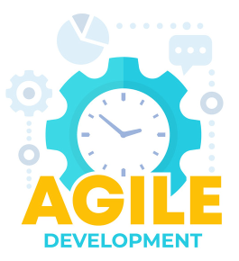
Agile udvikling – Spring 2023 Lecture 04
Andrea Valente
aval@sdu.dk

Slide 2
Recap: where are we?
In my game project… there are:
An idea for a software (my game for example)
A reason why we want to do it and for which target audience
An elevator pitch + mood board
A set of stories, sorted using ”XP planning game”

Slide 3
So now we can…
Talk about how to organize the working space for the team
Explore how to implement user stories ->
Experimenting with pair programming

Slide 4
How to organize the workspace!
According to XP…

Slide 5
Easy access to important info
Put plans, spikes, ideas and solutions on the walls

Slide 6
Direct communication
You should get information simply looking around

Slide 7
Status → on the wall

Slide 8
Trello
A good way to keep user stories organized is to use a tool like Trello (or Google Docs … ).
Trello for tracking Project and Timeboxes
Adding new items to the list of user story
Re-ordering and/or deleting stories and requirements
Moving stories across the board, to being in “in progress”, to “done”
Towards the end of an iteration:
Verify the stories you have worked on, if they are OK, move to “done” list
End of each iteration:
Move possible stories still to complete to the next iteration list

Slide 9
Trello task
Work in groups
Familiarize yourseves with Trello
Set up a few columns that are relevant for your project
Add a few user stories into your column
Discuss how you would move them, as the project progresses:
to help knowning the state of the project over time
10 min

Slide 10

Questions?

Slide 11
Break

Slide 12
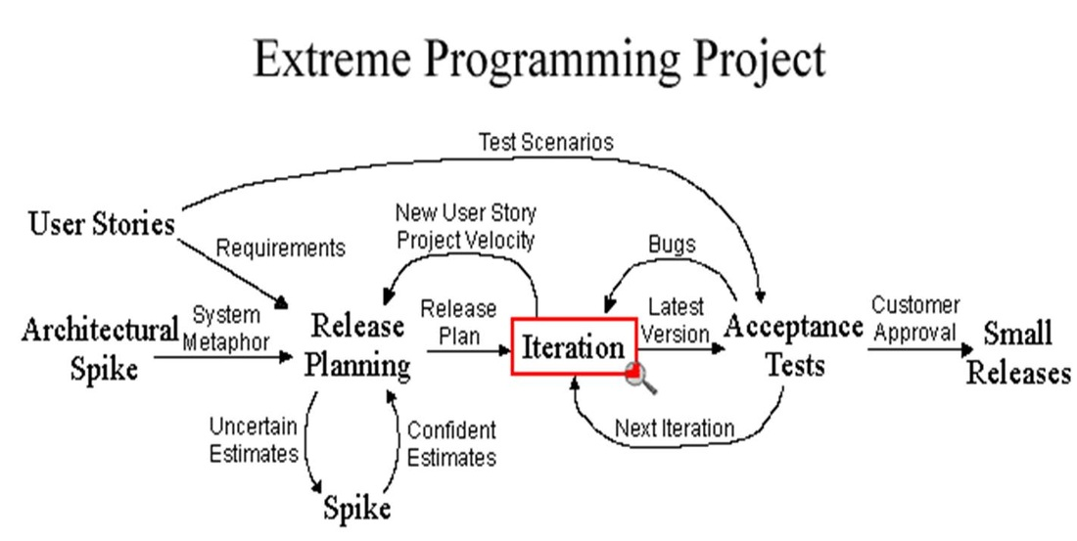
The entire XP project…
18 weeks

Slide 13
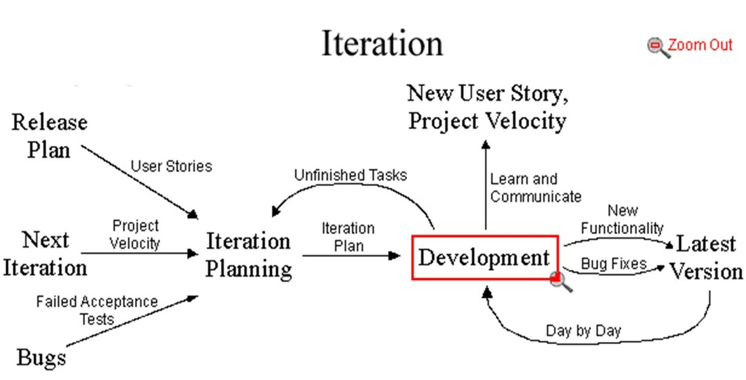
3 weeks

Slide 14
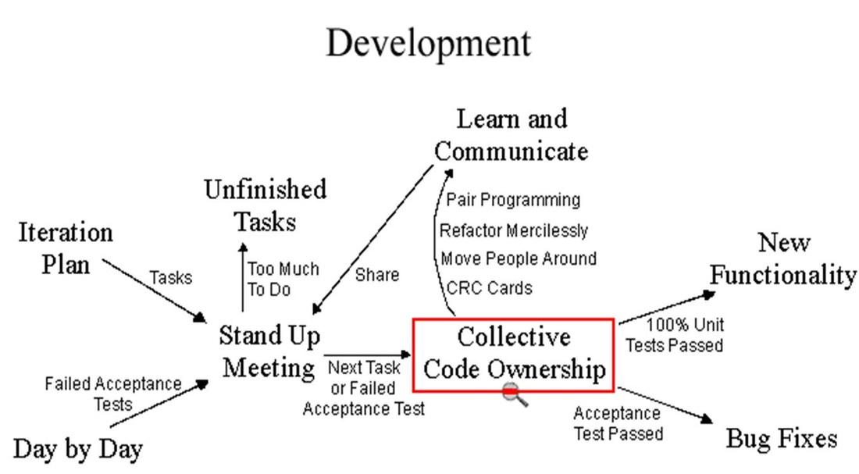
1 day

Slide 15
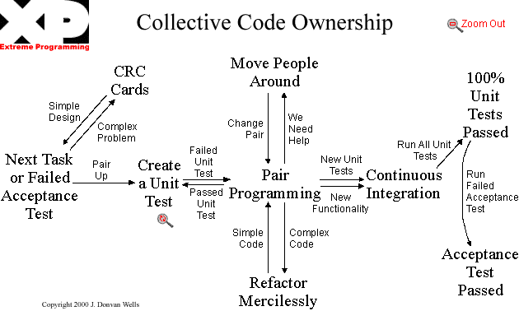
hours

Slide 16
Key ideas
Collective Ownership
Anybody who sees an opportunity to add value to any portion of the code is required to do so at any time.
Contrast this to two other models of code ownership:
no ownership
and individual ownership
In the olden days, nobody owned any particular piece of code. If someone wanted to change some code, they did it to suit their own purpose, whether it fit well with what was already there or not.
The result was chaos(!)
Continuous Integration
Code is integrated and tested after a few hours—a day of development at most.
One simple way to do this is to have a machine dedicated to integration.
And pair programming…

Slide 17
What is pair programming?
[Beck] book page 51
”All production code is written with two people looking at one machine, with one keyboard and one mouse”
ROLES: There are two roles in each pair.
One partner, the one with the keyboard and the mouse, is thinking about the best way to implement this method right here.
The other partner is thinking more strategically
Pairing is dynamic:
If two people pair in the morning, in the afternoon they might easily be paired with other folks

Slide 18
Roles in pair programming
Pilot
As the pilot you control the keyboard and mouse and must do all the typing
As you decide what you will type and as you type try to speak aloud what you are doing and thinking
Listen intently to the navigators instructions
Ignore larger issues and focus on the task at hand
Focus on how you are going to program your solution to the problem
Navigator
As Navigator you should do no typing
Dictates the code that is to be written - the 'what'
Ongoing code review - look to ensure the code does what the driver thinks it does
If the pilot is not speaking much, encourage them by asking them to explain their code
Explains 'why' they have chosen the particular solution to this problems
Focus on the why
Both are working together!

Slide 19
Let me go back to… my game ;)
Remember our planning game?
Now we can start coding our stories…

Slide 20
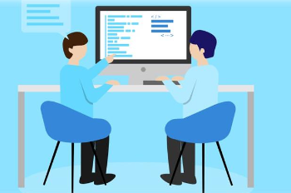
Pair programming practice
A key element of eXtremeProgramming everyday!
Can be quite a different experience to the more traditional programming -> alone
2 people per laptop (if 3, 2 will be navigators)
Let’s try
the planning game on some user stories
then some pair programming
using my game as an example, and starting from some code in P5.js
Switch roles: pilot and navigator

Slide 21
My stories (sorted again at the end of the planning game)
[G] Alice shuffles the deck
[G] Alice and Bob pick a card each and decide which “dimension” to bet on
[G] Alice and Bob compare the cards and decide who won, assign points and keep scores
[Y] Alice plays against the computer/AI
[Y] Bob loves to look at the cards in the deck, because they are beautifully drawn
[G] Carl reviews the cards to memorize the attributes of each planet, to improve his strategy and possibly play better in the future
[R] The AI can be set to be easy to beat or very hard
[Y] Alice, Bob and Carl play a tournament, keeping scores and highscores
[R] Alice shows her score to some friends (social sharing)
[R] Bob uses a minimalistic, very clear GUI to play a match online

Slide 22
Pair programming task
Now you can:
Pick the fist story from the top of the stack
Code/review in pairs
Test and find erros/problems
When done, pick next story and iterate

Slide 23
Example of possible things to do in the pair programming session…
Implement few cards as simple objects in an array (the deck) -> NEXT PAGE!
Write a shuffle the deck function
Write a function that given 2 cards and the “dimension”, decides who won (card 1 or card 2)
Write a piece of code that randomly draws 2 cards (different) from the deck
Write a function that, given a card, draws it on screen. How beautiful can you make it?
Write a function that given a card, decides a “dimension” to be on: the AI of the online game. How “perfect” or “stupid” should this be?
Implement a smart GUI for the game
Keep scores and highscores, possible persistent
Implement a 2-player mode
Implement multiple skins for your cards
Extensions of the deck:
“Default win” special card :D
More cards with more planets
Allow for players tournaments
Notes:
I can give you the code for “Implement few cards as simple objects in an array (the deck)”

Slide 24
A possible start… in P5
“Implement few cards as simple objects in an array (the deck)”
…
https://editor.p5js.org/andrea270872/sketches/k02YFTrMI
If you prefer, work with plain JavaScript for this pair programming task ;)
15-20
min

Slide 25
For now/next time
Try out pair programming on your project

