Slide 1
Applikationsudvikling II
Lecture 5
Andrea Valente
aval@sdu.dk
https://portal.findresearcher.sdu.dk/en/persons/aval

Slide 2
Topics:
WPF
WPF architecture: AKA existing classes
Components
XAML
A simple example
Events and handlers
Design of GUIs
Use my own classes too, in a WPF application

Slide 3
Main source …
A very nice tutorial on WPF
https://wpf-tutorial.com/

Slide 4
What is WPF
“WPF, which stands for Windows Presentation Foundation, is Microsoft's latest approach to a GUI framework, used with the .NET framework.”
But what IS a GUI framework?
GUI stands for Graphical User Interface…
A GUI framework allows you to create an application with a wide range of GUI elements, like labels, textboxes and other well known elements (or CONTROLS)
Without a GUI framework you would have to draw these elements manually and handle all of the user interaction scenarios like text and mouse input.
This is a LOT of work, so instead, most developers will use a GUI framework which will do all the basic work and allow the developers to focus on making great applications.
https://wpf-tutorial.com/

Slide 5
…
WinForms is simply a layer on top of the standard Windows controls (e.g. a TextBox),
But: WPF is built from scratch and doesn't rely on standard Windows controls in almost all situations
Works also on other OS
More: https://wpf-tutorial.com/about-wpf/wpf-vs-winforms/

Slide 6
Basic controls
Typical controls are:
Buttons
Labels
Panels
Check boxes and radio buttons
Text boxes and text blocks
Combo boxes
You might know these from Window’s GUI or from HTML forms…
NOTE: every control in WPF is an object created from a class ->
The whole framework is object-oriented! :)

Slide 7
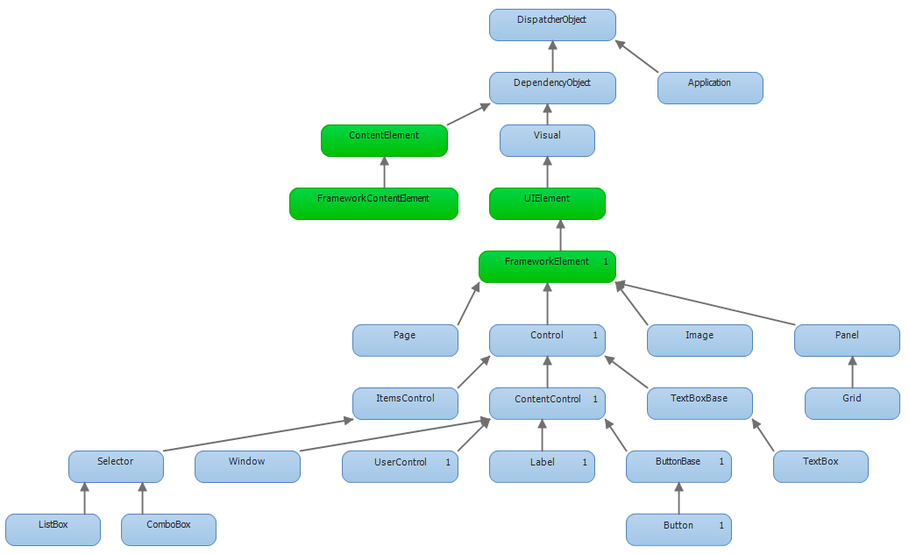
A part of the WPF class hierarchy
Every control in WPF is an object created from a class
A button will be an instance of the class Button

Slide 8
Code or visual editor?
Since WPF is object-oriented, I could write my WPF application like this:
Button b = new Button();
b.Content = “Click me!";
AddChild( b );
… but this gets annoying/long very quickly :/
So instead we can use a sort of HTLM/XML to define the buttons and controls, and layouts of a window -> enter XAML !

Slide 9
XAML
Even better: visual editor to create the XAML file!!
“XAML, which stands for eXtensible Application Markup Language, is Microsoft's variant of XML for describing a GUI.”
The idea is:
You write a XAML file that says “put a button here, with some text as content, a text box there”
and visual studio generates all the code to create and connect the right objects together
If you need to say “when this button is clicked, do X” then you write a function X and write in your XAML document that your button will call X when clicked -> this is called “CodeBehind”
So: CodeBehind handles all the events in your XAML GUI

Slide 10
Summary of the ides so far
WPF is a framework to create GUIs
It has many types of controls
Every control is a class and I define a GUI by creating code that instanciates objects from the WPF classes
But… I don’t want to, too much work -> so I write an XAML file instead
Visual studio auto-magically converts XAML to C# code and makes the objects for me at the start of my app
Finally: I can be even more lazy -> I can visually compose my XAML

Slide 11
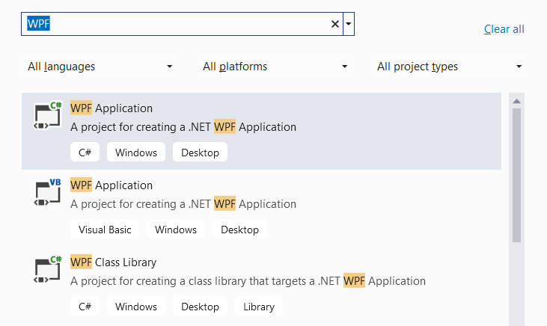
Let’s try with an example
Open visual studio
Create a new project
Choose: WPF application in C#
Then next -> and create
The project will have 2 parts:
An XAML file/GUI design
A C# file, with some code for the “main window”

Slide 12
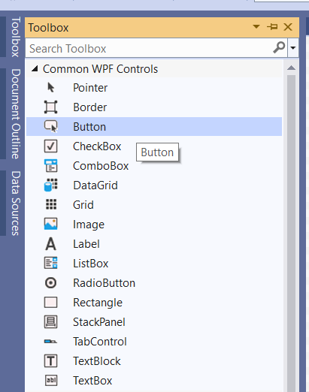
Add a button
Open the toolbox (top-left)
You will see the common controls
Drag the button to your main window
The button can then be placed and customized (e.g. resized)

Slide 13
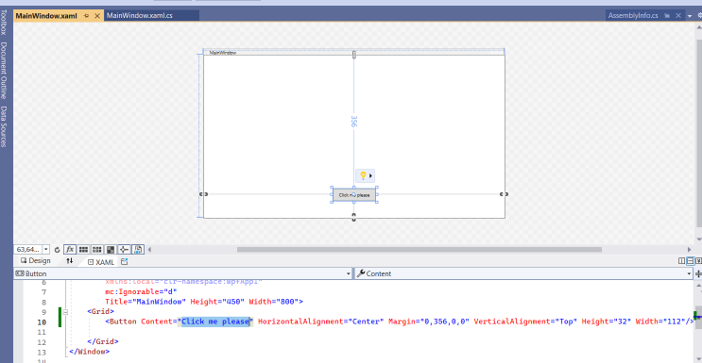
Now change the text inside the button
This is a good moment to build+run ;)

Slide 14
Now the button should do something!
Simply click the button in the XAML design window
A new method will be written for you in your MainWindow class
The method is usually called: Button_Click
And has a couple of parameters, including the source object, here it will be the button that was clicked, i.e. the source of the click even
Put some code in that method
NOTE: Console.WriteLine does not work in WPF apps :(
MessageBox.Show(“thanks for clicking”);
Then look at my code: code\Example1.cs
This is a good moment to build+run ;)

Slide 15
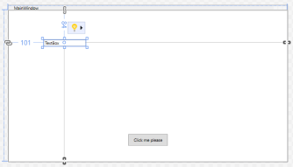
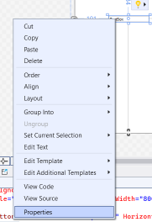
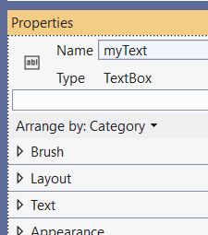
Text box: reading and writing
Add a text box control to your GUI
Go in properties then give it a name
<Grid>
<Button Content="Click me please" HorizontalAlignment="Center" Margin="0,356,0,0" VerticalAlignment="Top" Height="32" Width="112" Click="Button_Click"/>
<TextBox HorizontalAlignment="Left" Margin="101,84,0,0"
TextWrapping="Wrap" Text="TextBox" VerticalAlignment="Top" Width="120"/>
</Grid>
Then in the button’s CLICK method write:
MessageBox.Show( "You typed: " + myText.Text );

Slide 16
Text and numbers
Look at my code: code\Example2.cs

Slide 17
Task: add a few ”common controls”
Just try out some of the typical elements of a GUI …
5
min

Slide 18
Break
Questions so far?

Slide 19
OK, but what do I put in my GUI?
Now that I know how to put stuff in my GUI, and eventually handle events (like click), the question is…
How do I decide the look of my GUI?
Decide -> ”design”
We need a way to quickly design possible GUIs, show them to the customer, and from there, implement 1 GUI in XAML+C#
Enter: wireframes

Slide 20
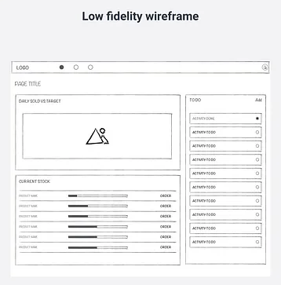
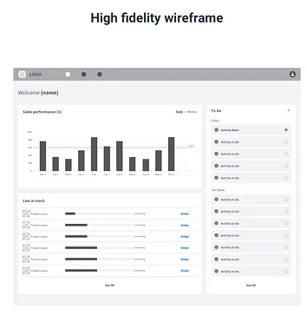
Wireframes
“A wireframe is a simple grey-scale schematic blueprint of the website or app that focuses purely on content and structural elements of a layout.”
When used well, wireframes can increase collaboration and stimulate creativity. They should be created as part of a collaborative process between design, product management, and development.
Wireframes are especially important in driving a feedback loop with the team on information architecture, content hierarchy, page layout, and indicate any interaction or state design
Typical scenario:
the stakeholder pitches an idea,
the product manager gathers the business value,
the designer creates the visual and the context of use,
and later on, the developers create the digital product or software
From https://uxplanet.org/lo-fi-vs-hi-fi-wireframes-and-the-importance-of-designing-the-flow-9b283ae62982

Slide 21
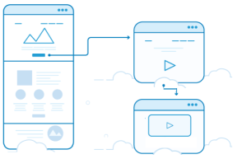
User flow
“A user flow is a path a user takes to complete a task or achieve a meaningful goal”
We can draw the user flow in our wireframe
“User flows capture the essence of what wireframes were built to do: map the user's experience.”

Slide 22

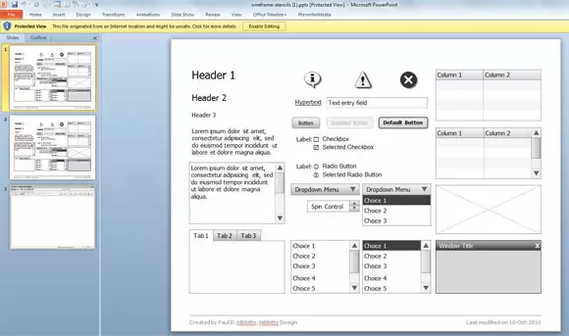
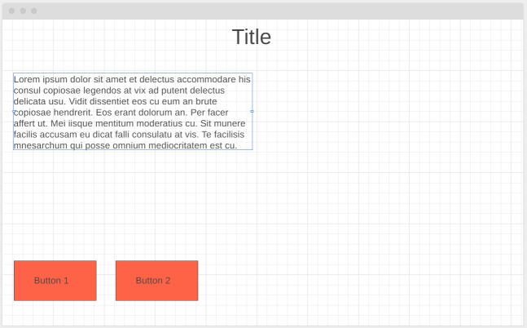
You can use (free) online tools or Powerpoint
https://wireframe.cc/

Slide 23

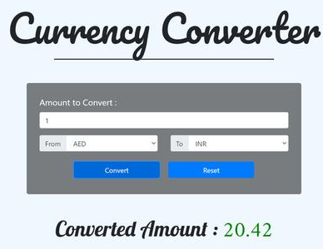
Task: design the GUI of a currency converter
Examples on the right ->
Create a wireframe of your GUI
Create an new WPF project
Use the visual designer to create a GUI
The “convert” button should just convert dkk to usd usd = dkk * 0.147
Do not implement multiple currencies for now
15
min

Slide 24
Break
Questions so far?

Slide 25
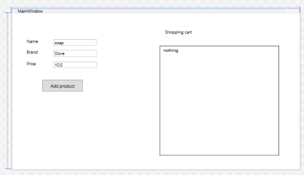
Use my own classes in a WPF application
I want to add properties to the MainWindow class
Trick: place the new classes in a separate file ;) And use them in the MainWindow constructor and methods
Look at the example: code/example3.cs
Window
WPF
MainWindow
1
Product
*

Slide 26
Tasks for next time
(but you can start here, in groups if you like)

Slide 27
Work on the ShoppingCart example
Add a few properties to the Product
Change the constructor so you can pass all the properties when you create a new Product
Change the GUI to let you input all the properties (including the new ones)
Add a ”empty” button, that when clicked removes all products from the list, and refreshes the textblock. HINT: use the Clear() method for the list.
Change the method that refreshes the list on screen, and make it also calculate the total of the price for the whole shopping cart. Write the total in a new textbox that you will place below the textblock.
Notes:
https://www.tutorialspoint.com/how-to-empty-a-chash-list#:~:text=To%20empty%20a%20C%23%20list%2C%20use%20the%20Clear()%20method.

