Slide 1
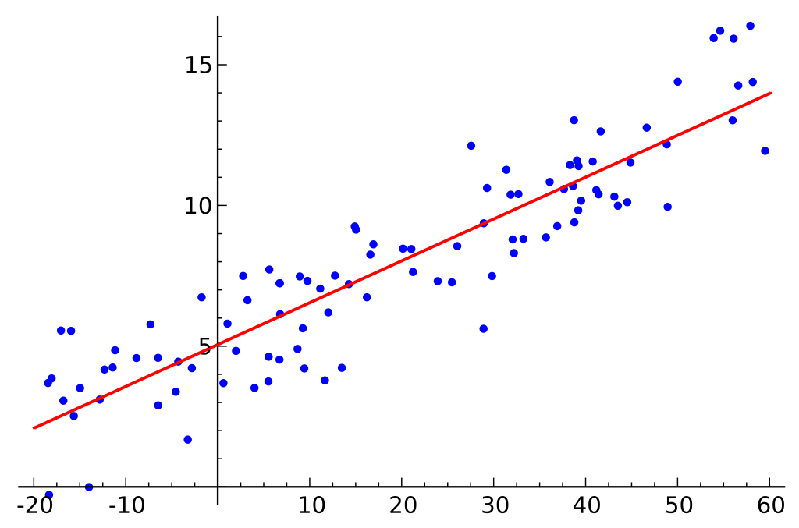
Regression
Andrea Murphy and Josh Quigley

Slide 2
WHAT IS REGRESSION?
Notes:
In machine learning, Regression is used to predict the outcome of an event based on the relationship between variables obtained from the data-set.

Slide 3
Exploratory Analysis
The Dataset
The dataset was obtained at:
https://archive.ics.uci.edu/ml/datasets/News+Popularity+in+Multiple+Social+Media+Platforms
The collected data relates to a period of 8 months, between November 2015 and July 2016, accounting for about 100,000 news items on four different topics: economy, microsoft, obama and palestine.
Description:
Attributes (Columns): 11
Instances (Rows): 93239

Slide 4
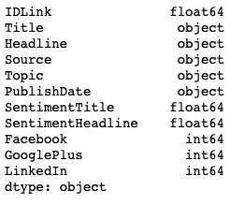
Data types
Exploratory Analysis

Slide 5
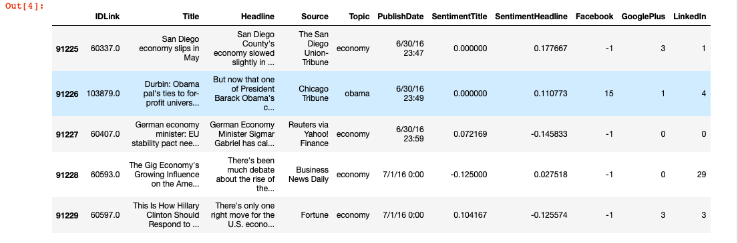
Exploratory Analysis
Attribute Information

Slide 6
Project
Prediction tasks are to:
If given the Facebook popularity for a news story, can we accurately predict its popularity on GooglePlus?
If given Facebook popularity for news stories, what is the predicted SentimentHeadline score?
What time of day results in the most popular news stories?

Slide 7
Exploratory Analysis
Of models

Slide 8
Conclusion
Facebook Popularity can be vaguely predict popularity on other social media platforms, in this case GooglePlus
Facebook Popularity does not correlate nor predict SentimentHeadline scores
Publishing Later in the day tends to lead towards more popularity on Facebook
This was a challenging dataset and probably not the best choice for Regression

Slide 9
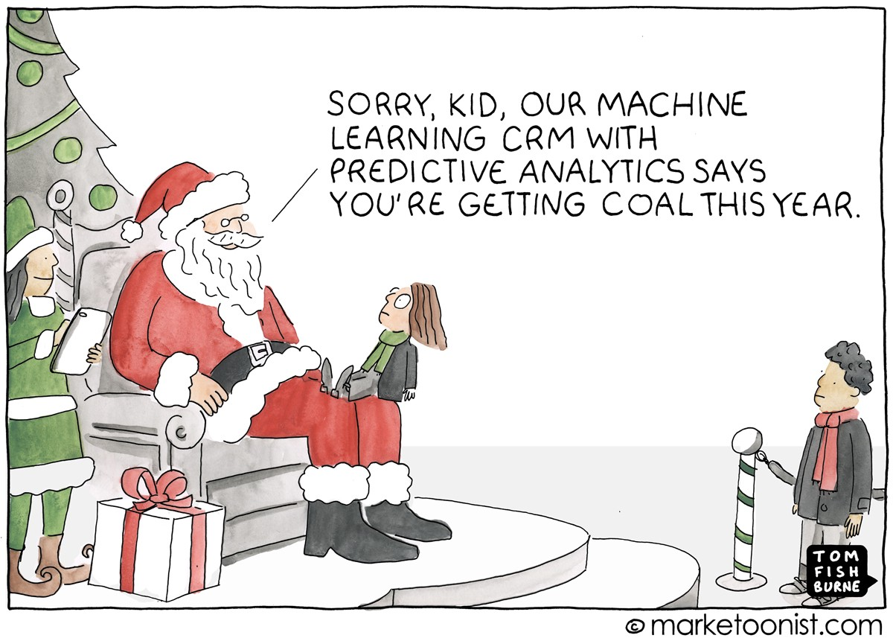
QUESTIONS?

