Slide 1

Climate change Analysis
Machine learning Project Andrea Porrazzo

Slide 2
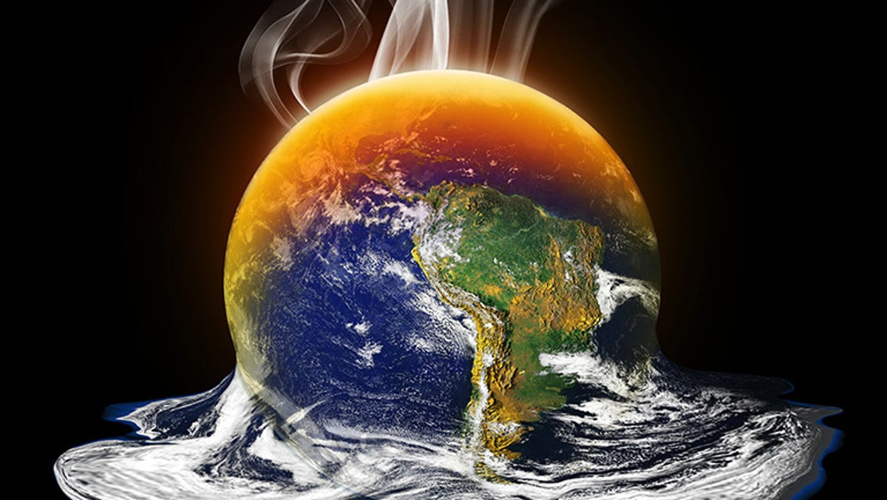
Define the project goals
Analyze the relationships among these variable categories and evaluate the contribution of factors like country economy, energy use, land use, etc. on greenhouse gas emissions, precipitations, etc. in the dataset on world data bank and then a clustering analysis of countries compared to a group of features.

Slide 3
The dataset
shape: 28 columns, 13512 rows
all columns are of type "object"
the missing values are denoted by NaN
the rows marked as 'Text' in the columns 'SCALE' and 'Decimals' are almost completely composed of NaN values
the columns represent key values are country, years, the series code and series name
the column 'Series name' contains the country-specific features required for the analysis

Slide 4
Data Cleaning
Removing rows marked as "Text" in the "SCALE" and "Decimals" columns
Removing the unnecessary columns "Country name", "Series code", "SCALE", "Decimals"
Transform the ".." strings and empty cells (" ") into NaN values for easier recognission as missing values
Transform all data columns into a numerical data type
Rename the features in column "Series name”

Slide 5
Data frame transformation
Remove the remaining missing values in an optimal way
Filtering the years by missing values
Filtering the countries by missing values
Checking the columns for missing values
It is necessary to transform the data frame into a suitable format- the feature from the 'Series name' column into separate columns and the years into a single column. This is done by picking the corresponding values of each feature together with their countries and years, melting these into a single column and then combine them into a new data frame with all features (based on the same countries and years)
Notes:
It is necessary to transform the data frame into a suitable format- the feature from the 'Series name' column into separate columns and the years into a single column. This is done by picking the corresponding values of each feature together with their countries and years, melting these into a single column and then combine them into a new data frame with all features (based on the same countries and years):

Slide 6
Feature engineering
The available columns reveal that the features representing CO2 emissions and energy use have three different reference values:
per capita: co2_per_cap and en_per_cap
per unit of GDP: co2_per_gdp and en_per_gdp
total values: co2_ttl

Slide 7
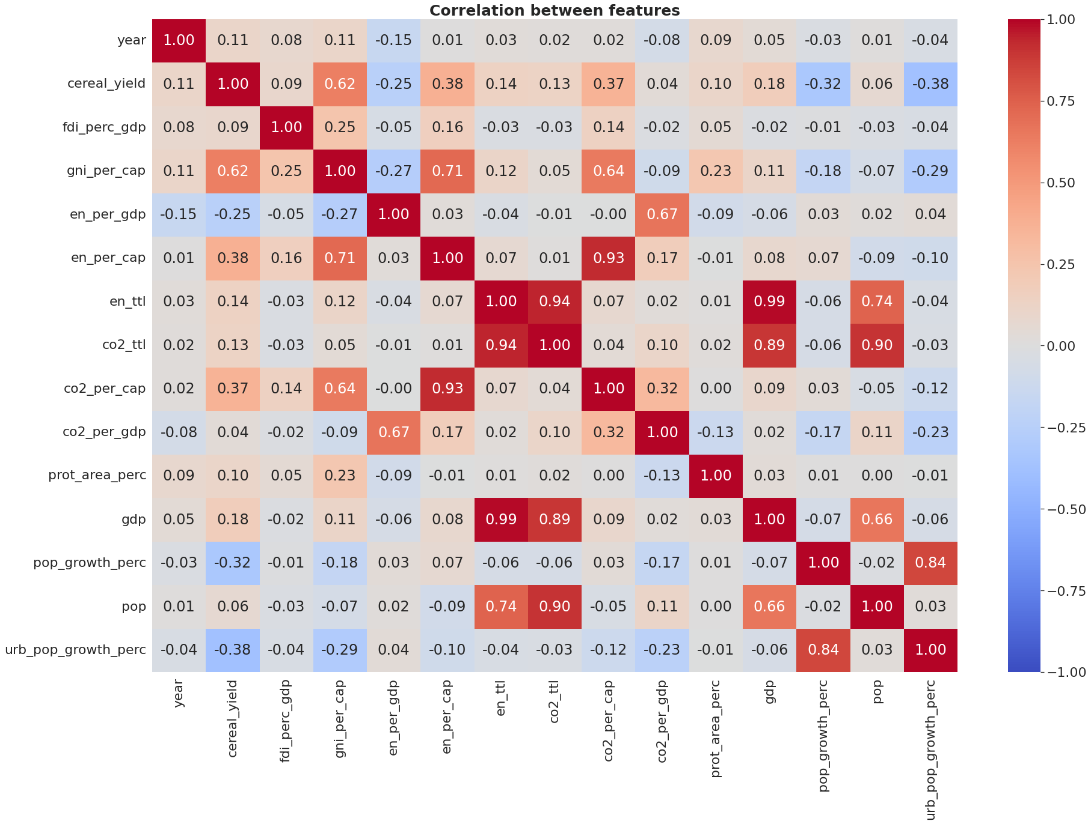
Correlation between features
When comparing the dependencies of co2_ttl, co2_per_cap and co2_per_gdp with other features, co2_per_cap correlates with a bigger amount of other variables. It also represents the CO2 emissions independently of population size, making it more representative when analyzing and comparing the emissions of countries with different sizes and population counts.
Notes:
Since the chosen variables are referred to the population count, it wouldn't make much sence to take the variable pop (indicating the population count) - this can be also seen from the weak correlation coefficient.
After plot:
The most obvious linear dependency of co2_per_cap is with en_per_cap. Apparent hints for nonlinear relationships can be observed in the plots of co2_per_cap versus gni, pop_urb_aggl_perc, pop_growth_perc, urb_pop_growth_perc.

Slide 8
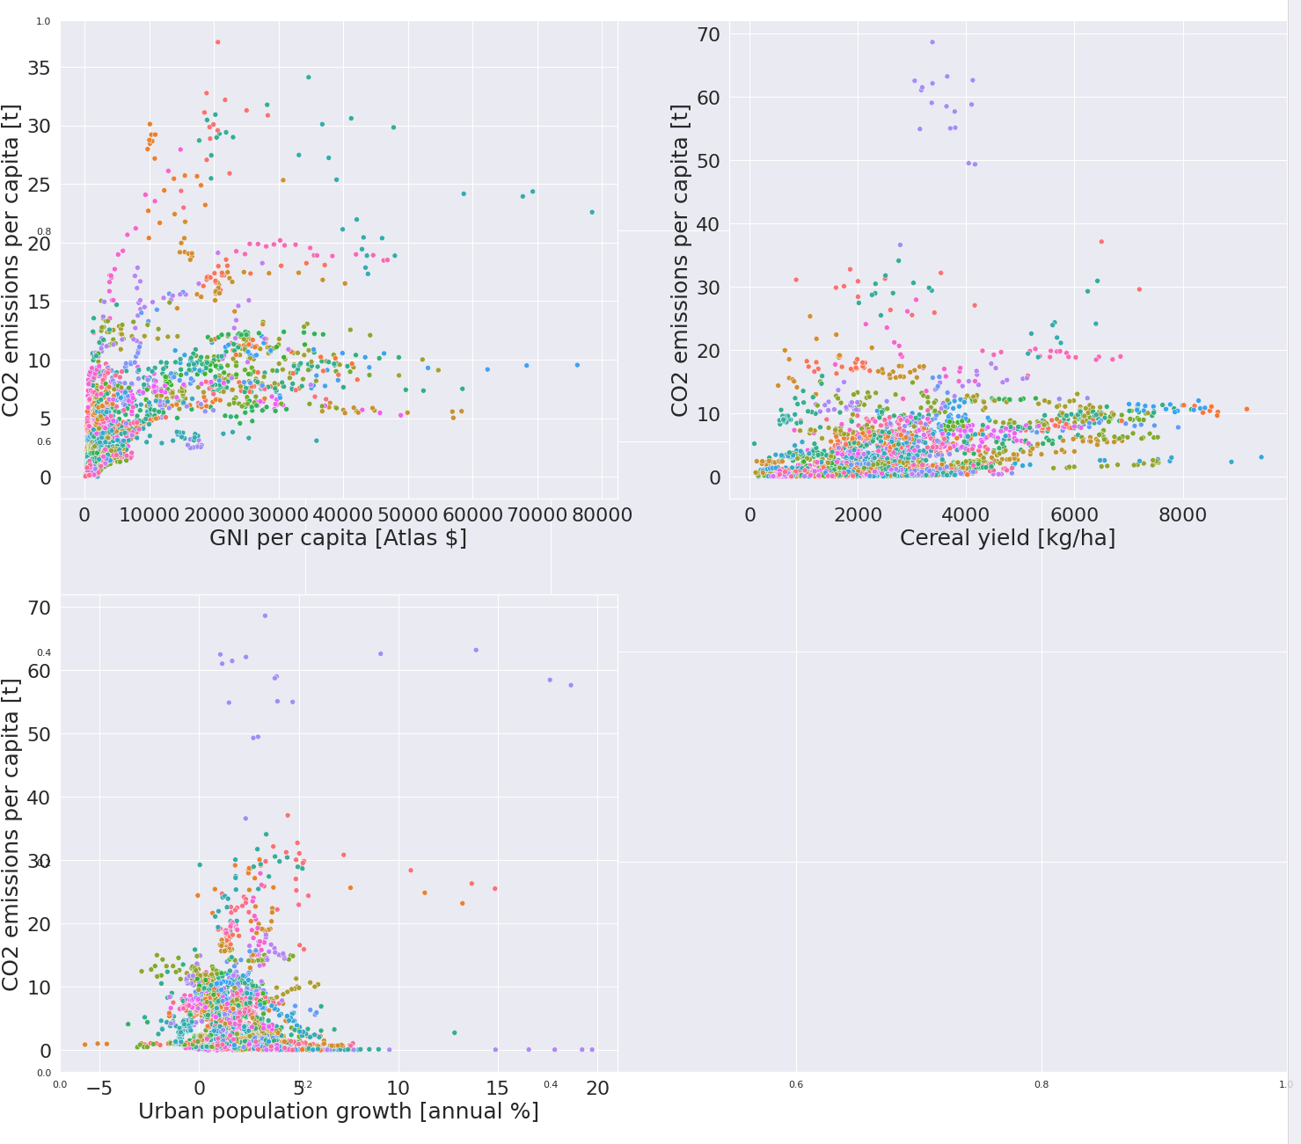
Correlation between features
The CO2 emissions per capita exhibit strong linear dependency on energy use and show nonlinear relationships with other variables.
In most cases are visible not only local trends for each single country but also global trends for all observations. The global trends can in certain cases be divided into multiple data point paths for certain groups of countries or clusters of countries.
Notes:
The variables representing CO2 emissions and energy use both referred to the population count (per capita) are related to more features and are taken for further analysis.
The CO2 emissions per capita exhibit strong linear dependency on energy use and show nonlinear relationships with other variables.
In most cases are visible not only local trends for each single country but also global trends for all observations. The global trends can in certain cases be divided into multiple data point paths for certain groups of countries or clusters of countries.
Groups of outliers with the same colors corresponding to certain countries have been detected. The group that stands out the most from the global trends origins from the data series on the United Arab Emirates

Slide 9
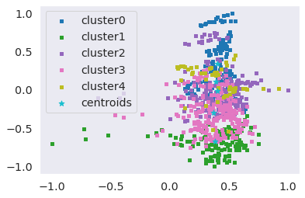
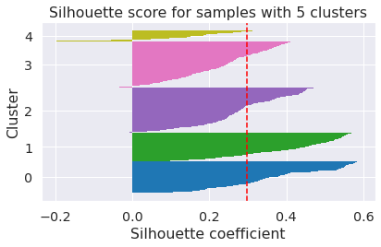
Clustering Analysis KMEANS algorithm
Notes:
I implement the KMEANS++ clustering algorithm after use MinMaxScaler , transform everything in log10 base and standardize via min max.
good_k=5

Slide 10
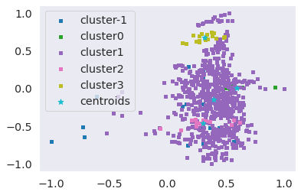
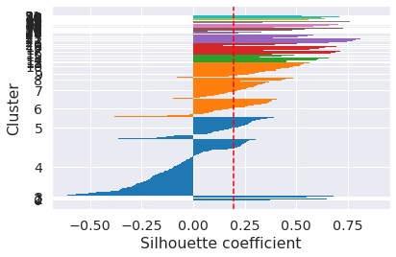
Clustering Analysis DBSCAN algorithm
Notes:
I implement the DBSCAN clustering algorithm. There are 3 clusters.
Best eps is 0.28 with n_clusters 52

