Slide 1

Department of Computer Science
Artificial Intelligence Fundamentals
FOOTBALL-BETTING DETECTION SYSTEM
Andrea Tufo

Slide 2





Roadmap
STUDY
DATA
FILTER & ELAB
SHOW RESULTS
Study of the phenomenon. Analysing how match fixers are used to act.
Retrive data and try to figure it out what kind of metrics can be usefull in order to reach my goal.
Filter usefull data and start to elaborate it.
Show the final prediction.

Slide 3



WHAT are we LOOKING FOR?
The goal of this system is to find anomalies in football matches and try to understand if a match is not valid.
The best way to do it is to looking for match data.
Try to find out if a match is a rigged match seeking bets anomalies it’s quite impossible.

Slide 4
Data structure
ID | HT | AT | STAGE | LEAGUE | …
1
All matches of all european leagues since 2011 until 2016.
ID | EVENT_TYPE | EVENT_TEAM | LOCATION | EVENT_ OUTCOME | …
1
1
1
1
All events per
match.

Slide 5
How does the algorithm work?
The system try to undertstand the offensiveness of a team, during every match throught a calculation of an index.
Of course during a season a team could be more or less offensive according to some factors like: injuries, placing, number of disqualified footballer.
But in average a team offensiveness depends above all by the ability of the team members and, in general by the football team inteded as the entire Club, including staff, coach, trainers and managers.

Slide 6
TRansition MODEL
In order to compute this transition model, the algorithm find an average answering to the question: How many times in average a football team goes from states 1 to states 2? And this for all the possible transitions.
The possible states for a team in my case are two: a state for one or less goal scored and a states for two or more goals scored.
State 1
1 or 0 goal scored
State 2
2 or more goals scored

Slide 7
TRansition MODEL
Of course in order to make the complexity not increase I chose to have only to states. But one improvement for the system can be surely add more states.

Slide 8

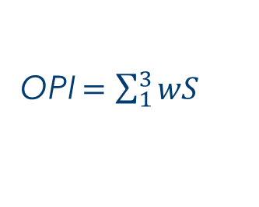
OPI INDEX
OPI (Offensive Potential Index).
A team in a match can have a specific OPI, calculated by the number of shots realized during the match and also by the locations of where the shots came from.
Dividing the field into three areas we can have three differents spots where a shot could be performed.
OPI $=\sum_{1}^{3}{wS}$
$$w=weight of the area$$
$$S=number of shots from that aerea$$

Slide 9
sensor MODEL
Once we calculate the OPI for each team we can calulate a mean and a variation, as in the normal probability distribution. Than we retrive some intervals as shown in the figure.
Denstiry of probability function
The sensor model is represented by OPI. The system calulates how many times the OPI is high/low when we are in state 1 or state 2. It takes a «sample team» to calculate it, of course it can be improved by calculate an average taking all the teams rather than taking only one team.
µ - (µ /σ)
µ
OPI

Slide 10
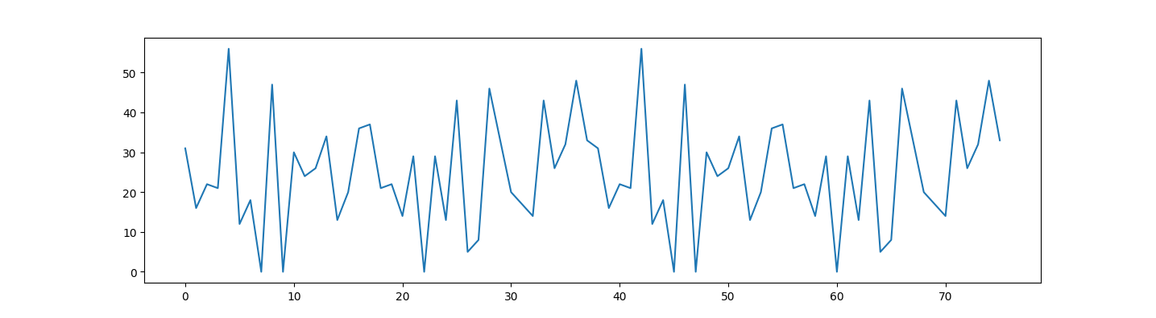
GRPAHS
OPI
time

Slide 11
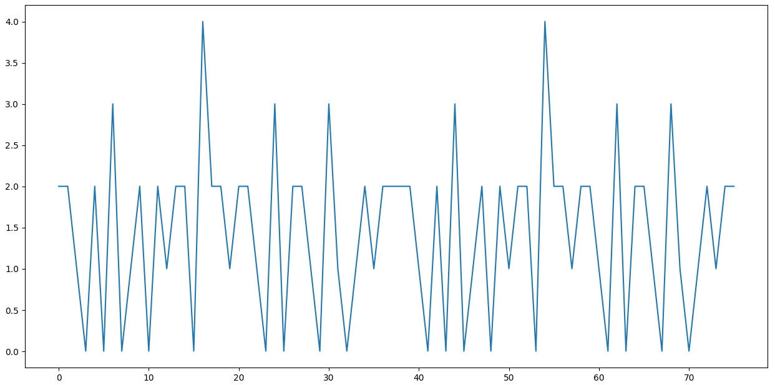
GRAPHS
N° of goals scored
time

Slide 12
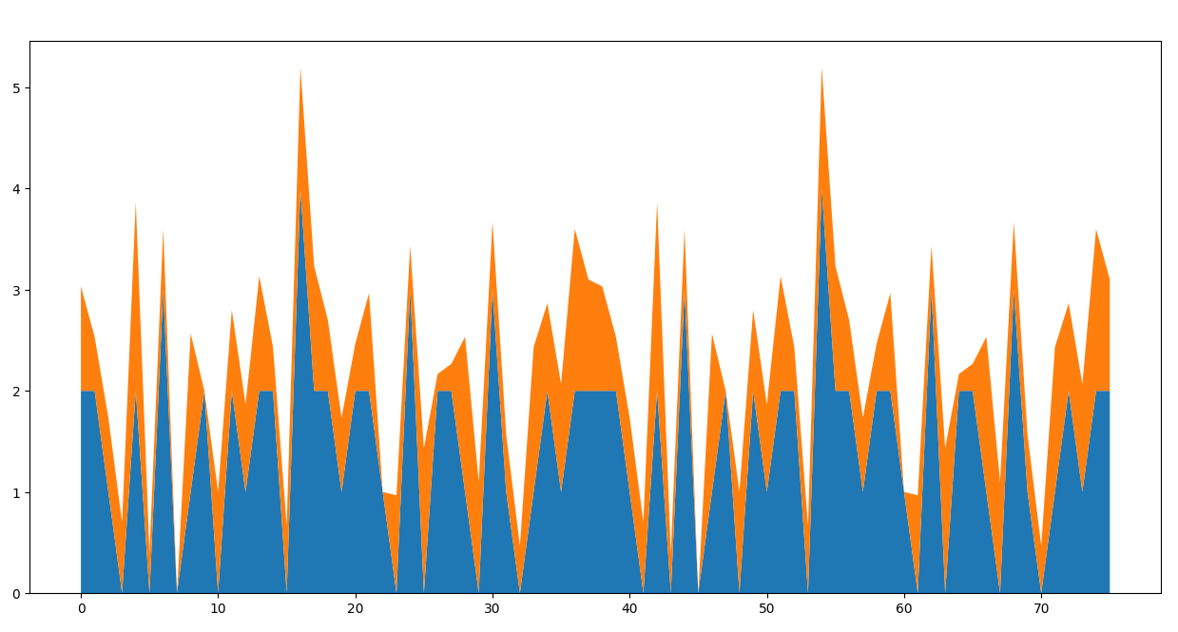
GRAPHS
Number of goals
OPI normilezed
time

Slide 13
FINAL MODEL
RECAP
transition model: two states, zero or one goal scored and two or more goal scored.
sensor model: average level of OPI in the states.
evidences: actual level of OPI of that team in that match.

Slide 14

FINAL MODEL
VS …
VS …
… VS
… VS
VS …
VS …
… VS
… VS
FORWARD – BACKWARD
Or
FORWARD
(or only BACKWARD but…)
t edvidences
VS
VS …
VS …
… VS
… VS
VS …
VS …
… VS
… VS

Slide 15
EXTErnal materials
Aima python library
Kaggle for datasets
github

Slide 16
Thank you for your time!

