Slide 1
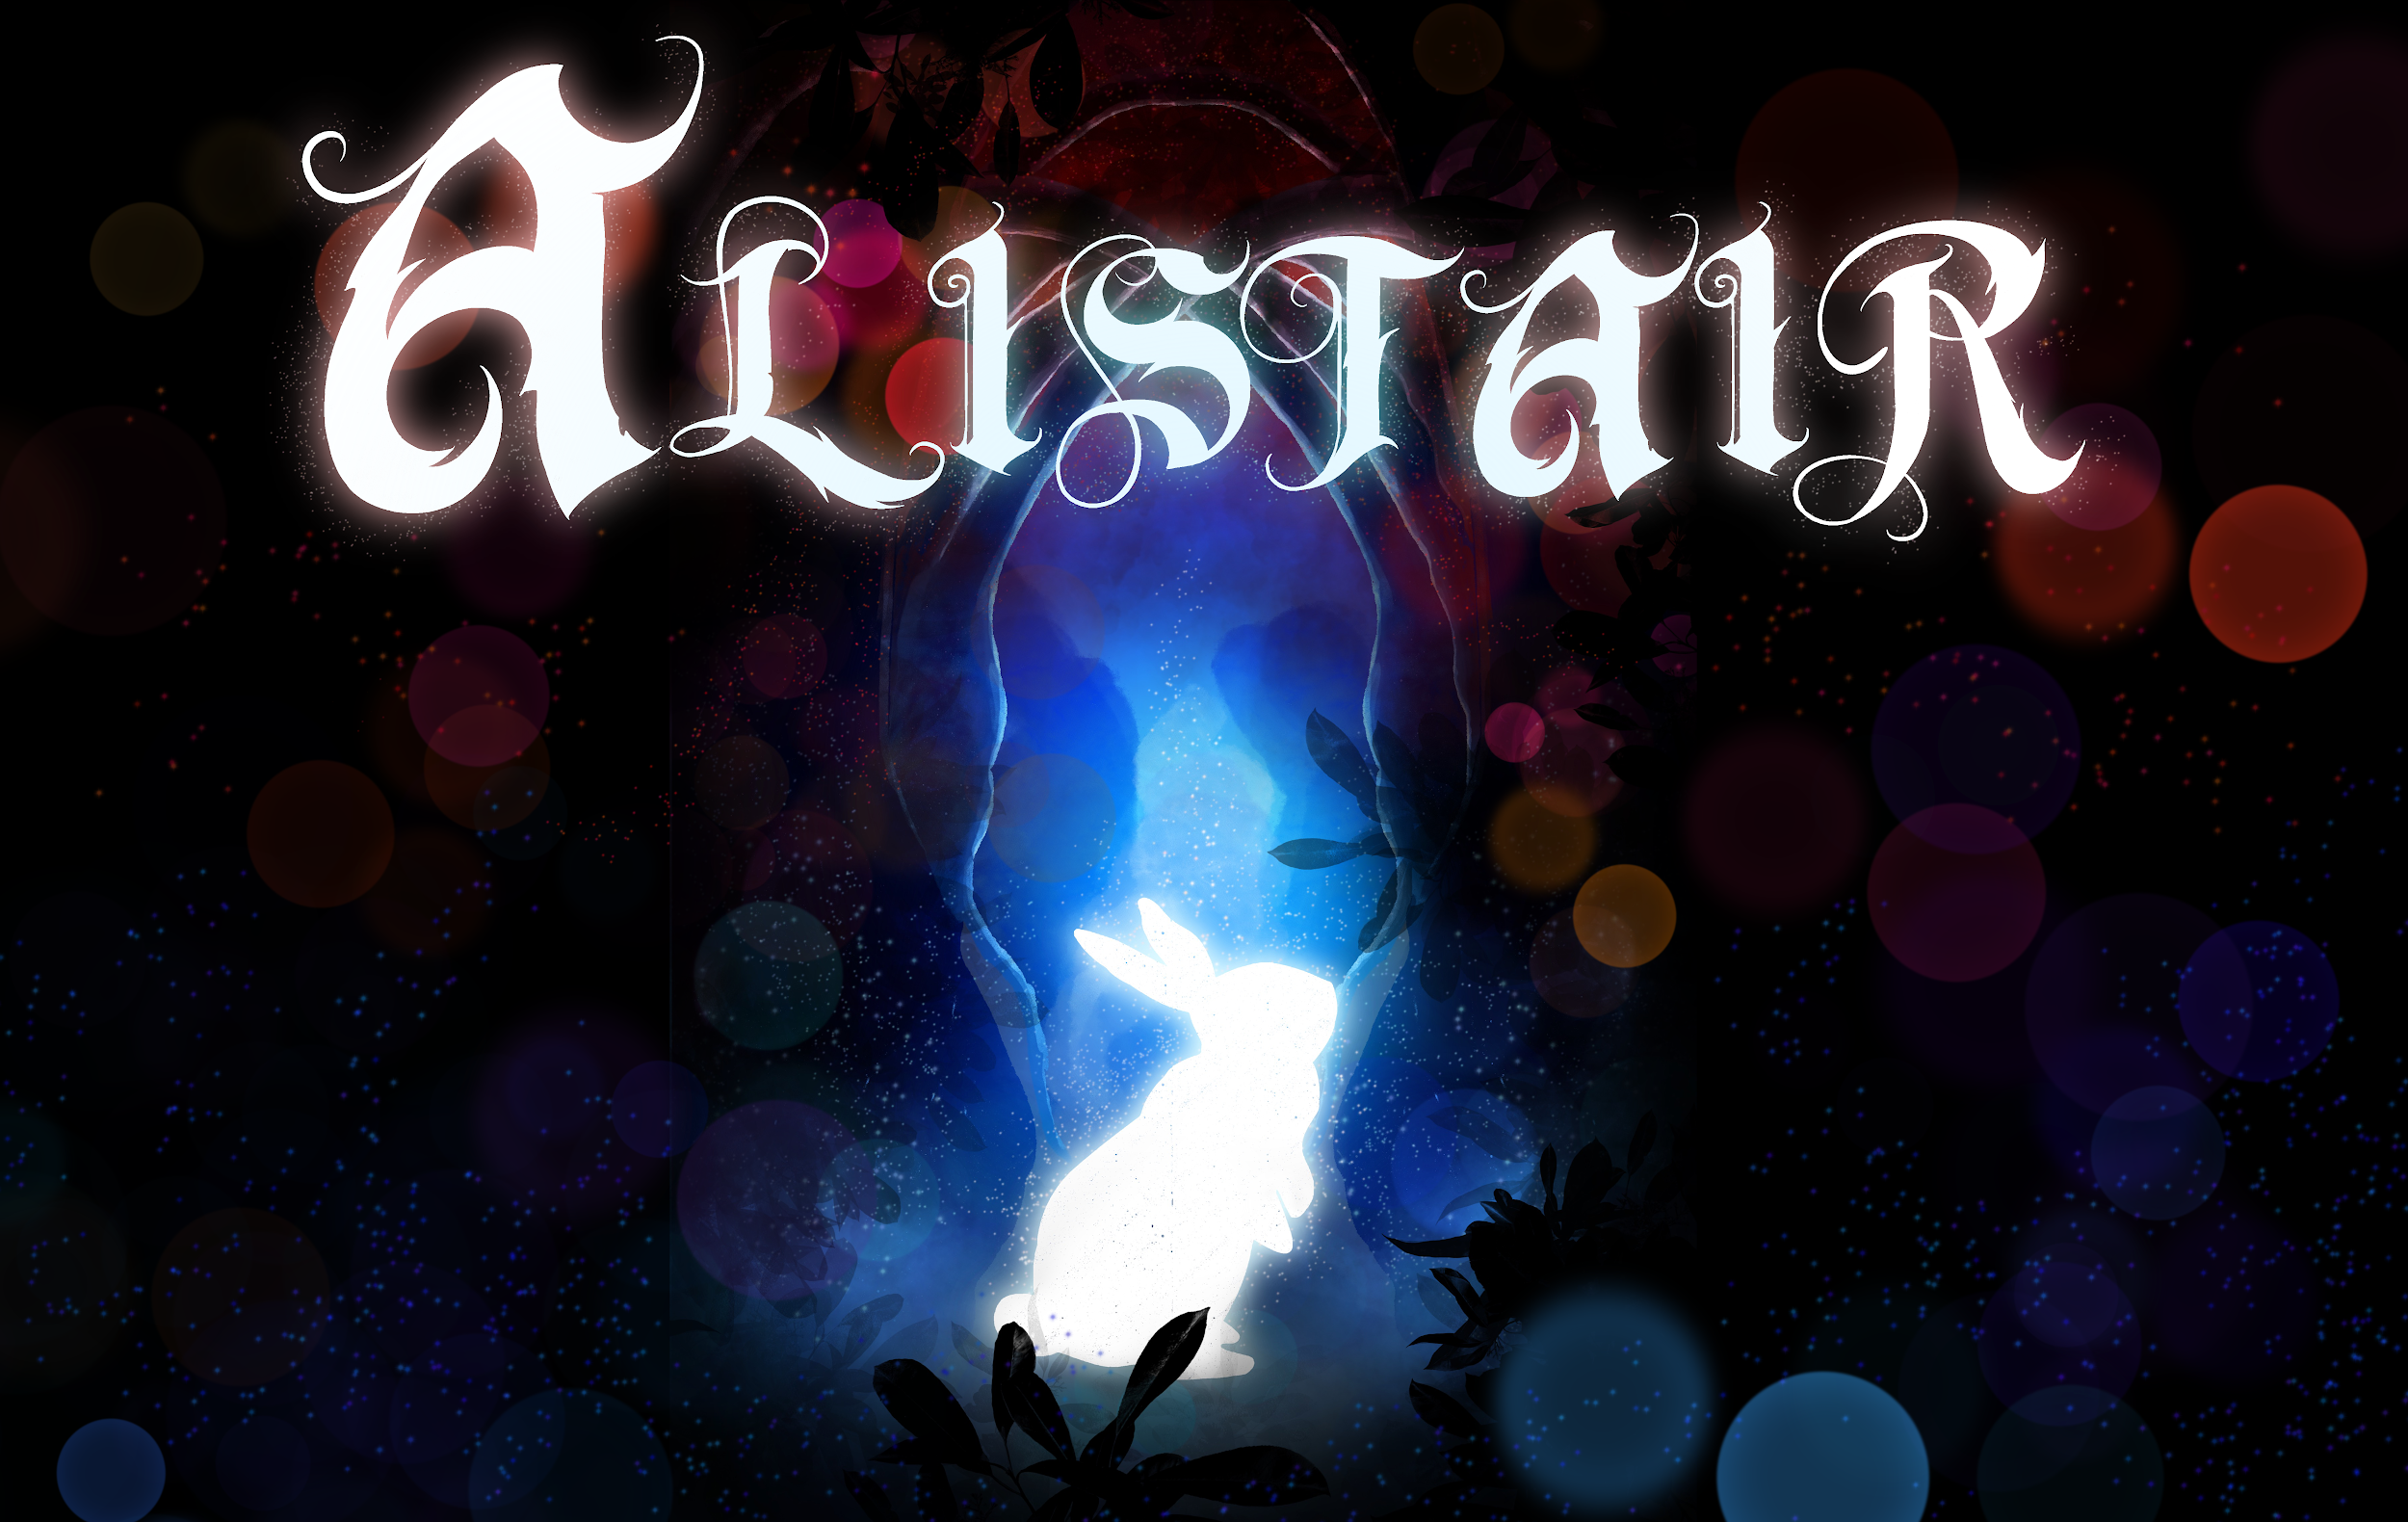

Slide 2
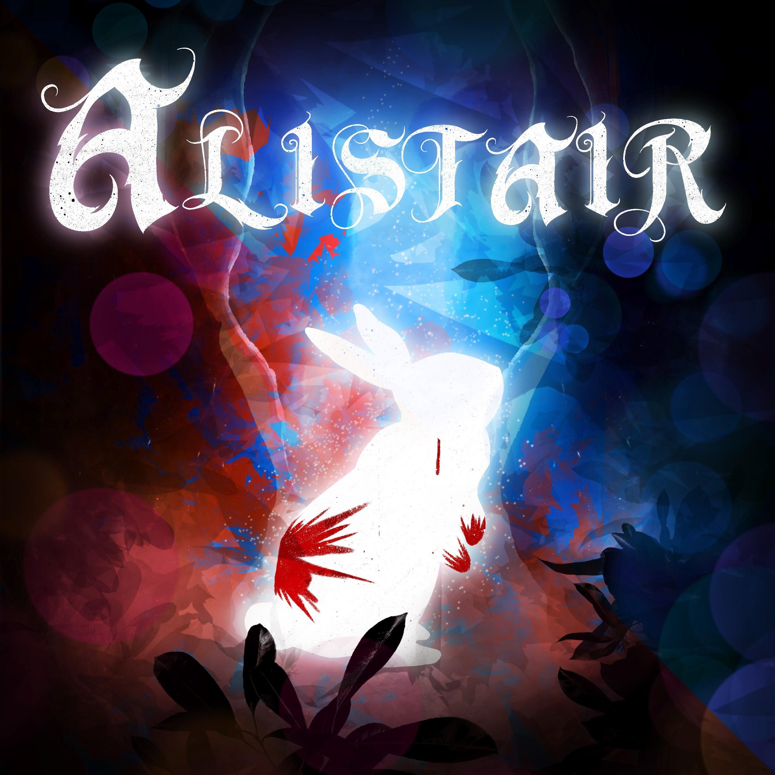
ALISTAIR Developed By: Elena Kosowski
Andrea Abellera Composed By: Marc Yu Miles Acquaviva Art and 3D Modeling:
Jacqueline Ferreira
Notes:
-Inspired by a darker take on imaginations: the manifestation of guilt in your nightmares -You play a character who dreams of a forest, and you must catch a rabbit named Alistair before the fog consumes you and Alistair
-While the game isn’t complete and only has simple gameplay -Alistair was your younger brother -After your younger sister murders him, you have nightmares about being unable to protect him

Slide 3

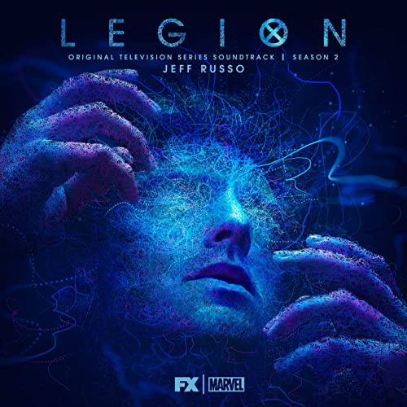
Electronic Orchestral Score
Portal
+
Legion

Slide 4
Live Recording: Izzi Guzman
Adrian Rincon
Quinten Cohen
Rhiannon Ramsey-Brimberg
Will Figler
Logan Mitchell
Gret Price
Collin Vodicka
Austin Burkett
Alyssa Fabian

Slide 5
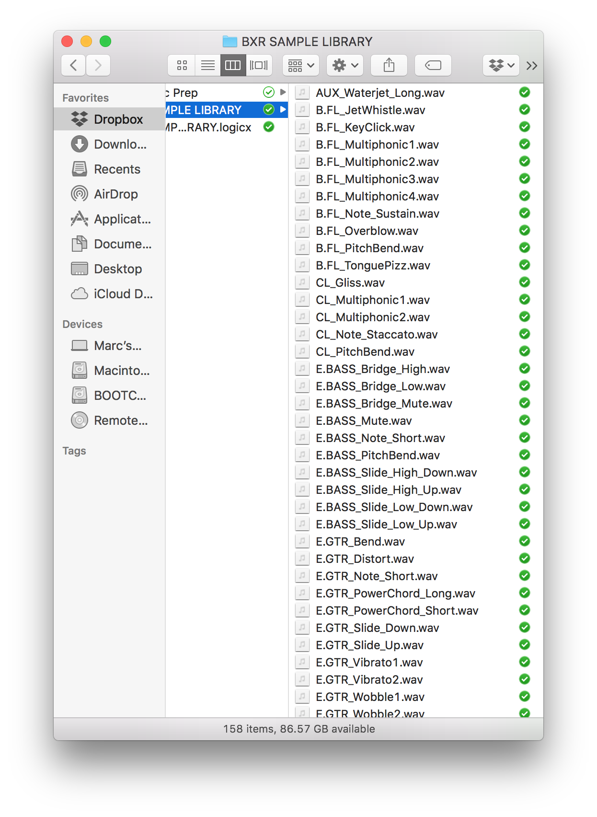

Slide 6


SPECIAL THANKS
3D Printer • CNC Mill
Laser Engraver • Spindle
Table Saw • Hand Drill
Waterjet Cutting Machine
Additional String SFX
Notes:
-Project Manus: effort to expand student communities and resources -Recorded on campus -Disney, Netflix, Amazon, LucasFilm
-Parasite, Star Wars, Get Out, Skyrim, Total War: Warhammer, and more

Slide 7
Alistair Original Soundtrack
1. Suite
2. Awake
3. Into the Void Again
4. Slipping Away
5. Resurfacing
6. Just A Dream
7. Alistair the Rabbit
8. Beware the Nightmare
9. Portal To Sinister Depths
10. Can’t Hide
11. It’s Coming...
12. All Over Again
13. Don’t Let Me Go
14. Promise I Won’t Hurt You
15. Already Gone
16. Brat
17. Whispers
18. Shadows Won’t Help
19. A Dangerous Place to Be
20. Come Back
21. I’m Dead
22. Sweet Sweet Alistair
23. She Was Always There
24. Dark Forest
25. The Fog
26. The Three Bees
27. Night Sky
28. Locked-In
29. Family
30. A Tragic Story
31. Lily
32. Hallelujah
33. Love Like You
Notes:
-80 minutes of music, 33 cues -Almost entirely live recorded with live samples from Berklee, MIT, and Budapest Scoring -M01 Suite, M15 Dark Forest, M16 The Fog, M20 Family, M21 A Tragic Story, M91 Love Like You

