Slide 1

Web Development Workshop
By yours truly, Andrea

Slide 2

On behalf of the WICS website committee coordinator
< RecruitingVolunteers />

Slide 3

Let’s gooooo

Slide 4

THE BIG BOSS
in the CS industry entry-levels
React: You must learn me to get job >:)

Slide 5
A very long time ago, I tried making a basic webpage. I only used the <h1>'s, <p>'s, <img>'s, with a few other tags.
Every now and then I would copy code of small JS games into my computer. I will edit one or two things from the HTML, CSS, or JS files. I do not fully understand how they tie together but I'm very happy seeing that when I open the HTML file again, the change reflects.
I got a MEAN stack book. Read through pages of docs without really understanding anything
I went through FreeCodeCamp's lessons. I took the Responsive Web Certification modules then jumped into React. I only semi-understood React and quickly forgot everything
MISA - Volunteered to help out in a Jekyll website. Worked with basic but essential parts of HTML like classes vs ids. Learned how to serve websites with the CLI (as opposed to double-clicking an HTML file)
On a friend's recommendation, I started learning Figma. I used it to make graphic design and animations, and UI designs much later
WICS - Their website migrated from Jekyll to React. I was part of the web committee but had zero experience with React and Next.js. With lots of trial and error, I fully revamped the contact page
HCI 1 - I led and coached our group to develop a high-fidelity web prototype. Learned CSS grids to make layouts
Ecoyou - Attended a hackathon and worked with a developer that turned my UI design into a React frontend like magic
Simple web stack - Tried developing my own React app with .NET, plastering bits and pieces of code from the hackathon and doing some research
Only half-understood many things
1st internship with Delphi Tech Corp - Learned to be well-versed with vanilla JS, JQuery, and AJAX. Started making CSS art in my free time
Casually CSS - Published my first npm library of CSS artworks
HCI 2 - Made a mobile-friendly fully-responsive prototype from a single .js file
LibP2P/IPFS - Higher contact with async JS and understanding more Node architecture
TD Community and Tools developer - Learned to hack the CSS and JS to modify frontends - good lessons on hierarchy
Casually.dev - A full summer project on learning Svelte and building a big site with many complex components from scratch
Lego Instruction Maker - React Native, first dev contact with Typescript, ngl coming from a mainly JS background I had to spam the :any typing and shove all my components to one interface
WebLC3 - Applied all the skills so far in a high-stake project! Learned state management(globals/dispatches/stores), component lifecycles, middleware, difference between client vs server side rendering, dev vs prod builds. Understood Typescript better
Packet Visual - This became a chance for me to revisit React development. It's like an RPG boss that destroys you the first time as a young child. After many level ups and completing adventures, you return ready to fight the big boss again!
Casually Components – Publishing my own component library on various Node frontend frameworks - Angular, React, Vue, Svelte, Solid
SWE2 - CI/CD pipelines and automated builds and tests
CONVO
LUTED
WebDev journey

Slide 6
😱
MISCONCEPTIONS
These thinking traps are common

Slide 7

What is this pattern [state, useState]? What is difference between function, or the const variable with the arrow thingy ()=>{}. What’s up with onMount and async wrappers. Why are some code in double brackets {{ code }}, single brackets { code }, or no brackets at all! When do I use the right one? Why do some variables have a $ on front or a () at the end? What in the world is happening with `<div :class = "'class1 class2 ${gridStyle}'">`
Dynamic WebDev is easy to learn
Relevant:
https://dev.to/lukelavalva/super-mario-jsx-and-the-destruction-of-the-web-development-learning-curve-3ln4

Slide 8

..and modern web application architecture be
Relevant:
https://youtu.be/Sxxw3qtb3_g

Slide 9
You can learn with one sitting
Finishing tutorials, small puzzles, or following through step-by-step sample apps won't make you learn for the long term 😢
This workshop is an introduction. You learn by engaging in active development

Slide 10

To make a dynamic website,
I must learn React
This Photo by Unknown Author is licensed under CC BY-SA
Single .js file can also achieve dynamicity! (in fact, I encourage coding vanilla on your first portfolios)
Frameworks are better for large-scale projects

Slide 11
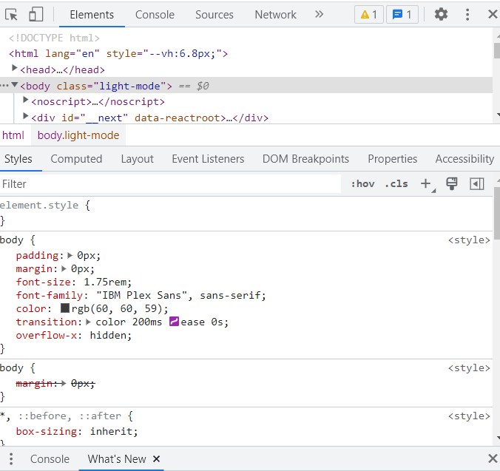
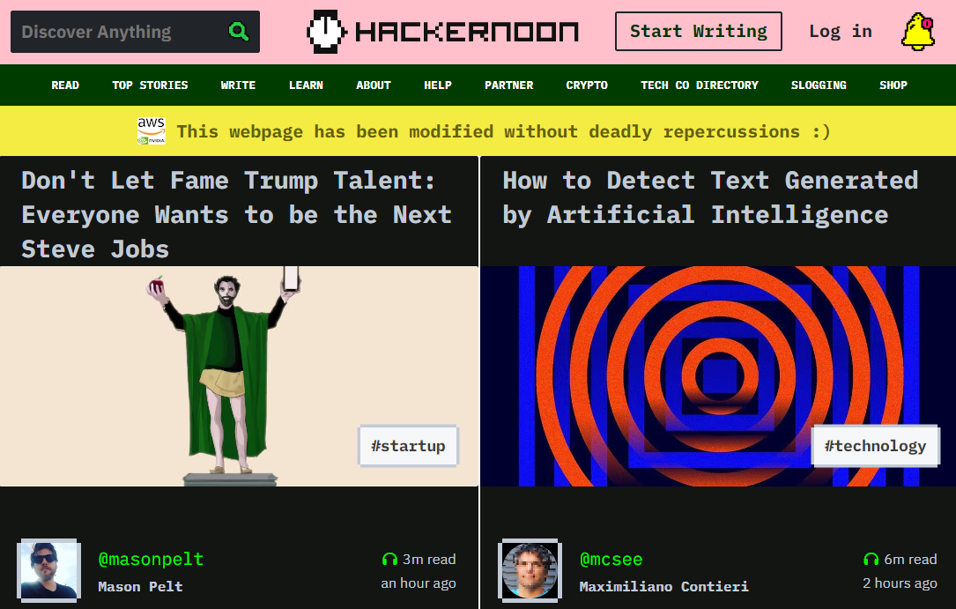
Built-in Browser Console
CTRL + SHIFT + J
Offers direct HTML and style override, Javascript runtime, and network resources and sources debugging
Try it on any your browser!

Slide 12
HTML
Le building block of everything

Slide 13
JAVASCRIPT
Popular language for web development
Javascript has the ability to directly refer to any element on the screen and modify it!
You want to change the text here?
You want to turn this bar pink?
You want to load boxes for blogs and
fill it with information?
Javascript can do it 👍

Slide 14
What is it like as a programming language?
Javascript is a dynamic language, meaning you don't need to define the type for the variables you create.
This is convenient, but can also be problematic or confusing.
let cat = 0
cat = []
cat = () => { console.log("Meow") }
cat = { class: "animal", sound: "Meow" }
cat = "Jokes on you, I'm just a string at the end"
console.log(cat)
If you prefer defining types, use Typescript. It's better for larger engineered projects with multiple devs. On frameworks, TS and JS programs are compatible, they can call functions from each other!
JS is a scripting language. When HTML links it, the content as is will be run from top to bottom

Slide 15
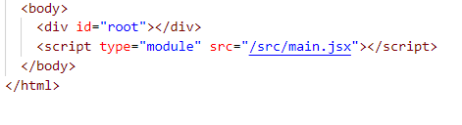
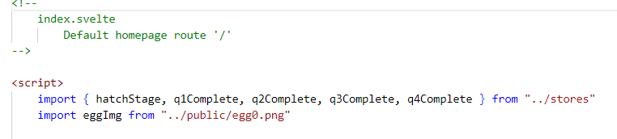
It is both functional and object-oriented
Write it as a class or a function 🥰
MODULES – export and import functions to be used by other files!
HTML can import js script
JS can import another js module
TS can import js module
React can import js module
Vue can import js module
Svelte can import js module

Slide 16
Other stuff you will encounter in the NodeJS ecosystem
(but we won’t touch on them for this workshop)
**Node modules and packages** - See that package.json file? Yes, that's important. npm makes it possible for you to plug-and-play any development library or tool to your stack
The NodeJS dev's headache - **Common JS requires vs ES6 modules**
There are a couple ways to connect a js via script or module... the compiler or runtime may scream at you if it's not the right way or cannot access the resource *CORS*
Other dev tools like builders/bundlers (vite, webpack, parcel, babel, grunt) and test libraries. Your app skeleton will come pre-packaged with at least one builder to allow you to serve your app :)
Extensions to other device platforms - React Native (mobile), ElectronJS (desktop)
Web dev on frameworks can be a bridge to desktop and mobile dev too!

Slide 17
START FRESH WITH
A SKELETON

Slide 18

PREREQUISITE
Get NodeJS for your OS
https://nodejs.org/en/
https://nodejs.org/en/download/package-manager/

Slide 19



`npm init vite`
Generates the fastest starter apps for
What could I say? I’m a fan 🤩
Let’s use it!

Slide 20
START FANCY WITH A DEMO APP

Slide 21


REPOSITORY
https://github.com/andreaabellera/FreeTheEgg

Slide 22
Quest 1- Math game
Variables that react to change (known as states or refs) are what makes dynamic apps efficient to work with!
Try your hand on this modified grade school math game

Slide 23
Quest 2 – Component Artist
Our app is made of components, building pieces of our site known by a name. On any page or layout, you can import components and use them indefinitely. The bar on top is called a Header. That bar below is a Footer. The where this text is right now is a Guide. You can change how our website looks by playing with a Palette. You can observe what's the code behind-the-scenes that run behind the scenes in real time in real time with the CodeBox!

Slide 24
Quest 3 - Unboxing
You can put something inside something an easy way while maintain how they both look!
These are known as slots

Slide 25
**Props** - data that is passed into a component's scope
In Svelte,
- **Props** - Pass data from parent to child
- **Dispatch** - Pass data from child to parent
- **Stores** - Pass data from anywhere to anywhere! (OP feature)
- **globalThis**, **global**, **window**, **localStorage** - Store and get data from anywhere. Built into your Node or browser environment rather than framework. Not dynamic or reactive even if you use it in conjunction with reactive states, you need to check manually via polling or on event

Slide 26
Revisiting OP
State Management

Slide 27

MyDataStructure.ts
> Pass data from anywhere to anywhere! (OP feature)
It is called **State Management**
Learn its power and you will transcend frontend
It doesn't matter if the variable watching it is 18 hierarchies up or 14 folders down from the component or script that updated the data, it's going to get and respond to that change
Set a single stores file
Set every file that is interested on that data to subscribe to it
stores.js
Hero.vue
somefile.js

Slide 28
HOOKS

Slide 29
YOUR CHOICE

Slide 30
This is an excerpt 🥲
I did not finish everything I aimed for (e.g. React and Vue apps for FreetheEgg) but will continue developing the repo after this workshop
Thanks for tuning in!

