Slide 1
Reproducible Research
Denver NICAR -- March 11, 2016
Bill Alpert
Barron’s – Dow Jones

Slide 2
Why Reproducible Research ?
Credibility -- Evidence for your story’s truth.
Sharing -- Give other groups a head start.
Quality -- Reinforces good work practices,
e.g. Do It Once, commenting, version control,
no cutting & pasting changes…script everything.
Teamwork – Easier collaboration,
with others and your future self.

Slide 3
Requirements for Reproducibility
1. Include the original unmodified data sources.
2. If raw data is transformed,
preserve that transformation in scripts.
3. Document everything you do
using # comments.
4. Produce a "human digestible" artifact
(.html, .pdf etc.).

Slide 4

A Good Book
https://github.com/christophergandrud/Rep-Res-Book

Slide 5
https://www.coursera.org/course/repdata
“Reproducible Research
Part of the Data Science Specialization »
Learn the concepts and tools behind reporting modern data analyses in a reproducible manner…”

Slide 6
Don’t just reproduce….

Slide 7
Don’t just reproduce….
Preplicate !

Slide 8
Preplication =
Replication in a story’s preparation.

Slide 9
Huh? Preplication by who?
By the folks you’re investigating!
Share your scripts and data, securely, with those you plan to write about.
Invite them to explain, critique, debug, falsify.
Wouldn’t you’d do that with documents?

Slide 10



March 2, 2015

Slide 11
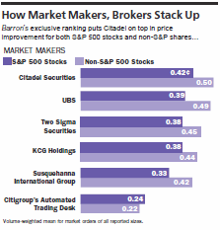
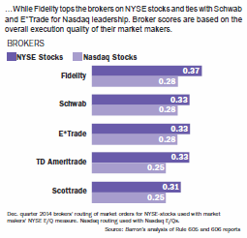
March 2, 2015

Slide 12
The Preplication/Replication Files
rule605/
README.Rmd
README.html
analysis/
form605_write_functions.R
rule605_report.Rmd
Rule605_report.html
results_data/
data/
constituent_data/
russell1000_constituents.csv
Sp500constituents.csv
tickers_AMEX.csv
tickers_NASDAQ.csv
tickers_NYSE.csv
f605_data/
sample_rule605_data.dat
gather_source/
form605_makefile.R
form605_merge_data.R
install_packages.R

Slide 13
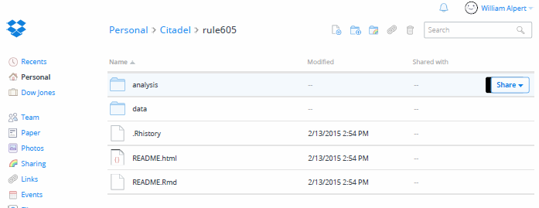
Preplication Files in a
Password-Protected Dropbox

Slide 14
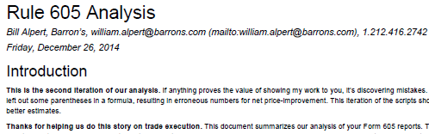
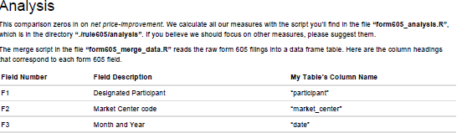
Dynamic HTML Documentation using Markdown
Step-by-step instructions to run the code
A data codebook

Slide 15
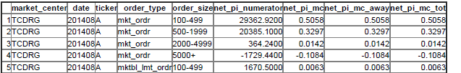
Dynamic HTML Documentation using Markdown
Formulas
Tables

Slide 16
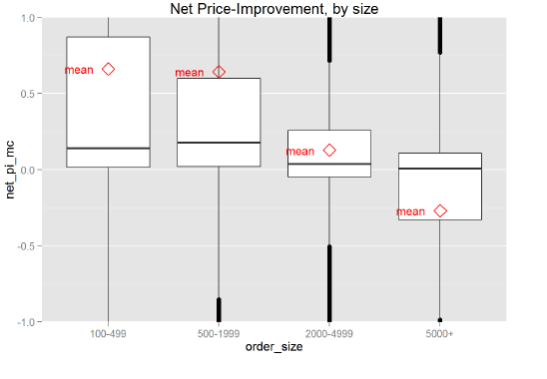
Dynamic HTML Documentation using Markdown
Figures

Slide 17
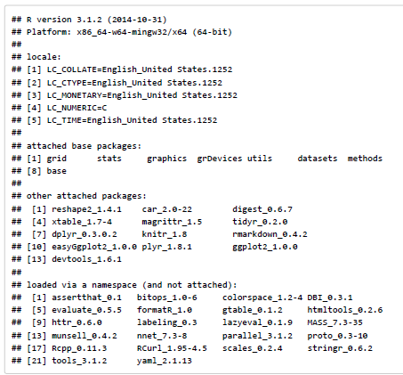
Dynamic HTML Documentation using Markdown
Session Info on Packages, etc.

Slide 18
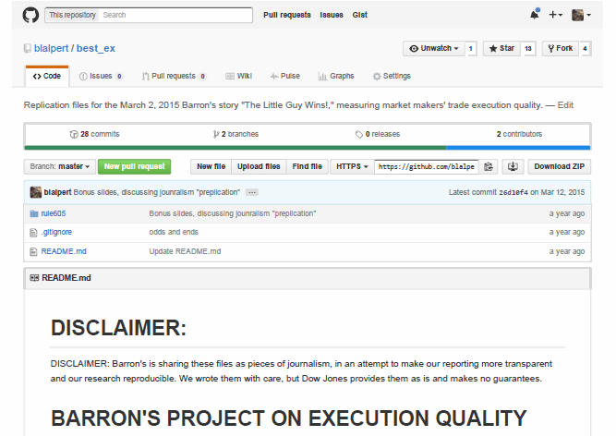
The GitHub repository

Slide 19
Why Preplication ?
No Surprises – The data version
Fairness
Duty of care
…

Slide 20
Why Preplication ?
No Surprises – The data version
Fairness
Duty of care
Getting the answer right

Slide 21
Requirements for Preplicability
1. Include the original unmodified data sources.
2. If raw data is transformed,
preserve that transformation in scripts.
3. Document your script lavishly,
using # comments.
4. Produce a "human digestible" artifact
(.html, .pdf etc.), with Markdown.

Slide 22
Requirements for Preplicability (continued)
5. Plain text: it’ll always be in style.
6. Confidentiality: compartmentalize sources
you’re “confronting” from each other’s data.
Don’t publish libelous work-in-progress.
7. Free, open source, cross-platform (R, Jupyter, PC/Mac)
8. A stable, vanilla software environment ensures needed software remains available.

Slide 23
Don’t just reproduce….
Preplicate !

