Slide 1


Slide 2

Vision
University might be hard, and hard might be to get connected with other students.
We aim to create a community where students can find cheap notes, the uploader of that notes may gain some money.

Slide 3
Problems
Students want to always find the cheap and valuable materials to study and they are becoming better at it.
Often students have to find another job to pay for their study and living expenses.
Difficult to find high quality materials online with the same teaching methods of your professors.
Not enough communication between students.
Not enough communication between students.

Slide 4

Today’s solutions
Search for answers on the web.
Use an online tutor.
Buy a full pack of notes in facebook pages

Slide 5
Why are these solution not efficient ?
Expensive
Buy a full pack of notes, hire an online tutor is expensive.
Boring
Finding the right information using the engine research usually takes long time.
No Quality
When you get a full pack of notes you might like some part, not all of them.

Slide 6
Our Solutions
Access notes for 5$/ month
Become a tutor and earn money
Upload your notes and get paid
Sell your
used books

Slide 7
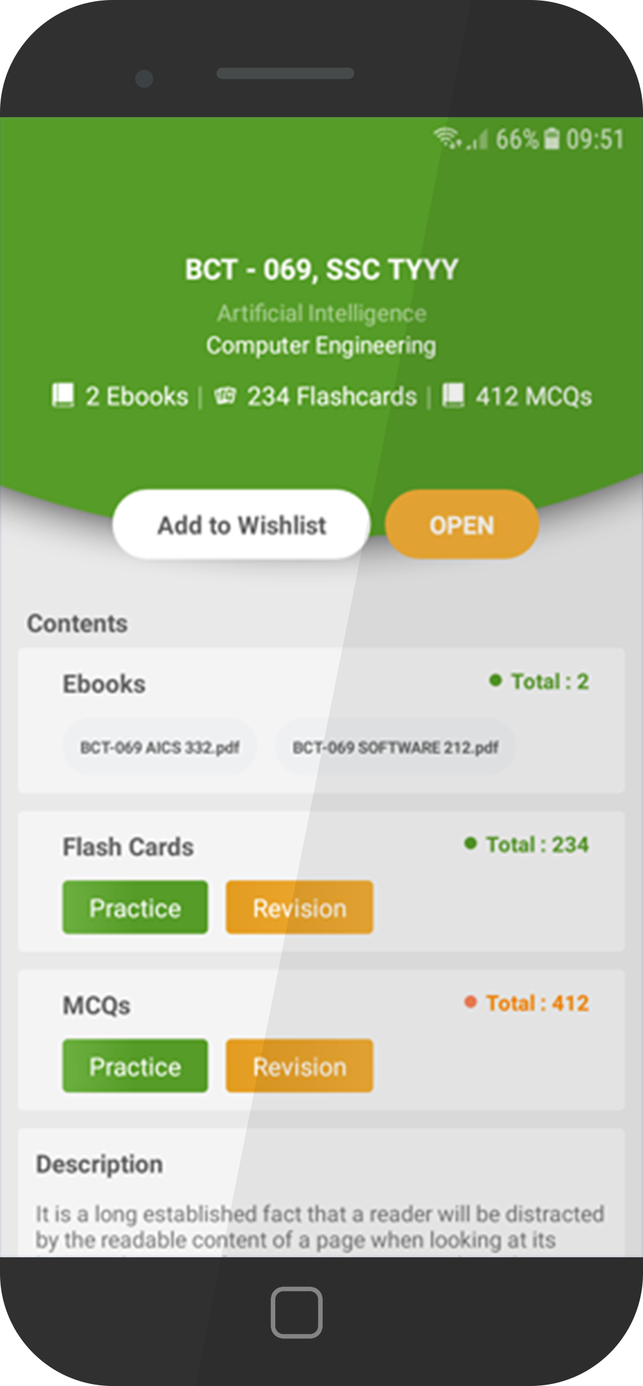
Mobile application
Web application
Fast access
Check your stats
Access notes from anywhere
Check money, views, subscribe and so forth.
Search Notes
Upload notes
Access all your course notes
Upload and manage your notes.
MCQ test
Send newsletter
Do the MCQ test in our app
Notify the students when you upload something

Slide 8
Notes quality benchmark
The notes that are uploaded have to follow a certain standard.
Vote the notes!
Stars metter!
Any students can give a feedback to the notes.
Notes lower than 4 stars would not meeting our benchmark.

Slide 9
Payment method
50% of the revenue are given to students, based on their skill.
More
View...
More
Stars...
Fair payment
More
Cash out !

Slide 10


Customers profile
University Students
between 19 and 30 years old
With studying issue
With a low budget

Slide 11
Competitor
StudySoup
USA Based
Other cost involved
StudySoup is operating only
In the Usa market
Student must buy also the study guide.
Over 1 million subscribe
Expensive
The business model is working very well
StudySoup cost 11$/month, for a 1 year subscription.

Slide 12
Unfair advantages
1st in Europe & Asia Market
Business model working in USA
Target customers well defined
Cheap and use full
The product is use full, for uploaders that can gain some money & Downloaders, that can get notes for a cheap price
No real competitor with the same business model in Europe and Asia
That give us a confirmation that the software is valuable.
We know where customers are and how to reach them.

Slide 13
Market
210 millions students worldwide
½ Students are in China & India
We have 210 millions possible customers
That market has not be touch by a similar software
Right time
Students want fine always a way to gain some extra cash

