Slide 1


Slide 2

StuSmart
StuSmart is easiest way to access digital documentations for studying purpose . It is made to break barriers between student and professors.

Slide 3

Problems
No enough communication between students.
It is hard to find online high quality materials with the same teaching method of your professors.
Lack of interactive materials.
students hav to find often another job to pay their study and living expenses.
Students want always find the cheap and valuable material to study. It is well/known that students are becoming wise on this topic.

Slide 4
Today solution
The solution today is to use StudySoup,where you have to pay an expensive subscription fees ( 120$ yearly ). This will give you access to a range of documents in different campus in United States. With a lot of daily notes made by students. The writers are paid by the company to upload notes. There are not suitable solution now a days. The only solution is find a tutor online. It is kind of expensive.

Slide 5
Why it does not work
A student might be week just in one subject. It is expensive to pay for that subscription. that cost 120$ a year.
Other cost are involved for example buying a study guide.
Tutor online are really expensive. Some subscription method are asking 15$ a week just half an hour of talking.
A student who upload notes does not get enough money.
Some students have access to chat with a tutor but the chat is well known that can be confusional. Is better a face to face exchange of information.

Slide 6
Our Solution
We want create a market place. Where students can upload notes. They will get a 50% for any user that subscribe under one of their courses. Also they can be tutor for a student in the platform. They can chat and then see each other and explain the lesson.
Subscription: 5$/ month.

Slide 7
Our Solution
Student Side
Uploader Students.
Can sell used books.
Can upload their profile as tutor for one course.
Can upload daily notes and they will get paid by our platform.
Subscribed Students.
We will have a low fee as 5$/month.
Students will have access to a lot of things, such as Daily Notes, Full notes and tutor.
Our solution is a 3 way win, for professors, uploader and downloader.

Slide 8
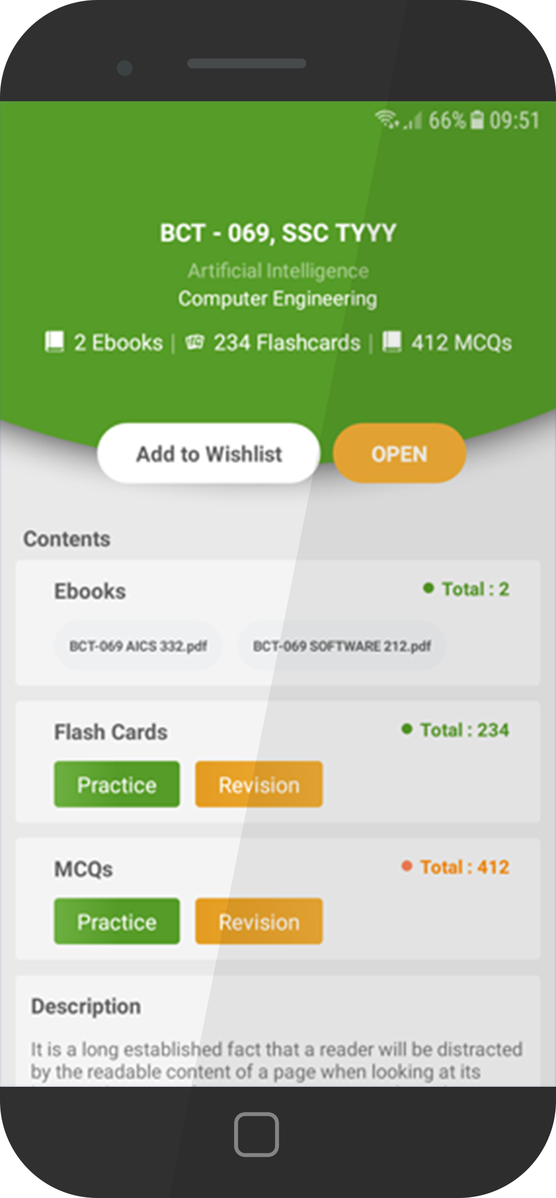
Our Products
Mobile application
It will be used by the students to download the file. Easiest way to access and download documents.
Web application
Used for all the case scenario: Students and professors Uploading and downloading

Slide 9
Business model
We are generating revenue getting a low monthly fee. The monthly fee will be splitted between us, the student who upload free content.
The student can get more money by becoming tutor.

Slide 10

Customer Profile
Students
beetwen 19 - 30 yars old

Slide 11
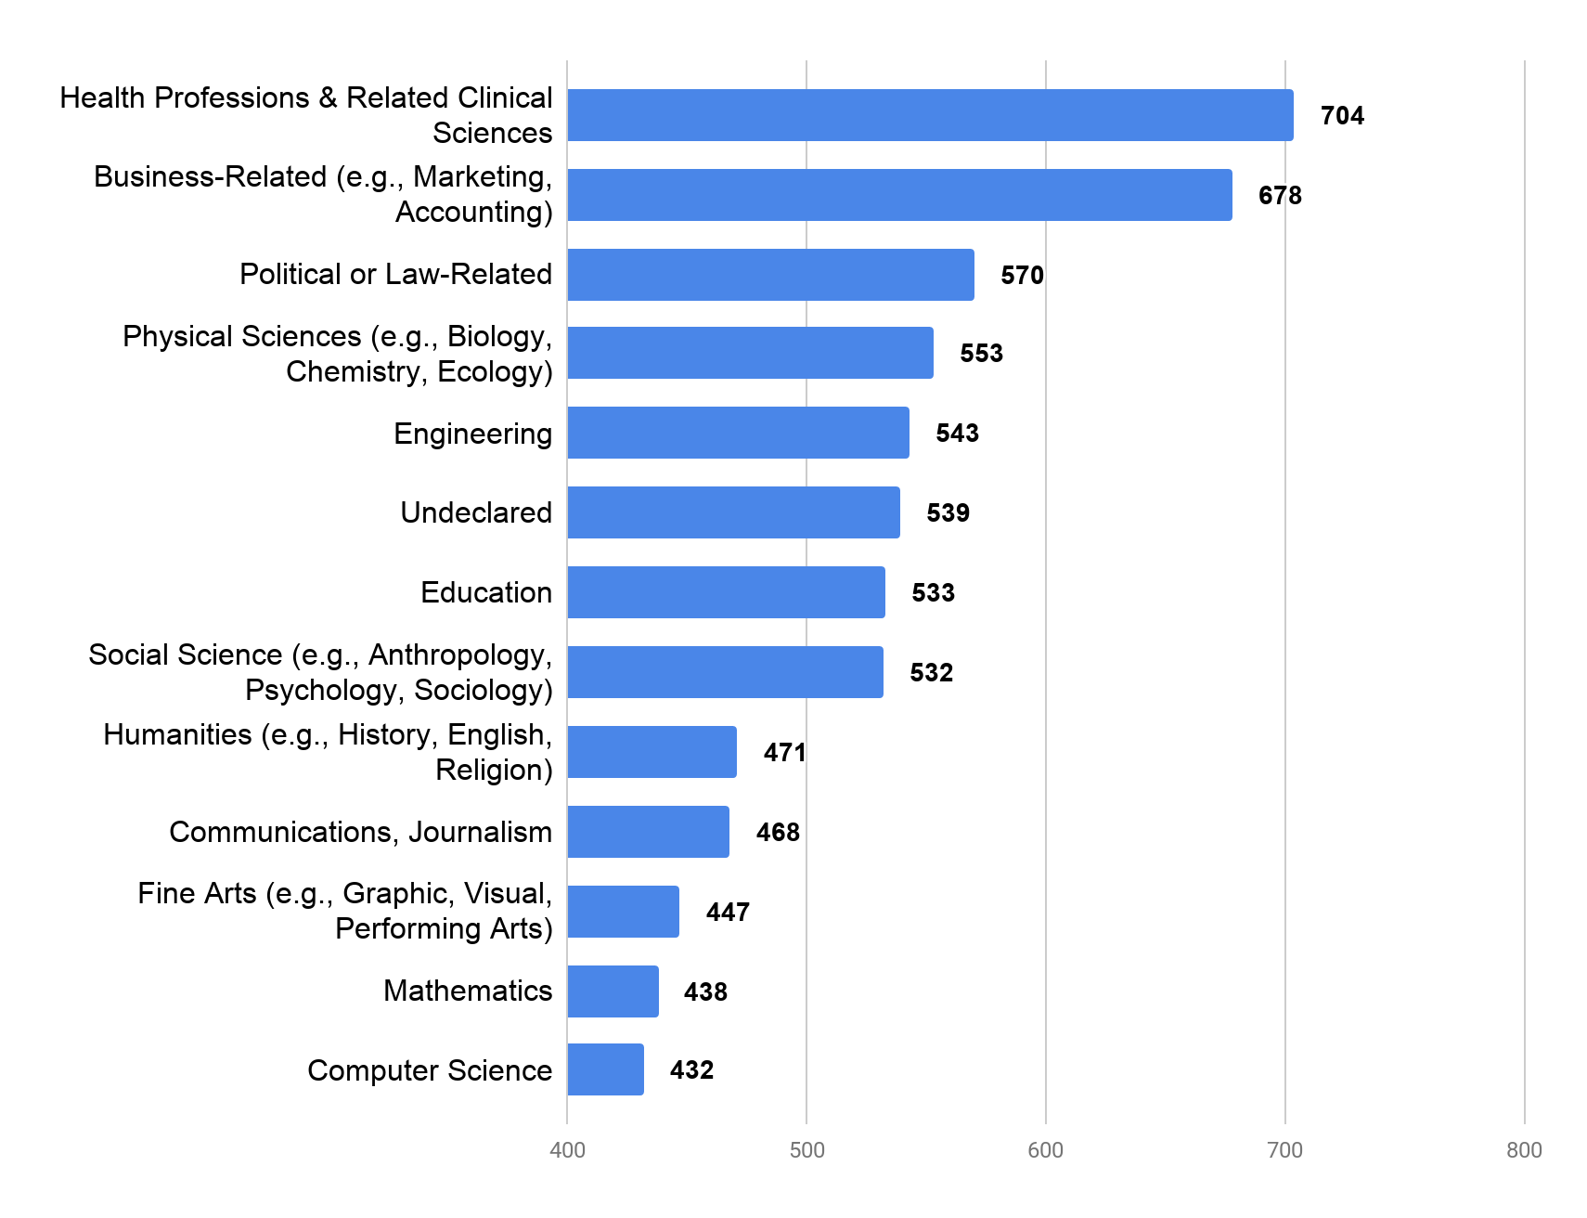
Market
How much does it spend a student ? This shows how much a student spend based on courses. there are 207 millions, according to UNESCO.

