Slide 1


Slide 2

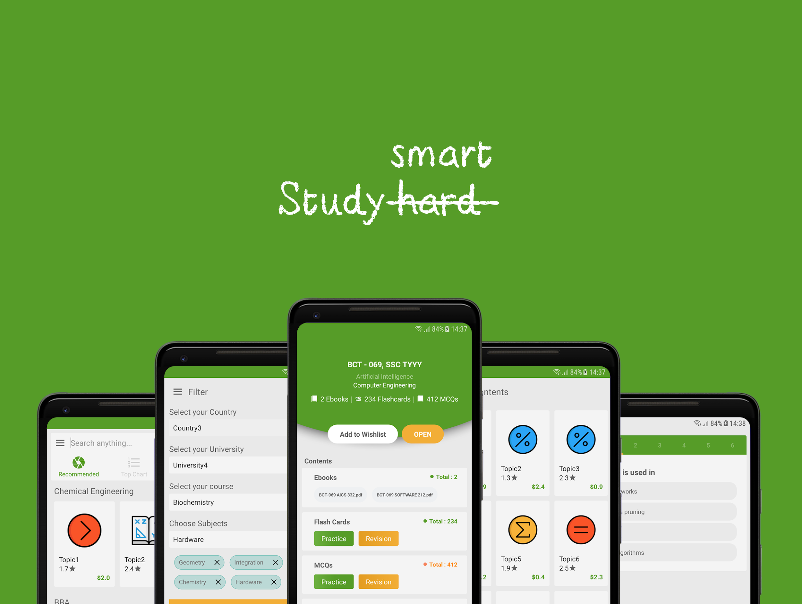
StuSmart
P2P market for university notes

Slide 3

Problems
Not enough communication between students.
Difficult to find high quality materials online with the same teaching methods of your professors.
Lack of interactive materials.
Often students have to find another job to pay for their study and living expenses.
Students want to always find the cheap and valuable materials to study and are becoming better at it.

Slide 4

Today solutions
Search for answers on the web.
Use an online tutor.
Buy a full pack of notes in facebook group.

Slide 5
Why are these solution not efficient ?
Too Expensive
Boring
Time wasting

Slide 6
Our Solutions
Upload your notes and get paid
Become a tutor and earn money
Access notes for 5$/ month
Sell your used books

Slide 7
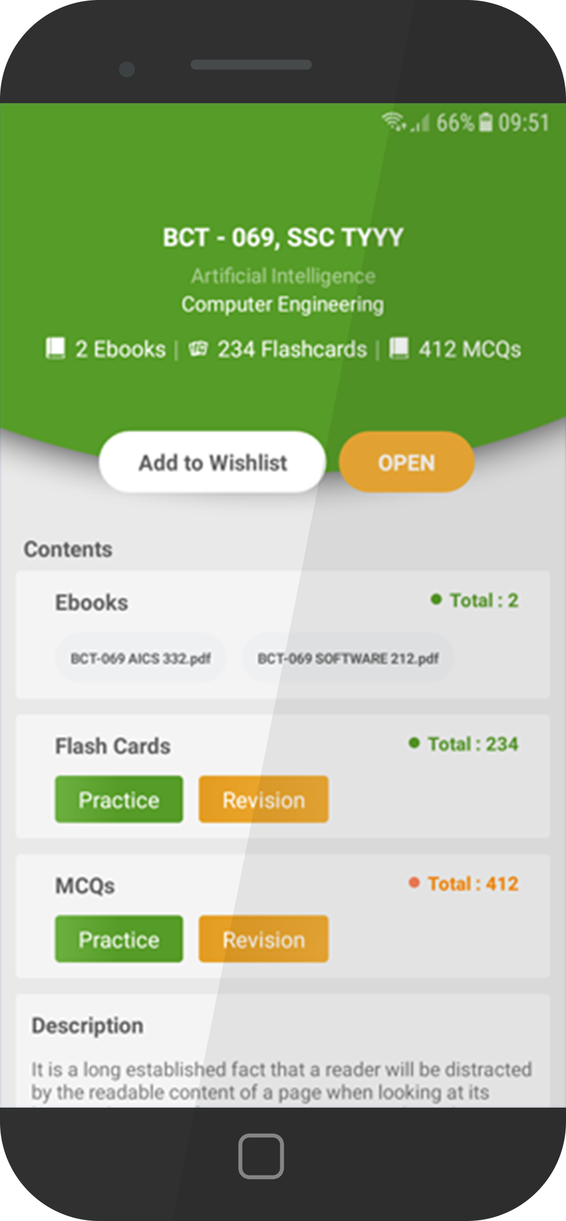
Our product
Mobile application:
Fast way to view the notes.
Web application:
Upload and download notes.

Slide 8

Notes quality benchmark
The notes that are uploaded have to follow a certain standard.
Users can votes for the notes quality
Notes lower than 4 stars would not meeting our benchmark.

Slide 9
Payment method
50% of the revenue are given to students, based on their skill.
More Start and View
More pay out

Slide 10

Customers profile
Students
19 - 30 years old

Slide 11
Competitor
StudySoup
USA based
Other Cost involved
Over 1 M subscribe
Expensive

Slide 12
Unfair advantages
1st in Europe and Asia market
Business model working in USA
Cheap and use full
Target audience defined

Slide 13
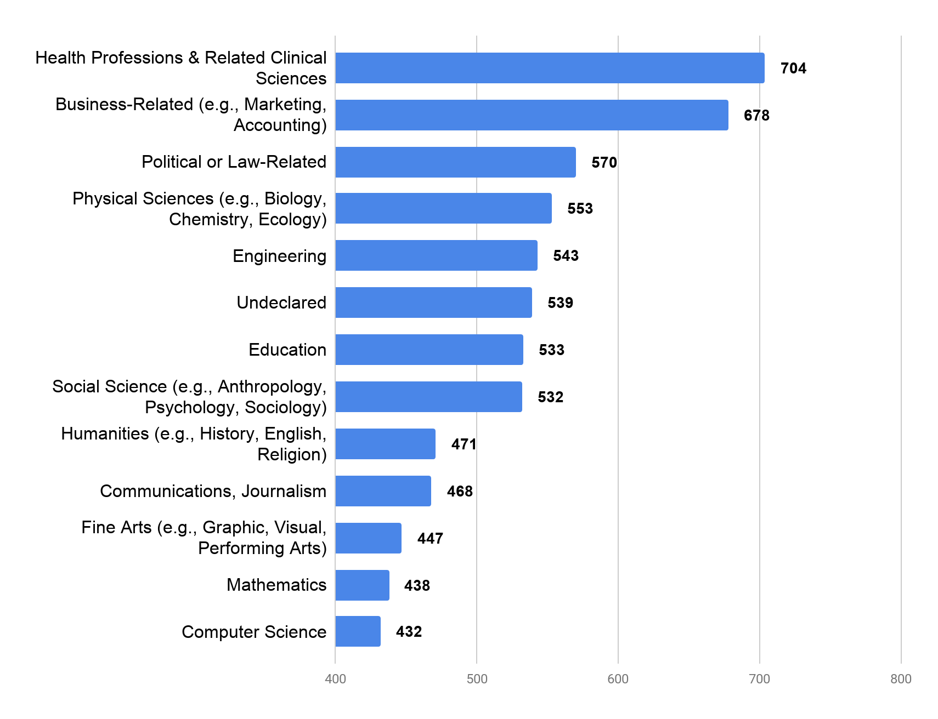
Market
210 millions student are currently worldwide according to UNESCO.
how much a student spends based on majors courses in USD.

