Slide 1


Slide 2

StuSmart
StuSmart is the easiest way to access digital documentations for studying purposes.
It is made to break barriers between students.

Slide 3

Problems
Not enough communication between students.
Difficult to find high quality materials online with the same teaching methods of your professors.
Lack of interactive materials.
Often students have to find another job to pay for their study and living expenses.
Students want to always find the cheap and valuable materials to study and are becoming better at it.

Slide 4
Solutions Used Today
Search for answers on the web.
Use an online tutor.
Buy a full pack of notes in facebook group.

Slide 5
Why are these solutions not efficient?
The answers that you find on google, youtube and forums might be good but take time to search and find. For example videos might have more information than necessary that you still need to go through to find the answers you are looking for, which can be pretty frustrating.
Online tutors are expensive at 15$ per week for half an hour a day is pretty expensive and not all students can afford it.
A student can buy a full pack of notes using facebook groups. It takes time to find the notes, you always need to check the quality, and it might not be useful all the way throughout the pack. It is quite expensive as some notes for one subject can cost more than 30$.

Slide 6
Our Solution
Web and Mobile platform:
Students can upload their courses notes online and get paid. The uploader can be a tutor for the students.
Other students can access the notes paying a subscription fee 5$/ month.

Slide 7
Problems We Are Solving
Students can make money and ease the need for long hours at side jobs that are needed today to pay for tuition.
Students can find suitable studying material for an affordable price.
Tutors can also be more affordable.

Slide 8
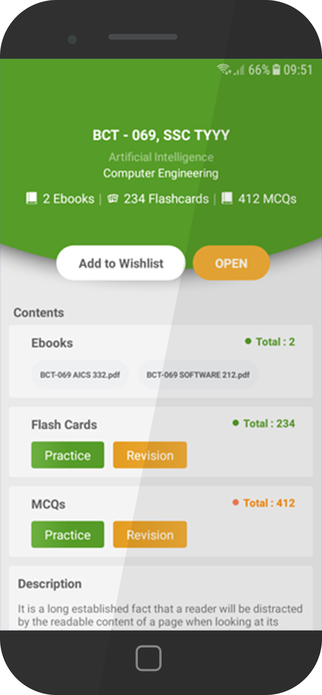
Our Products
Mobile application:
Will be used by students to download files. Easiest way to access and download documents.
Web application:
Used for all case scenarios: Students uploading and downloading

Slide 9
Notes quality benchmark
The notes that are uploaded have to follow a certain standard. For a low cost approach a 5-star rating has been implemented.
Notes lower than 4 stars would not meeting our benchmark. In this case we might not process the payment and /or delete the notes.

Slide 10
Payment method
The uploader will get a 50% fee from all the students who subscribe under his course.
If there is more than one uploader we have software that will keep track of views using a simple algorithm and will help us implement a fair payment method.
We will use Stars times Views for each student and that will be our guide to payment.
Whomever has more Stars and more Views will have a bigger payout.

Slide 11

Customer Profile
Student
between 19 - 30 years old

Slide 12
Competitor
The only competitor is StudySoup based in the USA. The software works only in the USA and has a count of 1 million subscriptions.
Their fee is pretty high at 11$/month for a yearly subscription and it has other separate fees as well, for example you must pay extra to buy study guide.
StudySoup does not operate in the our geographical area
StudySoup is not a truly affordable solution but is important to note that even with high costs it is working in the USA market.

Slide 13
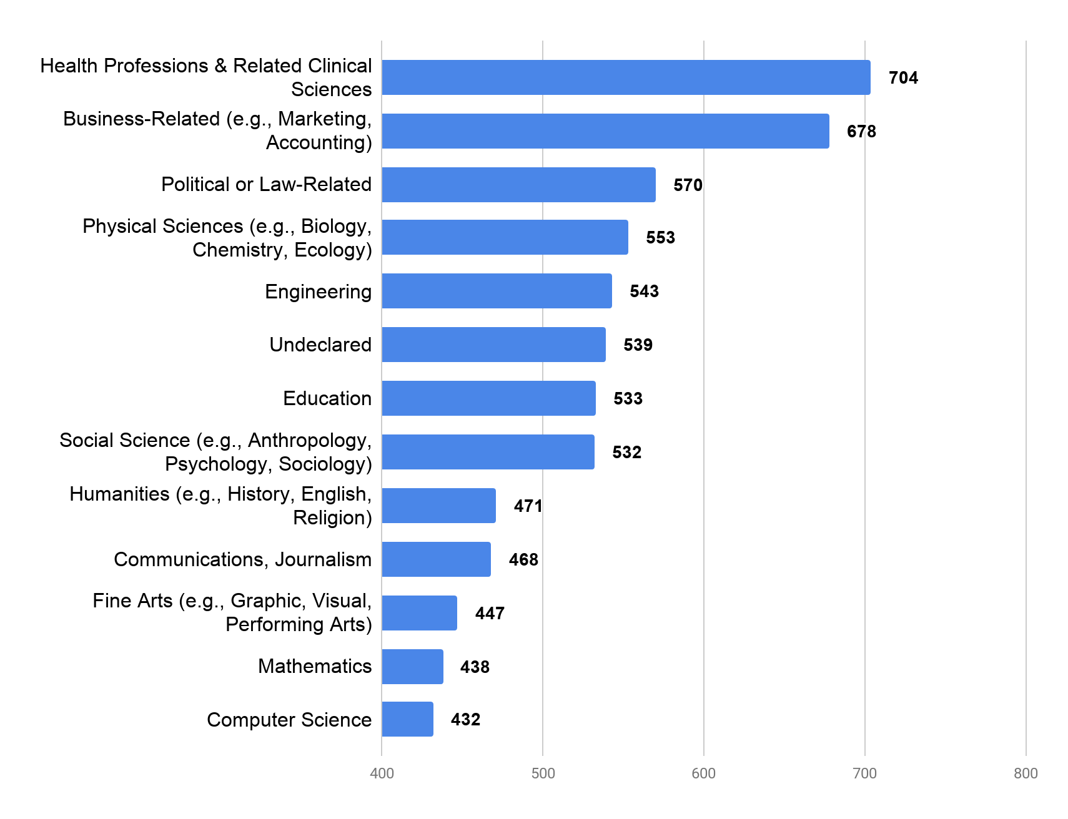
Market
How much is spent per student?
This graph shows how much a student spends based on majors courses in USD.
According to UNESCO there are over 207 million students worldwide.

Slide 14
Funding Target
Between $20,000 to $30,000
All the money will be directed towards the advertisement of our project and to get a first user base, either in Europe or Asia.
The target for this first stage is 10.000 users during the first year.

